Slide 1

Soteriology
Session 30
Dr. Andy Woods
Senior Pastor – Sugar Land Bible Church
Professor of Bible & Theology – College of Biblical Studies

Slide 2
Soteriology Overview
Definition
Election
Atonement
Salvation words
God’s one condition of salvation
Results of salvation
Eternal security
Faulty views of salvation

Slide 3
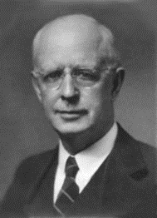
Soteriology Overview
This Session
VII. Eternal Security

Slide 4
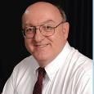
Definition of Eternal Security
“Eternal Security means that those who have been genuinely saved by God’s grace through faith alone in Christ alone shall never be in danger of God’s condemnation or loss of salvation but God’s grace and power keep them forever saved and secure.”
Dennis Rokser, Shall Never Perish Forever, p. 11

Slide 5
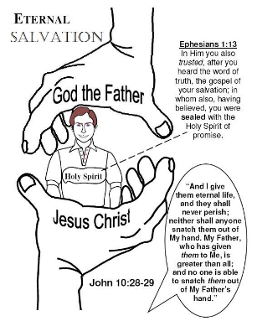
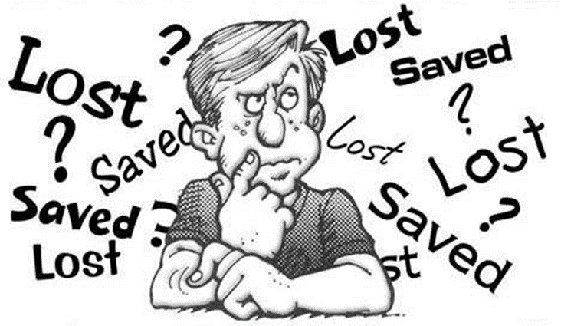
Eternal Security Outline
Eternal security arguments
Response to problem passages

Slide 6
Eternal Security Outline
Eternal security arguments
Response to problem passages

Slide 7
Evidence for Eternal Security
Because self-righteousness did not save us it is not a basis upon which salvation can be lost
Salvation is not given or maintained by works
If a believer can lose eternal life, then how can this life be eternal (John 3:16)?
The Bible’s promises guarantee security (John 10:28)
The assurance of salvation (1 John 5:14)
The believer is predestined for glory (Rom 8:29-30)
The Spirit’s seal cannot be broken (Eph 4:30)

Slide 8
Evidence for Eternal Security
God keeps us from falling (1 Pet 1:4-5)
Christ’s role as intercessor and advocate (John 17:11-12, 20)
Christ’s death perfectly dealt with all sins (Titus 2:14)
A believer cannot be removed from Christ’s body (1 Cor. 12:13)
The Bible does not specify which sins remove salvation
Believers with unfruitful lives still have salvation although lose rewards at the Bema Seat (1 Cor 3:15)

Slide 9
Eternal Security Outline
Eternal security arguments
Response to problem passages

Slide 10
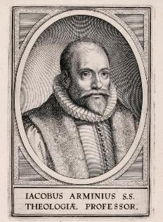
Introduction
Rejoice?
Jacob Arminius (1560‒1609)
Harmonization
The Bible cannot contradict itself
Biblical order

Slide 11
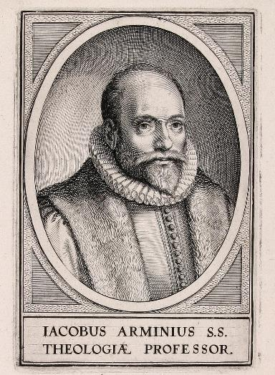
Response to Problem Passages
OT Passages
Passages from Matthew
Passages from John
Passages from Acts
Passages from Paul

Slide 12
Response to Problem Passages
Passages from James
Passages from Hebrews
Passages from 2 Peter
Passages from 1 John
Passages from Revelation
Miscellaneous argument

Slide 13
Response to Problem Passages
OT Passages
Passages from Matthew
Passages from John
Passages from Acts
Passages from Paul

Slide 14
1. OT Passages
Adam & Eve (Gen. 1‒3)
Nadab & Abihu (Lev. 10:1-2)
Korah’s rebellion (Num. 16)
Joshua 24:20
Saul (1 Sam. 16:14; 28; 1 Chron. 10:13-14)
Solomon (1 Kgs. 11)
David (Ps. 51:11)
Ezekiel 18:20

Slide 15
Response to Problem Passages
OT Passages
Passages from Matthew
Passages from John
Passages from Acts
Passages from Paul

Slide 16

2. Passages From Matthew
Matt. 6:14-15
Matt. 7:21-23
Matt. 8:11-12; 25:30
Matt. 10:32-33
Matt. 12:31-32
Matt. 24:13
Matt. 25:41

Slide 17
2. Passages From Matthew
Matt. 6:14-15
Matt. 7:21-23
Matt. 8:11-12; 25:30
Matt. 10:32-33
Matt. 12:31-32
Matt. 24:13
Matt. 25:41

Slide 18

Matthew 6:9, 14-15 (NASB)
“⁹ Our Father who is in heaven,
Hallowed be Your name… ¹⁴ For if you forgive others for their transgressions, your heavenly Father will also forgive you. ¹⁵ But if you do not forgive others, then your Father will not forgive your transgressions.”

Slide 19
Matthew 6:9, 14-15 (NASB)
“⁹ Our Father who is in heaven,
Hallowed be Your name… ¹⁴ For if you forgive others for their transgressions, your heavenly Father will also forgive you. 15 But if you do not forgive others, then your Father will not forgive your transgressions.”

Slide 20
2. Passages From Matthew
Matt. 6:14-15
Matt. 7:21-23
Matt. 8:11-12; 25:30
Matt. 10:32-33
Matt. 12:31-32
Matt. 24:13
Matt. 25:41

Slide 21
Matt. 7:21-23 (NASB)
“Not everyone who says to Me, ‘Lord, Lord,’ will enter the kingdom of heaven, but he who does the will of My Father who is in heaven will enter. ²² Many will say to Me on that day, ‘Lord, Lord, did we not prophesy in Your name, and in Your name cast out demons, and in Your name perform many miracles?’ ²³ And then I will declare to them, ‘I never knew you; depart from Me, you who practice lawlessness.’”

Slide 22
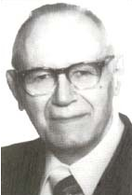
Problem Passages in the Gospel of John Part II: Untrustworthy Believers—John 2:23-25
“Many trusted in his name; i.e., because of the manner in which his power was displayed they accepted him as a great prophet and perhaps even as the Messiah. This, however, is not the same as saying that they surrendered their hearts to him. Not all faith is saving faith...”
William Hendriksen
Vol. 135: Bibliotheca Sacra Volume 135. 1978 (538) (138). Dallas, TX: Dallas Theological

Slide 23
2. Passages From Matthew
Matt. 6:14-15
Matt. 7:21-23
Matt. 8:11-12; 25:30
Matt. 10:32-33
Matt. 12:31-32
Matt. 24:13
Matt. 25:41

Slide 24
Matt. 8:11-12 (NASB)
“I say to you that many will come from east and west, and recline at the table with Abraham, Isaac and Jacob in the kingdom of heaven; ¹² but the sons of the kingdom will be cast out into the outer darkness; in that place there will be weeping and gnashing of teeth.”

Slide 25
Origin of the Universal Church
Matt 16:18 – future tense
Eph 2:14-15; 3:9; Rom 16:25-26; Col 1:26-27 – mystery
Eph 1:20-22 – Christ’s headship over church after Ascension
Eph 4:7-11 – spiritual gifts after Ascension
1 Cor. 12:13 – Spirit’s baptizing ministry
  Acts 1:5 – above to begin after Ascension
  Acts 11:15-16 – above began in the past
  Acts 2 – only place for beginning of Spirit’s baptizing ministry

Slide 26
2. Passages From Matthew
Matt. 6:14-15
Matt. 7:21-23
Matt. 8:11-12; 25:30
Matt. 10:32-33
Matt. 12:31-32
Matt. 24:13
Matt. 25:41

Slide 27
Matt. 10:32-33 (NASB)
“Therefore everyone who confesses Me before men, I will also confess him before My Father who is in heaven. But whoever denies Me before men, I will also deny him before My Father who is in heaven.”

Slide 28

Matthew and the Kingdom
Kingdom predicted (Isa 11:6-9)
Kingdom offered (Matt. 3:2; 4:17; 10:5-7)
Kingdom rejected (Matt. 12:24)
Kingdom postponed (Matt. 13)
Interim program? (Matt. 16:18; 28:18-20)
Kingdom ultimately accepted (Matt. 24:14; 25:31)
Toussaint, Behold the King, 18-20

Slide 29
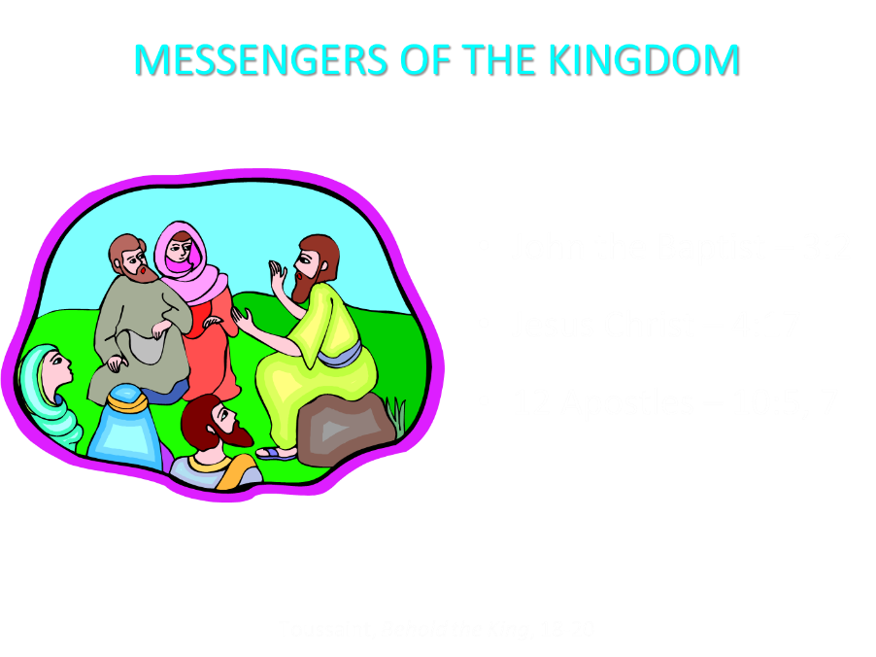

Slide 30
Matthew 10:5-7 (NASB)
“These twelve Jesus sent out after instructing them: “Do not go in the way of the Gentiles, and do not enter any city of the Samaritans; ⁶ but rather go to the lost sheep of the house of Israel. ⁷ And as you go, preach, saying, ‘The kingdom of heaven is at hand.’”

Slide 31
2. Passages From Matthew
Matt. 6:14-15
Matt. 7:21-23
Matt. 8:11-12; 25:30
Matt. 10:32-33
Matt. 12:31-32
Matt. 24:13
Matt. 25:41

Slide 32
Matthew 12:31-32 (NASB)
“Therefore I say to you, any sin and blasphemy shall be forgiven people, but blasphemy against the Spirit shall not be forgiven. Whoever speaks a word against the Son of Man, it shall be forgiven him; but whoever speaks against the Holy Spirit, it shall not be forgiven him, either in this age or in the age to come.”

Slide 33
Matthew 12:31-32
Context
Five key questions
Summary
Is suicide the unpardonable sin?
Notes:
Outline

Slide 34
Matthew 12:31-32
Context: (Matt 12:22-30)
Five key questions
Summary
Is suicide the unpardonable sin?
Notes:
Outline

Slide 35
Matthew 12:31-32
Context: (Matt 12:22-30)
Five key questions
Summary
Is suicide the unpardonable sin?
Notes:
Outline

Slide 36
II. Five Key Questions (Matt. 12:31-32)
What is the blasphemy against the Holy Spirit?
Who committed the blasphemy of this sin?
What did this sin reveal?
Why can’t this sin be forgiven?
Can this sin be committed today?
Dennis Rokser, Shall Never Perish, 227-236
Notes:
Outline

Slide 37
II. Five Key Questions (Matt. 12:31-32)
What is the blasphemy against the Holy Spirit?
Who committed the blasphemy of this sin?
What did this sin reveal?
Why can’t this sin be forgiven?
Can this sin be committed today?
Dennis Rokser, Shall Never Perish, 227-236
Notes:
Outline

Slide 38
II. Five Key Questions (Matt. 12:31-32)
What is the blasphemy against the Holy Spirit?
Who committed the blasphemy of this sin?
What did this sin reveal?
Why can’t this sin be forgiven?
Can this sin be committed today?
Dennis Rokser, Shall Never Perish, 227-236
Notes:
Outline

Slide 39
II. Five Key Questions (Matt. 12:31-32)
What is the blasphemy against the Holy Spirit?
Who committed the blasphemy of this sin?
What did this sin reveal?
  Their unbelief
  Their self righteousness
  Matt. 12:34-35
Why can’t this sin be forgiven?
Can this sin be committed today?
Dennis Rokser, Shall Never Perish, 227-236
Notes:
Outline

Slide 40
II. Five Key Questions (Matt. 12:31-32)
What is the blasphemy against the Holy Spirit?
Who committed the blasphemy of this sin?
What did this sin reveal?
Why can’t this sin be forgiven?
  Personally – They would not believe in the savior who could save them (John 3:18; 8:24; Acts 10:43)
  Nationally – They rejected the offer of the kingdom
Can this sin be committed today?
Dennis Rokser, Shall Never Perish, 227-236
Notes:
Outline

Slide 41
II. Five Key Questions (Matt. 12:31-32)
What is the blasphemy against the Holy Spirit?
Who committed the blasphemy of this sin?
What did this sin reveal?
Why can’t this sin be forgiven?
  Personally – They would not believe in the savior who could save them (John 3:18; 8:24; Acts 10:43)
  Nationally – They rejected the offer of the kingdom
Can this sin be committed today?
Dennis Rokser, Shall Never Perish, 227-236
Notes:
Outline

Slide 42
II. Five Key Questions (Matt. 12:31-32)
What is the blasphemy against the Holy Spirit?
Who committed the blasphemy of this sin?
What did this sin reveal?
Why can’t this sin be forgiven?
  Personally – They would not believe in the savior who could save them (John 3:18; 8:24; Acts 10:43)
  Nationally – They rejected the offer of the kingdom
Can this sin be committed today?
Dennis Rokser, Shall Never Perish, 227-236
Notes:
Outline

Slide 43
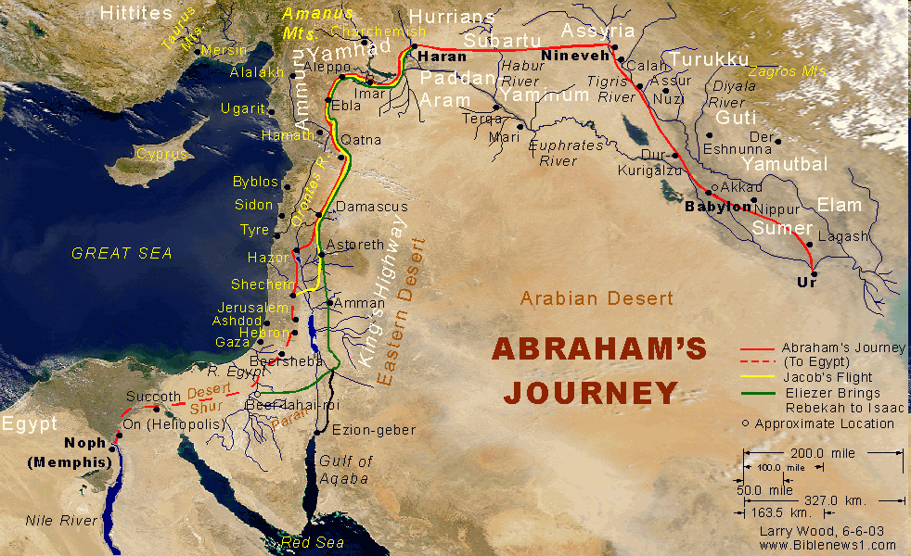

Slide 44
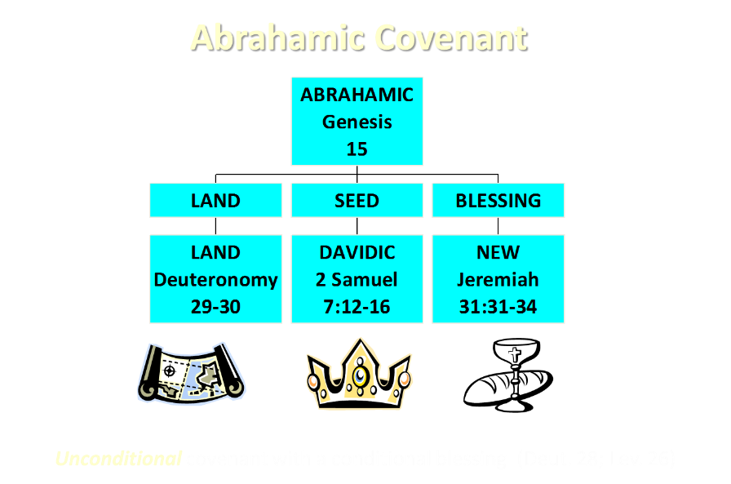

Slide 45
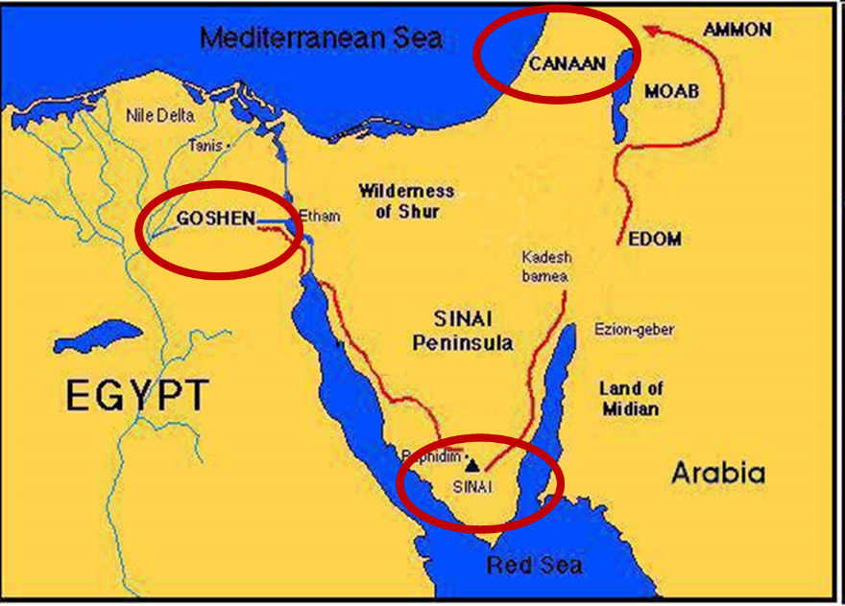

Slide 46

Exodus 19:5-6
“Now then, if you will indeed obey My voice and keep My covenant, then you shall be My own possession among all the peoples, for all the earth is Mine; and you shall be to Me a kingdom of priests and a holy nation.’ These are the words that you shall speak to the sons of Israel.”

Slide 47
Six Parts of a Suzerain-Vassal Treaty* in Deuteronomy
Preamble (1:1-5)
Prologue (1:6–4:40)
Covenant obligations (5–26)
  Deut 17:15
  John 5:39, 46
Storage and reading instructions (27:2-3; 31:9, 24, 26)
Witnesses (32:1)
Blessings and curses (28)
*Suzerainty–Vassal treaty, which Ancient Near Eastern kings made, were only with redeemed or conquered nations and never with individuals. (2007). Christian Apologetics Journal, 6.

Slide 48
Six Parts of a Suzerain-Vassal Treaty* in Deuteronomy
Preamble (1:1-5)
Prologue (1:6–4:40)
Covenant obligations (5–26)
  Deut 17:15
  John 5:39, 46
Storage and reading instructions (27:2-3; 31:9, 24, 26)
Witnesses (32:1)
Blessings and curses (28)
*Suzerainty–Vassal treaty, which Ancient Near Eastern kings made, were only with redeemed or conquered nations and never with individuals. (2007). Christian Apologetics Journal, 6.

Slide 49

Matthew and the Kingdom
Kingdom predicted (Isa 11:6-9)
Kingdom offered (Matt. 3:2; 4:17; 10:5-7)
Kingdom rejected (Matt. 12:24)
Judgment upon first – century national Israel (Deut. 28:49-50; Matt. 24:34-37; Luke 19:41-44; Acts 2:40-41)
Kingdom postponed (Matt. 13)
Interim program? (Matt. 16:18, 21; 28:18-20)
Kingdom ultimately accepted (Matt. 23:38-39; 24:14; 25:31)
Toussaint, Behold the King, 18-20

Slide 50
Matthew and the Kingdom
Kingdom predicted (Isa 11:6-9)
Kingdom offered (Matt. 3:2; 4:17; 10:5-7)
Kingdom rejected (Matt. 12:24)
Judgment upon first – century national Israel (Deut. 28:49-50; Matt. 24:34-37; Luke 19:41-44; Acts 2:40-41)
Kingdom postponed (Matt. 13)
Interim program? (Matt. 16:18, 21; 28:18-20)
Kingdom ultimately accepted (Matt. 23:38-39; 24:14; 25:31)
Toussaint, Behold the King, 18-20

Slide 51
OT PROPHETS DESCRIBE THE KINGDOM
Kingdom Characteristics
Is. 2:1-4; 11:6-9
  Jerusalem = center of world spiritual and political authority
  Perfect justice
  World peace
  Peace in the animal kingdom
  Universal spiritual knowledge.

Slide 52
Matthew and the Kingdom
Kingdom predicted (Isa 11:6-9)
Kingdom offered (Matt. 3:2; 4:17; 10:5-7)
Kingdom rejected (Matt. 12:24)
Judgment upon first – century national Israel (Deut. 28:49-50; Matt. 24:34-37; Luke 19:41-44; Acts 2:40-41)
Kingdom postponed (Matt. 13)
Interim program? (Matt. 16:18, 21; 28:18-20)
Kingdom ultimately accepted (Matt. 23:38-39; 24:14; 25:31)
Toussaint, Behold the King, 18-20

Slide 53
MESSENGERS OF THE KINGDOM
John the Baptist – 3:2
Jesus Christ – 4:17
12 Apostles – 10:5, 7
Toussaint, Behold the King, 18-20

Slide 54
Matthew and the Kingdom
Kingdom predicted (Isa 11:6-9)
Kingdom offered (Matt. 3:2; 4:17; 10:5-7)
Kingdom rejected (Matt. 12:24)
Judgment upon first – century national Israel (Deut. 28:49-50; Matt. 24:34-37; Luke 19:41-44; Acts 2:40-41)
Kingdom postponed (Matt. 13)
Interim program? (Matt. 16:18, 21; 28:18-20)
Kingdom ultimately accepted (Matt. 23:38-39; 24:14; 25:31)
Toussaint, Behold the King, 18-20

Slide 55
Matthew and the Kingdom
Kingdom predicted (Isa 11:6-9)
Kingdom offered (Matt. 3:2; 4:17; 10:5-7)
Kingdom rejected (Matt. 12:24)
Judgment upon first – century national Israel (Deut. 28:49-50; Matt. 24:34-37; Luke 19:41-44; Acts 2:40-41)
Kingdom postponed (Matt. 13)
Interim program? (Matt. 16:18, 21; 28:18-20)
Kingdom ultimately accepted (Matt. 23:38-39; 24:14; 25:31)
Toussaint, Behold the King, 18-20

Slide 56
Matthew and the Kingdom
Kingdom predicted (Isa 11:6-9)
Kingdom offered (Matt. 3:2; 4:17; 10:5-7)
Kingdom rejected (Matt. 12:24)
Judgment upon first – century national Israel (Deut. 28:49-50; Matt. 24:34-37; Luke 19:41-44; Acts 2:40-41)
Kingdom postponed (Matt. 13)
Interim program? (Matt. 16:18, 21; 28:18-20)
Kingdom ultimately accepted (Matt. 23:38-39; 24:14; 25:31)
Toussaint, Behold the King, 18-20

Slide 57
Matthew and the Kingdom
Kingdom predicted (Isa 11:6-9)
Kingdom offered (Matt. 3:2; 4:17; 10:5-7)
Kingdom rejected (Matt. 12:24)
Judgment upon first – century national Israel (Deut. 28:49-50; Matt. 24:34-37; Luke 19:41-44; Acts 2:40-41)
Kingdom postponed (Matt. 13)
Interim program? (Matt. 16:18, 21; 28:18-20)
Kingdom ultimately accepted (Matt. 23:38-39; 24:14; 25:31)
Toussaint, Behold the King, 18-20

Slide 58
Transition from Public to Private Ministry
 | PUBLIC | PRIVATE
Scripture | 1–12 | 13–28
Focus | Nation | Remnant
Miracles | Proof to nation | Training for remnant
Offer | Prominent | Disappears
Teaching | Discourse | Parabolic
Interim program | Not mentioned | Prominent
Toussaint, Behold the King, 18-20

Slide 59
Matthew Outline
Pedigree of the king (1–2)
  Preparation of the king (3–4)
    Pedagogy of the king (5–7)
      Power of the king (8–9)
        Program of the king (10)
          Progressive rejection of the king (11–12)
        Preparation of the king’s disciples (13–20)
      Presentation & rejection of the king (21–23)
    Prophecies of the king (24–25)
  Passion of the king (26–27)
Proof of the king (28)

Slide 60
Matthew Outline
Pedigree of the king (1–2)
  Preparation of the king (3–4)
    Pedagogy of the king (5–7)
      Power of the king (8–9)
        Program of the king (10)
          Progressive rejection of the king (11–12)
        Preparation of the king’s disciples (13–20)
      Presentation & rejection of the king (21–23)
    Prophecies of the king (24–25)
  Passion of the king (26–27)
Proof of the king (28)

Slide 61
Matthew and the Kingdom
Kingdom predicted (Isa 11:6-9)
Kingdom offered (Matt. 3:2; 4:17; 10:5-7)
Kingdom rejected (Matt. 12:24)
Judgment upon first – century national Israel (Deut. 28:49-50; Matt. 24:34-37; Luke 19:41-44; Acts 2:40-41)
Kingdom postponed (Matt. 13)
Interim program? (Matt. 16:18, 21; 28:18-20)
Kingdom ultimately accepted (Matt. 23:38-39; 24:14; 25:31)
Toussaint, Behold the King, 18-20

Slide 62
II. Five Key Questions (Matt. 12:31-32)
What is the blasphemy against the Holy Spirit?
Who committed the blasphemy of this sin?
What did this sin reveal?
Why can’t this sin be forgiven?
Can this sin be committed today?
  Personally?
    No – loss of salvation
    Yes – dying in unbelief
  Nationally? – No
Dennis Rokser, Shall Never Perish, 227-236
Notes:
Outline

Slide 63
II. Five Key Questions (Matt. 12:31-32)
What is the blasphemy against the Holy Spirit?
Who committed the blasphemy of this sin?
What did this sin reveal?
Why can’t this sin be forgiven?
Can this sin be committed today?
  Personally?
    No – loss of salvation
    Yes – dying in unbelief
  Nationally? – No
Dennis Rokser, Shall Never Perish, 227-236
Notes:
Outline

Slide 64
II. Five Key Questions (Matt. 12:31-32)
What is the blasphemy against the Holy Spirit?
Who committed the blasphemy of this sin?
What did this sin reveal?
Why can’t this sin be forgiven?
Can this sin be committed today?
  Personally?
    No – loss of salvation
    Yes – dying in unbelief
  Nationally? – No
Dennis Rokser, Shall Never Perish, 227-236
Notes:
Outline

Slide 65
Committing Blasphemy Against the Holy Sprit Today?
No commands in the epistles against blasphemy against the Holy Spirit
Epistolary commands involving the Spirit
  Do not lie to the Spirit (Acts 5:3)
  Do not grieve the Spirit (Eph. 4:30)
  Do not quench the Sprit (1 Thess. 5:19)
  Walk according to the Spirit (Gal. 5:16)
  Be filled with the Spirit (Eph. 5:18)

Slide 66
II. Five Key Questions (Matt. 12:31-32)
What is the blasphemy against the Holy Spirit?
Who committed the blasphemy of this sin?
What did this sin reveal?
Why can’t this sin be forgiven?
Can this sin be committed today?
  Personally?
    No – loss of salvation
    Yes – dying in unbelief
  Nationally? – No
Dennis Rokser, Shall Never Perish, 227-236
Notes:
Outline

Slide 67
II. Five Key Questions (Matt. 12:31-32)
What is the blasphemy against the Holy Spirit?
Who committed the blasphemy of this sin?
What did this sin reveal?
Why can’t this sin be forgiven?
Can this sin be committed today?
  Personally?
    No – loss of salvation
    Yes – dying in unbelief
  Nationally? – No
Dennis Rokser, Shall Never Perish, 227-236
Notes:
Outline

Slide 68
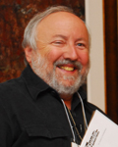
Arnold Fruchtenbaum, Israelology, pg. 617
“In verses 30–37, He pronounced a judgment on the Jewish generation of that day. That generation had committed the unpardonable sin: the blasphemy of the Holy Spirit. The unpardonable sin was not an individual sin but a national sin. It was committed by that generation of Israel in Jesus’ day and cannot be applied to subsequent Jewish generations. The content and definition of the unpardonable sin is the national rejection of the Messiahship of Jesus by Israel while He was physically present on the basis that He was demon possessed. This sin was unpardonable, and judgment was set.”

Slide 69
“The judgment came in the year A.D. 70 with the destruction of Jerusalem and the Temple and the world-wide dispersion of the Jewish people. It was a national sin committed by the generation of Jesus’ day, and for that generation the sin was unpardonable. From this point on a special emphasis is placed on this generation in the gospels, for it was guilty of a very unique sin. At this point, His offer of the Messianic Kingdom was rescinded. It will not now be established in their day because of the unpardonableness of that sin.”
Arnold Fruchtenbaum, Israelology, pg. 617

Slide 70
Matthew 12:31-32
Context
Five key questions
Summary
Is suicide the unpardonable sin?
Notes:
Outline

Slide 71
III. Summary
Pharisees attributed Christ’s miracles to Satan
Pharisees did not believe in Christ as their Messiah
A person must believe in Jesus to be saved
The sin committed by the unbelieving Pharisees marks the nation’s official rejection of the kingdom offer
This sin is a one-time sin that cannot be replicated in subsequent generations or today
The offer is then withdrawn as Christ announces His soon death and coming church (Matt. 16:18, 21)
There is no loss of salvation because the Pharisees were never saved to begin with
Dennis Rokser, Never Perish, 234-35
Notes:
Outline

Slide 72
Matthew 12:31-32
Context
Five key questions
Summary
Is suicide the unpardonable sin?
Notes:
Outline

Slide 73
Seven Suicides of the Bible
Abimelech (Judges 9:54)
Samson (Judges 16:26-31)
Saul’s armor bearer (1 Sam. 31:5)
Saul (1 Sam. 31:3-6)
Ahithophel (2 Sam. 17)
Zimri (1 Kgs. 16:18)
Judas (Matt. 27:4-5)

Slide 74
Seven Suicides of the Bible
Abimelech (Judges 9:54)
Samson (Judges 16:26-31)
Saul’s armor bearer (1 Sam. 31:5)
Saul (1 Sam. 31:3-6)
Ahithophel (2 Sam. 17)
Zimri (1 Kgs. 16:18)
Judas (Matt. 27:4-5)

Slide 75
Seven Suicides of the Bible
Abimelech (Judges 9:54)
Samson (Judges 16:26-31) – Heb. 11:32
Saul’s armor bearer (1 Sam. 31:5)
Saul (1 Sam. 31:3-6) – 1 Sam. 28:19
Ahithophel (2 Sam. 17)
Zimri (1 Kgs. 16:18)
Judas (Matt. 27:4-5)

Slide 76
Romans 8:38-39 (NASB)
“For I am convinced that neither death, nor life, nor angels, nor principalities, nor things present, nor things to come, nor powers, ³⁹ nor height, nor depth, nor any other created thing, will be able to separate us from the love of God, which is in Christ Jesus our Lord.”

Slide 77
Romans 8:38-39 (NASB)
“For I am convinced that neither death, nor life, nor angels, nor principalities, nor things present, nor things to come, nor powers, ³⁹ nor height, nor depth, nor any other created thing, will be able to separate us from the love of God, which is in Christ Jesus our Lord.”

Slide 78
2. Passages From Matthew
Matt. 6:14-15
Matt. 7:21-23
Matt. 8:11-12; 25:30
Matt. 10:32-33
Matt. 12:31-32
Matt. 24:13
Matt. 25:41

Slide 79
Matt. 24:13 (NASB)
“But the one who endures to the end, he will be saved.”

Slide 80
2. Passages From Matthew
Matt. 6:14-15
Matt. 7:21-23
Matt. 8:11-12; 25:30
Matt. 10:32-33
Matt. 12:31-32
Matt. 24:13
Matt. 25:41

Slide 81
Matt. 25:41 (NASB)
“Then He will also say to those on His left, ‘Depart from Me, accursed ones, into the eternal fire which has been prepared for the devil and his angels.”

Slide 82
Angelic Salvation?
“Because the angels are a company and not a race, they sinned individually, and not in some federal head of the race [as was true with humanity's fall in the person of Adam]. It may be that because of this that God made no provision of salvation for the fallen angels.”
Thiessen, Lectures in ST, 134 (emphasis and insertion added)

Slide 83
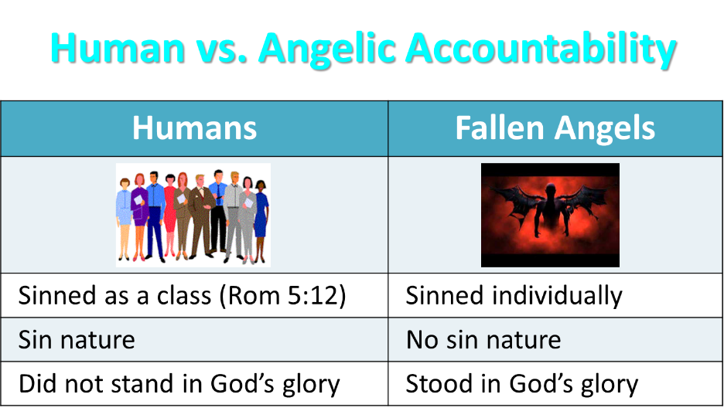

Slide 84
CONCLUSION

Slide 85
2. Passages From Matthew
Matt. 6:14-15
Matt. 7:21-23
Matt. 8:11-12; 25:30
Matt. 10:32-33
Matt. 12:31-32
Matt. 24:13
Matt. 25:41

