Slide 1
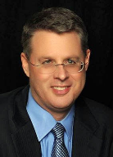
Soteriology Session 31
Dr. Andy Woods
Senior Pastor – Sugar Land Bible Church
Professor of Bible & Theology – College of Biblical Studies

Slide 2
Soteriology Overview
Definition
Election
Atonement
Salvation words
God’s one condition of salvation
Results of salvation
Eternal security
Faulty views of salvation

Slide 3
Soteriology Overview
This Session
VII. Eternal Security

Slide 4
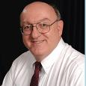
Definition of Eternal Security
“Eternal Security means that those who have been genuinely saved by God’s grace through faith alone in Christ alone shall never be in danger of God’s condemnation or loss of salvation but God’s grace and power keep them forever saved and secure.”
Dennis Rokser, Shall Never Perish Forever, p. 11

Slide 5
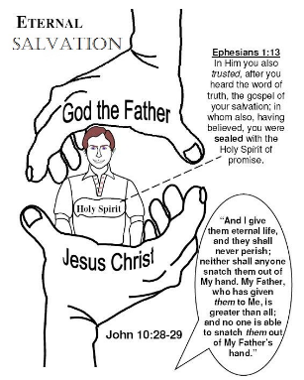
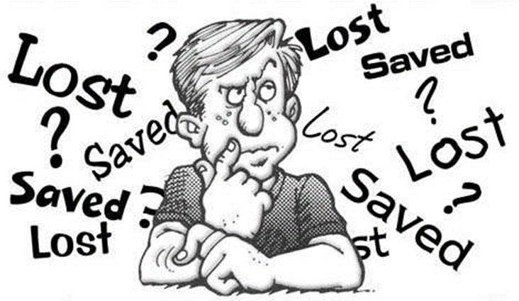
Eternal Security Outline
Eternal security arguments
Response to problem passages

Slide 6
Eternal Security Outline
Eternal security arguments
Response to problem passages

Slide 7
Evidence for Eternal Security
Because self-righteousness did not save us it is not a basis upon which salvation can be lost
Salvation is not given or maintained by works
If a believer can lose eternal life, then how can this life be eternal (John 3:16)?
The Bible’s promises guarantee security (John 10:28)
The assurance of salvation (1 John 5:14)
The believer is predestined for glory (Rom 8:29-30)
The Spirit’s seal cannot be broken (Eph 4:30)

Slide 8
Evidence for Eternal Security
God keeps us from falling (1 Pet 1:4-5)
Christ’s role as intercessor and advocate (John 17:11-12, 20)
Christ’s death perfectly dealt with all sins (Titus 2:14)
A believer cannot be removed from Christ’s body (1 Cor. 12:13)
The Bible does not specify which sins remove salvation
Believers with unfruitful lives still have salvation although lose rewards at the Bema Seat (1 Cor 3:15)

Slide 9
Eternal Security Outline
Eternal security arguments
Response to problem passages

Slide 10
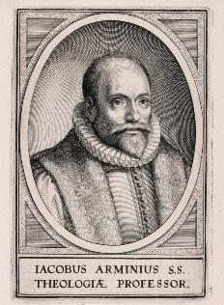
Introduction
Rejoice?
Jacob Arminius (1560‒1609)
Harmonization
The Bible cannot contradict itself
Biblical order

Slide 11
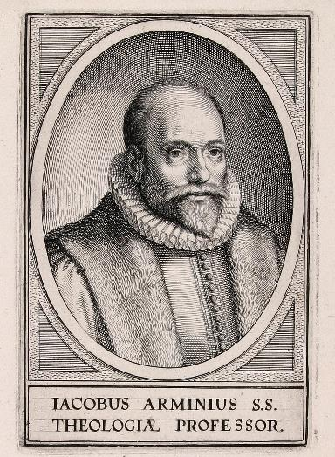
Response to Problem Passages
OT Passages
Passages from Matthew
Passages from John
Passages from Acts
Passages from Paul

Slide 12
Response to Problem Passages
Passages from James
Passages from Hebrews
Passages from 2 Peter
Passages from 1 John
Passages from Revelation
Miscellaneous argument

Slide 13
Response to Problem Passages
OT Passages
Passages from Matthew
Passages from John
Passages from Acts
Passages from Paul

Slide 14
1. OT Passages
Adam & Eve (Gen. 1‒3)
Nadab & Abihu (Lev. 10:1-2)
Korah’s rebellion (Num. 16)
Joshua 24:20
Saul (1 Sam. 16:14; 28; 1 Chron. 10:13-14)
Solomon (1 Kgs. 11)
David (Ps. 51:11)
Ezekiel 18:20

Slide 15
Response to Problem Passages
OT Passages
Passages from Matthew
Passages from John
Passages from Acts
Passages from Paul

Slide 16
2. Passages From Matthew
Matt. 6:14-15
Matt. 7:21-23
Matt. 8:11-12; 25:30
Matt. 10:32-33
Matt. 12:31-32
Matt. 24:13
Matt. 25:41

Slide 17
2. Passages From Matthew
Matt. 6:14-15
Matt. 7:21-23
Matt. 8:11-12; 25:30
Matt. 10:32-33
Matt. 12:31-32
Matt. 24:13
Matt. 25:41

Slide 18
2. Passages From Matthew
Matt. 6:14-15
Matt. 7:21-23
Matt. 8:11-12; 25:30
Matt. 10:32-33
Matt. 12:31-32
Matt. 24:13
Matt. 25:41

Slide 19
2. Passages From Matthew
Matt. 6:14-15
Matt. 7:21-23
Matt. 8:11-12; 25:30
Matt. 10:32-33
Matt. 12:31-32
Matt. 24:13
Matt. 25:41

Slide 20
Matt. 8:11-12 (NASB)
“I say to you that many will come from east and west, and recline at the table with Abraham, Isaac and Jacob in the kingdom of heaven; ¹² but the sons of the kingdom will be cast out into the outer darkness; in that place there will be weeping and gnashing of teeth.”

Slide 21
Origin of the Universal Church
Matt 16:18 – future tense
Eph 2:14-15; 3:9; Rom 16:25-26; Col 1:26-27 – mystery
Eph 1:20-22 – Christ’s headship over church after Ascension
Eph 4:7-11 – spiritual gifts after Ascension
1 Cor. 12:13 – Spirit’s baptizing ministry
Acts 1:5 – above to begin after Ascension
Acts 11:15-16 – above began in the past
Acts 2 – only place for beginning of Spirit’s baptizing ministry

Slide 22
2. Passages From Matthew
Matt. 6:14-15
Matt. 7:21-23
Matt. 8:11-12; 25:30
Matt. 10:32-33
Matt. 12:31-32
Matt. 24:13
Matt. 25:41

Slide 23
Matt. 10:32-33 (NASB)
“Therefore everyone who confesses Me before men, I will also confess him before My Father who is in heaven. But whoever denies Me before men, I will also deny him before My Father who is in heaven.”

Slide 24
Matthew and the Kingdom
Kingdom predicted (Isa 11:6-9)
Kingdom offered (Matt. 3:2; 4:17; 10:5-7)
Kingdom rejected (Matt. 12:24)
Kingdom postponed (Matt. 13)
Interim program? (Matt. 16:18; 28:18-20)
Kingdom ultimately accepted (Matt. 24:14; 25:31)
Toussaint, Behold the King, 18-20

Slide 26
Matthew 10:5-7 (NASB)
“These twelve Jesus sent out after instructing them: “Do not go in the way of the Gentiles, and do not enter any city of the Samaritans; ⁶ but rather go to the lost sheep of the house of Israel. ⁷ And as you go, preach, saying, ‘The kingdom of heaven is at hand.’”

Slide 27
2. Passages From Matthew
Matt. 6:14-15
Matt. 7:21-23
Matt. 8:11-12; 25:30
Matt. 10:32-33
Matt. 12:31-32
Matt. 24:13
Matt. 25:41

Slide 28
2. Passages From Matthew
Matt. 6:14-15
Matt. 7:21-23
Matt. 8:11-12; 25:30
Matt. 10:32-33
Matt. 12:31-32
Matt. 24:13
Matt. 25:41

Slide 29
Matt. 24:13 (NASB)
“But the one who endures to the end, he will be saved.”

Slide 30
2. Passages From Matthew
Matt. 6:14-15
Matt. 7:21-23
Matt. 8:11-12; 25:30
Matt. 10:32-33
Matt. 12:31-32
Matt. 24:13
Matt. 25:41

Slide 31
Matt. 25:41 (NASB)
“Then He will also say to those on His left, ‘Depart from Me, accursed ones, into the eternal fire which has been prepared for the devil and his angels.”

Slide 32
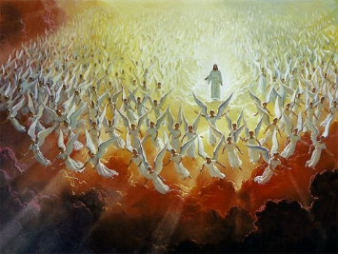
Angelic Salvation?
“Because the angels are a company and not a race, they sinned individually, and not in some federal head of the race [as was true with humanity's fall in the person of Adam]. It may be that because of this that God made no provision of salvation for the fallen angels.”
Thiessen, Lectures in ST, 134 (emphasis and insertion added)

Slide 34
CONCLUSION

Slide 35
2. Passages From Matthew
Matt. 6:14-15
Matt. 7:21-23
Matt. 8:11-12; 25:30
Matt. 10:32-33
Matt. 12:31-32
Matt. 24:13
Matt. 25:41

