Slide 1
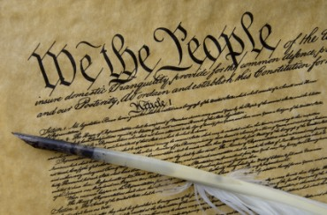
THE BIBLE AND VOTING
Part 11
Dr. Andy Woods

Slide 2

Introductory Remarks
A stewardship issue (1 Cor. 4:2)
A biblical issue (2 Tim. 3:16)
Biblical principles rather than partisanship

Slide 3
The Bible and Voting
Economic issues
Social issues
Foreign affairs

Slide 4
The Bible and Voting
Economic issues
Social issues
Foreign affairs

Slide 5
Economic Issues
Ownership of private property? (Deut. 19:15)
Pursuit of economic self interest? (Gen. 8:21)
Proper definition of compassion? (2 Thess. 3:10)
Who provides charity? (1 Tim. 5:3-8)
Family is the building block of society? (Deut. 6:6-7)
Wealth retained within the family? (Prov. 13:22)
The earth experiences cyclical patterns? (Gen. 8:22)
Environmental stewardship rather than earth worship? (Rom. 1:22-23)
Opposition to runaway debt? (Prov. 22:7)
Limitations upon the government? (Acts 5:29)

Slide 6
The Bible and Voting
Economic issues
Social issues
Foreign affairs

Slide 7
Social Issues
Legal protection for the unborn? (Gen. 25:23)
Legal protection for the elderly? (Lev. 19:32)
Hetero-sexual monogamous marriage as the standard for society? (Gen. 2:18-25)
Advocacy capital punishment? (Gen. 9:6)
The right to restrict alcohol, pornography, & gambling? (Lev. 10:9; Matt. 5:27-28; Prov. 13:11)
Parental authority over children? (Eph. 6:4)
Public expressions of Christianity? (Mark 16:15)
Right to keep and bear arms? (Luke 22:36)

Slide 8
The Bible and Voting
Economic issues
Social issues
Foreign affairs

Slide 9
Foreign Affairs
Favor national sovereignty above global governance? (Gen. 11:1-9)
Favor the reality and enforceability of our national borders? (Acts 17:26)
Support for the nation of Israel? (Gen. 12:3)
Pursuit of peace though strength? (Jer. 17:9)

Slide 10
Foreign Affairs
Favor national sovereignty above global governance? (Gen. 11:1-9)
Favor the reality and enforceability of our national borders? (Acts 17:26)
Support for the nation of Israel? (Gen. 12:3)
Pursuit of peace though strength? (Jer. 17:9)

Slide 11
Foreign Affairs
Favor national sovereignty above global governance? (Gen. 11:1-9)
Favor the reality and enforceability of our national borders? (Acts 17:26)
Support for the nation of Israel? (Gen. 12:3)
Pursuit of peace though strength? (Jer. 17:9)

Slide 12
Foreign Affairs
Favor national sovereignty above global governance? (Gen. 11:1-9)
Favor the reality and enforceability of our national borders? (Acts 17:26)
Support for the nation of Israel? (Gen. 12:3)
Pursuit of peace though strength? (Jer. 17:9)

Slide 13
Overview
The Divine Purpose for Israel
The Divine Protection of Israel
The Proper Perspective Concerning Israel
Notes:
Outline

Slide 14
Overview
The Divine Purpose for Israel
The Divine Protection of Israel
The Proper Perspective Concerning Israel
Notes:
Outline

Slide 15

Genesis 12:3
“And I will bless those who bless you, And the one who curses you I will curse. And in you all the families of the earth will be blessed.” (NASB)

Slide 16
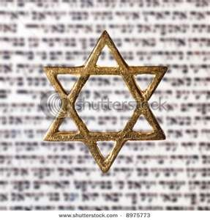
Israel’s Three Blessings to the World
(Gen 12:3b)
Scripture (Rom 3:2)
Savior (John 4:22)
Kingdom (Isa 2:2-3)

Slide 17


Slide 18
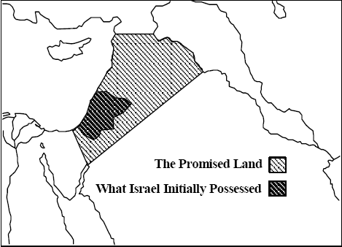
Thomas L. Constable, Notes on Numbers, p.99

Slide 19
Overview
The Divine Purpose for Israel
The Divine Protection of Israel
The Proper Perspective Concerning Israel
Notes:
Outline

Slide 20
Genesis 12:3
“And I will bless those who bless you, And the one who curses you I will curse. And in you all the families of the earth will be blessed.” (NASB)

Slide 21
Zechariah 2:8
“For thus says the Lord of hosts, “After glory He has sent me against the nations which plunder you, for he who touches you, touches the apple of His eye.”

Slide 22
Genesis 12:3
“And I will bless those who bless you, And the one who curses you I will curse. And in you all the families of the earth will be blessed.” (NASB)

Slide 23
Overview
The Divine Purpose for Israel
The Divine Protection of Israel
The Proper Perspective Concerning Israel
Notes:
Outline

Slide 24
III. The Proper Perspective Concerning Israel
Attitude
Angelic conflict
Apostate condition?
Practical reasons
Notes:
Outline

Slide 25
III. The Proper Perspective Concerning Israel
Attitude
Angelic conflict
Apostate condition?
Practical reasons
Notes:
Outline

Slide 26
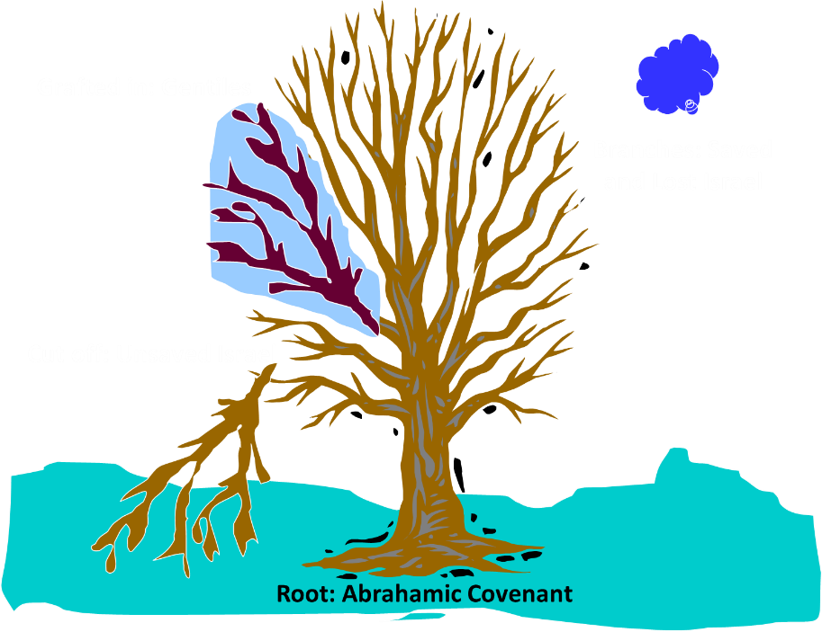
Notes:
26

Slide 27
Christian Anti-Semitism
  “First, their synagogues should be set on fire…Secondly, their homes should likewise be broken down and destroyed…Thirdly, they should be deprived of their prayer books and Talmuds…”

Slide 28
Christian Anti-Semitism
  “…Fourthly, their rabbis must be forbidden under threat of death to teach any more…Fifthly, passport and traveling privileges should be absolutely forbidden to the Jews…Sixthly, they ought to be stopped from usury (charging interest on loans…”

Slide 29
Christian Anti-Semitism
  “Seventhly, let the young and strong Jews and Jewesses be given the flail, the ax, the hoe, the spade, the distaff, and spindle, and let the earn their bread by the sweat of their noses…We ought to drive the rascally lazy bones out of our system...”
Martin Luther, Concerning the Jews and Their Lies, cited in Michael Brown’s Our Hands Are Stained with Blood, pp. 14-15.

Slide 30
Christian Anti-Semitism
  “…Therefore away with them… To sum up, dear princes and nobles who have Jews in your domains, if this advice of mine does not suit you, then find a better one so that you and we may all be free of this insufferable devilish burden–the Jews.”
Martin Luther, Concerning the Jews and Their Lies, cited in Michael Brown’s Our Hands Are Stained with Blood, pp. 14-15.

Slide 31
Decide?
Weeping Jewish remnant (John 12:19)
Edomite Herodian Dynasty
Roman soldiers executed Christ (John 18:30-31)
Christ partially blamed the Gentiles (Matt. 20:18-19)
Christ died for the world's sin (John 3:16)
The Father is responsible (Isa. 53:10)
Christ is responsible (John 10:17-18)
“A” culprit vs. “the” culprit (Acts 2:23)

Slide 32
III. The Proper Perspective Concerning Israel
Attitude
Angelic conflict
Apostate condition?
Practical reasons
Notes:
Outline

Slide 33
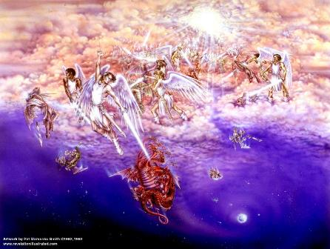
Biblical Reality of the Angelic World
Job 1:12
2 Kings 6:15-17
1 Chron 21:1
Dan 10:12-13, 20
Matt 16:21-23
Eph 6:12

Slide 34
Revelation 12:1-5
¹And a great sign appeared in heaven: a woman clothed in the sun, and the moon under her feet, and upon her head a crown of twelve stars; ²and she was with child; and she cried out, being in labor pain to give birth. ³And another sign was seen in heaven: and behold, a great red dragon, having seven heads and ten horns, and upon his heads seven diadems. (NASV 1995)

Slide 35
Revelation 12:1-5 (cont’d)
⁴And his tail swept a third part of the stars of heaven, and did cast them to the earth: and the dragon stood before the woman that is about to give birth, so that when she gave birth he may devour her child. ⁵And she gave birth to a son, a man child, who is to rule all the nations with a rod of iron: and her child was caught up unto God, and to his throne. (NASV 1995)

Slide 36
Revelation: 12 Symbols
Son = Messiah (Rev 12:5; Ps. 2:9; Acts 1:9)
Dragon = Satan (Rev 12:3, 9)
Woman = Israel (Rev 12:1; Gen 37:9-10)

Slide 37
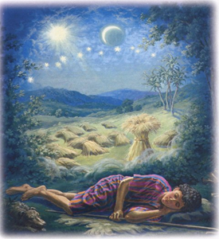
Genesis 37:9
Now he had still another dream, and related it to his brothers, and said, “Lo, I have had still another dream; and behold, the sun and the moon and eleven stars were bowing down to me.

Slide 38
Genesis 37:10
He related it to his father and to his brothers; and his father rebuked him and said to him, “What is this dream that you have had? Shall I and your mother and your brothers actually come to bow ourselves down before you to the ground?”

Slide 39
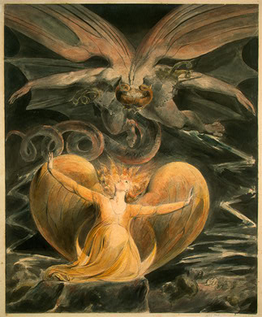
2 CYCLES OF SATANIC PERSECUTION
(Revelation 12:13-16)
“Pursues the woman” = persecution of Israel 12:13-14
“Flood from his mouth” = tries to destroy Israel 12:15-16

Slide 40
Descriptions of Satanic Hatred
(Revelation 12:12-17)
Wrath 12:12
Persecution 12:13
Sweep away 12:15
Enraged 12:17
War 12:17

Slide 41
Matthew 23:37-39
“Jerusalem, Jerusalem, who kills the prophets and stones those who are sent to her! How often I wanted to gather your children together, the way a hen gathers her chicks under her wings, and you were unwilling. ³⁸ Behold, your house is being left to you desolate! ³⁹ For I say to you, from now on you will not see Me until you say, ‘Blessed is He who comes in the name of the Lord!’”

Slide 42
III. The Proper Perspective Concerning Israel
Attitude
Angelic conflict
Apostate condition?
Practical reasons
Notes:
Outline

Slide 43
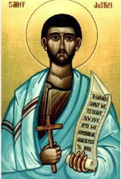
“But I and every other completely orthodox Christian feel certain that there will be a resurrection of the flesh, followed by a thousand years in the rebuilt, embellished, and enlarged city of Jerusalem as was announced by the prophets Ezekiel, Isaiah, and the others.”
Justin Martyr, Dialogue with Trypho, 80.

Slide 44
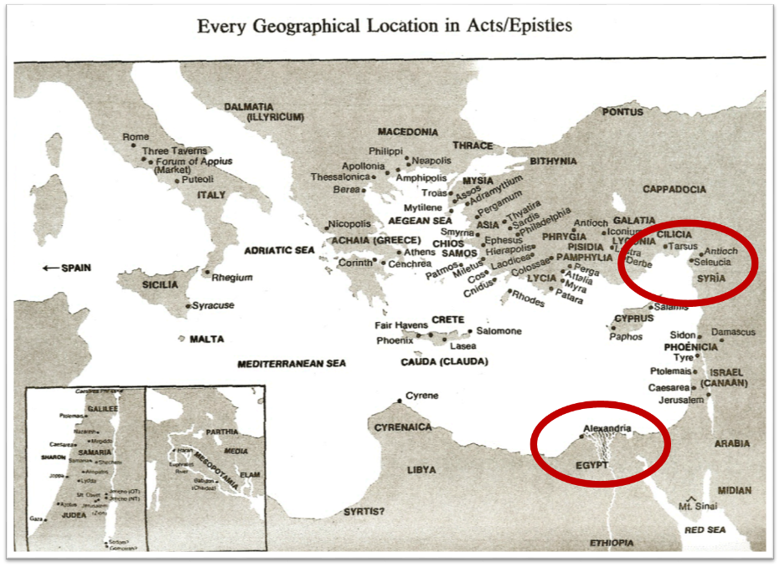

Slide 45
Ezekiel 36:24-28
“For I will take you from the nations, gather you from all the lands and bring you into your own land. ²⁵ Then I will sprinkle clean water on you, and you will be clean; I will cleanse you from all your filthiness and from all your idols. ²⁶ Moreover, I will give you a new heart and put a new spirit within you; and I will remove the heart of stone from your flesh and give you a heart of flesh. ²⁷ I will put My Spirit within you and cause you to walk in My statutes, and you will be careful to observe My ordinances. ²⁸ You will live in the land that I gave to your forefathers; so you will be My people, and I will be your God.”

Slide 46
Ezekiel 37:7-11
So I prophesied as I was commanded; and as I prophesied, there was a noise, and behold, a rattling; and the bones came together, bone to its bone. ⁸ And I looked, and behold, sinews were on them, and flesh grew and skin covered them; but there was no breath in them. ⁹ Then He said to me, “Prophesy to the breath, prophesy, son of man, and say to the breath, ‘Thus says the Lord God, “Come from the four winds, O breath, and breathe on these slain, that they come to life.”’” ¹⁰ So I prophesied as He commanded me, and the breath came into them, and they came to life and stood on their feet, an exceedingly great army. ¹¹ Then He said to me, “Son of man, these bones are the whole house of Israel; behold, they say, ‘Our bones are dried up and our hope has perished. We are completely cut off’.”

Slide 47
Zechariah 12:10
“I will pour out on the house of David and on the inhabitants of Jerusalem, the Spirit of grace and of supplication, so that they will look on Me whom they have pierced; and they will mourn for Him, as one mourns for an only son, and they will weep bitterly over Him like the bitter weeping over a firstborn.”

Slide 48
Israel’s Two Regatherings
THE PRESENT (FIRST) REGATHERING | THE PERMANENT (SECOND) REGATHERING
Return to part of the land | Return to all the land
Return in unbelief | Return in faith
Restored to the land only | Restored to the land and the Lord
Sets the stage for Tribulation (discipline) | Sets the stage for Millennium (blessing)
Adapted from: Price, Jerusalem In Prophecy, 219

Slide 49
Romans 11:28-29
“From the standpoint of the gospel they are enemies for your sake, but from the standpoint of God’s choice they are beloved for the sake of the fathers; ²⁹ for the gifts and the calling of God are irrevocable.”

Slide 50
III. The Proper Perspective Concerning Israel
Attitude
Angelic conflict
Apostate condition?
Practical reasons
Notes:
Outline

Slide 51
Transforming David Into Goliath?
 | Neighbors | Israel
Number of nations | 22 | 1
Size | 640 Times Israel’s Size | 1/19th Size of California
Population | 250 million (1.4 billion Muslims worldwide) | 13 million
Type of government | Dictatorships | Democracy
Wealth | Most of the world’s oil | Some potential oil discoveries
http://www.mefacts.com/cached.asp?x_id=10190

Slide 52
Transforming David Into Goliath?
 | Neighbors | Israel
Peaceful co-existence? | Limited desire for peace (except for Egypt and Jordan) | Desire for peace
Religious freedom | Christianity persecuted | Christianity growing
Holy book | Koran commands worldwide submission | Torah promises small allotment of land
Mention of Jerusalem in Holy book | Koran = 0 | OT = 1000x
http://www.mefacts.com/cached.asp?x_id=10190

Slide 53
Quran Surah* 24:55
(*chapter)
“Allah has promised those who have believed among you and done righteous deeds that He will surely grant them succession [Caliphate] upon the earth just as He granted it to those before them and that He will surely establish for them [therein] their religion which He has preferred for them and that He will surely substitute for them, after their fear, security, [for] they worship Me, not associating anything with Me. But whoever disbelieves after that - then those are the defiantly disobedient.”

Slide 54
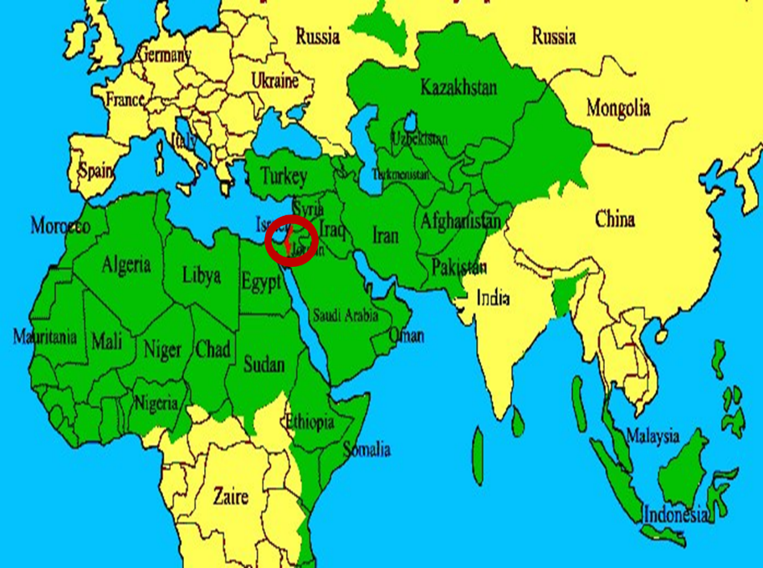

Slide 55


Slide 56
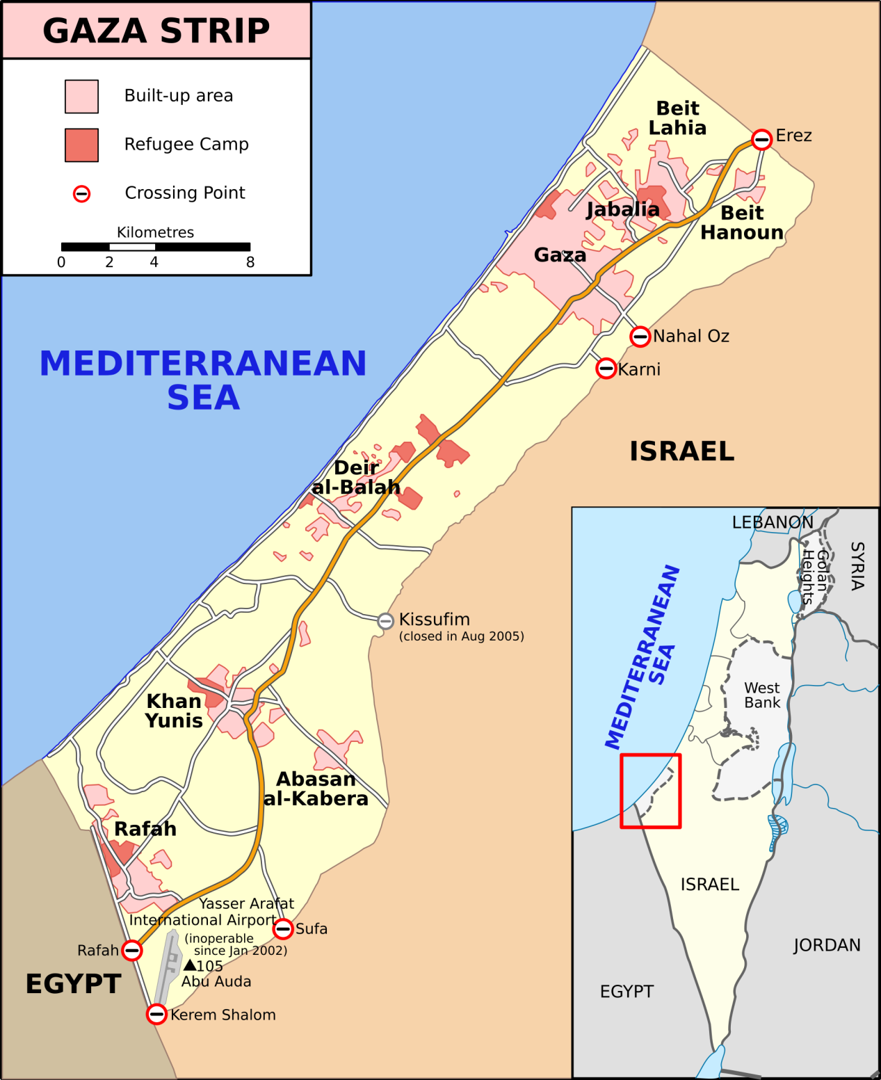

Slide 57
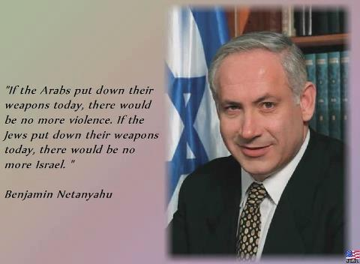

Slide 58

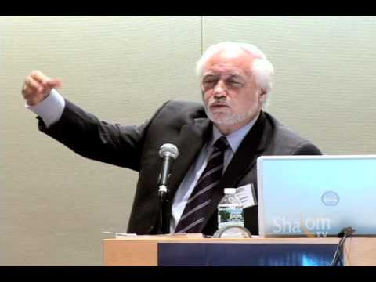

Slide 59
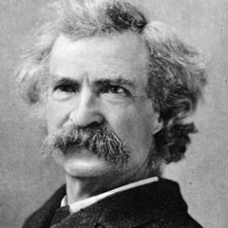
“... A desolate country whose soil is rich enough, but is given over wholly to weeds… a silent mournful expanse…. a desolation is here that not even imagination can grace with the pomp of life and action…. we never saw a human being on the whole route…. there was hardly a tree or shrub anywhere. Even the olive tree and the cactus, those fast friends of a worthless soil, had almost deserted the country.”
Mark Twain, The Innocents Abroad, Complete, 1st ed. (A Public Domain Book, 1869), 267, 285, 302. These quotes can be found in chapters 47, 49, 52.

Slide 60
Why?
COUNTRY | GROSS DOMESTIC PRODUCT
Israel | $123 billion
Egypt | $81 billion
Syria | $26 billion
Lebanon | $21 billion
Jordan | $12 billion
Source: CIA World Fact Book, 2005

Slide 61
Ezekiel 37:7-11
So I prophesied as I was commanded; and as I prophesied, there was a noise, and behold, a rattling; and the bones came together, bone to its bone. ⁸ And I looked, and behold, sinews were on them, and flesh grew and skin covered them; but there was no breath in them. ⁹ Then He said to me, “Prophesy to the breath, prophesy, son of man, and say to the breath, ‘Thus says the Lord God, “Come from the four winds, O breath, and breathe on these slain, that they come to life.”’” ¹⁰ So I prophesied as He commanded me, and the breath came into them, and they came to life and stood on their feet, an exceedingly great army. ¹¹ Then He said to me, “Son of man, these bones are the whole house of Israel; behold, they say, ‘Our bones are dried up and our hope has perished. We are completely cut off’.”

Slide 62
Zechariah 12:2-3
“Behold, I am going to make Jerusalem a cup that causes reeling to all the peoples around; and when the siege is against Jerusalem, it will also be against Judah. ³ It will come about in that day that I will make Jerusalem a heavy stone for all the peoples; all who lift it will be severely injured. And all the nations of the earth will be gathered against it.

Slide 63
Zechariah 12:2-3
“Behold, I am going to make Jerusalem a cup that causes reeling to all the peoples around; and when the siege is against Jerusalem, it will also be against Judah. ³ It will come about in that day that I will make Jerusalem a heavy stone for all the peoples; all who lift it will be severely injured. And all the nations of the earth will be gathered against it.

Slide 64
Zechariah 14:2
“For I will gather all the nations against Jerusalem to battle, and the city will be captured, the houses plundered, the women ravished and half of the city exiled, but the rest of the people will not be cut off from the city.”

Slide 65
Joel 3:2
“I will gather all the nations And bring them down to the valley of Jehoshaphat. Then I will enter into judgment with them there On behalf of My people and My inheritance, Israel, Whom they have scattered among the nations; And they have divided up My land.”

Slide 66
Thomas L. Constable, Notes on Numbers, p.99

Slide 67
Conclusion

Slide 68
Overview
The Divine Purpose for Israel
The Divine Protection of Israel
The Proper Perspective Concerning Israel
Notes:
Outline

