Slide 1
THE BIBLE AND VOTING Part 12
Dr. Andy Woods

Slide 2
Introductory Remarks
A stewardship issue (1 Cor. 4:2)
A biblical issue (2 Tim. 3:16)
Biblical principles rather than partisanship

Slide 3
The Bible and Voting
Economic issues
Social issues
Foreign affairs

Slide 4
The Bible and Voting
Economic issues
Social issues
Foreign affairs

Slide 5
Economic Issues
Ownership of private property? (Deut. 19:15)
Pursuit of economic self interest? (Gen. 8:21)
Proper definition of compassion? (2 Thess. 3:10)
Who provides charity? (1 Tim. 5:3-8)
Family is the building block of society? (Deut. 6:6-7)
Wealth retained within the family? (Prov. 13:22)
The earth experiences cyclical patterns? (Gen. 8:22)
Environmental stewardship rather than earth worship? (Rom. 1:22-23)
Opposition to runaway debt? (Prov. 22:7)
Limitations upon the government? (Acts 5:29)

Slide 6
The Bible and Voting
Economic issues
Social issues
Foreign affairs

Slide 7
Social Issues
Legal protection for the unborn? (Gen. 25:23)
Legal protection for the elderly? (Lev. 19:32)
Hetero-sexual monogamous marriage as the standard for society? (Gen. 2:18-25)
Advocacy capital punishment? (Gen. 9:6)
The right to restrict alcohol, pornography, & gambling? (Lev. 10:9; Matt. 5:27-28; Prov. 13:11)
Parental authority over children? (Eph. 6:4)
Public expressions of Christianity? (Mark 16:15)
Right to keep and bear arms? (Luke 22:36)

Slide 8
The Bible and Voting
Economic issues
Social issues
Foreign affairs

Slide 9
Foreign Affairs
Favor national sovereignty above global governance? (Gen. 11:1-9)
Favor the reality and enforceability of our national borders? (Acts 17:26)
Support for the nation of Israel? (Gen. 12:3)
Pursuit of peace though strength? (Jer. 17:9)

Slide 10
Foreign Affairs
Favor national sovereignty above global governance? (Gen. 11:1-9)
Favor the reality and enforceability of our national borders? (Acts 17:26)
Support for the nation of Israel? (Gen. 12:3)
Pursuit of peace though strength? (Jer. 17:9)

Slide 11
Foreign Affairs
Favor national sovereignty above global governance? (Gen. 11:1-9)
Favor the reality and enforceability of our national borders? (Acts 17:26)
Support for the nation of Israel? (Gen. 12:3)
Pursuit of peace though strength? (Jer. 17:9)

Slide 12
Foreign Affairs
Favor national sovereignty above global governance? (Gen. 11:1-9)
Favor the reality and enforceability of our national borders? (Acts 17:26)
Support for the nation of Israel? (Gen. 12:3)
Pursuit of peace though strength? (Jer. 17:9)

Slide 13
Foreign Affairs
Favor national sovereignty above global governance? (Gen. 11:1-9)
Favor the reality and enforceability of our national borders? (Acts 17:26)
Support for the nation of Israel? (Gen. 12:3)
Pursuit of peace though strength? (Jer. 17:9)

Slide 14
Overview
Terrorism’s false causes
Terrorism’s true causes
Ineffective deterrents of terrorism
Effective deterrents to terrorism
Going too far in deterring terrorism
Legitimate methods in deterring terrorism
Notes:
Outline

Slide 15
Overview
Terrorism’s false causes
Terrorism’s true causes
Ineffective deterrents of terrorism
Effective deterrents to terrorism
Going too far in deterring terrorism
Legitimate methods in deterring terrorism
Notes:
Outline

Slide 16
Overview
Terrorism’s false causes
Terrorism’s true causes
Ineffective deterrents of terrorism
Effective deterrents to terrorism
Going too far in deterring terrorism
Legitimate methods in deterring terrorism
Notes:
Outline

Slide 17
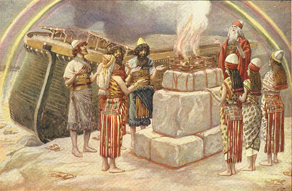
Genesis 8:21
The Lord smelled the soothing aroma; and the Lord said to Himself, “I will never again curse the ground on account of man, for the intent of man’s heart is evil from his youth; and I will never again destroy every living thing, as I have done.[emphasis mine].

Slide 18
Mark 7:20-23
“And He was saying, “That which proceeds out of the man, that is what defiles the man. ²¹ For from within, out of the heart of men, proceed the evil thoughts, fornications, thefts, murders, adulteries, ²² deeds of coveting and wickedness, as well as deceit, sensuality, envy, slander, pride and foolishness. ²³ All these evil things proceed from within and defile the man.”

Slide 19
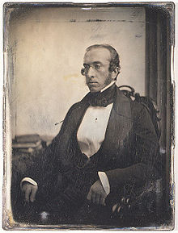
Robert Charles Winthrop
“All societies of men must be governed in some way or other. The less they may have of stringent State Government, the more they must have of individual self-government. The less they rely on public law or physical force, the more they must rely on private moral restraint. Men, in a word, must necessarily be controlled, either by a power within them, or by a power without them; either by the Word of God, or by the strong arm of man; either by the Bible, or by the bayonet. It may do for other countries and other governments to talk about the State supporting religion. Here, under our own free institutions, it is Religion which must support the State.”
Robert Winthrop, Addresses and Speeches on Various Occasions (Boston, MA: Little, Brown, 1852), 172. Speech to the Massachusetts Bible Society (1849-05-28).

Slide 20
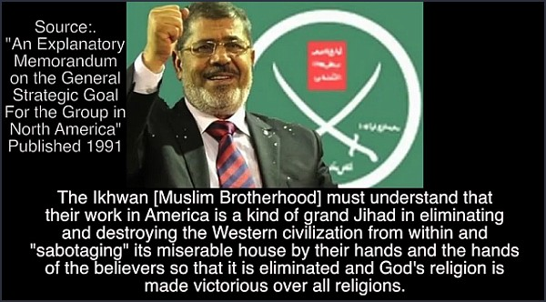

Slide 21
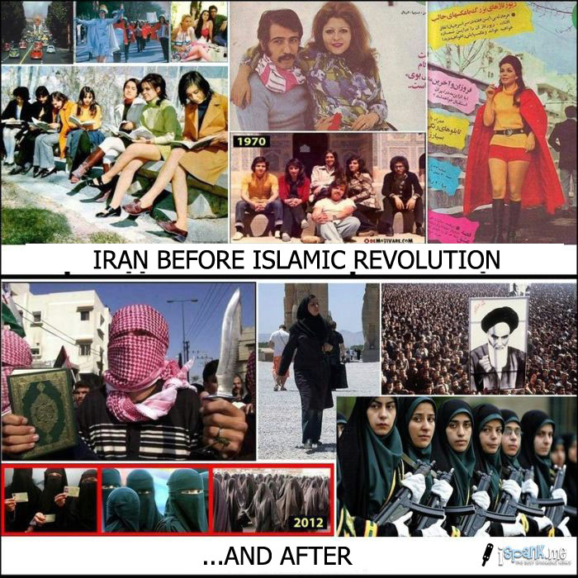

Slide 22
Overview
Terrorism’s false causes
Terrorism’s true causes
Ineffective deterrents of terrorism
Effective deterrents to terrorism
Going too far in deterring terrorism
Legitimate methods in deterring terrorism
Notes:
Outline

Slide 23
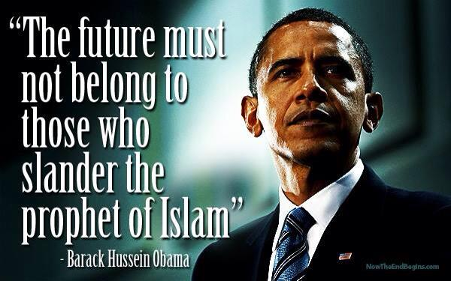

Slide 24
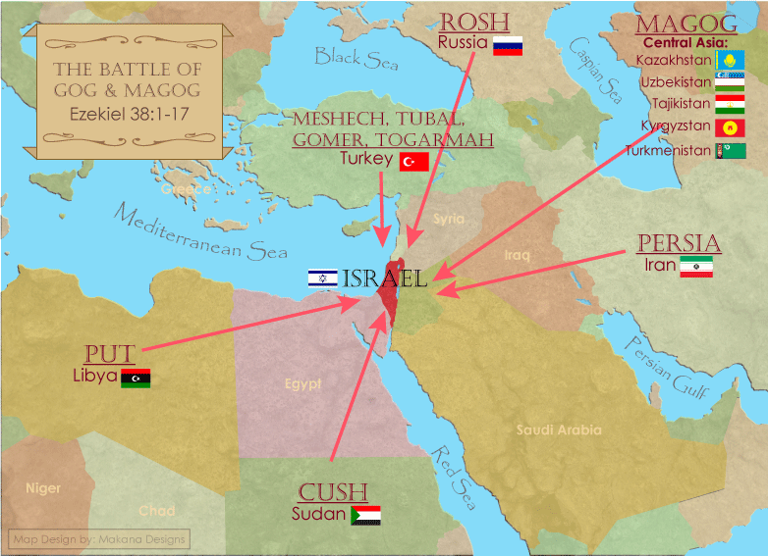

Slide 25
Overview
Terrorism’s false causes
Terrorism’s true causes
Ineffective deterrents of terrorism
Effective deterrents to terrorism
Going too far in deterring terrorism
Legitimate methods in deterring terrorism
Notes:
Outline

Slide 26
Robert Charles Winthrop
“All societies of men must be governed in some way or other. The less they may have of stringent State Government, the more they must have of individual self-government. The less they rely on public law or physical force, the more they must rely on private moral restraint. Men, in a word, must necessarily be controlled, either by a power within them, or by a power without them; either by the Word of God, or by the strong arm of man; either by the Bible, or by the bayonet. It may do for other countries and other governments to talk about the State supporting religion. Here, under our own free institutions, it is Religion which must support the State.”
Robert Winthrop, Addresses and Speeches on Various Occasions (Boston, MA: Little, Brown, 1852), 172. Speech to the Massachusetts Bible Society (1849-05-28).

Slide 28
Overview
Terrorism’s false causes
Terrorism’s true causes
Ineffective deterrents of terrorism
Effective deterrents to terrorism
Going too far in deterring terrorism
Legitimate methods in deterring terrorism
Notes:
Outline

Slide 29
Overview
Terrorism’s false causes
Terrorism’s true causes
Ineffective deterrents of terrorism
Effective deterrents to terrorism
Going too far in deterring terrorism
Legitimate methods in deterring terrorism
Notes:
Outline

Slide 30
Conclusion

Slide 31
Overview
Terrorism’s false causes
Terrorism’s true causes
Ineffective deterrents of terrorism
Effective deterrents to terrorism
Going too far in deterring terrorism
Legitimate methods in deterring terrorism
Notes:
Outline

