Slide 1
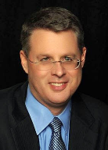
Soteriology Session 33
Dr. Andy Woods
Senior Pastor – Sugar Land Bible Church
Professor of Bible & Theology – College of Biblical Studies

Slide 2
Soteriology Overview
Definition
Election
Atonement
Salvation words
God’s one condition of salvation
Results of salvation
Eternal security
Faulty views of salvation

Slide 3
Soteriology Overview
This Session
VII. Eternal Security

Slide 4
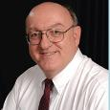
Definition of Eternal Security
“Eternal Security means that those who have been genuinely saved by God’s grace through faith alone in Christ alone shall never be in danger of God’s condemnation or loss of salvation but God’s grace and power keep them forever saved and secure.”
Dennis Rokser, Shall Never Perish Forever, p. 11

Slide 5
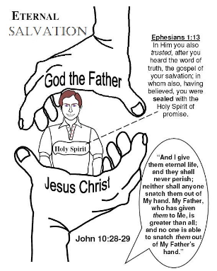
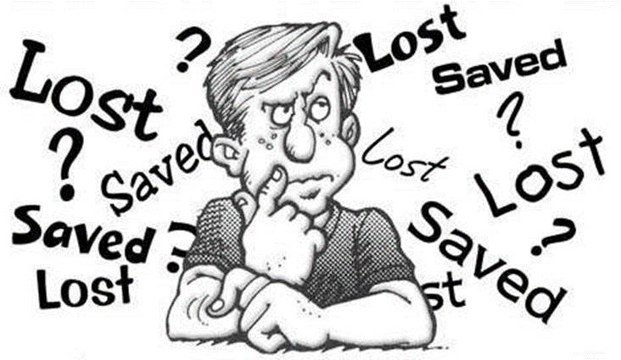
Eternal Security Outline
Eternal security arguments
Response to problem passages

Slide 6
Eternal Security Outline
Eternal security arguments
Response to problem passages

Slide 7
Evidence for Eternal Security
Because self-righteousness did not save us it is not a basis upon which salvation can be lost
Salvation is not given or maintained by works
If a believer can lose eternal life, then how can this life be eternal (John 3:16)?
The Bible’s promises guarantee security (John 10:28)
The assurance of salvation (1 John 5:14)
The believer is predestined for glory (Rom 8:29-30)
The Spirit’s seal cannot be broken (Eph 4:30)

Slide 8
Evidence for Eternal Security
God keeps us from falling (1 Pet 1:4-5)
Christ’s role as intercessor and advocate (John 17:11-12, 20)
Christ’s death perfectly dealt with all sins (Titus 2:14)
A believer cannot be removed from Christ’s body (1 Cor. 12:13)
The Bible does not specify which sins remove salvation
Believers with unfruitful lives still have salvation although lose rewards at the Bema Seat (1 Cor 3:15)

Slide 9
Eternal Security Outline
Eternal security arguments
Response to problem passages

Slide 10
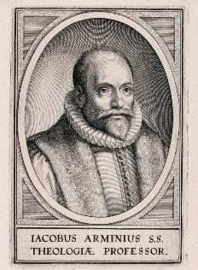
Introduction
Rejoice?
Jacob Arminius (1560‒1609)
Harmonization
The Bible cannot contradict itself
Biblical order

Slide 11
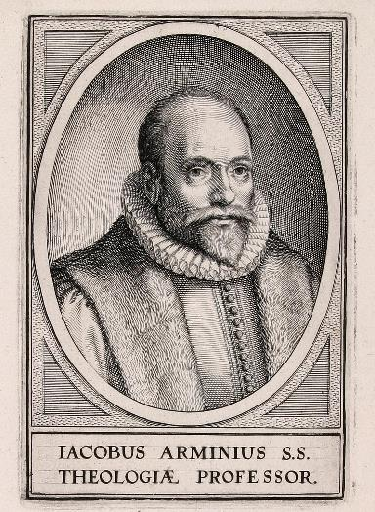
Response to Problem Passages
OT Passages
Passages from Matthew
Passages from John
Passages from Acts
Passages from Paul

Slide 12
Response to Problem Passages
Passages from James
Passages from Hebrews
Passages from 2 Peter
Passages from 1 John
Passages from Revelation
Miscellaneous argument

Slide 13
Response to Problem Passages
OT Passages
Passages from Matthew
Passages from John
Passages from Acts
Passages from Paul

Slide 14
1. OT Passages
Adam & Eve (Gen. 1‒3)
Nadab & Abihu (Lev. 10:1-2)
Korah’s rebellion (Num. 16)
Joshua 24:20
Saul (1 Sam. 16:14; 28; 1 Chron. 10:13-14)
Solomon (1 Kgs. 11)
David (Ps. 51:11)
Ezekiel 18:20

Slide 15
Response to Problem Passages
OT Passages
Passages from Matthew
Passages from John
Passages from Acts
Passages from Paul

Slide 16
2. Passages From Matthew
Matt. 6:14-15
Matt. 7:21-23
Matt. 8:11-12; 25:30
Matt. 10:32-33
Matt. 12:31-32
Matt. 24:13
Matt. 25:41

Slide 17
2. Passages From Matthew
Matt. 6:14-15
Matt. 7:21-23
Matt. 8:11-12; 25:30
Matt. 10:32-33
Matt. 12:31-32
Matt. 24:13
Matt. 25:41

Slide 18
Matthew 12:31-32
Context
Five key questions
Summary
Is suicide the unpardonable sin?
Notes:
Outline

Slide 19
Matthew 12:31-32
Context
Five key questions
Summary
Is suicide the unpardonable sin?
Notes:
Outline

Slide 20
Seven Suicides of the Bible
Abimelech (Judges 9:54)
Samson (Judges 16:26-31)
Saul’s armor bearer (1 Sam. 31:5)
Saul (1 Sam. 31:3-6)
Ahithophel (2 Sam. 17)
Zimri (1 Kgs. 16:18)
Judas (Matt. 27:4-5)

Slide 21
Seven Suicides of the Bible
Abimelech (Judges 9:54)
Samson (Judges 16:26-31)
Saul’s armor bearer (1 Sam. 31:5)
Saul (1 Sam. 31:3-6)
Ahithophel (2 Sam. 17)
Zimri (1 Kgs. 16:18)
Judas (Matt. 27:4-5)

Slide 22
Seven Suicides of the Bible
Abimelech (Judges 9:54)
Samson (Judges 16:26-31) – Heb. 11:32
Saul’s armor bearer (1 Sam. 31:5)
Saul (1 Sam. 31:3-6) – 1 Sam. 28:19
Ahithophel (2 Sam. 17)
Zimri (1 Kgs. 16:18)
Judas (Matt. 27:4-5)

Slide 23
Romans 8:38-39 (NASB)
“For I am convinced that neither death, nor life, nor angels, nor principalities, nor things present, nor things to come, nor powers, ³⁹ nor height, nor depth, nor any other created thing, will be able to separate us from the love of God, which is in Christ Jesus our Lord.”

Slide 24
Romans 8:38-39 (NASB)
“For I am convinced that neither death, nor life, nor angels, nor principalities, nor things present, nor things to come, nor powers, ³⁹ nor height, nor depth, nor any other created thing, will be able to separate us from the love of God, which is in Christ Jesus our Lord.”

Slide 25
Response to Problem Passages
OT Passages
Passages from Matthew
Passages from John
Passages from Acts
Passages from Paul

Slide 26
3. Passages From John’s Gospel
John 6:66
John 15:6
John 20:30-31

Slide 27
3. Passages From John’s Gospel
John 6:66
John 15:6
John 20:30-31

Slide 28
John 6:66 (NASB)
“As a result of this many of His disciples withdrew and were not walking with Him anymore.”

Slide 29
a. John 6:66
“Disciple” is not a technical term
“Disciple” can refer to both saved and unsaved students under Christ’s teaching
Examples
Matthew 7:21-23
Judas (Matt. 10:1-4; John 6:64, 71)
False converts or those who never believed
No mention of loss of salvation

Slide 30
Matt. 7:21-23 (NASB)
“Not everyone who says to Me, ‘Lord, Lord,’ will enter the kingdom of heaven, but he who does the will of My Father who is in heaven will enter. ²² Many will say to Me on that day, ‘Lord, Lord, did we not prophesy in Your name, and in Your name cast out demons, and in Your name perform many miracles?’ ²³ And then I will declare to them, ‘I never knew you; depart from Me, you who practice lawlessness.’”

Slide 31
a. John 6:66
“Disciple” is not a technical term
“Disciple” can refer to both saved and unsaved students under Christ’s teaching
Examples
Matthew 7:21-23
Judas (Matt. 10:1-4; John 6:64, 71)
False converts or those who never believed
No mention of loss of salvation

Slide 32
3. Passages From John’s Gospel
John 6:66
John 15:6
John 20:30-31

Slide 33
John 15:6 (NASB)
“If anyone does not abide in Me, he is thrown away as a branch and dries up; and they gather them, and cast them into the fire and they are burned.”

Slide 34
b. John 15:6
Context-John 15:1-8
Saved audience
“In me” (John 15:2; 14:11)
“Clean” (John 15:3; 13:10-11)
Judas’ departure (John 13:29-31)
Abiding (vss. 4, 5, 7) and fruit bearing (vss. 2, 4, 5, 8, 16)
Men (not God) cast the branches into the fire (vs. 6)
“Fire” not always hell (1 Cor. 3:15; Heb. 6:8; 1 Pet. 1:6-7)
Pruning to bear more fruit (John 15:2; Heb. 12:5-11)

Slide 35
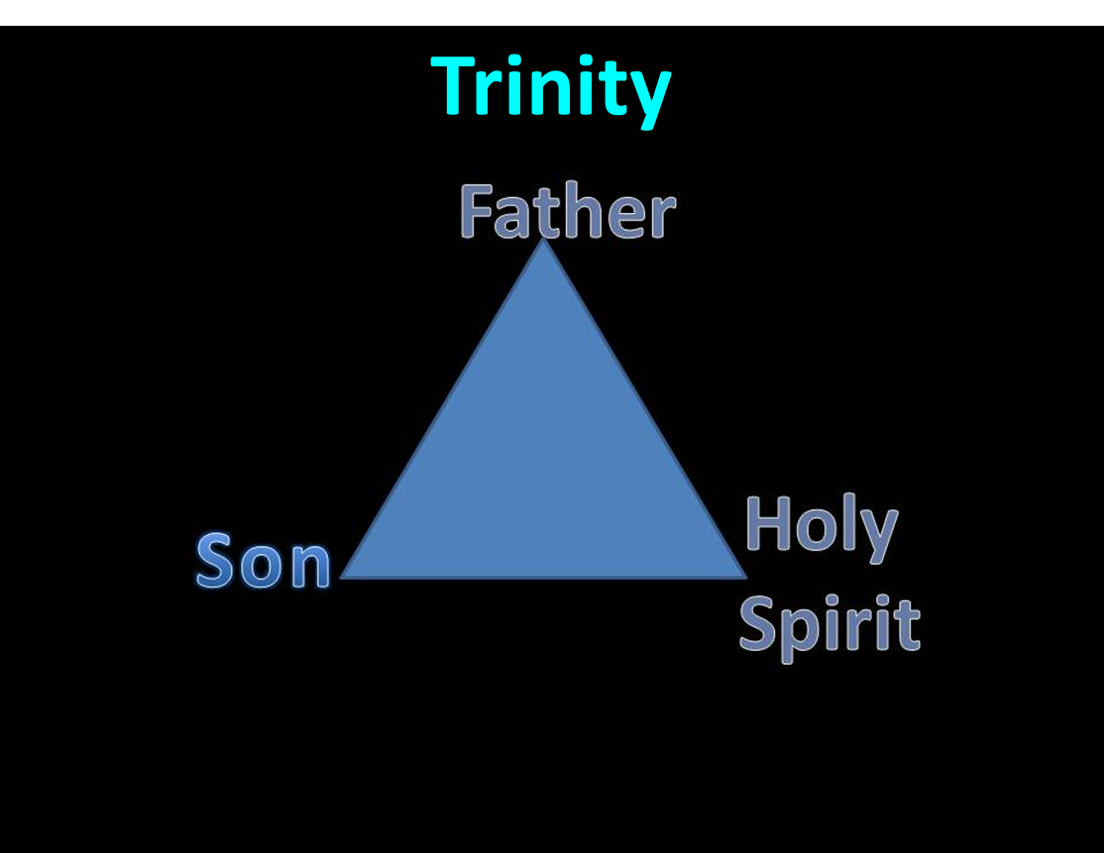

Slide 36
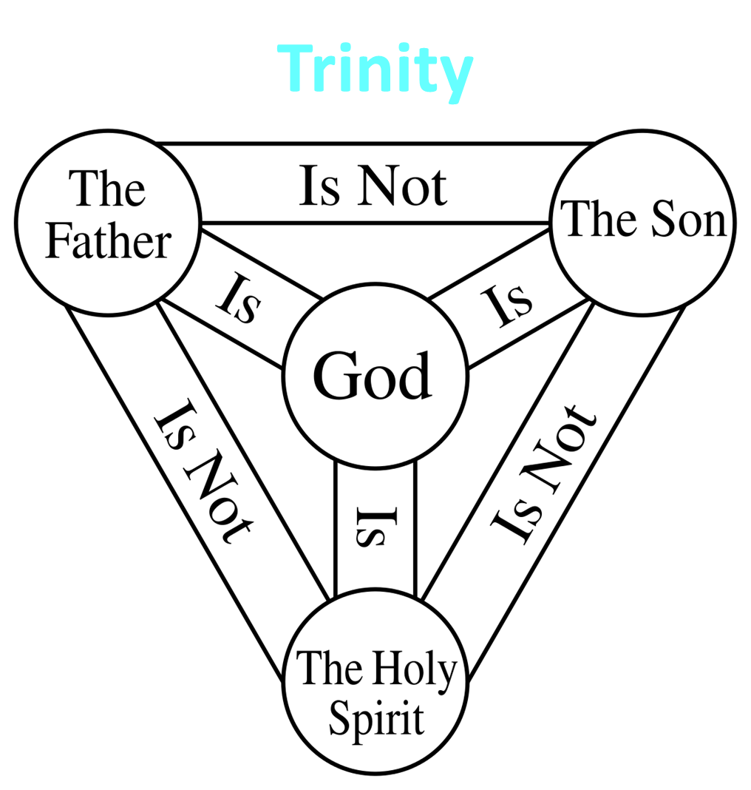

Slide 37
3. Passages From John’s Gospel
John 6:66
John 15:6
John 20:30-31

Slide 38
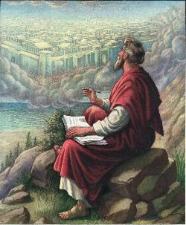
John 20:30-31
“Therefore many other signs Jesus also performed in the presence of the disciples, which are not written in this book; but these have been written so that you may believe that Jesus is the Christ, the Son of God; and that believing you may have life in His name.”

Slide 39
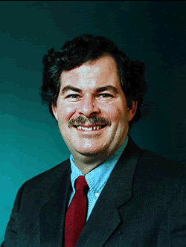
Believing Forever?
“The aspectual force of the present ho pisteuōn seems to be in contrast with ho pisteusas…The present was the tense of choice most likely because the NT writers by and large saw continual belief as a necessary condition of salvation. Along these lines, it seems significant that the promise of salvation is almost always given to ho pisteuōn, almost never to ho pisteusas…”
Daniel B. Wallace, Greek Grammar Beyond the Basics: An Exegetical Syntax of the New Testament with Scripture, Subject, and Greek Word Indexes (Grand Rapids: Zondervan, 1996), 621, n. 22.

Slide 40
c. John 20:30-31
Present tense participle “believing”-John 3:16, 18; 5:24
Abuse of the present tense
Present tense does not always require continual behavior
Mark 6:14
John the “baptizer”
John already dead!
Not describing continual baptizing
Just describing him
How many times doe you have to MURDER before you are a MURDERER? Once! Same with a FISHERMAN & BELIEVER

Slide 41
Present Tense Participle Does Not Always Mean Forever
John 4:13
John 4:26
John 4:36
John 5:3
John 5:24
John 6:14
John 11:26
Mark 6:14
Bob Wilkin, “The One Who Believes: Is Continuous Faith Required to be Born Again?,” online: http://www.faithalone.org/magazine/y2006/06jf1.html, accessed 06 May 2015.

Slide 42
c. John 20:30-31
Does not preclude ongoing faith but does not require it
Other verb forms also used to describe belief (John 8:30-31)
It is possible for a Christian to struggle with faith
a. 2 Tim. 2:13 – “faithless” = unbelieving
b. Jas. 1:5-8
c. Peter’s sinking and three-fold denial

Slide 43
John 8:30-31 (NASB)
“As He spoke these things, many came to *believe in Him. So Jesus was saying to those Jews who had ⁺believed Him, “If you continue in My word, then you are truly disciples of Mine.”
* aorist active indicative
⁺ perfect active participle

Slide 44
c. John 20:30-31
Does not preclude ongoing faith but does not require it
Other verb forms also used to describe belief (John 8:30-31)
It is possible for a Christian to struggle with faith
a. 2 Tim. 2:13 – “faithless” = unbelieving
b. Jas. 1:5-8
c. Peter’s sinking and three-fold denial

Slide 45
2 Timothy 2:13 (NASB)
“If we are faithless [without faith], He remains faithful, for He cannot deny Himself.”

Slide 46
James 1:5-8 (NASB)
“But if any of you lacks wisdom, let him ask of God, who gives to all generously and without reproach, and it will be given to him. ⁶ But he must ask in faith without any doubting, for the one who doubts is like the surf of the sea, driven and tossed by the wind. ⁷ For that man ought not to expect that he will receive anything from the Lord, ⁸ being a double-minded man, unstable in all his ways.”

Slide 47
c. John 20:30-31
Does not preclude ongoing faith but does not require it
Other verb forms also used to describe belief (John 8:30-31)
It is possible for a Christian to struggle with faith
a. 2 Tim. 2:13 – “faithless” = unbelieving
b. Jas. 1:5-8
c. Peter’s sinking and three-fold denial

Slide 48
CONCLUSION

Slide 49
3. Passages From John’s Gospel
John 6:66
John 15:6
John 20:30-31

