Slide 1
Christian Love

Slide 2
Outline
History
Definition
Questions to consider

Slide 3
1 Corinthians 13:13
But now faith, hope, love, abide these three; but the greatest of these is love.

Slide 4
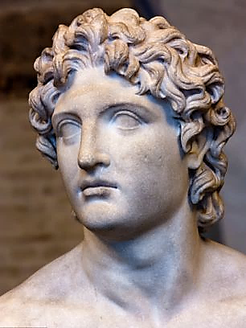
Alexander the Great

Slide 5
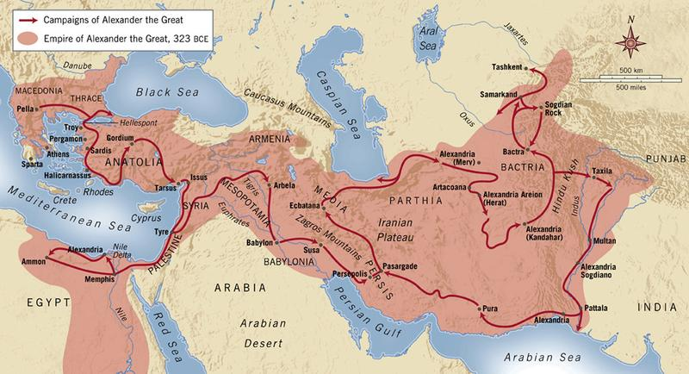
Campaigns of Alexander the Great

Slide 6
Campaigns of Alexander the Great

Slide 7
Campaigns of Alexander the Great

Slide 8
Campaigns of Alexander the Great

Slide 9
Campaigns of Alexander the Great

Slide 10
Campaigns of Alexander the Great

Slide 11
Greek Terms for love
ἀγάπη – divine, selfless, unconditional
Φιλέω – natural affection, brotherly
στοργή – familial
ἔρως – romantic, sexual

Slide 12
Greek Terms for love in the Bible
ἀγάπη – divine, selfless, unconditional
Φιλέω – natural affection, brotherly
στοργή – familial

Slide 13
Agape, love
Divine
Selfless
Self-sacrificial
Unconditional
Volitional
Emotion-less
Gratuitous
Prizing the object loved
Flows from God
Christ demonstrated
Freely gives
Unmerited
Willed
Free to act
A fruit of the Spirit

Slide 14
God is love

Slide 15
John 4:7
Beloved, let us love one another, for love is from God…

Slide 16
Lev 19:18
…You shall love your neighbor as yourself…

Slide 17
1 John 4:8
The one who does not love does not know God, for God is love.

Slide 18
John 14:23-24
“If anyone loves Me, he will keep My word…”
“He who does not love Me does not keep My words…”

Slide 19
John 14:15
“If you love Me, you will keep My commandments.”

Slide 20
John 14:21
““He who has My commandments and keeps them is the one who loves Me”

Slide 21
2 John 6
“And this is love, that we walk according to His commandments.”

Slide 22
1 John 5:3
“For this is the love of God, that we keep His commandments; and His commandments are not burdensome.”

Slide 23
Gal 5:22 – 23
“But the fruit of the Spirit is love, joy, peace, patience, kindness, goodness, faithfulness, gentleness, self-control...”

Slide 24
2 Cor 5:14-15
“For the love of Christ controls us, having concluded this, that one died for all, therefore all died; and He died for all, so that they who live might no longer live for themselves, but for Him who died and rose again on their behalf.

Slide 25
1 John 3:16
“We know love by this, that He laid down His life for us; and we ought to lay down our lives for the brethren.”

Slide 26
1 John 3:18
“Little children, let us not love with word or with tongue, but in deed and truth.

Slide 27
Eph 4:16
“from whom the whole body, being fitted and held together by what every joint supplies, according to the proper working of each individual part, causes the growth of the body for the building up of itself in love.

Slide 28
John 14:15
“If you love Me, you will keep My commandments.”

Slide 29
John 14:21
““He who has My commandments and keeps them is the one who loves Me”

Slide 30
John 14:23
“If anyone loves Me, he will keep My word…”
“He who does not love Me does not keep My words…”

Slide 31
John 14:23
“If anyone loves Me, he will keep My word…”
“He who does not love Me does not keep My words…”

Slide 32
Eph 5:1-2
“Therefore be imitators of God, as beloved children; and walk in love, just as Christ also loved you and gave Himself up for us, an offering and a sacrifice to God as a fragrant aroma.”

Slide 33
Conclusion
History
Definition
Questions to consider

Slide 34
Agape, love
Divine
Selfless
Self-sacrificial
Unconditional
Volitional
Emotion-less
Gratuitous
Prizing the object loved
Flows from God
Christ demonstrated
Freely gives
Unmerited
Willed
Free to act
A fruit of the Spirit

