Slide 1
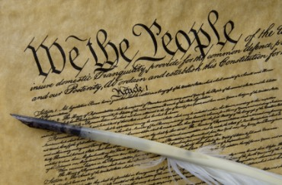
THE BIBLE AND VOTING
Part 6
Dr. Andy Woods

Slide 2

Introductory Remarks
A stewardship issue (1 Cor. 4:2)
A biblical issue (2 Tim. 3:16)
Biblical principles rather than partisanship

Slide 3
The Bible and Voting
Economic issues
Social issues
Foreign affairs

Slide 4
The Bible and Voting
Economic issues
Social issues
Foreign affairs

Slide 5
Economic Issues
Ownership of private property? (Deut. 19:15)
Pursuit of economic self interest? (Gen. 8:21)
Proper definition of compassion? (2 Thess. 3:10)
Who provides charity? (1 Tim. 5:3-8)
Family is the building block of society? (Deut. 6:6-7)
Wealth retained within the family? (Prov. 13:22)
The earth experiences cyclical patterns? (Gen. 8:22)
Environmental stewardship rather than earth worship? (Rom. 1:22-23)
Opposition to runaway debt? (Prov. 22:7)
Limitations upon the government? (Acts 5:29)

Slide 6
The Bible and Voting
Economic issues
Social issues
Foreign affairs

Slide 7
Social Issues
Legal protection for the unborn? (Gen. 25:23)
Legal protection for the elderly? (Lev. 19:32)
Hetero-sexual monogamous marriage as the standard for society? (Gen. 2:18-25)
Advocacy capital punishment? (Gen. 9:6)
The right to restrict alcohol, pornography, & gambling? (Lev. 10:9; Matt. 5:27-28; Prov. 13:11)
Parental authority over children? (Eph. 6:4)
Public expressions of Christianity? (Mark 16:15)
Right to keep and bear arms? (Luke 22:36)

Slide 8
Social Issues
Legal protection for the unborn? (Gen. 25:23)
Legal protection for the elderly? (Lev. 19:32)
Hetero-sexual monogamous marriage as the standard for society? (Gen. 2:18-25)
Advocacy capital punishment? (Gen. 9:6)
The right to restrict alcohol, pornography, & gambling? (Lev. 10:9; Matt. 5:27-28; Prov. 13:11)
Parental authority over children? (Eph. 6:4)
Public expressions of Christianity? (Mark 16:15)
Right to keep and bear arms? (Luke 22:36)

Slide 9
Social Issues
Legal protection for the unborn? (Gen. 25:23)
Legal protection for the elderly? (Lev. 19:32)
Hetero-sexual monogamous marriage as the standard for society? (Gen. 2:18-25)
Advocacy capital punishment? (Gen. 9:6)
The right to restrict alcohol, pornography, & gambling? (Lev. 10:9; Matt. 5:27-28; Prov. 13:11)
Parental authority over children? (Eph. 6:4)
Public expressions of Christianity? (Mark 16:15)
Right to keep and bear arms? (Luke 22:36)

Slide 10
Social Issues
Legal protection for the unborn? (Gen. 25:23)
Legal protection for the elderly? (Lev. 19:32)
Hetero-sexual monogamous marriage as the standard for society? (Gen. 2:18-25)
Advocacy capital punishment? (Gen. 9:6)
The right to restrict alcohol, pornography, & gambling? (Lev. 10:9; Matt. 5:27-28; Prov. 13:11)
Parental authority over children? (Eph. 6:4)
Public expressions of Christianity? (Mark 16:15)
Right to keep and bear arms? (Luke 22:36)

Slide 11
Social Issues
Legal protection for the unborn? (Gen. 25:23)
Legal protection for the elderly? (Lev. 19:32)
Hetero-sexual monogamous marriage as the standard for society? (Gen. 2:18-25)
Advocacy capital punishment? (Gen. 9:6)
The right to restrict alcohol, pornography, & gambling? (Lev. 10:9; Matt. 5:27-28; Prov. 13:11)
Parental authority over children? (Eph. 6:4)
Public expressions of Christianity? (Mark 16:15)
Right to keep and bear arms? (Luke 22:36)

Slide 12
Social Issues
Legal protection for the unborn? (Gen. 25:23)
Legal protection for the elderly? (Lev. 19:32)
Hetero-sexual monogamous marriage as the standard for society? (Gen. 2:18-25)
Advocacy capital punishment? (Gen. 9:6)
The right to restrict alcohol, pornography, & gambling? (Lev. 10:9; Matt. 5:27-28; Prov. 13:11)
Parental authority over children? (Eph. 6:4)
Public expressions of Christianity? (Mark 16:15)
Right to keep and bear arms? (Luke 22:36)

Slide 13
Social Issues
Legal protection for the unborn? (Gen. 25:23)
Legal protection for the elderly? (Lev. 19:32)
Hetero-sexual monogamous marriage as the standard for society? (Gen. 2:18-25)
Advocacy capital punishment? (Gen. 9:6)
The right to restrict alcohol, pornography, & gambling? (Lev. 10:9; Matt. 5:27-28; Prov. 13:11)
Parental authority over children? (Eph. 6:4)
Public expressions of Christianity? (Mark 16:15)
Right to keep and bear arms? (Luke 22:36)

Slide 14
Social Issues
Legal protection for the unborn? (Gen. 25:23)
Legal protection for the elderly? (Lev. 19:32)
Hetero-sexual monogamous marriage as the standard for society? (Gen. 2:18-25)
Advocacy capital punishment? (Gen. 9:6)
The right to restrict alcohol, pornography, & gambling? (Lev. 10:9; Matt. 5:27-28; Prov. 13:11)
Parental authority over children? (Eph. 6:4)
Public expressions of Christianity? (Mark 16:15)
Right to keep and bear arms? (Luke 22:36)

Slide 15

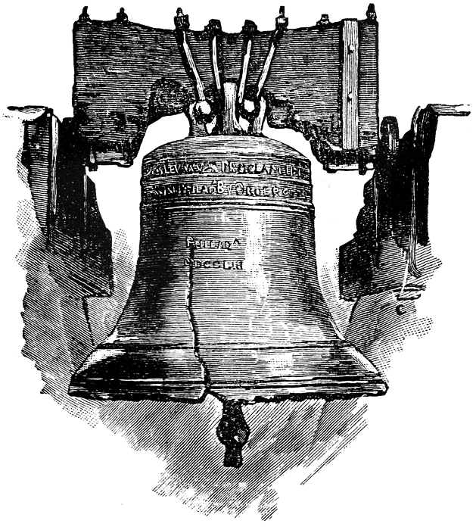
Leviticus 25:10
“And you shall consecrate the fiftieth year, and proclaim liberty throughout [all] the land to all its inhabitants. It shall be a Jubilee for you; and each of you shall return to his possession, and each of you shall return to his family.”
.

Slide 16
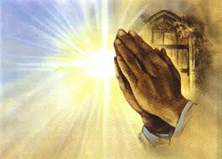
Engle v. Vitale, 370 U.S. 421-22 (1962).
“Almighty God, we acknowledge our dependence upon Thee, and we beg thy blessings upon us, our parents, our teachers, and our country.”

Slide 17

Scripture and Psychological Damage
“But if portions of the New Testament were read without explanation, they could be, and in his specific experience with children Dr. Grayzel observed, had been, psychologically harmful to the child and had caused a divisive force within the social media of the school.”
School District of Abington Township v. Schempp, 374 U.S. 203, 209 (1963).

Slide 18
First Amendment
“Congress shall make no law respecting an establishment of religion, or prohibiting the free exercise there of.”

Slide 19

Baer v. Kolmorgen
181 NYS 2d. 230, 237 (1958).
“Much has been written in recent years concerning Thomas Jefferson’s reference in 1802 to ‘a wall of separation between church and state...’ [It] has received so much attention that one would almost think at times that it is to be found somewhere in our Constitution.”

Slide 20

Article 124 of the Soviet Union Constitution
“In order to ensure to citizens freedom of conscience, the church in the USSR is separated from the state, and the school from the church” (italics added).
Amos J. Peaslee, Constitutions of Nations (Concord, NH: Rumford, 1950), 3:280.

Slide 21
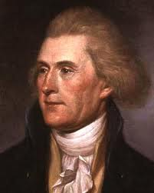
Thomas Jefferson
“One passage, in the paper you enclosed me, must be corrected. It is the following, ‘and all say it was yourself more than any other individual, that planned and established it,’ i.e., the Constitution. I was in Europe when the Constitution was planned, and never saw it till after it was established.”
Thomas Jefferson, The Writings of Thomas Jefferson, 20 vols., ed. Albert Ellery Bergh (Washington D.C: Thomas Jefferson Memorial Association, 1904), 10:325, to Dr. Joseph Priestly on June 19, 1802.

Slide 22

No Precedent
“Finally, in Engel v. Vitale, only last year, these principles were so universally recognized that the court, without the citation of a single case… reaffirmed them” (italics added).
School District of Abington Township v. Schempp, 374 U.S. 203, 220-21 (1963).

Slide 23
Lack of Pre-1947 Precedent
case | date | pre 1947 citations | post 1947 citations
Levitt v. Committee | 1973 | 0 | 18
Committee v. Nyquist | 1973 | 1 | 99
Stone v. Graham | 1980 | 0 | 9
Marsh v. Chambers | 1982 | 1 | 32
Barton, Myth of Separation, 163-66.

Slide 24
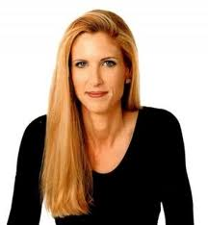
Ann Coulter
“First they claim there is no place for religion in the public square, and then they expand the public square to include everything.”
Ann Coulter, “Foreword,” in Speechless: Silencing the Christians, ed. Donald E. Wildmon (Minneapolis, MN: Vigilante, 2009), xiii.

Slide 25

Dr. James Dobson
“I have to be honest. It’s a very scary time for our nation right now. We’re kind of at a watershed moment...We’re just trampling the Constitution. It’s bulling. It’s just a straight bully tactic…that’s not the country our forefathers foresaw.”
http://www.theblaze.com/stories/2013/05/17/trampling-the-constitution-famed-christian-claims-irs-bullied-ministry-threatened-to-deny-tax-application-over-criticism-of-obama/

Slide 26
Social Issues
Legal protection for the unborn? (Gen. 25:23)
Legal protection for the elderly? (Lev. 19:32)
Hetero-sexual monogamous marriage as the standard for society? (Gen. 2:18-25)
Advocacy capital punishment? (Gen. 9:6)
The right to restrict alcohol, pornography, & gambling? (Lev. 10:9; Matt. 5:27-28; Prov. 13:11)
Parental authority over children? (Eph. 6:4)
Public expressions of Christianity? (Mark 16:15)
Right to keep and bear arms? (Luke 22:36)

Slide 27
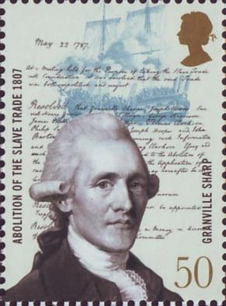
Granville Sharpe
"No Englishman can be truly loyal who opposed the principles of English law whereby the people are required to have arms of defence in peace, for mutual as well as private defence…The laws of England always required the people to be armed, and not only armed, but to be expert in arms."
Les Adams, The Second Amendment Primer: A Citizen’s Guidebook to the History, Sources, and Authorities for the Constitutional Guarantee of the Right to Keep and Bear Arms (NY: Skyhorse, 2013), 63.

Slide 28
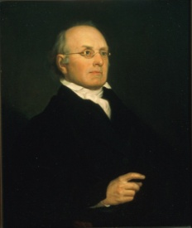
Joseph Story
"The next amendment is: ‘A well regulated militia being necessary to the security of a free state, the right of the people to keep and bear arms shall not be infringed.’ The importance of this article will scarcely be doubted by any persons, who have duly reflected upon the subject…The right of the citizens to keep and bear arms has justly been considered, as the palladium of the liberties of a republic..."
Joseph Story, Commentaries on the Constitution of the United States (Boston, MA: Hilliard, Gray, 1833), 3:746-747, sections 1889-1890.

Slide 29
Joseph Story
“…since it offers a strong moral check against the usurpation and arbitrary power of rulers; and will generally, even if these are successful in the first instance, enable the people to resist and triumph over them…There is certainly no small danger, that indifference may lead to disgust, and disgust to contempt; and thus gradually undermine all the protection intended by this clause of our national bill of rights."
Joseph Story, Commentaries on the Constitution of the United States (Boston, MA: Hilliard, Gray, 1833), 3:746-747, sections 1889-1890.

Slide 30
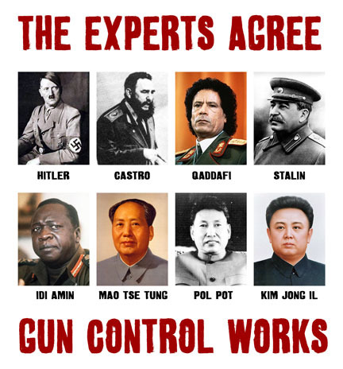

Slide 31
Social Issues
Legal protection for the unborn? (Gen. 25:23)
Legal protection for the elderly? (Lev. 19:32)
Hetero-sexual monogamous marriage as the standard for society? (Gen. 2:18-25)
Advocacy capital punishment? (Gen. 9:6)
The right to restrict alcohol, pornography, & gambling? (Lev. 10:9; Matt. 5:27-28; Prov. 13:11)
Parental authority over children? (Eph. 6:4)
Public expressions of Christianity? (Mark 16:15)
Right to keep and bear arms? (Luke 22:36)

Slide 32
The Bible and Voting
Economic issues
Social issues
Foreign affairs

Slide 33
Foreign Affairs
Favor national sovereignty above global governance? (Gen. 11:1-9)
Favor the reality and enforceability of our national borders? (Acts 17:26)
Support for the nation of Israel? (Gen. 12:3)
Pursuit of peace though strength? (Jer. 17:9)

Slide 34
Foreign Affairs
Favor national sovereignty above global governance? (Gen. 11:1-9)
Favor the reality and enforceability of our national borders? (Acts 17:26)
Support for the nation of Israel? (Gen. 12:3)
Pursuit of peace though strength? (Jer. 17:9)

Slide 35
Genesis 11:1-4
¹ Now the whole earth used the same language and the same words. ² It came about as they journeyed east, that they found a plain in the land of Shinar and settled there. ³ They said to one another, “Come, let us make bricks and burn them thoroughly.” And they used brick for stone, and they used tar for mortar. ⁴ They said, “Come, let us build for ourselves a city, and a tower whose top will reach into heaven, and let us make for ourselves a name, otherwise we will be scattered abroad over the face of the whole earth.”

Slide 36
Genesis 11:5-7
⁵ The Lord came down to see the city and the tower which the sons of men had built. ⁶ The Lord said, “Behold, they are one people, and they all have the same language. And this is what they began to do, and now nothing which they purpose to do will be impossible for them. ⁷ “Come, let Us go down and there confuse their language, so that they will not understand one another’s speech.”

Slide 37
Genesis 11:8-9
⁸ So the Lord scattered them abroad from there over the face of the whole earth; and they stopped building the city. ⁹ Therefore its name was called Babel, because there the Lord confused the language of the whole earth; and from there the Lord scattered them abroad over the face of the whole earth.

Slide 38
Genesis 11:6
The Lord said, “Behold, they are one people, and they all have the same language. And this is what they began to do, and now nothing which they purpose to do will be impossible for them.”

Slide 39
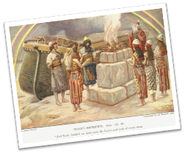
Genesis 8:21
The Lord smelled the soothing aroma; and the Lord said to Himself, “I will never again curse the ground on account of man, for the intent of man’s heart is evil from his youth; and I will never again destroy every living thing, as I have done.[emphasis mine].

Slide 40
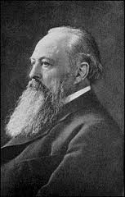
Lord Acton
“All power tends to corrupt and absolute power corrupts absolutely.”

Slide 41
God’s Doctrine of Nations
Since Babel | Deut. 32:8; Acts 17:26
Millennium | Isaiah 2:4; 66:18; Zech. 14:16-18 Rev.12:5; 20:3
Eternal State | Rev. 21:24, 26

Slide 42
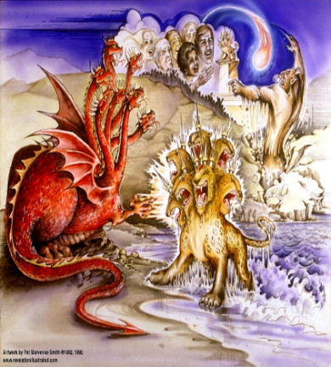
Satan’s Goal of Globalism
  Dan. 7:23
  Rev. 13:7-8; Rev. 5:9
  Rev. 17:15
Notes:
That’s good enough

Slide 43
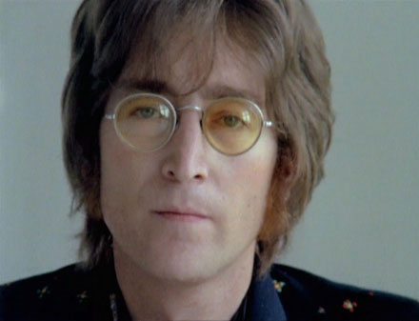
John Lennon
Song “Imagine”
…imagine a time when there will be “no countries,” “no religion,” “no heaven,” “no hell,” “no possessions,” everyone “living for today,” and the world “as one.”

Slide 44
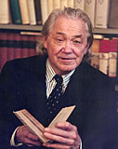
Henry Steele Commager cited in The New World Order, page 147
The inescapable fact, traumatized by the energy crisis, the population crisis, armaments race, and so forth, is that nationalism as we have noted in the 19th and much of the 20th century is as much of an anachronism today as with States Rights when Calhoun preached it and Jefferson Davis fought for it.

Slide 45
Henry Steele Commager cited in The New World Order, page 147
“Just as we know, or should know, that none of our domestic problems can be solved within the artificial boundaries of the states, so none of our global problems can be solved within the largely artificial boundaries of the nations.”

Slide 46

David Rockefeller cited in Memoirs, page 405.
“For more than a century ideological extremists…have seized upon well-publicized incidents…to attack the Rockefeller family for the inordinate influence they claim we wield over American political and economic institutions. Some even believe we are part of a secret cabal working against the best interests of the United States, characterizing my family and me as 'internationalists' and of conspiring with others around the world to build a more integrated global political and economic structure--one world, if you will. If that's the charge, I stand guilty, and I am proud of it.”

Slide 47
Humanist Manifesto II (1973)
We deplore the division of humankind on nationalistic grounds. We have reached a turning point in human history where the best option is to transcend the limits of national sovereignty and to move toward the building of a world community… a system of world law and world order based upon transnational federal government.

Slide 48

A New Pledge of Allegiance?
“I pledge allegiance to the flag and my constitutional rights with which it comes. And to the diversity, in which our nation stands, one nation, part of one planet, with liberty, freedom, choice and justice for all.”
Globalist Pledge of Allegiance in U.S. School, Boulder High School, October 2007, Kerby Anderson

Slide 49

Alphabet Soup?
GATT | WHO
NAFTA | ICC
WTO | LOST
NATO | ISA
UN | EEC
IMF | ECM
WSSD | NAU

Slide 50
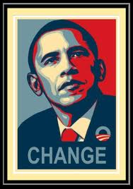
American Exceptionalism?
“I believe in American exceptionalism, just as I suspect that the Brits believe in British exceptionalism and the Greeks believe in Greek exceptionalism."
www.youtube.com/watch?v=c15wk3InDws

Slide 51
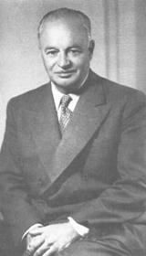
American Exceptionalism?
“To achieve world government, it is necessary to remove from the minds of men their individualism, loyalty to family tradition, national patriotism, and religious dogmas.”
SOURCE: George Brock Chisholm, First Director of the World Health Organization (WHO), Speech, Conference on Education, Asilomar, California, September 11, 1954

Slide 52
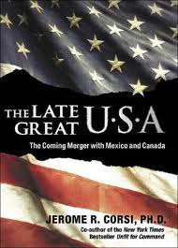
Regionalism
European Common Market
North American Union
Notes:
Outline

Slide 53

March 7, 2013—Question for Defense Secretary Leon Panetta from Sen. Jeff Sessions at a Senate Armed Services Committee.
Sessions asked Panetta if he could "initiate a no-fly zone in Syria "without Congressional approval. "Again, our goal would be to seek international permission and we would ...come to the Congress and inform you and determine how best to approach this, whether or not we would want to get permission from the Congress…," Panetta said. "I'm almost breathless about that," Sessions responded. "What I heard you say is, we're going to seek international approval and then we'll come and tell the Congress what we might do and we might seek Congressional approval."

Slide 54
March 7, 2013—Question for Defense Secretary Leon Panetta from Sen. Jeff Sessions at a Senate Armed Services Committee.
Panetta explained that if U.S. forces are working as part of an international coalition, then the administration would want "to get the appropriate permissions," which he said is something "all of these countries would want." Sessions pressed the issue and asked "what entity" the administration would seek permission from. Sessions said he was all in favor of international support, but added that he was "baffled by the idea that somehow, an international assembly" would provide a legal basis for the deployment of the U.S. military. Sessions responded that international bodies "provide no legal authority" to deploy U.S. military into combat operations.

Slide 55
Foreign Affairs
Favor national sovereignty above global governance? (Gen. 11:1-9)
Favor the reality and enforceability of our national borders? (Acts 17:26)
Support for the nation of Israel? (Gen. 12:3)
Pursuit of peace though strength? (Jer. 17:9)

Slide 56
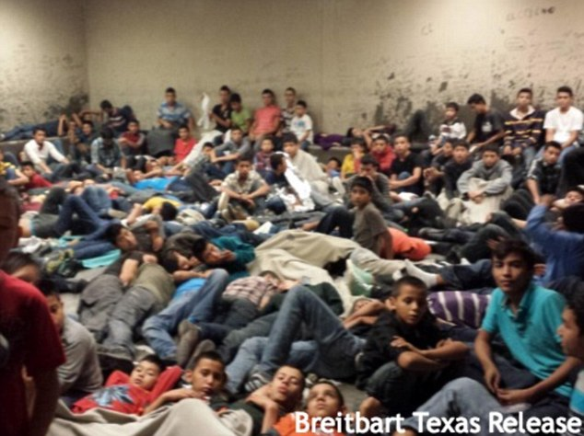

Slide 57
Foreign Affairs
Favor national sovereignty above global governance? (Gen. 11:1-9)
Favor the reality and enforceability of our national borders? (Acts 17:26)
Support for the nation of Israel? (Gen. 12:3)
Pursuit of peace though strength? (Jer. 17:9)

Slide 58
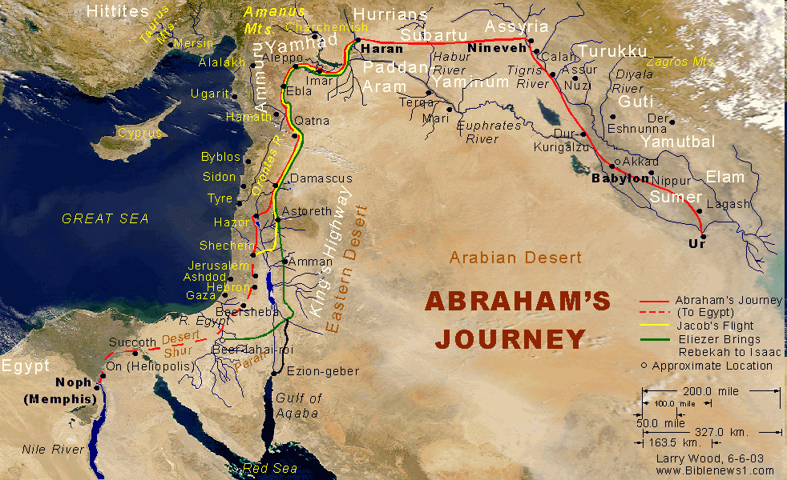

Slide 59


Slide 60
How Israel Has Blessed the World
(Gen 12:3; Rom 9:4-5)
Patriarchs
Law
Prophets
Messiah (John 4:22; Rom 9:5)
Apostles
Biblical writers
Early church
Early Christian martyrs
Paul
Future kingdom

Slide 61

Israel’s Three Blessings to the World
(Gen 12:3b)
Scripture (Rom 3:2)
Savior (John 4:22)
Kingdom (Isa 2:2-3)

Slide 62
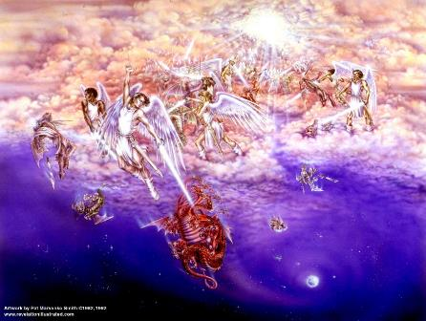
Biblical Reality of the Angelic World
Job 1:12
2 Kings 6:15-17
1 Chron 21:1
Dan 10:12-13, 20
Matt 16:21-23
Eph 6:12

Slide 63
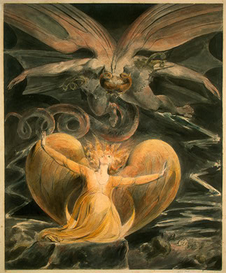
2 CYCLES OF SATANIC PERSECUTION
(Revelation 12:13-16)
“Pursues the woman” = persecution of Israel 12:13-14
“Flood from his mouth” = tries to destroy Israel 12:15-16

Slide 64
Descriptions of Satanic Hatred
(Revelation 12:12-17)
Wrath 12:12
Persecution 12:13
Sweep away 12:15
Enraged 12:17
War 12:17

Slide 65


Slide 66

Statue & Stone

Slide 67
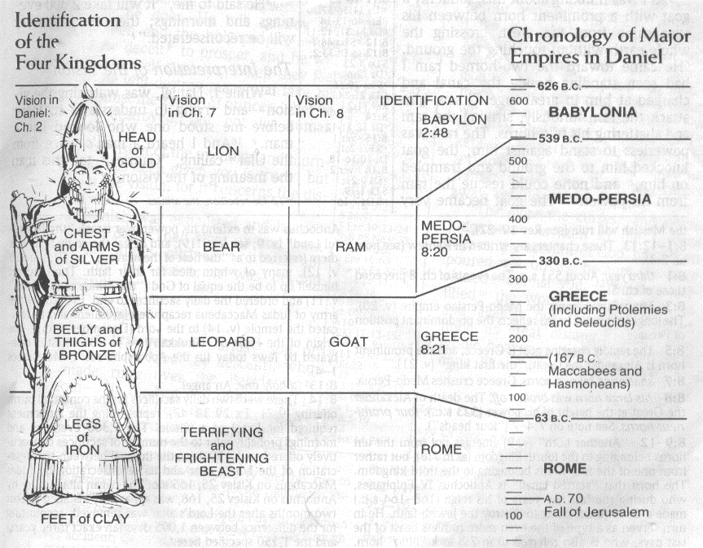

Slide 68
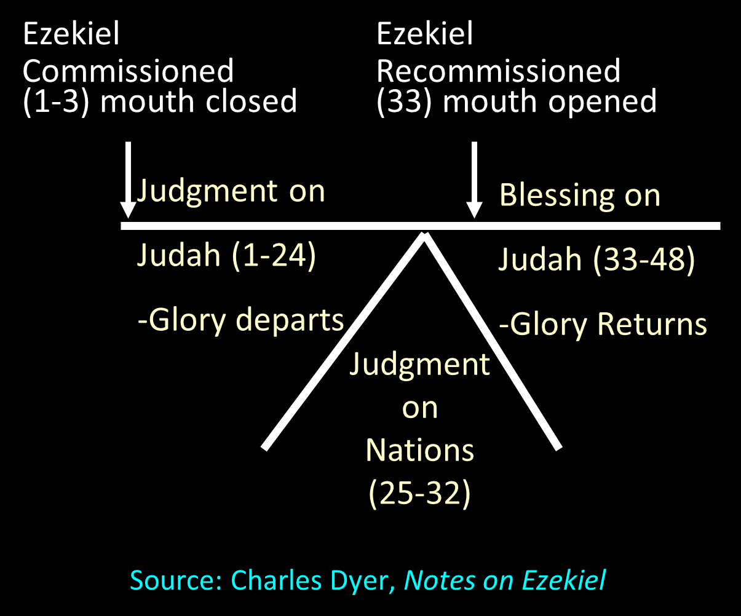

Slide 69
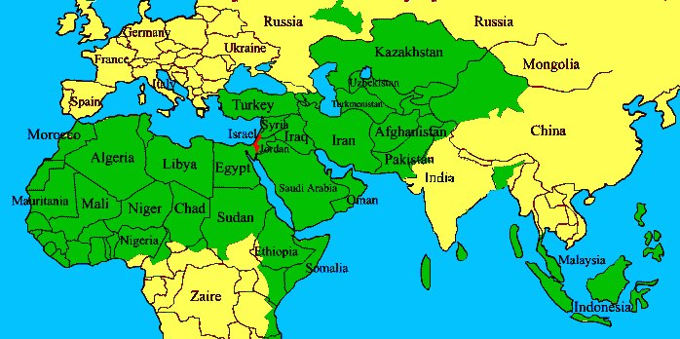

Slide 70
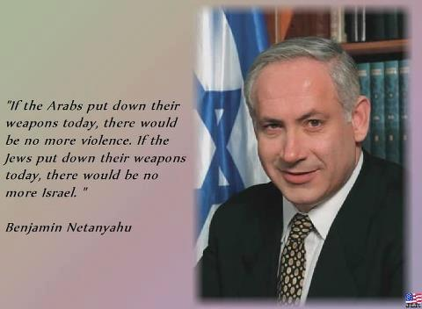

Slide 71
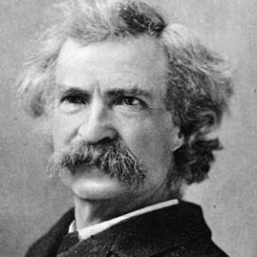
“... A desolate country whose soil is rich enough, but is given over wholly to weeds… a silent mournful expanse…. a desolation is here that not even imagination can grace with the pomp of life and action…. we never saw a human being on the whole route…. there was hardly a tree or shrub anywhere. Even the olive tree and the cactus, those fast friends of a worthless soil, had almost deserted the country.”
Mark Twain, The Innocents Abroad, Complete, 1st ed. (A Public Domain Book, 1869), 267, 285, 302. These quotes can be found in chapters 47, 49, 52.

Slide 72
Foreign Affairs
Favor national sovereignty above global governance? (Gen. 11:1-9)
Favor the reality and enforceability of our national borders? (Acts 17:26)
Support for the nation of Israel? (Gen. 12:3)
Pursuit of peace though strength? (Jer. 17:9)

Slide 73
Genesis 8:21
The Lord smelled the soothing aroma; and the Lord said to Himself, “I will never again curse the ground on account of man, for the intent of man’s heart is evil from his youth; and I will never again destroy every living thing, as I have done.[emphasis mine].

Slide 74
Quran Surah* 24:55
(*chapter)
“Allah has promised those who have believed among you and done righteous deeds that He will surely grant them succession [Caliphate] upon the earth just as He granted it to those before them and that He will surely establish for them [therein] their religion which He has preferred for them and that He will surely substitute for them, after their fear, security, [for] they worship Me, not associating anything with Me. But whoever disbelieves after that - then those are the defiantly disobedient.”

Slide 75
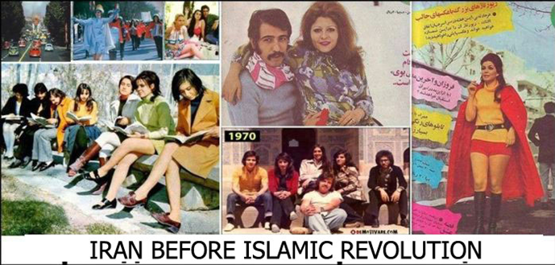
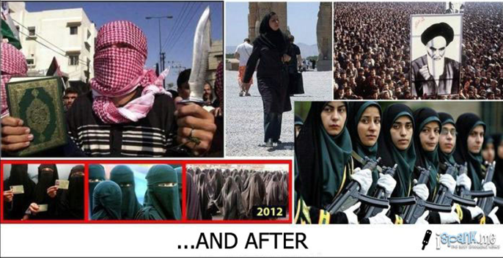

Slide 76
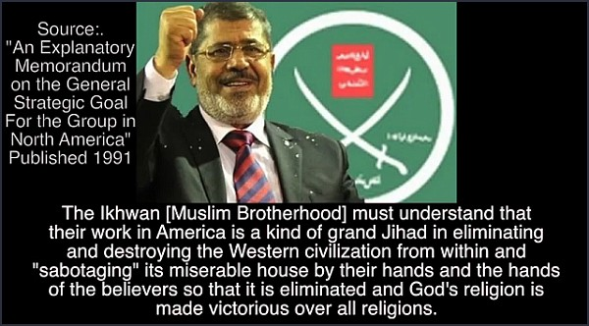

Slide 77
Foreign Affairs
Favor national sovereignty above global governance? (Gen. 11:1-9)
Favor the reality and enforceability of our national borders? (Acts 17:26)
Support for the nation of Israel? (Gen. 12:3)
Pursuit of peace though strength? (Jer. 17:9)

Slide 78
Conclusion

Slide 79
The Bible and Voting
Economic issues
Social issues
Foreign affairs

