Slide 1
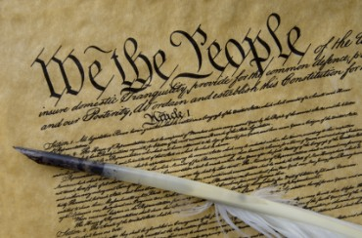
THE BIBLE AND VOTING
Part 7
Dr. Andy Woods

Slide 2
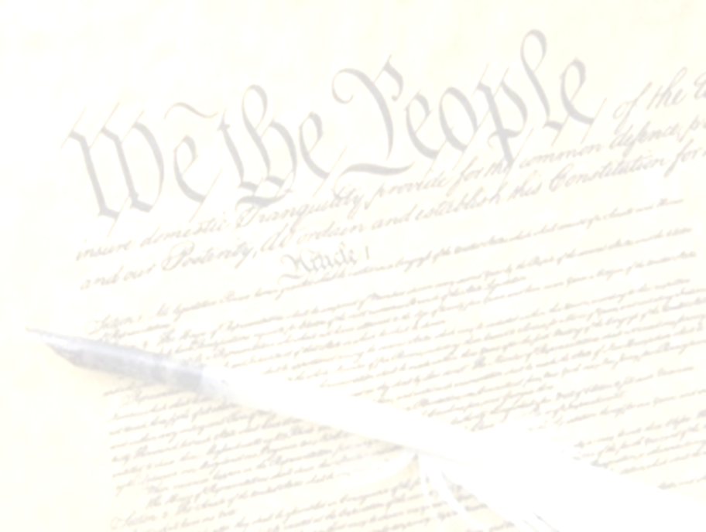
Introductory Remarks
A stewardship issue (1 Cor. 4:2)
A biblical issue (2 Tim. 3:16)
Biblical principles rather than partisanship

Slide 3
The Bible and Voting
Economic issues
Social issues
Foreign affairs

Slide 4
The Bible and Voting
Economic issues
Social issues
Foreign affairs

Slide 5
Economic Issues
Ownership of private property? (Deut. 19:15)
Pursuit of economic self interest? (Gen. 8:21)
Proper definition of compassion? (2 Thess. 3:10)
Who provides charity? (1 Tim. 5:3-8)
Family is the building block of society? (Deut. 6:6-7)
Wealth retained within the family? (Prov. 13:22)
The earth experiences cyclical patterns? (Gen. 8:22)
Environmental stewardship rather than earth worship? (Rom. 1:22-23)
Opposition to runaway debt? (Prov. 22:7)
Limitations upon the government? (Acts 5:29)

Slide 6
The Bible and Voting
Economic issues
Social issues
Foreign affairs

Slide 7
Social Issues
Legal protection for the unborn? (Gen. 25:23)
Legal protection for the elderly? (Lev. 19:32)
Hetero-sexual monogamous marriage as the standard for society? (Gen. 2:18-25)
Advocacy capital punishment? (Gen. 9:6)
The right to restrict alcohol, pornography, & gambling? (Lev. 10:9; Matt. 5:27-28; Prov. 13:11)
Parental authority over children? (Eph. 6:4)
Public expressions of Christianity? (Mark 16:15)
Right to keep and bear arms? (Luke 22:36)

Slide 8
The Bible and Voting
Economic issues
Social issues
Foreign affairs

Slide 9
Foreign Affairs
Favor national sovereignty above global governance? (Gen. 11:1-9)
Favor the reality and enforceability of our national borders? (Acts 17:26)
Support for the nation of Israel? (Gen. 12:3)
Pursuit of peace though strength? (Jer. 17:9)

Slide 10
Foreign Affairs
Favor national sovereignty above global governance? (Gen. 11:1-9)
Favor the reality and enforceability of our national borders? (Acts 17:26)
Support for the nation of Israel? (Gen. 12:3)
Pursuit of peace though strength? (Jer. 17:9)

Slide 11
Overview
The Divine Perspective on Globalism
Satan’s Goal of Instituting Globalism
Stage Setting Events
Impact on voting
The Good News
Notes:
Outline

Slide 12
Overview
The Divine Perspective on Globalism
Satan’s Goal of Instituting Globalism
Stage Setting Events
Impact on voting
The Good News
Notes:
Outline

Slide 13

Genesis 11:1-4
¹ Now the whole earth used the same language and the same words. ² It came about as they journeyed east, that they found a plain in the land of Shinar and settled there. ³ They said to one another, “Come, let us make bricks and burn them thoroughly.” And they used brick for stone, and they used tar for mortar. ⁴ They said, “Come, let us build for ourselves a city, and a tower whose top will reach into heaven, and let us make for ourselves a name, otherwise we will be scattered abroad over the face of the whole earth.”

Slide 14
Genesis 11:5-7
⁵ The Lord came down to see the city and the tower which the sons of men had built. ⁶ The Lord said, “Behold, they are one people, and they all have the same language. And this is what they began to do, and now nothing which they purpose to do will be impossible for them. ⁷ “Come, let Us go down and there confuse their language, so that they will not understand one another’s speech.”

Slide 15
Genesis 11:8-9
⁸ So the Lord scattered them abroad from there over the face of the whole earth; and they stopped building the city. ⁹ Therefore its name was called Babel, because there the Lord confused the language of the whole earth; and from there the Lord scattered them abroad over the face of the whole earth.

Slide 16
Genesis 11:6
The Lord said, “Behold, they are one people, and they all have the same language. And this is what they began to do, and now nothing which they purpose to do will be impossible for them.”

Slide 17
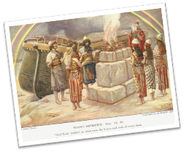
Genesis 8:21
The Lord smelled the soothing aroma; and the Lord said to Himself, “I will never again curse the ground on account of man, for the intent of man’s heart is evil from his youth; and I will never again destroy every living thing, as I have done.[emphasis mine].

Slide 18
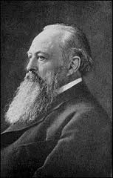
Lord Acton
“All power tends to corrupt and absolute power corrupts absolutely.”

Slide 19
God’s Doctrine of Nations
Since Babel | Deut. 32:8; Acts 17:26
Millennium | Isaiah 2:4; 66:18; Zech. 14:16-18; Rev.12:5; 20:3
Eternal State | Rev. 21:24, 26

Slide 20
Overview
The Divine Perspective on Globalism
Satan’s Goal of Instituting Globalism
Stage Setting Events
Impact on voting
The Good News
Notes:
Outline

Slide 21
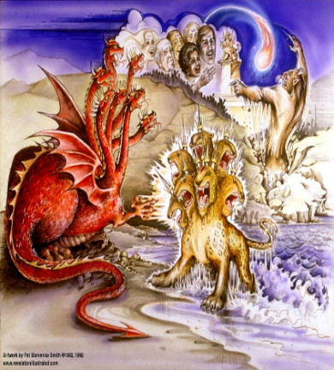
Satan’s Goal of Globalism
  Dan. 7:23
  Rev. 13:7-8; Rev. 5:9
  Rev. 13:16-18
  Rev. 17:15
Notes:
That’s good enough

Slide 22
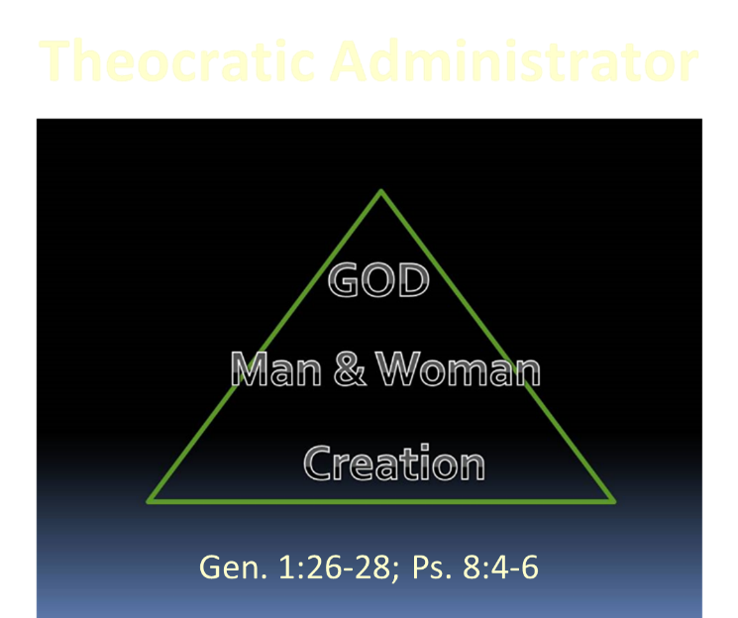

Slide 23
Overview
The Divine Perspective on Globalism
Satan’s Goal of Instituting Globalism
Stage Setting Events
Impact on voting
The Good News
Notes:
Outline

Slide 24
Stage Setting Events
Elite thinking
Educational system
Global management by crisis
Marginalization of the US Constitution
International Criminal Court
Regionalism as a Prerequisite for Globalism

Slide 25
Stage Setting Events
Elite thinking
Educational system
Global management by crisis
Marginalization of the US Constitution
International Criminal Court
Regionalism as a Prerequisite for Globalism

Slide 26
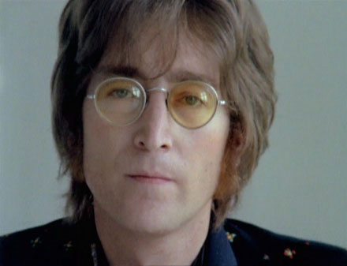
John Lennon
Song “Imagine”
…imagine a time when there will be “no countries,” “no religion,” “no heaven,” “no hell,” “no possessions,” everyone “living for today,” and the world “as one.”

Slide 27
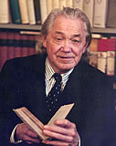
Henry Steele Commager cited in The New World Order, page 147
The inescapable fact, traumatized by the energy crisis, the population crisis, armaments race, and so forth, is that nationalism as we have noted in the 19th and much of the 20th century is as much of an anachronism today as with States Rights when Calhoun preached it and Jefferson Davis fought for it.

Slide 28
Henry Steele Commager cited in The New World Order, page 147
“Just as we know, or should know, that none of our domestic problems can be solved within the artificial boundaries of the states, so none of our global problems can be solved within the largely artificial boundaries of the nations.”

Slide 29

David Rockefeller cited in Memoirs, page 405.
“For more than a century ideological extremists…have seized upon well-publicized incidents…to attack the Rockefeller family for the inordinate influence they claim we wield over American political and economic institutions. Some even believe we are part of a secret cabal working against the best interests of the United States, characterizing my family and me as 'internationalists' and of conspiring with others around the world to build a more integrated global political and economic structure--one world, if you will. If that's the charge, I stand guilty, and I am proud of it.”

Slide 30
Stage Setting Events
Elite thinking
Educational system
Global management by crisis
Marginalization of the US Constitution
International Criminal Court
Regionalism as a Prerequisite for Globalism

Slide 31
Humanist Manifesto II (1973)
“We deplore the division of humankind on nationalistic grounds. We have reached a turning point in human history where the best option is to transcend the limits of national sovereignty and to move toward the building of a world community… a system of world law and world order based upon transnational federal government.”

Slide 32
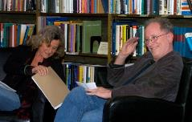
Bill Ayers in a recent speech at the University of Oregon on the subject of Teaching and Organizing for “Social Justice”
“The great challenge for our generation [is]…to think differently about citizenship means, to think differently about what it means to be a ‘citizen of the world.’ One of the great dangers that we live in right now, is…that the American Empire is in decline–that economically, and politically, and in some ways culturally, that we are in decline…and that the game is over. It’s over. Now what?”
Erica Ritz, "Bill Ayers to University Students: America’s ‘Game Is Over’ and ‘Another World’ Is Coming," online: http://www.theblaze.com/stories/2012/05/02/bill-ayers-to-university-students-americas-game-is-over-and-another-world-is-coming/. May 2, 2012, accessed 14 November 2014.

Slide 33
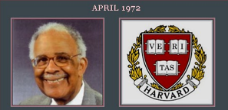
Humanist Proselytizing
“Every child in America entering school at the age of five is mentally ill because he comes to school with certain allegiances to our founding fathers, toward our elected officials, toward his parents, toward a belief in a supernatural being, and toward the sovereignty of this nation as a separate entity. It's up to you as teachers to make all these sick children well by creating the international child of the future.”
Chester M. Pierce, Harvard psychiatrist, speaking as an expert in public education at the 1973 International Education Seminar.

Slide 34


Slide 35

A New Pledge of Allegiance?
“I pledge allegiance to the flag and my constitutional rights with which it comes. And to the diversity, in which our nation stands, one nation, part of one planet, with liberty, freedom, choice and justice for all.”
Globalist Pledge of Allegiance in U.S. School, Boulder High School, October 2007, Kerby Anderson

Slide 36
Stage Setting Events
Elite thinking
Educational system
Global management by crisis
Marginalization of the US Constitution
International Criminal Court
Regionalism as a Prerequisite for Globalism

Slide 37
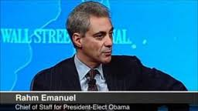
Management by Crisis
“You never let a serious crisis go to waste. And what I mean by that it’s an opportunity to do things you think you could not do before.” Rahm Emanuel
www.youtube.com/watch?v=Pb-YuhFWCr4

Slide 38
UN Globalism Conferences
UN Conference | Stated Goal
Earth summit, Río de Janeiro, 1992 | Protect the environment
Human rights conference, Vienna, 1993 | Protect human rights
Population Conference, Cairo, 1994 | Prevent starvation and poverty

Slide 39
UN Globalism Conferences
UN Conference | Stated Goal
Women’s conference, Beijing, 1995 | Protect women’s rights
Habitat conference, Istanbul, 1996 | Provide global housing for all
Climate change conference, Copenhagen, 2009 | Implement climate change policy

Slide 40
Gaia Hypothesis
“In searching for a new enemy to unite us, we came up with the idea that pollution, the threat of global warming, water shortages, famine and the like would fit the bill...”
Alexander King and Betrand Schneider, The First Global Revolution (New York: Pantheon, 1991), 115.

Slide 41
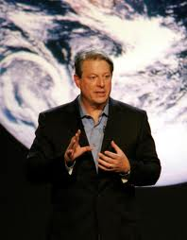
Gaia Hypothesis
According to Al Gore, “we must make the rescue of the environment the central organizing principle for civilization.”
Al Gore, Earth in the Balance (New York: Houghton Mifflin, 1992), 269.

Slide 42

Alphabet Soup?
GATT | WHO
NAFTA | ICC
WTO | LOST
NATO | ISA
UN | EEC
IMF | ECM
WSSD | NAU

Slide 43
Stage Setting Events
Elite thinking
Educational system
Global management by crisis
Marginalization of the US Constitution
International Criminal Court
Regionalism as a Prerequisite for Globalism

Slide 44
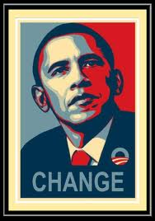
American Exceptionalism?
“I believe in American exceptionalism, just as I suspect that the Brits believe in British exceptionalism and the Greeks believe in Greek exceptionalism."
www.youtube.com/watch?v=c15wk3InDws

Slide 45
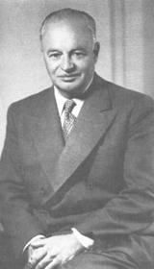
American Exceptionalism?
“To achieve world government, it is necessary to remove from the minds of men their individualism, loyalty to family tradition, national patriotism, and religious dogmas.”
SOURCE: George Brock Chisholm, First Director of the World Health Organization (WHO), Speech, Conference on Education, Asilomar, California, September 11, 1954

Slide 46
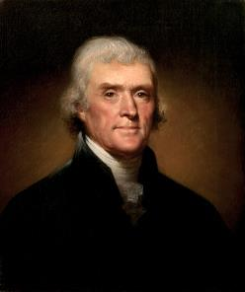
Thomas Jefferson
Kentucky Resolutions of 1798: "...in questions of power then, let no more be heard of confidence in man, but bind him down from mischief by the chains of the constitution..." (from draft)
Papers of Thomas Jefferson 30:529-556

Slide 47
A Flawed Document?
Obama described the U.S. Constitution as having ‘deep flaws’ during a September 2001 Chicago public radio program adding that the country’s Founding Fathers had ‘an enormous blind spot’ when they wrote it. Obama also remarked that the Constitution ‘reflected the fundamental flaw of this country that continues to this day.’"
David A. Patten, “Obama: Constitution is ‘Deeply Flawed,’” online: www.Newsmax.com, accessed 25 August 2009, 1.

Slide 48
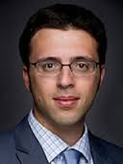
An Unknowable Constitution?
According to staff writer for The Washington Post and MSNBC Contributor Ezra Klein, “The issue with the Constitution is that the text is confusing because it was written more than 100 years ago and what people believe it says differs from person to person and differs depending upon what they want to get done.”
http://www.youtube.com/watch?v=bc4qHHIRcJw&feature=related

Slide 49
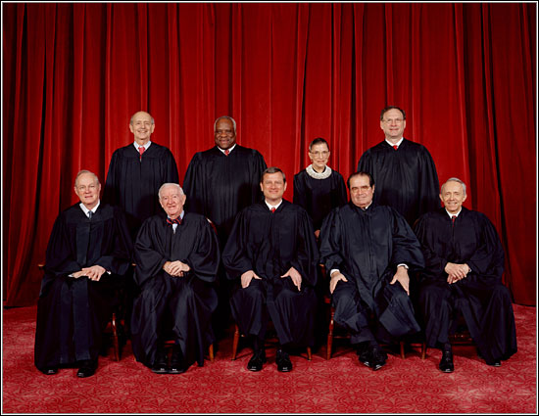
U.S. SUPREME COURT
BOWERS V. HARDWICK (1986)
LAWRENCE V. TEXAS (2003)

Slide 50
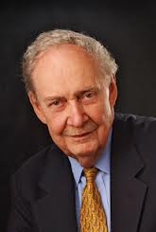
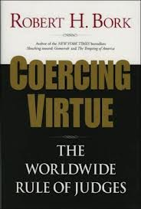

Slide 51
Stage Setting Events
Elite thinking
Educational system
Global management by crisis
Marginalization of the US Constitution
International Criminal Court
Regionalism as a Prerequisite for Globalism

Slide 52
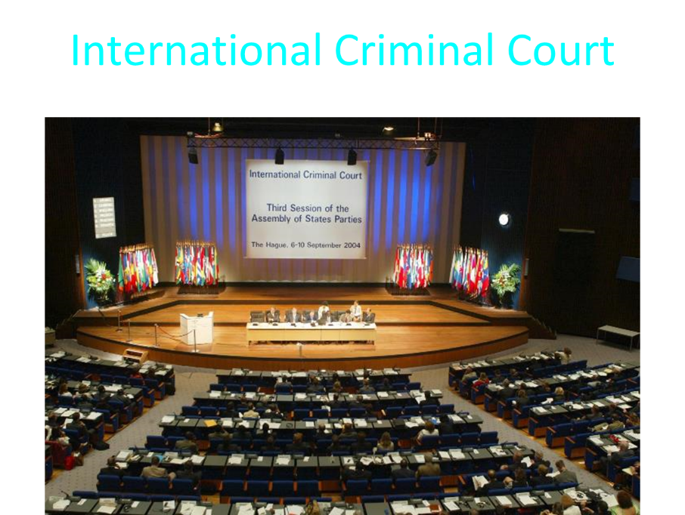

Slide 53

Founders’ Sources
34% Bible
8.3% Baron Montesquieu
7.9% William Blackstone
2.9% John Locke
Donald S. Lutz, The Origins of American Constitutionalism (Baton Rouge, LA: Louisiana State University Press, 1988), 141.

Slide 54
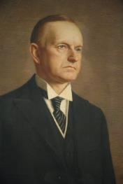
Calvin Coolidge
Calvin Coolidge stated July 5, 1926: "The principles...which went into the Declaration of Independence...are found in...the sermons...of the early colonial clergy...They preached equality because they believed in the fatherhood of God and the brotherhood of man. They justified freedom by the text that we are all created in the Divine image."
Calvin Coolidge, May 15, 1926, College of William and Mary, Williamsburg, Virginia, http.americanminute.com/index.php?date=05-15

Slide 55
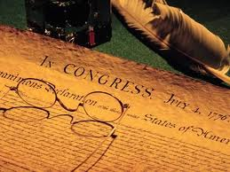
Declaration of Independence
“the Laws of Nature and of Nature’s God,”
“we hold these truths to be self evident, that all men are created equal,”
“they are endowed by their Creator with certain unalienable Rights,”
“appealing to the Supreme Judge of the world for the rectitude of our intentions,”
“with firm reliance on the protection of Divine Providence.”
Church of the Holy Trinity v. U.S., 143 U.S. 457, 467-68 (1892)

Slide 56
Basic Rights Absent in ICC
Burden of proof on the prosecution
Presumption of innocence
Right to an impartial jury
Right to a speedy trial
Right to an appeal
Protection against double jeopardy
Freedom from self-incrimination
Protection against cruel and unusual punishment
James Hirsen, The Coming Collision, 155-63

Slide 57
Stage Setting Events
Elite thinking
Educational system
Global management by crisis
Marginalization of the US Constitution
International Criminal Court
Regionalism as a Prerequisite for Globalism

Slide 58
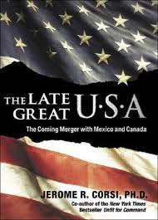

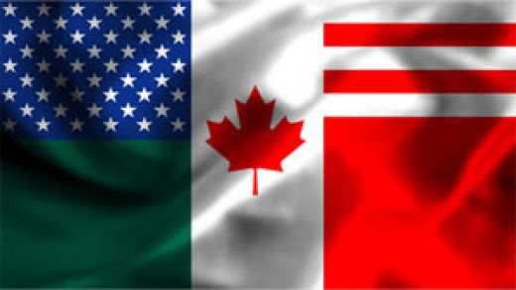
Regionalism
European Common Market
North American Union
Notes:
Outline

Slide 59
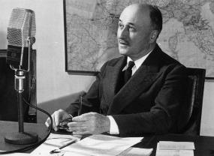
Regionalism as a Steeping
Stone into Globalism
"The sovereign nations of the past can no longer solve the problems of the present; they cannot ensure their own progress or control their own future… And the European community itself is only a stage on the way to the organized world of tomorrow."
Jean Monet, Memoirs (New York: Doubleday, 1978), 524.

Slide 60
Overview
The Divine Perspective on Globalism
Satan’s Goal of Instituting Globalism
Stage Setting Events
Impact on voting
The Good News
Notes:
Outline

Slide 61
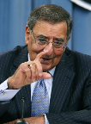
March 7, 2013—Question for Defense Secretary Leon Panetta from Sen. Jeff Sessions at a Senate Armed Services Committee.
Sessions asked Panetta if he could "initiate a no-fly zone in Syria” without Congressional approval. "Again, our goal would be to seek international permission and we would ...come to the Congress and inform you and determine how best to approach this, whether or not we would want to get permission from the Congress…," Panetta said.
"I'm almost breathless about that," Sessions responded. "What I heard you say is, we're going to seek international approval and then we'll come and tell the Congress what we might do and we might seek Congressional approval."

Slide 62
March 7, 2013—Question for Defense Secretary Leon Panetta from Sen. Jeff Sessions at a Senate Armed Services Committee.
Panetta explained that if U.S. forces are working as part of an international coalition, then the administration would want "to get the appropriate permissions," which he said is something "all of these countries would want."
Sessions pressed the issue and asked "what entity" the administration would seek permission from. Sessions said he was all in favor of international support, but added that he was "baffled by the idea that somehow, an international assembly" would provide a legal basis for the deployment of the U.S. military. Sessions responded that international bodies "provide no legal authority" to deploy U.S. military into combat operations.

Slide 63
Overview
The Divine Perspective on Globalism
Satan’s Goal of Instituting Globalism
Stage Setting Events
Impact on voting
The Good News
Notes:
Outline

Slide 64

Statue & Stone

Slide 65


Slide 66

OT PROPHETS DESCRIBE THE KINGDOM
Kingdom Characteristics
Is. 2:1-4; 11:6-9
  Jerusalem = center of world spiritual and political authority
  Perfect justice
  World peace
  Peace in the animal kingdom
  Universal spiritual knowledge

Slide 67
Conclusion

Slide 68
The Bible and Voting
Economic issues
Social issues
Foreign affairs

Slide 69
Foreign Affairs
Favor national sovereignty above global governance? (Gen. 11:1-9)
Favor the reality and enforceability of our national borders? (Acts 17:26)
Support for the nation of Israel? (Gen. 12:3)
Pursuit of peace though strength? (Jer. 17:9)

