Slide 1

Soteriology
Session 29
Dr. Andy Woods
Senior Pastor – Sugar Land Bible Church
Professor of Bible & Theology – College of Biblical Studies

Slide 2
Soteriology Overview
Definition
Election
Atonement
Salvation words
God’s one condition of salvation
Results of salvation
Eternal security
Faulty views of salvation

Slide 3
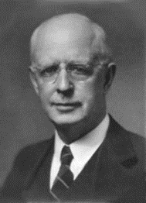
Soteriology Overview
This Session
VII. Eternal Security

Slide 4
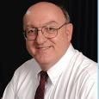
Definition of Eternal Security
“Eternal Security means that those who have been genuinely saved by God’s grace through faith alone in Christ alone shall never be in danger of God’s condemnation or loss of salvation but God’s grace and power keep them forever saved and secure.”
Dennis Rokser, Shall Never Perish Forever, p. 11

Slide 5
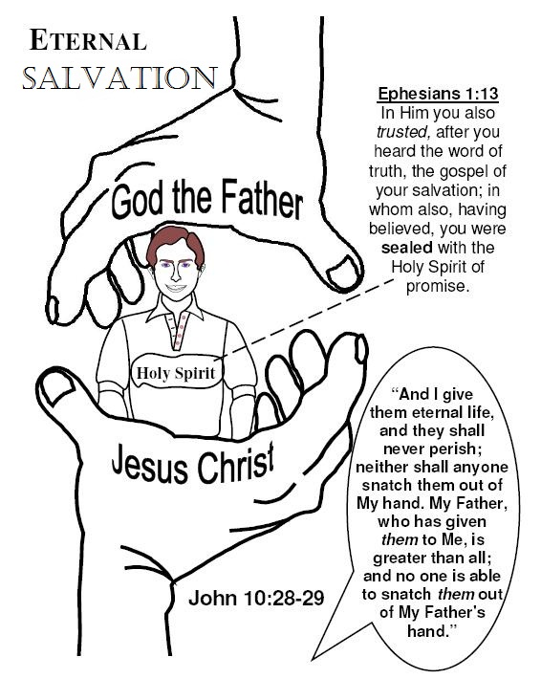
Eternal Security Outline
Eternal security arguments
Response to problem passages

Slide 6
Eternal Security Outline
Eternal security arguments
Response to problem passages

Slide 7
Evidence for Eternal Security
Because self-righteousness did not save us it is not a basis upon which salvation can be lost
Salvation is not given or maintained by works
If a believer can lose eternal life, then how can this life be eternal (John 3:16)?
The Bible’s promises guarantee security (John 10:28)
The assurance of salvation (1 John 5:14)
The believer is predestined for glory (Rom 8:29-30)
The Spirit’s seal cannot be broken (Eph 4:30)

Slide 8
Evidence for Eternal Security
God keeps us from falling (1 Pet 1:4-5)
Christ’s role as intercessor and advocate (John 17:11-12, 20)
Christ’s death perfectly dealt with all sins (Titus 2:14)
A believer cannot be removed from Christ’s body (1 Cor. 12:13)
The Bible does not specify which sins remove salvation
Believers with unfruitful lives still have salvation although lose rewards at the Bema Seat (1 Cor 3:15)

Slide 9
Eternal Security Outline
Eternal security arguments
Response to problem passages

Slide 10
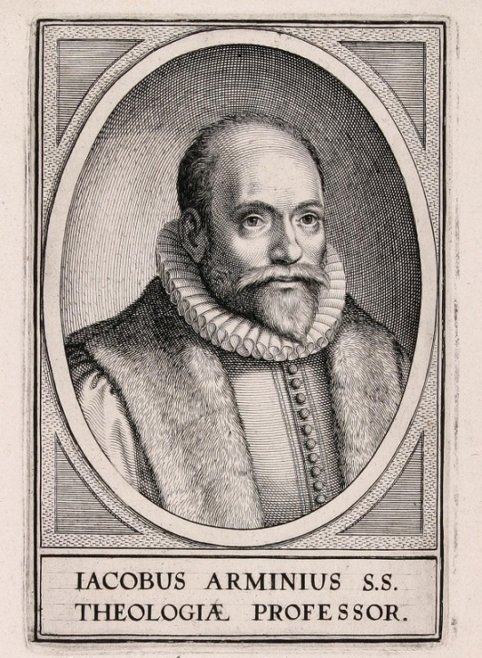
Introduction
Rejoice?
Jacob Arminius (1560‒1609)
Harmonization
The Bible cannot contradict itself
Biblical order

Slide 11
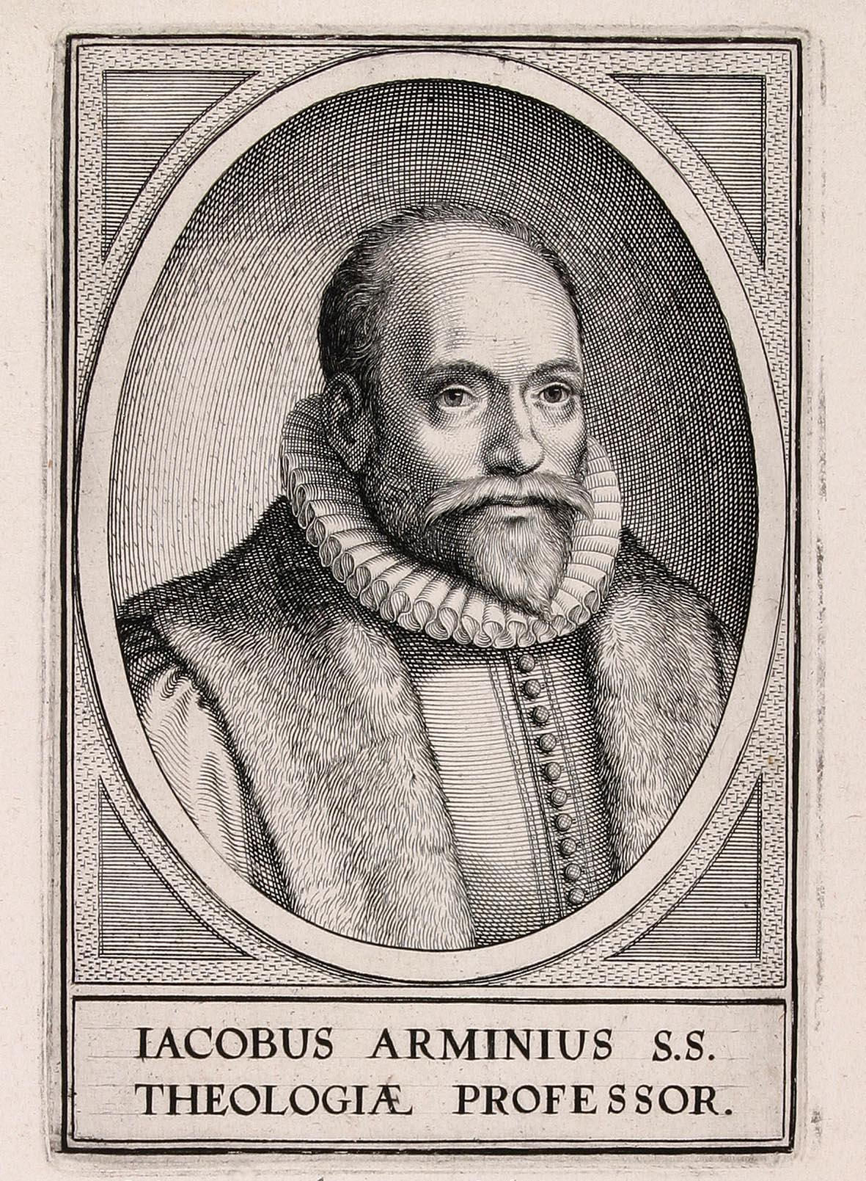
Response to Problem Passages
OT Passages
Passages from Matthew
Passages from John
Passages from Acts
Passages from Paul

Slide 12
Response to Problem Passages
Passages from James
Passages from Hebrews
Passages from 2 Peter
Passages from 1 John
Passages from Revelation
Miscellaneous argument

Slide 13
Response to Problem Passages
OT Passages
Passages from Matthew
Passages from John
Passages from Acts
Passages from Paul

Slide 14
1. OT Passages
Adam & Eve (Gen. 1‒3)
Nadab & Abihu (Lev. 10:1-2)
Korah’s rebellion (Num. 16)
Joshua 24:20
Saul (1 Sam. 16:14; 28; 1 Chron. 10:13-14)
Solomon (1 Kgs. 11)
David (Ps. 51:11)
Ezekiel 18:20

Slide 15
1. OT Passages
Adam & Eve (Gen. 1‒3)
Nadab & Abihu (Lev. 10:1-2)
Korah’s rebellion (Num. 16)
Joshua 24:20
Saul (1 Sam. 16:14; 28; 1 Chron. 10:13-14)
Solomon (1 Kgs. 11)
David (Ps. 51:11)
Ezekiel 18:20

Slide 16
1. OT Passages
Adam & Eve (Gen. 1‒3)
Nadab & Abihu (Lev. 10:1-2)
Korah’s rebellion (Num. 16)
Joshua 24:20
Saul (1 Sam. 16:14; 28; 1 Chron. 10:13-14)
Solomon (1 Kgs. 11)
David (Ps. 51:11)
Ezekiel 18:20

Slide 17
1. OT Passages
Adam & Eve (Gen. 1‒3)
Nadab & Abihu (Lev. 10:1-2)
Korah’s rebellion (Num. 16)
Joshua 24:20
Saul (1 Sam. 16:14; 28; 1 Chron. 10:13-14)
Solomon (1 Kgs. 11)
David (Ps. 51:11)
Ezekiel 18:20

Slide 18
1. OT Passages
Adam & Eve (Gen. 1‒3)
Nadab & Abihu (Lev. 10:1-2)
Korah’s rebellion (Num. 16)
Joshua 24:20
Saul (1 Sam. 16:14; 28; 1 Chron. 10:13-14)
Solomon (1 Kgs. 11)
David (Ps. 51:11)
Ezekiel 18:20

Slide 19
Six Parts of a Suzerain-Vassal Treaty* in Deuteronomy
Preamble (1:1-5)
Prologue (1:6–4:40)
Covenant obligations (5–26)
Storage and reading instructions (27:2-3; 31:9, 24, 26)
Witnesses (32:1)
Blessings and curses (28)
*Suzerainty–Vassal treaty, which Ancient Near Eastern kings made, were only with redeemed or conquered nations and never with individuals. (2007). Christian Apologetics Journal, 6.

Slide 20
Six Parts of a Suzerain-Vassal Treaty* in Deuteronomy
Preamble (1:1-5)
Prologue (1:6–4:40)
Covenant obligations (5–26)
Storage and reading instructions (27:2-3; 31:9, 24, 26)
Witnesses (32:1)
Blessings and curses (28)
*Suzerainty–Vassal treaty, which Ancient Near Eastern kings made, were only with redeemed or conquered nations and never with individuals. (2007). Christian Apologetics Journal, 6.

Slide 21
1. OT Passages
Adam & Eve (Gen. 1‒3)
Nadab & Abihu (Lev. 10:1-2)
Korah’s rebellion (Num. 16)
Joshua 24:20
Saul (1 Sam. 16:14; 28; 1 Chron. 10:13-14)
Solomon (1 Kgs. 11)
David (Ps. 51:11)
Ezekiel 18:20

Slide 22
1. OT Passages
Adam & Eve (Gen. 1‒3)
Nadab & Abihu (Lev. 10:1-2)
Korah’s rebellion (Num. 16)
Joshua 24:20
Saul (1 Sam. 16:14; 28; 1 Chron. 10:13-14)
Solomon (1 Kgs. 11)
David (Ps. 51:11)
Ezekiel 18:20

Slide 23
1. OT Passages
Adam & Eve (Gen. 1‒3)
Nadab & Abihu (Lev. 10:1-2)
Korah’s rebellion (Num. 16)
Joshua 24:20
Saul (1 Sam. 16:14; 28; 1 Chron. 10:13-14)
Solomon (1 Kgs. 11)
David (Ps. 51:11)
Ezekiel 18:20

Slide 24
Work of the Spirit in the OT
 | OT/GOSPELS | TODAY
Reception of all of the Spirit at the moment of salvation? | Subsequent to salvation (Exod 31:3) | At moment of salvation (Rom 8:9)
How long is the indwelling? | Temporary indwelling (1 Sam 16:14; Ps 51:11) | Permanent indwelling (John 14:16)
Who is indwelt? | Selective indwelling (Joel 2:28) | Universal indwelling (1 Cor 12:13)

Slide 25
1. OT Passages
Adam & Eve (Gen. 1‒3)
Nadab & Abihu (Lev. 10:1-2)
Korah’s rebellion (Num. 16)
Joshua 24:20
Saul (1 Sam. 16:14; 28; 1 Chron. 10:13-14)
Solomon (1 Kgs. 11)
David (Ps. 51:11)
Ezekiel 18:20

Slide 26
1. OT Passages
Adam & Eve (Gen. 1‒3)
Nadab & Abihu (Lev. 10:1-2)
Korah’s rebellion (Num. 16)
Joshua 24:20
Saul (1 Sam. 16:14; 28; 1 Chron. 10:13-14)
Solomon (1 Kgs. 11)
David (Ps. 51:11)
Ezekiel 18:20

Slide 27
Response to Problem Passages
OT Passages
Passages from Matthew
Passages from John
Passages from Acts
Passages from Paul

Slide 28
2. Passages From Matthew
Matt. 6:14-15
Matt. 7:21-23
Matt. 10:32-33
Matt. 12:31-32
Matt. 24:13
Matt. 25:30; 8:11-12
Matt. 25:41

Slide 29
2. Passages From Matthew
Matt. 6:14-15
Matt. 7:21-23
Matt. 10:32-33
Matt. 12:31-32
Matt. 24:13
Matt. 25:30; 8:11-12
Matt. 25:41

Slide 30

Matthew 6:9, 14-15 (NASB)
“⁶ Our Father who is in heaven,
Hallowed be Your name… ¹⁴ For if you forgive others for their transgressions, your heavenly Father will also forgive you. ¹⁵ But if you do not forgive others, then your Father will not forgive your transgressions.”

Slide 31
Matthew 6:9, 14-15 (NASB)
“⁶ Our Father who is in heaven,
Hallowed be Your name… ¹⁴ For if you forgive others for their transgressions, your heavenly Father will also forgive you. 15 But if you do not forgive others, then your Father will not forgive your transgressions.”

Slide 32
2. Passages From Matthew
Matt. 6:14-15
Matt. 7:21-23
Matt. 10:32-33
Matt. 12:31-32
Matt. 24:13
Matt. 25:30; 8:11-12
Matt. 25:41

Slide 33
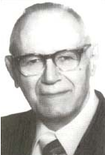
Problem Passages in the Gospel of John Part II: Untrustworthy Believers—John 2:23-25
“Many trusted in his name; i.e., because of the manner in which his power was displayed they accepted him as a great prophet and perhaps even as the Messiah. This, however, is not the same as saying that they surrendered their hearts to him. Not all faith is saving faith...”
William Hendriksen
Vol. 135: Bibliotheca Sacra Volume 135. 1978 (538) (138). Dallas, TX: Dallas Theological

Slide 34
2. Passages From Matthew
Matt. 6:14-15
Matt. 7:21-23
Matt. 10:32-33
Matt. 12:31-32
Matt. 24:13
Matt. 25:30; 8:11-12
Matt. 25:41

Slide 35
Matt. 10:32-33 (NASB)
“Therefore everyone who confesses Me before men, I will also confess him before My Father who is in heaven. But whoever denies Me before men, I will also deny him before My Father who is in heaven.”

Slide 36

Matthew and the Kingdom
Kingdom predicted (Isa 11:6-9)
Kingdom offered (Matt. 3:2; 4:17; 10:5-7)
Kingdom rejected (Matt. 12:24)
Kingdom postponed (Matt. 13)
Interim program? (Matt. 16:18; 28:18-20)
Kingdom ultimately accepted (Matt. 24:14; 25:31)
Toussaint, Behold the King, 18-20

Slide 37
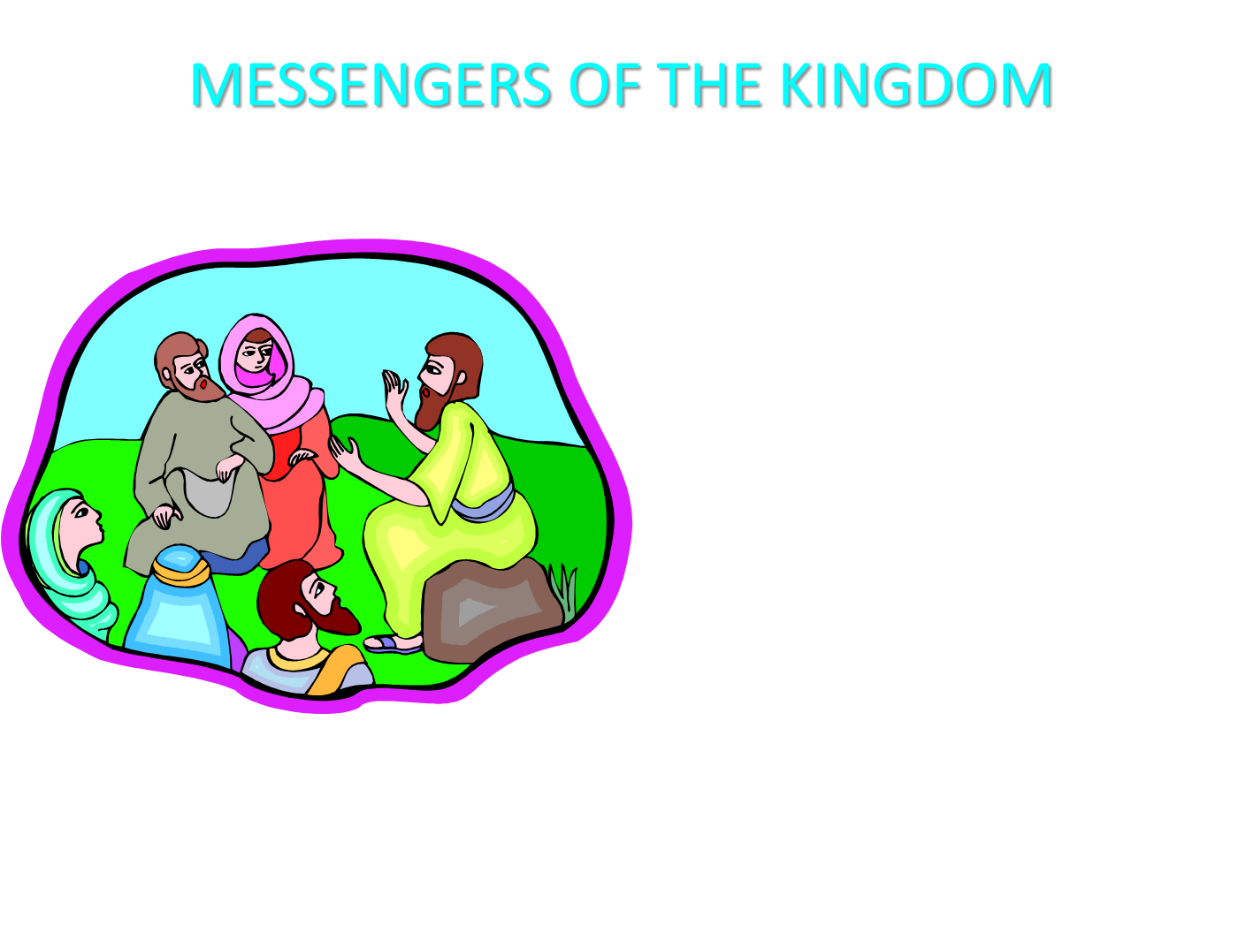

Slide 38
Matthew 10:5-7 (NASB)
“These twelve Jesus sent out after instructing them: “Do not go in the way of the Gentiles, and do not enter any city of the Samaritans; ⁶ but rather go to the lost sheep of the house of Israel. ⁷ And as you go, preach, saying, ‘The kingdom of heaven is at hand.’”

Slide 39
2. Passages From Matthew
Matt. 6:14-15
Matt. 7:21-23
Matt. 10:32-33
Matt. 12:31-32
Matt. 24:13
Matt. 25:30; 8:11-12
Matt. 25:41

Slide 40
2. Passages From Matthew
Matt. 6:14-15
Matt. 7:21-23
Matt. 10:32-33
Matt. 12:31-32
Matt. 24:13
Matt. 25:30; 8:11-12
Matt. 25:41

Slide 41
2. Passages From Matthew
Matt. 6:14-15
Matt. 7:21-23
Matt. 10:32-33
Matt. 12:31-32
Matt. 24:13
Matt. 25:30; 8:11-12
Matt. 25:41

Slide 42
Origin of the Universal Church
Matt 16:18 – future tense
Eph 2:14-15; 3:9; Rom 16:25-26; Col 1:26-27 – mystery
Eph 1:20-22 – Christ’s headship over church after Ascension
Eph 4:7-11 – spiritual gifts after Ascension
1 Cor. 12:13 – Spirit’s baptizing ministry
  Acts 1:5 – above to begin after Ascension
  Acts 11:15-16 – above began in the past
  Acts 2 – only place for beginning of Spirit’s baptizing ministry

Slide 43
2. Passages From Matthew
Matt. 6:14-15
Matt. 7:21-23
Matt. 10:32-33
Matt. 12:31-32
Matt. 24:13
Matt. 25:30; 8:11-12
Matt. 25:41

Slide 44
Angelic Salvation?
“Because the angels are a company and not a race, they sinned individually, and not in some federal head of the race [as was true with humanity's fall in the person of Adam]. It may be that because of this that God made no provision of salvation for the fallen angels.”
Thiessen, Lectures in ST, 134 (emphasis and insertion added)

Slide 45
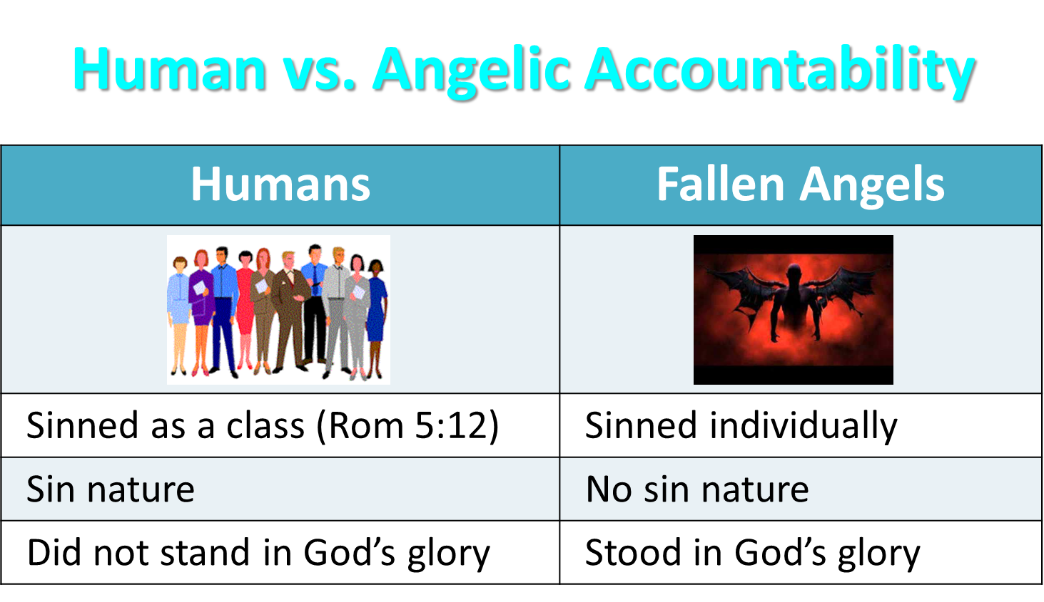

Slide 46
CONCLUSION

Slide 47
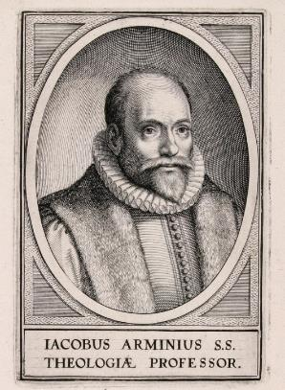
2. Passages From Matthew
Matt. 6:14-15
Matt. 7:21-23
Matt. 10:32-33
Matt. 12:31-32
Matt. 24:13
Matt. 25:30; 8:11-12
Matt. 25:41

