Slide 1
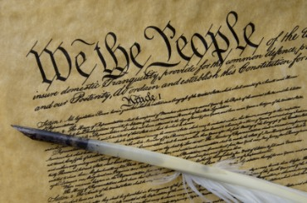
THE BIBLE AND VOTING
Part 8
Dr. Andy Woods

Slide 2
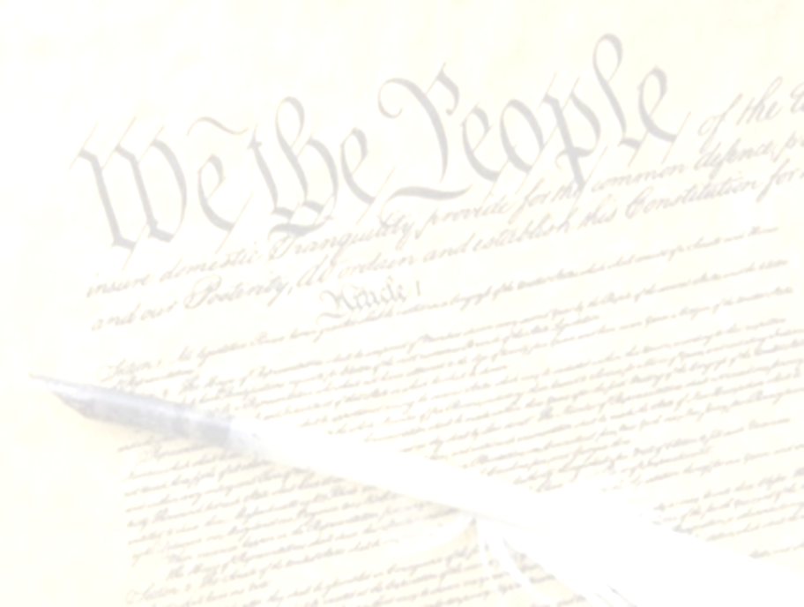
Introductory Remarks
A stewardship issue (1 Cor. 4:2)
A biblical issue (2 Tim. 3:16)
Biblical principles rather than partisanship

Slide 3
The Bible and Voting
Economic issues
Social issues
Foreign affairs

Slide 4
The Bible and Voting
Economic issues
Social issues
Foreign affairs

Slide 5
Economic Issues
Ownership of private property? (Deut. 19:15)
Pursuit of economic self interest? (Gen. 8:21)
Proper definition of compassion? (2 Thess. 3:10)
Who provides charity? (1 Tim. 5:3-8)
Family is the building block of society? (Deut. 6:6-7)
Wealth retained within the family? (Prov. 13:22)
The earth experiences cyclical patterns? (Gen. 8:22)
Environmental stewardship rather than earth worship? (Rom. 1:22-23)
Opposition to runaway debt? (Prov. 22:7)
Limitations upon the government? (Acts 5:29)

Slide 6
The Bible and Voting
Economic issues
Social issues
Foreign affairs

Slide 7
Social Issues
Legal protection for the unborn? (Gen. 25:23)
Legal protection for the elderly? (Lev. 19:32)
Hetero-sexual monogamous marriage as the standard for society? (Gen. 2:18-25)
Advocacy capital punishment? (Gen. 9:6)
The right to restrict alcohol, pornography, & gambling? (Lev. 10:9; Matt. 5:27-28; Prov. 13:11)
Parental authority over children? (Eph. 6:4)
Public expressions of Christianity? (Mark 16:15)
Right to keep and bear arms? (Luke 22:36)

Slide 8
The Bible and Voting
Economic issues
Social issues
Foreign affairs

Slide 9
Foreign Affairs
Favor national sovereignty above global governance? (Gen. 11:1-9)
Favor the reality and enforceability of our national borders? (Acts 17:26)
Support for the nation of Israel? (Gen. 12:3)
Pursuit of peace though strength? (Jer. 17:9)

Slide 10
Foreign Affairs
Favor national sovereignty above global governance? (Gen. 11:1-9)
Favor the reality and enforceability of our national borders? (Acts 17:26)
Support for the nation of Israel? (Gen. 12:3)
Pursuit of peace though strength? (Jer. 17:9)

Slide 11
Foreign Affairs
Favor national sovereignty above global governance? (Gen. 11:1-9)
Favor the reality and enforceability of our national borders? (Acts 17:26)
Support for the nation of Israel? (Gen. 12:3)
Pursuit of peace though strength? (Jer. 17:9)

Slide 12
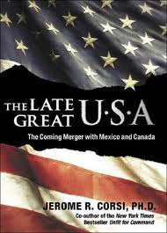
Overview
Biblical case for border enforcement
Objections
Notes:
Outline

Slide 13
Overview
Biblical case for border enforcement
Objections
Notes:
Outline

Slide 14

Genesis 11:1-4
¹ Now the whole earth used the same language and the same words. ² It came about as they journeyed east, that they found a plain in the land of Shinar and settled there. ³ They said to one another, “Come, let us make bricks and burn them thoroughly.” And they used brick for stone, and they used tar for mortar. ⁴ They said, “Come, let us build for ourselves a city, and a tower whose top will reach into heaven, and let us make for ourselves a name, otherwise we will be scattered abroad over the face of the whole earth.”

Slide 15
Genesis 11:5-7
⁵ The Lord came down to see the city and the tower which the sons of men had built. ⁶ The Lord said, “Behold, they are one people, and they all have the same language. And this is what they began to do, and now nothing which they purpose to do will be impossible for them. ⁷ “Come, let Us go down and there confuse their language, so that they will not understand one another’s speech.”

Slide 16
Genesis 11:8-9
⁸ So the Lord scattered them abroad from there over the face of the whole earth; and they stopped building the city. ⁹ Therefore its name was called Babel, because there the Lord confused the language of the whole earth; and from there the Lord scattered them abroad over the face of the whole earth.

Slide 17
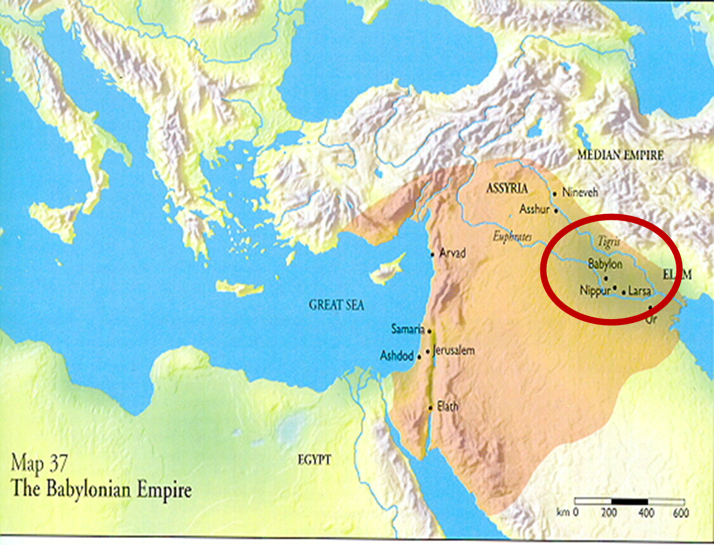

Slide 18
Genesis 11:6
The Lord said, “Behold, they are one people, and they all have the same language. And this is what they began to do, and now nothing which they purpose to do will be impossible for them.”

Slide 19
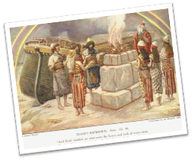
Genesis 8:21
The Lord smelled the soothing aroma; and the Lord said to Himself, “I will never again curse the ground on account of man, for the intent of man’s heart is evil from his youth; and I will never again destroy every living thing, as I have done.[emphasis mine].

Slide 20
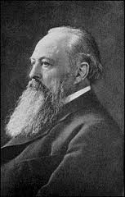
Lord Acton
“All power tends to corrupt and absolute power corrupts absolutely.”

Slide 21
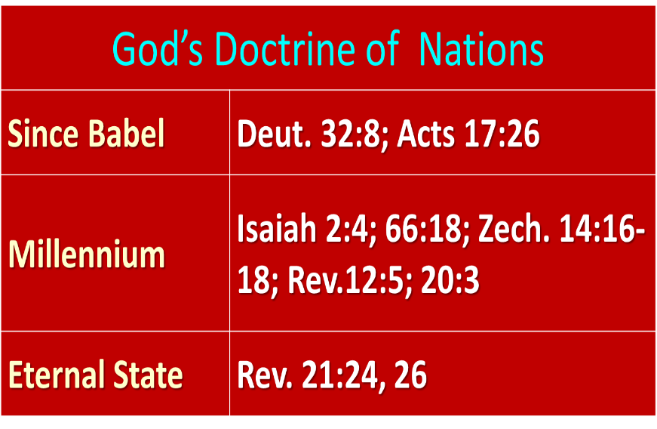

Slide 22
Overview
Biblical case for border enforcement
Objections
Notes:
Outline

Slide 23
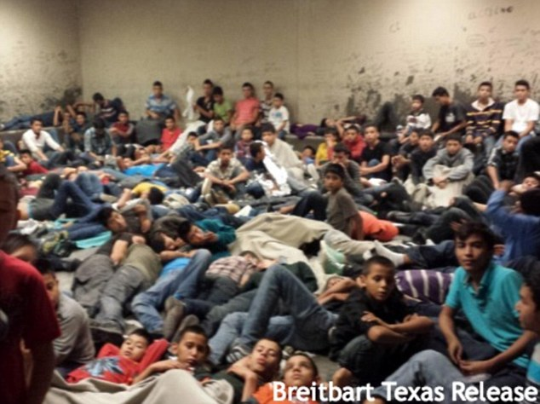

Slide 24
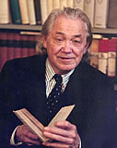
Henry Steele Commager cited in The New World Order, page 147
The inescapable fact, traumatized by the energy crisis, the population crisis, armaments race, and so forth, is that nationalism as we have noted in the 19th and much of the 20th century is as much of an anachronism today as with States Rights when Calhoun preached it and Jefferson Davis fought for it.

Slide 25
Henry Steele Commager cited in The New World Order, page 147
“Just as we know, or should know, that none of our domestic problems can be solved within the artificial boundaries of the states, so none of our global problems can be solved within the largely artificial boundaries of the nations.”

Slide 26
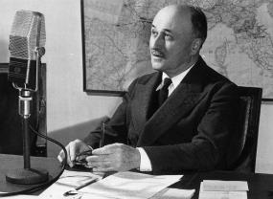
Regionalism as a Steeping
Stone into Globalism
"The sovereign nations of the past can no longer solve the problems of the present; they cannot ensure their own progress or control their own future… And the European community itself is only a stage on the way to the organized world of tomorrow."
Jean Monet, Memoirs (New York: Doubleday, 1978), 524.

Slide 27
Foreign Affairs
Favor national sovereignty above global governance? (Gen. 11:1-9)
Favor the reality and enforceability of our national borders? (Acts 17:26)
Support for the nation of Israel? (Gen. 12:3)
Pursuit of peace though strength? (Jer. 17:9)

Slide 28
Conclusion

Slide 29
Overview
Biblical case for border enforcement
Objections
Notes:
Outline

