Slide 1
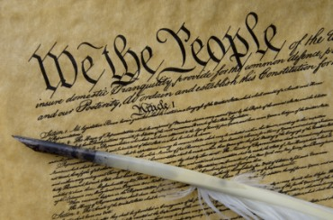
THE BIBLE AND VOTING
Dr. Andy Woods

Slide 2

Introductory Remarks
A stewardship issue (1 Cor. 4:2)
A biblical issue (2 Tim. 3:16)
Not a perfection/kingdom issue (Isa. 2:2-3)

Slide 3
Introductory Remarks
A stewardship issue (1 Cor. 4:2)
A biblical issue (2 Tim. 3:16)
Not a perfection/kingdom issue (Isa. 2:2-3)

Slide 4

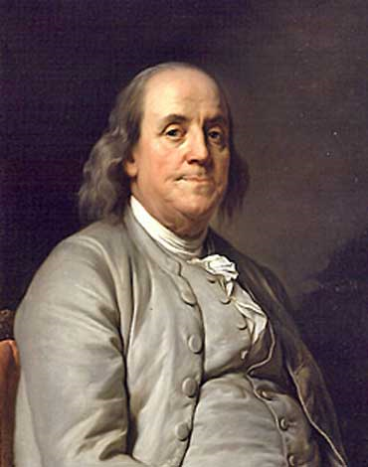
Benjamin Franklin
At the close of the Constitutional Convention of 1787, when queried as he left Independence Hall on the final day of deliberation (in the notes of Dr. James McHenry, one of Maryland’s delegates to the Convention) a lady asked Dr. Benjamin Franklin, “Well Doctor what have we got a republic or a monarchy?” Franklin responded, “A republic replied the Doctor if you can keep it.”
The Records of the Federal Convention of 1787, ed. Max Farrand, vol. 3, appendix A, p. 85 (1911, reprinted 1934).

Slide 5
Introductory Remarks
A stewardship issue (1 Cor. 4:2)
A biblical issue (2 Tim. 3:16)
Not a perfection/kingdom issue (Isa. 2:2-3)

Slide 6

2 Timothy 3:17
“so that the man of God may be adequate, equipped for every good work.”

Slide 7
2 Peter 1:3-4
Seeing that His divine power has granted to us everything pertaining to life and godliness, through the true knowledge of Him who called us by His own glory and excellence. For by these He has granted to us His precious and magnificent promises, so that by them you may become partakers of the divine nature, having escaped the corruption that is in the world by lust.

Slide 8
Introductory Remarks
A stewardship issue (1 Cor. 4:2)
A biblical issue (2 Tim. 3:16)
Not a perfection/kingdom issue (Isa. 2:2-3)

Slide 9
The Bible and Voting
Economic issues
Social issues
Foreign affairs

Slide 10
The Bible and Voting
Economic issues
Social issues
Foreign affairs

Slide 11
Economic Issues
Ownership of private property? (Deut. 19:15)
Pursuit of economic self interest? (Gen. 8:21)
Proper definition of compassion? (2 Thess. 3:10)
Who provides charity? (1 Tim. 5:3-8)
Family is the building block of society? (Deut. 6:6-7)
Wealth retained within the family? (Prov. 13:22)
The earth experiences cyclical patterns? (Gen. 8:22)
Environmental stewardship rather than earth worship? (Rom. 1:22-23)
Opposition to runaway debt? (Prov. 22:7)
Limitations upon the government? (Acts 5:29)

Slide 12
Economic Issues
Ownership of private property? (Deut. 19:15)
Pursuit of economic self interest? (Gen. 8:21)
Proper definition of compassion? (2 Thess. 3:10)
Who provides charity? (1 Tim. 5:3-8)
Family is the building block of society? (Deut. 6:6-7)
Wealth retained within the family? (Prov. 13:22)
The earth experiences cyclical patterns? (Gen. 8:22)
Environmental stewardship rather than earth worship? (Rom. 1:22-23)
Opposition to runaway debt? (Prov. 22:7)
Limitations upon the government? (Acts 5:29)

Slide 13
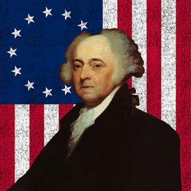
John Adams
“The moment the idea is admitted into society, that property is not as sacred as the laws of God, and that there is not a force of law and public justice to protect it, anarchy and tyranny commence. If "Thou Shalt Not Covet," and "Thou Shalt Not Steal" were not commandments of Heaven, they must be made inviolable precepts in every society before it can be civilized or made free.”
John Adams, A Defence of the Constitutions of Government of the United States of America, 3 vols., American Constitutional and Legal History, ed. Leonard W. Levy (London: Dilly, 1787; reprint, NY: Da Capo, 1971), 3:217

Slide 14
Karl Marx’s Communist Manifesto 1848
Abolish private property.
Heavy progressive income tax.
Abolish rights of inheritance.
Confiscation of property rights.
Central Bank.
Government ownership of communication and transportation.
Government ownership of factories and agriculture.
Government control of labor.
Corporate farms, regional planning.
Free Education fro All Children in Public Schools. Combination of Education with Industrial Production.

Slide 15
Economic Issues
Ownership of private property? (Deut. 19:15)
Pursuit of economic self interest? (Gen. 8:21)
Proper definition of compassion? (2 Thess. 3:10)
Who provides charity? (1 Tim. 5:3-8)
Family is the building block of society? (Deut. 6:6-7)
Wealth retained within the family? (Prov. 13:22)
The earth experiences cyclical patterns? (Gen. 8:22)
Environmental stewardship rather than earth worship? (Rom. 1:22-23)
Opposition to runaway debt? (Prov. 22:7)
Limitations upon the government? (Acts 5:29)

Slide 16
Genesis 8:21
The Lord smelled the soothing aroma; and the Lord said to Himself, “I will never again curse the ground on account of man, for the intent of man’s heart is evil from his youth; and I will never again destroy every living thing, as I have done.[emphasis mine].

Slide 17
Economic Issues
Ownership of private property? (Deut. 19:15)
Pursuit of economic self interest? (Gen. 8:21)
Proper definition of compassion? (2 Thess. 3:10)
Who provides charity? (1 Tim. 5:3-8)
Family is the building block of society? (Deut. 6:6-7)
Wealth retained within the family? (Prov. 13:22)
The earth experiences cyclical patterns? (Gen. 8:22)
Environmental stewardship rather than earth worship? (Rom. 1:22-23)
Opposition to runaway debt? (Prov. 22:7)
Limitations upon the government? (Acts 5:29)

Slide 18
Economic Issues
Ownership of private property? (Deut. 19:15)
Pursuit of economic self interest? (Gen. 8:21)
Proper definition of compassion? (2 Thess. 3:10)
Who provides charity? (1 Tim. 5:3-8)
Family is the building block of society? (Deut. 6:6-7)
Wealth retained within the family? (Prov. 13:22)
The earth experiences cyclical patterns? (Gen. 8:22)
Environmental stewardship rather than earth worship? (Rom. 1:22-23)
Opposition to runaway debt? (Prov. 22:7)
Limitations upon the government? (Acts 5:29)

Slide 19
Economic Issues
Ownership of private property? (Deut. 19:15)
Pursuit of economic self interest? (Gen. 8:21)
Proper definition of compassion? (2 Thess. 3:10)
Who provides charity? (1 Tim. 5:3-8)
Family is the building block of society? (Deut. 6:6-7)
Wealth retained within the family? (Prov. 13:22)
The earth experiences cyclical patterns? (Gen. 8:22)
Environmental stewardship rather than earth worship? (Rom. 1:22-23)
Opposition to runaway debt? (Prov. 22:7)
Limitations upon the government? (Acts 5:29)

Slide 20
Economic Issues
Ownership of private property? (Deut. 19:15)
Pursuit of economic self interest? (Gen. 8:21)
Proper definition of compassion? (2 Thess. 3:10)
Who provides charity? (1 Tim. 5:3-8)
Family is the building block of society? (Deut. 6:6-7)
Wealth retained within the family? (Prov. 13:22)
The earth experiences cyclical patterns? (Gen. 8:22)
Environmental stewardship rather than earth worship? (Rom. 1:22-23)
Opposition to runaway debt? (Prov. 22:7)
Limitations upon the government? (Acts 5:29)

Slide 21
Karl Marx’s Communist Manifesto 1848
Abolish private property.
Heavy progressive income tax.
Abolish rights of inheritance.
Confiscation of property rights.
Central Bank.
Government ownership of communication and transportation.
Government ownership of factories and agriculture.
Government control of labor.
Corporate farms, regional planning.
Free Education fro All Children in Public Schools. Combination of Education with Industrial Production.

Slide 22
Economic Issues
Ownership of private property? (Deut. 19:15)
Pursuit of economic self interest? (Gen. 8:21)
Proper definition of compassion? (2 Thess. 3:10)
Who provides charity? (1 Tim. 5:3-8)
Family is the building block of society? (Deut. 6:6-7)
Wealth retained within the family? (Prov. 13:22)
The earth experiences cyclical patterns? (Gen. 8:22)
Environmental stewardship rather than earth worship? (Rom. 1:22-23)
Opposition to runaway debt? (Prov. 22:7)
Limitations upon the government? (Acts 5:29)

Slide 23
Genesis 8:22
While the earth remains, Seedtime and harvest, And cold and heat, And summer and winter, And day and night Shall not cease.

Slide 24
Noahic vs. Abrahamic & Mosaic Covenants
 | Noahic Covenant | Abrahamic Covenant | Mosaic Covenant
Human instrument | Noah | Abraham | Moses
Scripture | Gen. 8‒9 | Gen. 12‒17 | Exod. 19‒40
People | World, humanity | Israel, Hebrews | Israel, Hebrews
Israel | Pre-Israel | Post-Israel | Post-Israel
Conditional or unconditional | Unconditional | Unconditional | Conditional
Promises | No more flood judgment, enduring earth, capital punishment | Ownership of land, seed, and blessing | Enjoyment or possession of land, seed, and blessing
Sign | Rainbow | Circumcision | Sabbath
Purpose | Restraint | Redemptive | Redemptive

Slide 25


Slide 26
Economic Issues
Ownership of private property? (Deut. 19:15)
Pursuit of economic self interest? (Gen. 8:21)
Proper definition of compassion? (2 Thess. 3:10)
Who provides charity? (1 Tim. 5:3-8)
Family is the building block of society? (Deut. 6:6-7)
Wealth retained within the family? (Prov. 13:22)
The earth experiences cyclical patterns? (Gen. 8:22)
Environmental stewardship rather than earth worship? (Rom. 1:22-23)
Opposition to runaway debt? (Prov. 22:7)
Limitations upon the government? (Acts 5:29)

Slide 27
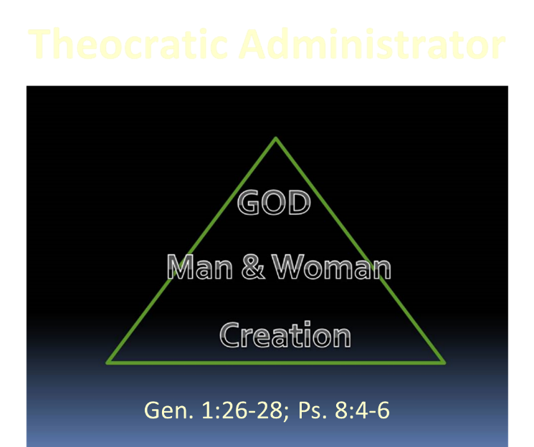

Slide 28
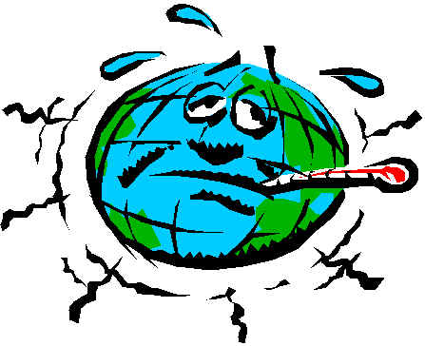
The Earth has a Fever

Slide 29


Slide 30
Gaia Hypothesis
“According to the Gaia Hypothesis, we are parts of a greater whole. If we endanger her, she will dispense with us in the interest of a higher value–that is, life itself.”
Vaclav Havel, “What the World Needs Now,” New Age Journal (September/October 1994): 162; quoted in William Grigg, Freedom on the Altar (Appleton, WI: American Opinion, 1995), 161.

Slide 31
Gaia Hypothesis
“Gaia is Mother Earth. Gaia is immortal. She is the eternal source of life. She does not need to reproduce herself as she is immortal. She is certainly the mother of us all, including Jesus…Gaia is not a tolerant mother. She is rigid and inflexible, ruthless in the destruction of whoever transgresses. Her unconscious objective is that of maintaining a world adapted to life. If we men hinder this objective we will be eliminated without pity.”
James Lovelock, Orion Nature Quart 8, no. 1 (1989): 58; quoted in Coffman, Saviors of the Earth, 145.

Slide 32
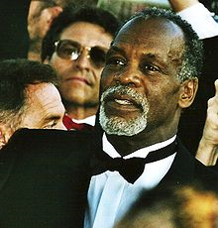
Gaia Hypothesis
"What happened in Haiti could happen to anywhere in the Caribbean because all these island nations are in peril because of global warming…When we see what we did at the climate summit in Copenhagen, this is the response, this is what happens, you know what I'm sayin'?"
www.huffingtonpost.com/.../danny-glover-haiti-earthq_n_425160.html

Slide 33
Gaia Hypothesis
“In searching for a new enemy to unite us, we came up with the idea that pollution, the threat of global warming, water shortages, famine and the like would fit the bill...”
Alexander King and Betrand Schneider, The First Global Revolution (New York: Pantheon, 1991), 115.

Slide 34
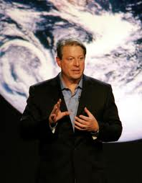
Gaia Hypothesis
According to Al Gore, “we must make the rescue of the environment the central organizing principle for civilization.”
Al Gore, Earth in the Balance (New York: Houghton Mifflin, 1992), 269.

Slide 35
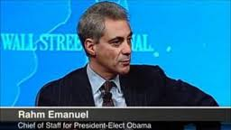
Management by Crisis
“You never let a serious crisis go to waste. And what I mean by that it’s an opportunity to do things you think you could not do before.” Rahm Emanuel
www.youtube.com/watch?v=Pb-YuhFWCr4

Slide 36
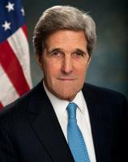
Remarks on Climate Change
“When I think about the array of…global threats –… terrorism, epidemics, poverty, the proliferation of weapons of mass destruction – all challenges that know no borders – the reality is that climate change ranks right up there with every single one of them...Or think about the proliferation of weapons of mass destruction. It doesn’t keep us safe if the United States secures its nuclear arsenal, while other countries fail to prevent theirs from falling into the hands of terrorists…”
http://www.state.gov/secretary/remarks/2014/02/221704.htm

Slide 37
UN Globalism Conferences
UN Conference | Stated Goal
Earth summit, Río de Janeiro, 1992 | Protect the environment
Human rights conference, Vienna, 1993 | Protect human rights
Population Conference, Cairo, 1994 | Prevent starvation and poverty

Slide 38
UN Globalism Conferences
UN Conference | Stated Goal
Women’s conference, Beijing, 1995 | Protect women’s rights
Habitat conference, Istanbul, 1996 | Provide global housing for all
Climate change conference, Copenhagen, 2009 | Implement climate change policy

Slide 39
Conclusion:
The Bible and Voting – Part 1

Slide 40
The Bible and Voting
Economic issues
Social issues
Foreign affairs

Slide 41
Economic Issues
Ownership of private property? (Deut. 19:15)
Pursuit of economic self interest? (Gen. 8:21)
Proper definition of compassion? (2 Thess. 3:10)
Who provides charity? (1 Tim. 5:3-8)
Family is the building block of society? (Deut. 6:6-7)
Wealth retained within the family? (Prov. 13:22)
The earth experiences cyclical patterns? (Gen. 8:22)
Environmental stewardship rather than earth worship? (Rom. 1:22-23)
Opposition to runaway debt? (Prov. 22:7)
Limitations upon the government? (Acts 5:29)

