Slide 1
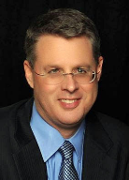
Soteriology Session 22
Dr. Andy Woods
Senior Pastor – Sugar Land Bible Church
Professor of Bible & Theology – College of Biblical Studies

Slide 2
Soteriology Overview
Definition
Election
Atonement
Salvation words
God’s one condition of salvation
Results of salvation
Eternal security
Faulty views of salvation

Slide 3
Soteriology Overview
This Session
VII. Eternal Security

Slide 4
Introduction
Probation?
Wait until the end of his life?
Eph. 4:14
The Bible answers this question
The Bible cannot contradict itself
Definition
Not all who profess faith in Christ actually have it (John 3:18; 5:39-40)
It matters: 1. productivity, 2. motive, 3. joy
Preview

Slide 5
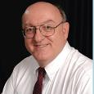
Definition of Eternal Security
“Eternal Security means that those who have been genuinely saved by God’s grace through faith alone in Christ alone shall never be in danger of God’s condemnation or loss of salvation but God’s grace and power keep them forever saved and secure.”
Dennis Rokser, Shall Never Perish Forever, p. 11

Slide 6
Eternal Security Outline
Eternal security arguments
Response to problem passages

Slide 7
Eternal Security Outline
Eternal security arguments
Response to problem passages

Slide 8
Evidence for Eternal Security
Because self-righteousness did not save us it is not a basis upon which salvation can be lost
Salvation is not given or maintained by works
If a believer can lose eternal life, then how can this life be eternal (John 3:16)?
The Bible’s promises guarantee security (John 10:28)
The assurance of salvation is possible (1 John 5:14)
The believer is predestined for glory (Rom 8:29-30)
The Spirit’s seal cannot be broken (Eph 4:30)

Slide 9
Evidence for Eternal Security
God keeps us from falling (1 Pet 1:4-5)
Christ’s role as intercessor and advocate (John 17:11-12, 20)
Christ’s death perfectly dealt with all sins (Titus 2:14)
A believer cannot be removed from Christ’s body (1 Cor. 12:13)
The Bible does not specify which sins remove salvation
Believers with unfruitful lives still have salvation although lose rewards at the Bema Seat (1 Cor 3:15)

Slide 10
Evidence for Eternal Security
Because self-righteousness did not save us it is not a basis upon which salvation can be lost
Salvation is not given or maintained by works
If a believer can lose eternal life, then how can this life be eternal (John 3:16)?
The Bible’s promises guarantee security (John 10:28)
The assurance of salvation is possible (1 John 5:14)
The believer is predestined for glory (Rom 8:29-30)
The Spirit’s seal cannot be broken (Eph 4:30)

Slide 11
Evidence for Eternal Security
Because self-righteousness did not save us it is not a basis upon which salvation can be lost
Salvation is not given or maintained by works
If a believer can lose eternal life, then how can this life be eternal (John 3:16)?
The Bible’s promises guarantee security (John 10:28)
The assurance of salvation is possible (1 John 5:14)
The believer is predestined for glory (Rom 8:29-30)
The Spirit’s seal cannot be broken (Eph 4:30)

Slide 12
Evidence for Eternal Security
Because self-righteousness did not save us it is not a basis upon which salvation can be lost
Salvation is not given or maintained by works
If a believer can lose eternal life, then how can this life be eternal (John 3:16)?
The Bible’s promises guarantee security (John 10:28)
The assurance of salvation is possible (1 John 5:14)
The believer is predestined for glory (Rom 8:29-30)
The Spirit’s seal cannot be broken (Eph 4:30)

Slide 13
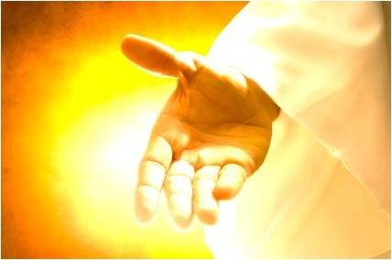
If a believer can lose eternal life, then how can this life be eternal (John 3:16)?
John 3:16
John 5:24
1 John 5:13
“Eternal” (aiōnios) is the same word used to describe God

Slide 14
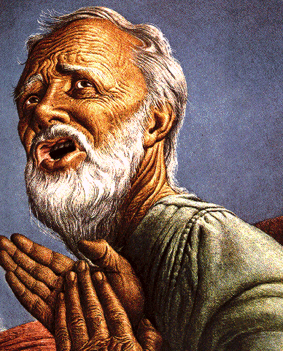
Eternal Life = Eternal Life
John 3:16
For God so loved the world, that He gave His only begotten Son, that whoever believes in Him shall not perish, but have eternal life.

Slide 15
Romans 16:26
“but now is manifested, and by the Scriptures of the prophets, according to the commandment of the eternal God, has been made known to all the nations, leading to obedience of faith.” (NASB)

Slide 16
Evidence for Eternal Security
Because self-righteousness did not save us it is not a basis upon which salvation can be lost
Salvation is not given or maintained by works
If a believer can lose eternal life, then how can this life be eternal (John 3:16)?
The Bible’s promises guarantee security (John 10:28)
The assurance of salvation is possible (1 John 5:14)
The believer is predestined for glory (Rom 8:29-30)
The Spirit’s seal cannot be broken (Eph 4:30)

Slide 17
The Bible’s Promises Guarantee Security (John 10:28)
God’s reliability – Num. 23:19; Rom. 3:4a; 2 Cor. 1:20; Titus 1:2; Heb. 6:18; 10:23
John 4:14
John 5:24
John 6:37-40
John 10:27-30
Romans 8:28-38
Heb. 13:5

Slide 18
Evidence for Eternal Security
Because self-righteousness did not save us it is not a basis upon which salvation can be lost
Salvation is not given or maintained by works
If a believer can lose eternal life, then how can this life be eternal (John 3:16)?
The Bible’s promises guarantee security (John 10:28)
The assurance of salvation is possible (1 John 5:14)
The believer is predestined for glory (Rom 8:29-30)
The Spirit’s seal cannot be broken (Eph 4:30)

Slide 19
The Assurance Of Salvation Is Possible (1 John 5:14)
Biblical examples of assurance
OT – Job 19:25-26; Ps. 23:6
Gospels – John 5:24; 6:47
Acts – Acts 16:30-31
Paul – Rom. 5:2; 8:23-24; Col. 1:27; Titus 2:13; 2 Cor. 5:8; Philip. 1:21-23; 3:20-21; 4:3; Col. 3:4; 2 Tim. 1:12
General letters – 1 Pet. 1:3-5; Heb. 2:14-15; 1 John 3:1-2; 5:13

Slide 20
1 John 5:13
“These things I have written to you who believe in the name of the Son of God, so that you may know that you have eternal life.” (NASB)

Slide 21
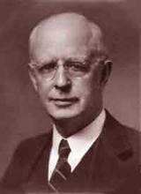
Lewis Sperry Chafer, Salvation: A Clear Doctrinal Analysis (Grand Rapids: Zondervan, 1977), 60. Italics added
Lewis Sperry Chafer
“There is a normal Christian experience. There are new and blessed emotions and desires. Old things do pass away; and behold all things do become new; but all such experiences are but secondary evidences, as to the fact of salvation, in that they grow out of that positive repose of faith which is the primary evidence.”

Slide 22
Evidence for Eternal Security
Because self-righteousness did not save us it is not a basis upon which salvation can be lost
Salvation is not given or maintained by works
If a believer can lose eternal life, then how can this life be eternal (John 3:16)?
The Bible’s promises guarantee security (John 10:28)
The assurance of salvation is possible (1 John 5:14)
The believer is predestined for glory (Rom 8:29-30)
The Spirit’s seal cannot be broken (Eph 4:30)

Slide 23
Romans 8:29–30
²⁹For those whom He foreknew, He also predestined to become conformed to the image of His Son, so that He would be the firstborn among many brethren; ³⁰ and these whom He predestined, He also called; and these whom He called, He also justified; and these whom He justified, He also glorified. (NASB95)

Slide 24
Evidence for Eternal Security
Because self-righteousness did not save us it is not a basis upon which salvation can be lost
Salvation is not given or maintained by works
If a believer can lose eternal life, then how can this life be eternal (John 3:16)?
The Bible’s promises guarantee security (John 10:28)
The assurance of salvation is possible (1 John 5:14)
The believer is predestined for glory (Rom 8:29-30)
The Spirit’s seal cannot be broken (Eph 4:30)

Slide 25
Ephesians 4:30
“Do not grieve the Holy Spirit of God, by whom you were sealed for the day of redemption.” (NASB95)

Slide 26
Evidence for Eternal Security
God keeps us from falling (1 Pet 1:4-5)
Christ’s role as intercessor and advocate (John 17:11-12, 20)
Christ’s death perfectly dealt with all sins (Titus 2:14)
A believer cannot be removed from Christ’s body (1 Cor. 12:13)
The Bible does not specify which sins remove salvation
Believers with unfruitful lives still have salvation although lose rewards at the Bema Seat (1 Cor 3:15)

Slide 27
1 Peter 1:3–6
“Blessed be the God and Father of our Lord Jesus Christ, who according to His great mercy has caused us to be born again to a living hope through the resurrection of Jesus Christ from the dead, ⁴ to obtain an inheritance which is imperishable and undefiled and will not fade away, reserved in heaven for you, ⁵ who are protected by the power of God through faith for a salvation ready to be revealed in the last time. ⁶ In this you greatly rejoice, even though now for a little while, if necessary, you have been distressed by various trials.”

Slide 28
Evidence for Eternal Security
God keeps us from falling (1 Pet 1:4-5)
Christ’s role as intercessor and advocate (John 17:11-12, 20)
Christ’s death perfectly dealt with all sins (Titus 2:14)
A believer cannot be removed from Christ’s body (1 Cor. 12:13)
The Bible does not specify which sins remove salvation
Believers with unfruitful lives still have salvation although lose rewards at the Bema Seat (1 Cor 3:15)

Slide 29
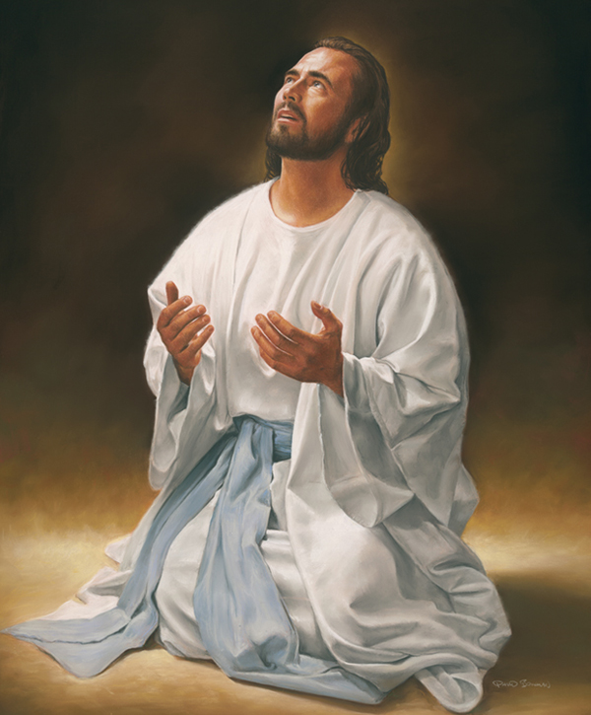
Christ Our Intercessor and Advocate
Intercessor
John 17:11-12, 20
Judas?
Answered?
Romans 8:26, 34
Hebrews 7:24-25

Slide 30
Christ Our Intercessor and Advocate
Advocate
1 John 2:1
Needed?
Job 1:8-11
Zech. 3:1
Luke 22:31-32
Rev. 12:10

Slide 31
Evidence for Eternal Security
God keeps us from falling (1 Pet 1:4-5)
Christ’s role as intercessor and advocate (John 17:11-12, 20)
Christ’s death perfectly dealt with all sins (Titus 2:14)
A believer cannot be removed from Christ’s body (1 Cor. 12:13)
The Bible does not specify which sins remove salvation
Believers with unfruitful lives still have salvation although lose rewards at the Bema Seat (1 Cor 3:15)

Slide 32
Christ’s Death Perfectly Dealt With All Sins
Ps. 103:12
Acts 10:43
Titus 2:14
Col. 2:10, 13
Heb. 9:12
John 19:30

Slide 33
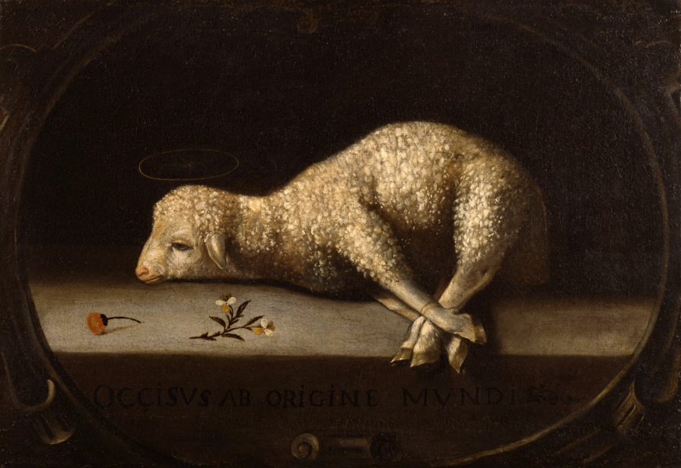
Finality of the Atonement
Finality communicated by:
Sat down
Col 3:1
Hebrews (Jewish readers) 1:3; 8:1; 10:12; 12:1-2
Rev 3:21
One time (hapax) – Heb 9:12, 26; 10:10, 12, 14
Finished (teleō) – John 19:30

Slide 34
Finality of the Atonement
Finality communicated by:
Sat down
Col 3:1
Hebrews (Jewish readers) 1:3; 8:1; 10:12; 12:1-2
Rev 3:21
One time (hapax) – Heb 9:12, 26; 10:10, 12, 14
Finished (teleō) – John 19:30

Slide 35
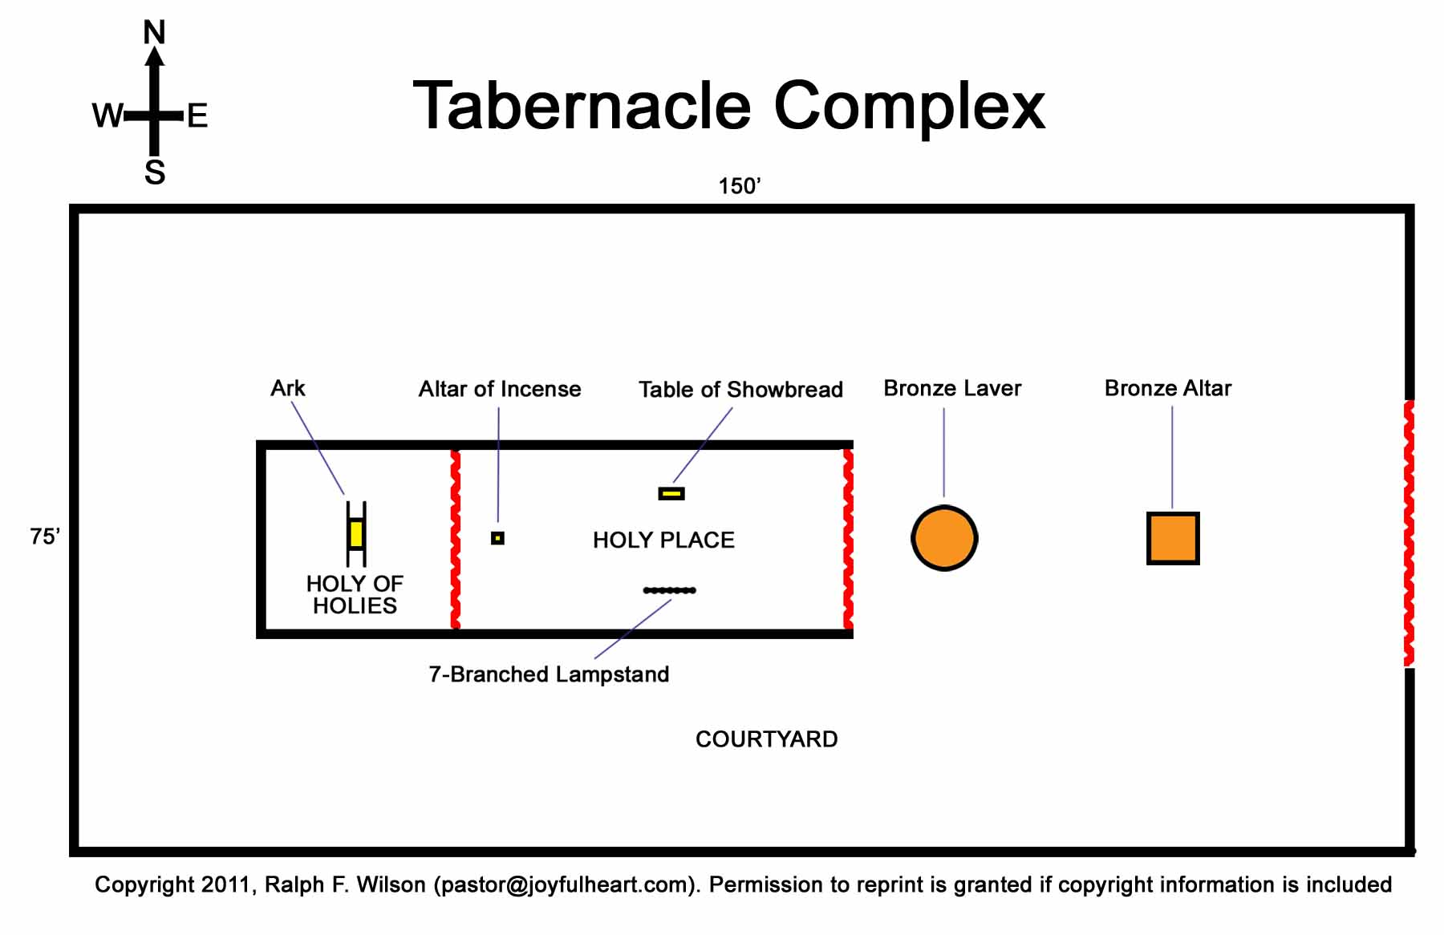
No Chairs in the Holy Place!

Slide 36
Finality of the Atonement
Finality communicated by:
Sat down
Col 3:1
Hebrews (Jewish readers) 1:3; 8:1; 10:12; 12:1-2
Rev 3:21
One time (hapax) – Heb 9:12, 26; 10:10, 12, 14
Finished (teleō) – John 19:30

Slide 37
Finality of the Atonement
Finality communicated by:
Sat down
Col 3:1
Hebrews (Jewish readers) 1:3; 8:1; 10:12; 12:1-2
Rev 3:21
One time (hapax) – Heb 9:12, 26; 10:10, 12, 14
Finished (teleō) – John 19:30

Slide 38
Evidence for Eternal Security
God keeps us from falling (1 Pet 1:4-5)
Christ’s role as intercessor and advocate (John 17:11-12, 20)
Christ’s death perfectly dealt with all sins (Titus 2:14)
A believer cannot be removed from Christ’s body (1 Cor. 12:13)
The Bible does not specify which sins remove salvation
Believers with unfruitful lives still have salvation although lose rewards at the Bema Seat (1 Cor 3:15)

Slide 39
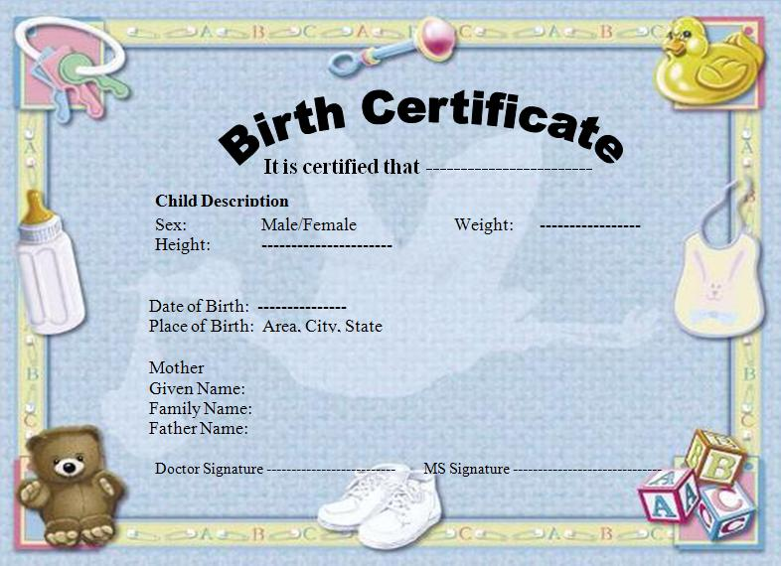
Undoing of Birth-Positional Truths
Baptism (1 Cor. 12:13)
Spiritual birth (John 1:12-13; 3:3; Jas. 1:18; 1 Pet. 1:23)
Gift (Eph. 2:8-9; Rom. 11:29)
“Have been saved” (Eph. 2:8-9)

Slide 40
Undoing of Birth-Positional Truths
Baptism (1 Cor. 12:13)
Spiritual birth (John 1:12-13; 3:3; Jas. 1:18; 1 Pet. 1:23)
Gift (Eph. 2:8-9; Rom. 11:29)
“Have been saved” (Eph. 2:8-9)

Slide 41
Undoing of Birth-Positional Truths
Baptism (1 Cor. 12:13)
Spiritual birth (John 1:12-13; 3:3; Jas. 1:18; 1 Pet. 1:23)
Gift (Eph. 2:8-9; Rom. 11:29)
“Have been saved” (Eph. 2:8-9)

Slide 42
Undoing of Birth-Positional Truths
Baptism (1 Cor. 12:13)
Spiritual birth (John 1:12-13; 3:3; Jas. 1:18; 1 Pet. 1:23)
Gift (Eph. 2:8-9; Rom. 11:29)
“Have been saved” (Eph. 2:8-9)

Slide 43
Ephesians 2:8-9
“⁸For by grace you have been saved through faith; and that not of yourselves, it is the gift of God; ⁹not as a result of works, so that no one may boast.” (NASB)

Slide 44
Undoing of Birth-Positional Truths
Baptism (1 Cor. 12:13)
Spiritual birth (John 1:12-13; 3:3; Jas. 1:18; 1 Pet. 1:23)
Gift (Eph. 2:8-9; Rom. 11:29)
“Have been saved” (Eph. 2:8-9)

Slide 45
Ephesians 2:8-9
“⁸For by grace you have been saved through faith; and that not of yourselves, it is the gift of God; ⁹not as a result of works, so that no one may boast.” (NASB)

Slide 46
Evidence for Eternal Security
God keeps us from falling (1 Pet 1:4-5)
Christ’s role as intercessor and advocate (John 17:11-12, 20)
Christ’s death perfectly dealt with all sins (Titus 2:14)
A believer cannot be removed from Christ’s body (1 Cor. 12:13)
The Bible does not specify which sins remove salvation
Believers with unfruitful lives still have salvation although lose rewards at the Bema Seat (1 Cor 3:15)

Slide 47
John 10:27-29
“My sheep hear My voice, and I know them, and they follow Me; ²⁸ and I give eternal life to them, and they will never perish [ou mē; aiōnia]; and no one will snatch them out of My hand. ²⁹ My Father, who has given them to Me, is greater than all; and no one is able to snatch them out of the Father’s hand.” (NASB)

Slide 48
Psalm 37:23-24
“The steps of a man are established by the Lord, and He delights in his way. When he falls, he will not be hurled headlong, because the Lord is the One who holds his hand.” (NASB)

Slide 49
Evidence for Eternal Security
God keeps us from falling (1 Pet 1:4-5)
Christ’s role as intercessor and advocate (John 17:11-12, 20)
Christ’s death perfectly dealt with all sins (Titus 2:14)
A believer cannot be removed from Christ’s body (1 Cor. 12:13)
The Bible does not specify which sins remove salvation
Believers with unfruitful lives still have salvation although lose rewards at the Bema Seat (1 Cor 3:15)

Slide 50
YIELDING TO THE OLD (SIN) NATURE
BELIEVER’S CONSEQUENCES | PASSAGE(S)
Lack of power | (Gal 5:16; 1 Thess. 5:19)
Grieving the Holy Spirit | (Eph 4:30-32)
Loss of joy | (Ps. 51:4, 12; Gal. 5:22-23)
Loss of spiritual sight | (2 Pet. 1:8-10; Luke 15:18-19)
Lack of growth | (1 Pet. 2:1-2)
Carnality | (1 Cor 3:1-3)
Unfruitfulness | (John 15:5, 8)
Lack of purpose | (Eccles. 1:2-3, 8; Mark 8:35)
Lack of stability | (Gal. 3:3; 2 Tim. 2:17; 2 Pet. 3:17)

Slide 51
4 Kinds of People from 1 Corinthians 3:1-3
Spiritual Believers
Infant
Believers
Unbelievers
Carnal
Believers
Notes:
Ray Steadman – “1st Californians”
Unbelievers vs Categories of Believers
Unbelievers – ψυχικός psuchikós; Natural, pertaining to the natural as distinguished from the spiritual
Spiritual Believers – πνευματικός pneumatikós; of persons who are spiritual, enlightened by the Holy Spirit
Infant Believers – σάρκινος sárkinos; with propensities of the flesh unto sin; νήπιος nḗpios; an infant, child, baby without any definite limitation of age. (This relates to immaturity and lack of instruction)
Carnal Believers – σαρκικός sarkikós; tendency to satisfy the flesh, implying sinfulness, sinful propensity, carnal (This relates to disobedience and open rebellion)

Slide 52
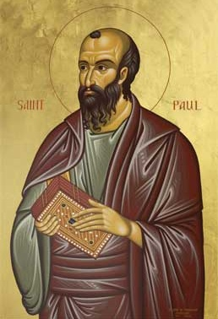
4 Kinds of People from 1 Corinthians 3:1-4
¹ And I, brethren, could not speak to you as to spiritual people but as to carnal, as to babes in Christ. ² I fed you with milk and not with solid food; for until now you were not able to receive it, and even now you are still not able; ³ for you are still carnal. For where there are envy, strife, and divisions among you, are you not carnal and behaving like mere men? ⁴ For when one says, “I am of Paul,” and another, “I am of Apollos,” are you not carnal?(NKJV)

Slide 53
Seven Truths About Carnality (1 Cor. 3:1-4)
Carnality hinders one’s growth but never his position in Christ (1 Cor. 3:1)
Carnality affects one’s desire and ability to take in and digest the Word of God (1 Cor. 3:2)
Carnality may be due to weakness or willfulness (1 Cor. 3:1-3)
Carnality is not automatically connected with time (1 Cor. 3:3)
Dennis Rokser, Shall Never Perish, p. 188

Slide 54
Seven Truths About Carnality (1 Cor. 3:1-4)
Carnality is evidenced by the works of the flesh in your life (1 Cor. 3:3)
Carnality is oftentimes characterized by self deception (1 Cor. 3:3-4)
Carnality in the believer's life causes him to walk like an unbeliever (1 Cor. 3:3)
Dennis Rokser, Shall Never Perish, p. 188

Slide 55
YIELDING TO THE OLD (SIN) NATURE
BELIEVER’S CONSEQUENCES | PASSAGE(S)
Lack of power | (Gal 5:16; 1 Thess. 5:19)
Grieving the Holy Spirit | (Eph 4:30-32)
Loss of joy | (Ps. 51:4, 12; Gal. 5:22-23)
Loss of spiritual sight | (2 Pet. 1:8-10; Luke 15:18-19)
Lack of growth | (1 Pet. 2:1-2)
Carnality | (1 Cor 3:1-3)
Unfruitfulness | (John 15:5, 8)
Lack of purpose | (Eccles. 1:2-3, 8; Mark 8:35)
Lack of stability | (Gal. 3:3; 2 Tim. 2:17; 2 Pet. 3:17)

Slide 56
YIELDING TO THE OLD (SIN) NATURE
BELIEVER’S CONSEQUENCES | PASSAGE(S)
Conviction | (2 Pet 2:7-8; Ps 32:1-5)
Divine discipline | (Heb 12:5-11)
Premature death | (Acts 5:1-11; 1 Cor 11:30; 1 John 5:16; Rev 2:22-23)
Loss of reward | (1 Cor 3:15; 9:27; 2 John 8; Rev 3:11)
Loss of fellowship | (1 John 1:9)
Excommunication | (1 Cor 5:4-5; Matt 18:15-17)
Temporal consequences | (Gal 6:7-8)
Unanswered prayer | (Ps 66:18; 1 Pet 3:7)
Loss of testimony | (Gen 19:14)
Loss of leadership privileges | (1 Tim 3:1-13; 2 Sam. 12)

Slide 57
Scripture’s Five Crowns (Rev 4:10: 3:11; 2 John 8)
Scripture | Crown | Purpose
1 Cor 9:24-27 | Incorruptible | Gaining mastery over the flesh
1 Thess 2:19-20 | Rejoicing | Soul winning
Jas 1:12; Rev 2:10 | Life | Enduring trials
1 Pet 5:2-4 | Glory | Shepherding God’s people
2 Tim 4:8 | Righteousness | Longing for His appearing

Slide 58
YIELDING TO THE OLD (SIN) NATURE
BELIEVER’S CONSEQUENCES | PASSAGE(S)
Conviction | (2 Pet 2:7-8; Ps 32:1-5)
Divine discipline | (Heb 12:5-11)
Premature death | (Acts 5:1-11; 1 Cor 11:30; 1 John 5:16; Rev 2:22-23)
Loss of reward | (1 Cor 3:15; 9:27; 2 John 8; Rev 3:11)
Loss of fellowship | (1 John 1:9)
Excommunication | (1 Cor 5:4-5; Matt 18:15-17)
Temporal consequences | (Gal 6:7-8)
Unanswered prayer | (Ps 66:18; 1 Pet 3:7)
Loss of testimony | (Gen 19:14)
Loss of leadership privileges | (1 Tim 3:1-13; 2 Sam. 12)

Slide 59
CONCLUSION

Slide 60
Evidence for Eternal Security
Because self-righteousness did not save us it is not a basis upon which salvation can be lost
Salvation is not given or maintained by works
If a believer can lose eternal life, then how can this life be eternal (John 3:16)?
The Bible’s promises guarantee security (John 10:28)
The assurance of salvation is possible (1 John 5:14)
The believer is predestined for glory (Rom 8:29-30)
The Spirit’s seal cannot be broken (Eph 4:30)

Slide 61
Evidence for Eternal Security
God keeps us from falling (1 Pet 1:4-5)
Christ’s role as intercessor and advocate (John 17:11-12, 20)
Christ’s death perfectly dealt with all sins (Titus 2:14)
A believer cannot be removed from Christ’s body (1 Cor. 12:13)
The Bible does not specify which sins remove salvation
Believers with unfruitful lives still have salvation although lose rewards at the Bema Seat (1 Cor 3:15)

