Slide 1
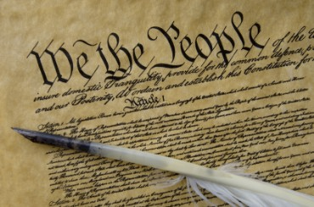
THE BIBLE AND VOTING Part 2
Dr. Andy Woods

Slide 2
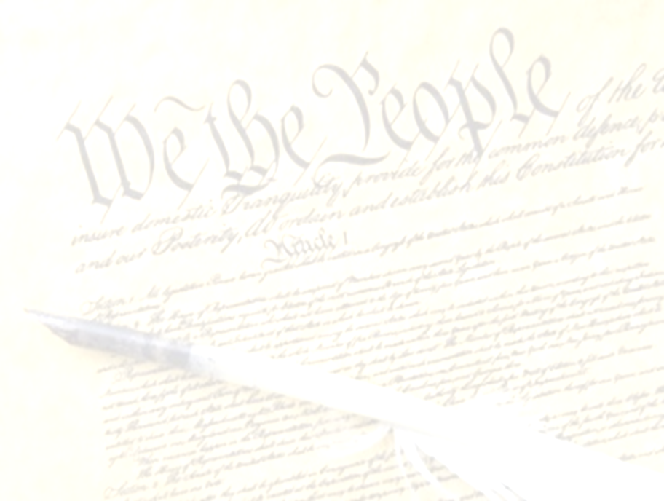
Introductory Remarks
A stewardship issue (1 Cor. 4:2)
A biblical issue (2 Tim. 3:16)
Biblical principles rather than partisanship

Slide 3
Introductory Remarks
A stewardship issue (1 Cor. 4:2)
A biblical issue (2 Tim. 3:16)
Biblical principles rather than partisanship

Slide 4
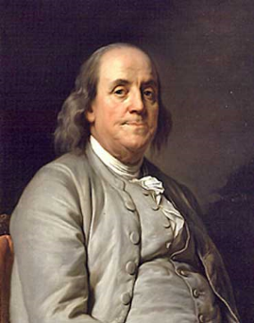
Benjamin Franklin
At the close of the Constitutional Convention of 1787, when queried as he left Independence Hall on the final day of deliberation (in the notes of Dr. James McHenry, one of Maryland’s delegates to the Convention) a lady asked Dr. Benjamin Franklin, “Well Doctor what have we got a republic or a monarchy?” Franklin responded, “A republic replied the Doctor if you can keep it.”
The Records of the Federal Convention of 1787, ed. Max Farrand, vol. 3, appendix A, p. 85 (1911, reprinted 1934).

Slide 5
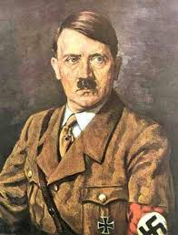
Adolf Hitler
"I will protect the German people. You take care of the church. You pastors should worry about getting people to heaven and leave this world to me."
Adolf Hitler to Martin Niemoller, cited in Charles Colson, Kingdoms in Conflict: An Insider's Challenging View of the Politics, Power, and the Pulpit (Grand Rapids: Zondervan, 1987), 140.

Slide 6
Introductory Remarks
A stewardship issue (1 Cor. 4:2)
A biblical issue (2 Tim. 3:16)
Biblical principles rather than partisanship

Slide 7
2 Timothy 3:17
“so that the man of God may be adequate, equipped for every good work.”

Slide 8
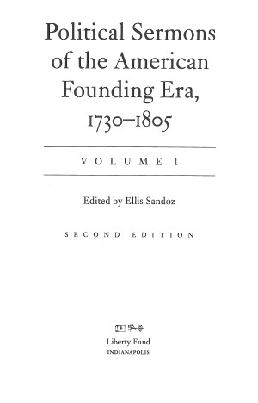
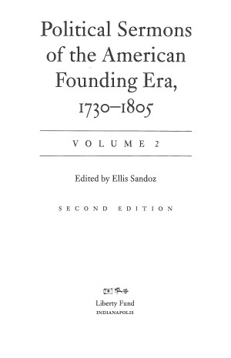

Slide 9
Introductory Remarks
A stewardship issue (1 Cor. 4:2)
A biblical issue (2 Tim. 3:16)
Biblical principles rather than partisanship

Slide 10
The Bible and Voting
Economic issues
Social issues
Foreign affairs

Slide 11
The Bible and Voting
Economic issues
Social issues
Foreign affairs

Slide 12
Economic Issues
Ownership of private property? (Deut. 19:15)
Pursuit of economic self interest? (Gen. 8:21)
Proper definition of compassion? (2 Thess. 3:10)
Who provides charity? (1 Tim. 5:3-8)
Family is the building block of society? (Deut. 6:6-7)
Wealth retained within the family? (Prov. 13:22)
The earth experiences cyclical patterns? (Gen. 8:22)
Environmental stewardship rather than earth worship? (Rom. 1:22-23)
Opposition to runaway debt? (Prov. 22:7)
Limitations upon the government? (Acts 5:29)

Slide 13
Economic Issues
Ownership of private property? (Deut. 19:15)
Pursuit of economic self interest? (Gen. 8:21)
Proper definition of compassion? (2 Thess. 3:10)
Who provides charity? (1 Tim. 5:3-8)
Family is the building block of society? (Deut. 6:6-7)
Wealth retained within the family? (Prov. 13:22)
The earth experiences cyclical patterns? (Gen. 8:22)
Environmental stewardship rather than earth worship? (Rom. 1:22-23)
Opposition to runaway debt? (Prov. 22:7)
Limitations upon the government? (Acts 5:29)

Slide 14
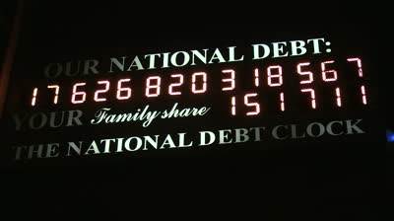
National Debt Clock

Slide 15
One Hundred Dollars
usdebt.kleptocracy.us

Slide 16
Ten Thousand Dollars

Slide 17
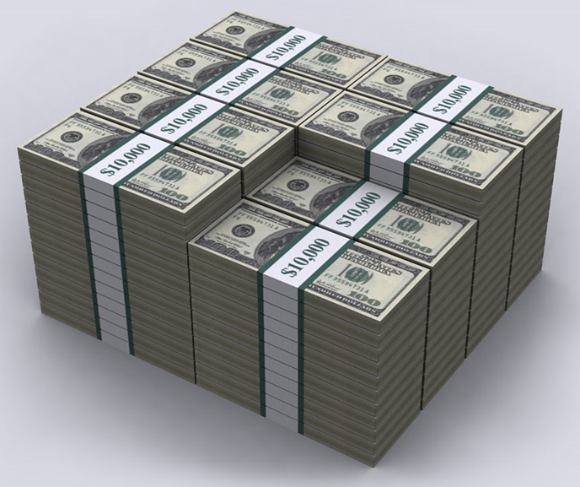
One Million Dollars

Slide 18
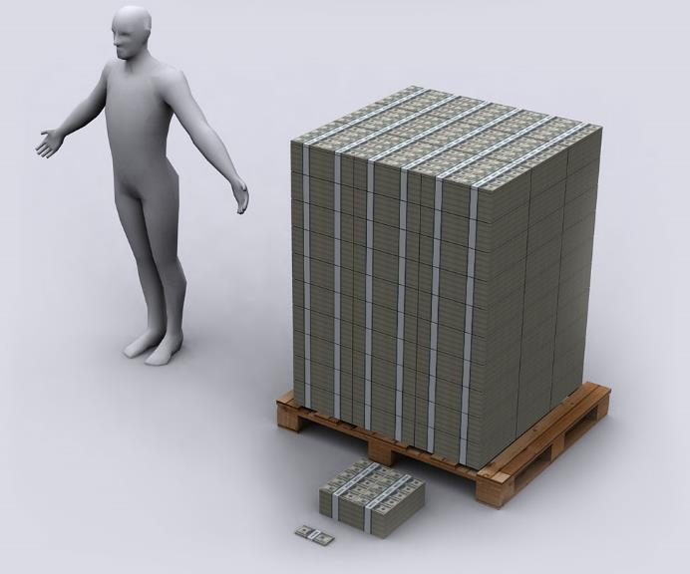
One Hundred Million Dollars

Slide 19
One Billion Dollars

Slide 20
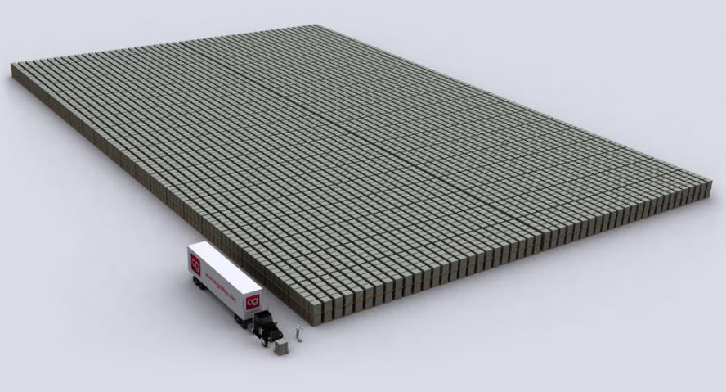
One Trillion Dollars

Slide 21
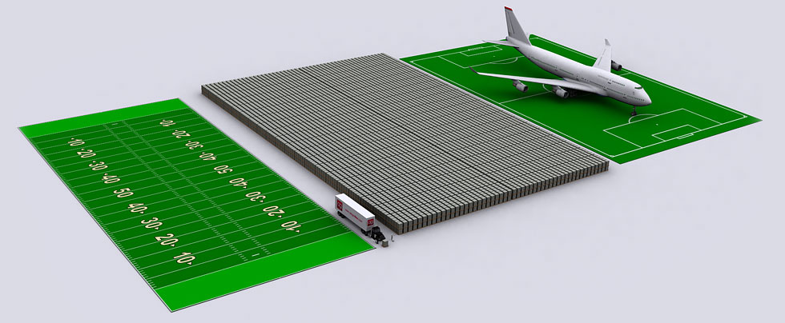
One Trillion Dollars

Slide 22
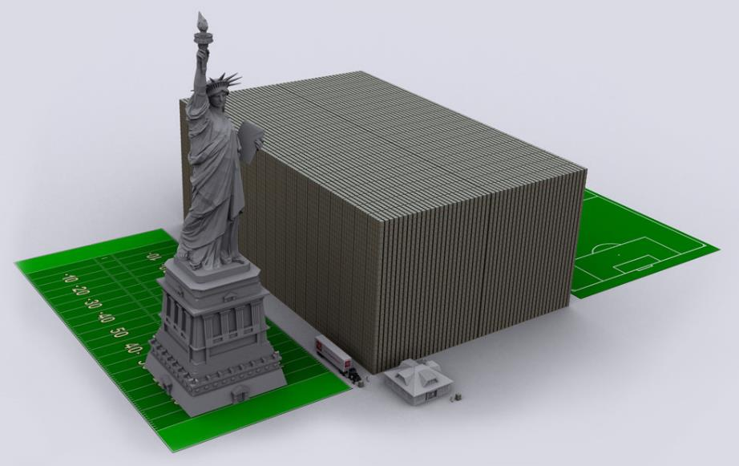
15 Trillion Dollars

Slide 23
114.5 Trillion Dollars

Slide 24
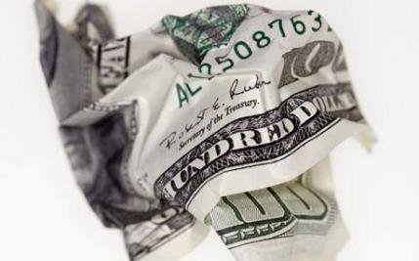
“UN wants new global currency to replace dollar: The dollar should be replaced with a global currency, the United Nations has said, proposing the biggest overhaul of the world's monetary system since the Second World War.”
Telegraph, By Edmund Conway, Economics Editor 6:45PM BST 07 Sep 2009

Slide 25
A Global Currency
"I think the dollar is now under question and I think the system will need to be reformed, so that the United States will be subject to the same discipline as is imposed on other countries….In the long run, having an international accounting unit rather than the dollar may, in fact, be to our advantage..."
Jennifer Ablan and Daniel Burns, "Soros Says U.S. Faces 'Lasting Slowdown,'" online: http://www.reuters.com/article/us-usa-economy-soros-exclusive-idUSTRE53537D20090406 , April 6 2009, accessed 21 January 2016.

Slide 26
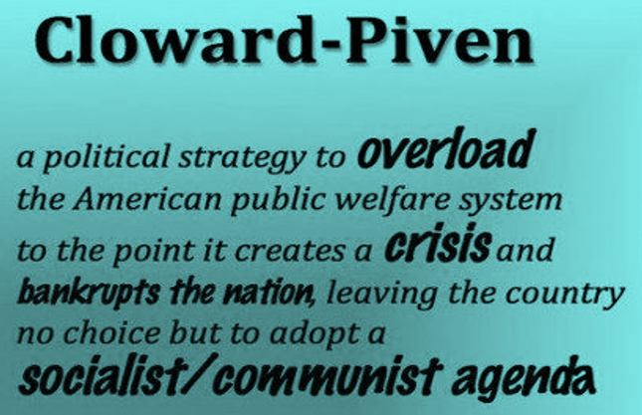
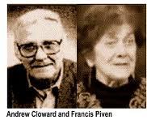

Slide 27
Economic Issues
Ownership of private property? (Deut. 19:15)
Pursuit of economic self interest? (Gen. 8:21)
Proper definition of compassion? (2 Thess. 3:10)
Who provides charity? (1 Tim. 5:3-8)
Family is the building block of society? (Deut. 6:6-7)
Wealth retained within the family? (Prov. 13:22)
The earth experiences cyclical patterns? (Gen. 8:22)
Environmental stewardship rather than earth worship? (Rom. 1:22-23)
Opposition to runaway debt? (Prov. 22:7)
Limitations upon the government? (Acts 5:29)

Slide 28
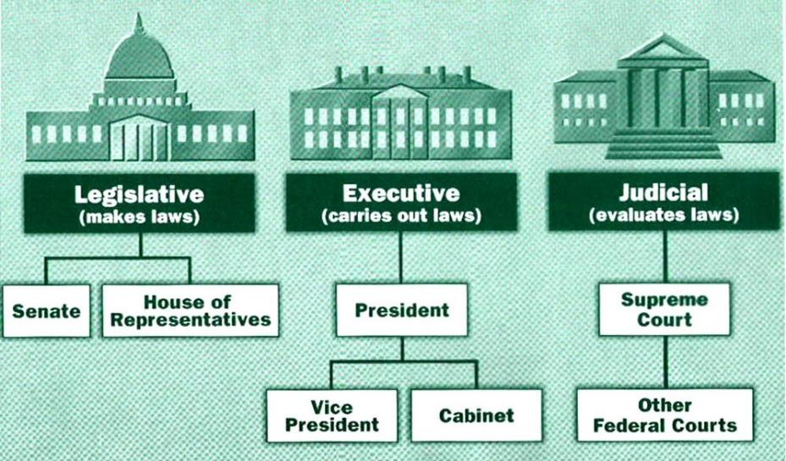

Slide 29
Tenth Amendment
“The powers not delegated to the United States by the Constitution nor prohibited by it to the States are reserved to the States respectively or to the people.”

Slide 30
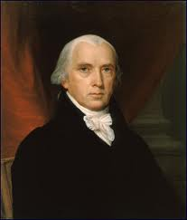
Federalist # 45
“The powers delegated by the proposed Constitution to the federal government, are few and defined. Those which are to remain in the State governments are numerous and indefinite.”
Alexander Hamilton, James Madison, and John Jay, The Federalist Papers, trans. Clinton Rossiter (New York, NY: Penguin, 1961), 292.

Slide 31
Declaration of Independence
“the Laws of Nature and of Nature’s God,”
“we hold these truths to be self evident, that all men are created equal,”
“they are endowed by their Creator with certain unalienable Rights,”
“appealing to the Supreme Judge of the world for the rectitude of our intentions,”
“with firm reliance on the protection of Divine Providence.”
Church of the Holy Trinity v. U.S., 143 U.S. 457, 467-68 (1892)

Slide 32
Founders’ Sources
34% Bible
8.3% Baron Montesquieu
7.9% William Blackstone
2.9% John Locke
Donald S. Lutz, The Origins of American Constitutionalism (Baton Rouge, LA: Louisiana State University Press, 1988), 141.

Slide 33
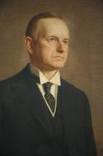
Calvin Coolidge
Calvin Coolidge stated July 5, 1926: "The principles...which went into the Declaration of Independence...are found in...the sermons...of the early colonial clergy...They preached equality because they believed in the fatherhood of God and the brotherhood of man. They justified freedom by the text that we are all created in the Divine image."
Calvin Coolidge, May 15, 1926, College of William and Mary, Williamsburg, Virginia, http.americanminute.com/index.php?date=05-15

Slide 34
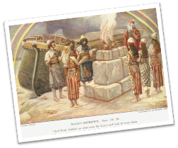
Genesis 8:21
The Lord smelled the soothing aroma; and the Lord said to Himself, “I will never again curse the ground on account of man, for the intent of man’s heart is evil from his youth; and I will never again destroy every living thing, as I have done.[emphasis mine].

Slide 35
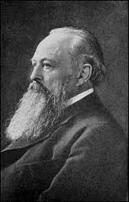
Lord Acton
“All power tends to corrupt and absolute power corrupts absolutely.”

Slide 36
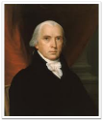
Federalist # 51
“But what is government but the greatest of all reflections on human nature? If men were angels, no government would be necessary. If angels were to govern men, neither external nor internal controls on government would be necessary. In framing a government which is to be administered by men over men, the great difficulty lies in this: you must first enable the government to control the governed; and in the next place oblige it to control itself.”
Alexander Hamilton, James Madison, and John Jay, The Federalist Papers, trans. Clinton Rossiter (New York, NY: Penguin, 1961), 322.

Slide 37
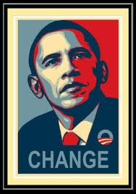
President Obama
“I urge this Congress to pursue a bipartisan, market-based solution to climate change…But if Congress won’t act soon to protect future generations, I will. I will direct my cabinet to come up with executive actions we can take, now and in the future, to reduce pollution, prepare our communities for the consequences of climate change, and speed the transition to more sustainable sources of energy.”.
http://www.greentechmedia.com/articles/read/state-of-the-union-2013-the-presidents-remarks-on-energy

Slide 38
President Obama
“But one of the things that I’ll be emphasizing in this meeting is the fact that we are not just going to be waiting for legislation in order to make sure that we’re providing Americans the kind of help that they need. I’ve got a pen and I’ve got a phone. I can use that pen to sign executive orders and take executive actions and administrative actions that move the ball forward in helping to make sure our kids are getting the best education possible and making sure that our businesses are getting the kind of support and help they need to grow and advance to make sure that people are getting the skills that they need to get those jobs that our businesses are creating. I’ve got a phone that allows me to convene Americans from every walk of life—nonprofits, businesses, the private sector, universities—to try to bring more and more Americans together around what I think is a unifying theme: making sure that this is a country where if you work hard, you can make it” (italics added).
https://www.youtube.com/watch?feature=player_detailpage&v=mogctYmt-p0

Slide 39
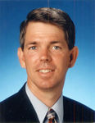
How Many Laws?
“We all know ignorance of the law is no excuse. If you violate a law, you suffer the penalty for it...If you take the U.S. code as it exists right now, today, if you read 700 pages a week of the U.S. code, national calculations are that you can finish the U.S. code in only 25,000 years.”
Erica Ricz, “David Barton Explains How You Could Be Committing Three Felonies a Day,” online: http://www.theblaze.com/stories/2014/11/04/david-barton-explains-how-you-could-be-committing-three-felonies-a-day/, November 4, 2014, accessed 15 December 2014.

Slide 40
Federalist # 62
“It will be of little avail to the people, that the laws are made by men of their own choice, if the laws be so voluminous that they cannot be read, or so incoherent that they cannot be understood; if they be repealed or revised before they are promulgated, or undergo such incessant changes that no man, who knows what the law is to-day, can guess what it will be tomorrow.”
Alexander Hamilton, James Madison, and John Jay, The Federalist Papers, trans. Clinton Rossiter (New York, NY: Penguin, 1961), 381.

Slide 41
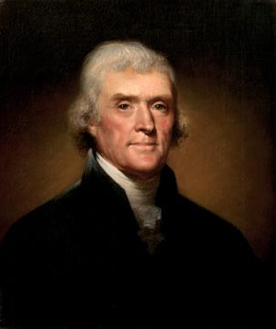
Thomas Jefferson
Kentucky Resolutions of 1798: "...in questions of power then, let no more be heard of confidence in man, but bind him down from mischief by the chains of the constitution..." (from draft)
Papers of Thomas Jefferson 30:529-556

Slide 42
Richard A. Posner
“...about academia and practical law, I see absolutely no value to a judge of spending decades, years, months, weeks, day, hours, minutes, or seconds studying the Constitution, the history of its enactment, its amendments, and its implementation (across the centuries—well, just a little more than two centuries, and of course less for many of the amendments). Eighteenth-century guys, however smart, could not foresee the culture, technology, etc., of the 21st century. Which means that the original Constitution, the Bill of Rights, and the post–Civil War amendments (including the 14th), do not speak to today...The Supreme Court treats the Constitution like it is authorizing the court to create a common law of constitutional law, based on current concerns, not what those 18th-century guys were worrying about. In short, let’s not let the dead bury the living.”
Judge Richard A. Posner, who was appointed by President Ronald Reagan in 1981 and serves on the U.S. Court of Appeals for the Seventh Circuit in Chicago, has published an op-ed at Slate declaring that the U.S. Constitution is a waste of time. http://www.slate.com/articles/news_and_politics/

Slide 43
Economic Issues
Ownership of private property? (Deut. 19:15)
Pursuit of economic self interest? (Gen. 8:21)
Proper definition of compassion? (2 Thess. 3:10)
Who provides charity? (1 Tim. 5:3-8)
Family is the building block of society? (Deut. 6:6-7)
Wealth retained within the family? (Prov. 13:22)
The earth experiences cyclical patterns? (Gen. 8:22)
Environmental stewardship rather than earth worship? (Rom. 1:22-23)
Opposition to runaway debt? (Prov. 22:7)
Limitations upon the government? (Acts 5:29)

Slide 44
Conclusion

Slide 45
The Bible and Voting
Economic issues
Social issues
Foreign affairs

Slide 46
The Bible and Voting
Economic issues
Social issues
Foreign affairs

