Slide 1
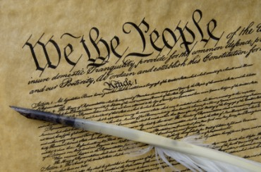
THE BIBLE AND VOTING
Part 3
Dr. Andy Woods

Slide 2

Introductory Remarks
A stewardship issue (1 Cor. 4:2)
A biblical issue (2 Tim. 3:16)
Biblical principles rather than partisanship

Slide 3
Introductory Remarks
A stewardship issue (1 Cor. 4:2)
A biblical issue (2 Tim. 3:16)
Biblical principles rather than partisanship

Slide 4

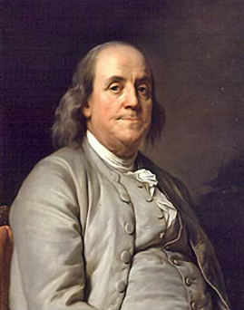
Benjamin Franklin
At the close of the Constitutional Convention of 1787, when queried as he left Independence Hall on the final day of deliberation (in the notes of Dr. James McHenry, one of Maryland’s delegates to the Convention) a lady asked Dr. Benjamin Franklin, “Well Doctor what have we got a republic or a monarchy?” Franklin responded, “A republic replied the Doctor if you can keep it.”
The Records of the Federal Convention of 1787, ed. Max Farrand, vol. 3, appendix A, p. 85 (1911, reprinted 1934).

Slide 5
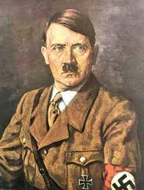
Adolf Hitler
"I will protect the German people. You take care of the church. You pastors should worry about getting people to heaven and leave this world to me."
Adolf Hitler to Martin Niemoller, cited in Charles Colson, Kingdoms in Conflict: An Insider's Challenging View of the Politics, Power, and the Pulpit (Grand Rapids: Zondervan, 1987), 140.

Slide 6
Introductory Remarks
A stewardship issue (1 Cor. 4:2)
A biblical issue (2 Tim. 3:16)
Biblical principles rather than partisanship

Slide 7

2 Timothy 3:17
“so that the man of God may be adequate, equipped for every good work.”

Slide 8
Introductory Remarks
A stewardship issue (1 Cor. 4:2)
A biblical issue (2 Tim. 3:16)
Biblical principles rather than partisanship

Slide 9
The Bible and Voting
Economic issues
Social issues
Foreign affairs

Slide 10
The Bible and Voting
Economic issues
Social issues
Foreign affairs

Slide 11
Economic Issues
Ownership of private property? (Deut. 19:15)
Pursuit of economic self interest? (Gen. 8:21)
Proper definition of compassion? (2 Thess. 3:10)
Who provides charity? (1 Tim. 5:3-8)
Family is the building block of society? (Deut. 6:6-7)
Wealth retained within the family? (Prov. 13:22)
The earth experiences cyclical patterns? (Gen. 8:22)
Environmental stewardship rather than earth worship? (Rom. 1:22-23)
Opposition to runaway debt? (Prov. 22:7)
Limitations upon the government? (Acts 5:29)

Slide 12
The Bible and Voting
Economic issues
Social issues
Foreign affairs

Slide 13
Social Issues
Legal protection for the unborn? (Gen. 25:23)
Legal protection for the elderly? (Lev. 19:32)
Hetero-sexual monogamous marriage as the standard for society? (Gen. 2:18-25)
Advocacy capital punishment? (Gen. 9:6)
The right to restrict alcohol, pornography, & gambling? (Lev. 10:9; Matt. 5:27-28; Prov. 13:11)
Parental authority over children? (Eph. 6:4)
Public expressions of Christianity? (Mark 16:15)
Right to keep and bear arms? (Luke 22:36)

Slide 14
Social Issues
Legal protection for the unborn? (Gen. 25:23)
Legal protection for the elderly? (Lev. 19:32)
Hetero-sexual monogamous marriage as the standard for society? (Gen. 2:18-25)
Advocacy capital punishment? (Gen. 9:6)
The right to restrict alcohol, pornography, & gambling? (Lev. 10:9; Matt. 5:27-28; Prov. 13:11)
Parental authority over children? (Eph. 6:4)
Public expressions of Christianity? (Mark 16:15)
Right to keep and bear arms? (Luke 22:36)

Slide 15

SLBC Position Statements # 1
SANCTITY OF LIFE – We believe that the fetus, from the moment of conception, is a person (Psalm 139:13-18). We also believe that all persons are created in the image of God regardless of age, health, function and/or condition of dependency.

Slide 16
Social Issues
Legal protection for the unborn? (Gen. 25:23)
Legal protection for the elderly? (Lev. 19:32)
Hetero-sexual monogamous marriage as the standard for society? (Gen. 2:18-25)
Advocacy capital punishment? (Gen. 9:6)
The right to restrict alcohol, pornography, & gambling? (Lev. 10:9; Matt. 5:27-28; Prov. 13:11)
Parental authority over children? (Eph. 6:4)
Public expressions of Christianity? (Mark 16:15)
Right to keep and bear arms? (Luke 22:36)

Slide 17
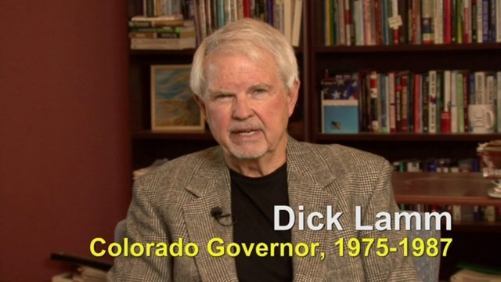
Richard D. Lamm
“DENVER, March 28, 1984— Elderly people who are terminally ill have a ''duty to die and get out of the way'' instead of trying to prolong their lives by artificial means, Gov. Richard D. Lamm of Colorado said Tuesday. People who die without having life artificially extended are similar to ''leaves falling off a tree and forming humus for the other plants to grow up,'' the Governor told a meeting of the Colorado Health Lawyers Association at St. Joseph's Hospital. ''You've got a duty to die and get out of the way,'' said the 48-year-old Governor. ''Let the others in society, our kids, build a reasonable life."
Quoted In Gov. Lamm Asserts Elderly, If Very Ill, Have 'Duty To Die,’ New York Times, March 29, 1984.

Slide 18
Social Issues
Legal protection for the unborn? (Gen. 25:23)
Legal protection for the elderly? (Lev. 19:32)
Hetero-sexual monogamous marriage as the standard for society? (Gen. 2:18-25)
Advocacy capital punishment? (Gen. 9:6)
The right to restrict alcohol, pornography, & gambling? (Lev. 10:9; Matt. 5:27-28; Prov. 13:11)
Parental authority over children? (Eph. 6:4)
Public expressions of Christianity? (Mark 16:15)
Right to keep and bear arms? (Luke 22:36)

Slide 19
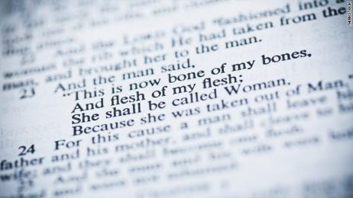
The Bible and Homosexuality
Creation (Gen. 1‒2)
Sodom and Gomorrah (Gen. 18‒19)
The Mosaic Law (Lev. 18; 20)
Jesus Christ (Matt. 19; John 2)
The Apostle Paul (Rom. 1; 1 Cor. 6; 1 Tim. 1)

Slide 20
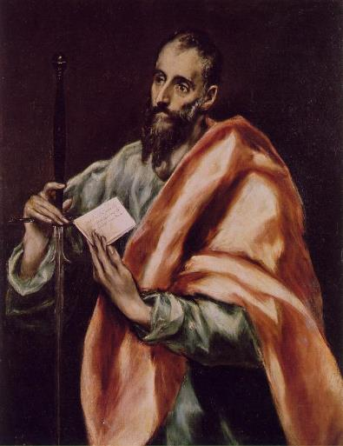
The Apostle Paul
Pro-Heterosexuality
  1 Cor. 7:2-5
  Eph. 5:22-33
  1 Tim. 3:2, 12
Anti-Homosexuality
  1 Cor. 6:9-11
  Rom. 1:26-27
  1 Tim. 1:9-10

Slide 21
1 Cor. 6:9-11
“Or do you not know that the unrighteous will not inherit the kingdom of God? Do not be deceived; neither fornicators, nor idolaters, nor adulterers, nor effeminate, nor homosexuals, nor thieves, nor the covetous, nor drunkards, nor revilers, nor swindlers, will inherit the kingdom of God. Such were some of you; but you were washed, but you were sanctified, but you were justified in the name of the Lord Jesus Christ and in the Spirit of our God.” (NASB)

Slide 22
1 Cor. 6:9-11
“Or do you not know that the unrighteous will not inherit the kingdom of God? Do not be deceived; neither fornicators, nor idolaters, nor adulterers, nor effeminate, nor homosexuals, nor thieves, nor the covetous, nor drunkards, nor revilers, nor swindlers, will inherit the kingdom of God. Such were some of you; but you were washed, but you were sanctified, but you were justified in the name of the Lord Jesus Christ and in the Spirit of our God.” (NASB)

Slide 23
1 Cor. 6:9-11
“Or do you not know that the unrighteous will not inherit the kingdom of God? Do not be deceived; neither fornicators, nor idolaters, nor adulterers, nor effeminate, nor homosexuals, nor thieves, nor the covetous, nor drunkards, nor revilers, nor swindlers, will inherit the kingdom of God. Such were some of you; but you were washed, but you were sanctified, but you were justified in the name of the Lord Jesus Christ and in the Spirit of our God.” (NASB)

Slide 24
1 Cor. 6:9-11
“Or do you not know that the unrighteous will not inherit the kingdom of God? Do not be deceived; neither fornicators, nor idolaters, nor adulterers, nor effeminate, nor homosexuals, nor thieves, nor the covetous, nor drunkards, nor revilers, nor swindlers, will inherit the kingdom of God. Such were some of you; but you were washed, but you were sanctified, but you were justified in the name of the Lord Jesus Christ and in the Spirit of our God.” (NASB)

Slide 25
Baker Faces Prison for Refusing to Bake Same-Sex Wedding Cake
“Jack Phillips is a baker who declined to bake a wedding cake for a same-sex couple because his Christian belief is that marriage exists only between a man and woman. Now a Colorado judge has ordered him to bake cakes for same-sex marriages, and if Phillips refuses, he could go to jail.”
Ken Klukowski, “Baker Faces Prison for Refusing to Bake Same-Sex Wedding Cake,” online: http://www.breitbart.com/Big-Government/2013/12/12/Christian-Baker-Willing-to-Go-to-Jail-for-Declining-Gay-Wedding-Cake, 12 December 2013, accessed 16 May 2014.

Slide 26
Oregon Declares War on Aaron & Melissa Klein
“In yet another example of gay activist overreach, an Oregon official has not only burdened a Christian couple with a ridiculous fine, he has imposed a gag order on them…In one of the most egregious anti-Christian acts committed by a state official in recent memory, Oregon Labor Commissioner Brad Avakian not only upheld the ridiculous $135,000 fine levied against Aaron and Melissa Klein for declining to bake a cake for a lesbian commitment ceremony, but he ordered the Kleins to ‘cease and desist’ from making any public comments about their religious convictions relative to this case.”
http://www.onenewsnow.com/perspectives/michael-brown/2015/07/06/oregon-declares-war-on-christian-faith

Slide 27
Social Issues
Legal protection for the unborn? (Gen. 25:23)
Legal protection for the elderly? (Lev. 19:32)
Hetero-sexual monogamous marriage as the standard for society? (Gen. 2:18-25)
Advocacy capital punishment? (Gen. 9:6)
The right to restrict alcohol, pornography, & gambling? (Lev. 10:9; Matt. 5:27-28; Prov. 13:11)
Parental authority over children? (Eph. 6:4)
Public expressions of Christianity? (Mark 16:15)
Right to keep and bear arms? (Luke 22:36)

Slide 28
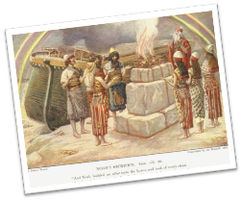
Genesis 8:21
“The Lord smelled the soothing aroma; and the Lord said to Himself, “I will never again curse the ground on account of man, for the intent of man’s heart is evil from his youth; and I will never again destroy every living thing, as I have done.” [emphasis mine].

Slide 29
Noahic vs. Abrahamic & Mosaic Covenants
Name | Noahic Covenant | Abrahamic Covenant | Mosaic Covenant
Human agent | Noah | Abraham | Moses
Scripture | Gen. 8‒9 | Gen. 12‒17 | Exod. 19‒40
Covenant (Berith) | Gen. 9:9 | Gen. 15:18 | Exod. 19:5
Party | World, humanity | Israel, Hebrews | Israel, Hebrews
Israel | Pre-Israel | Post-Israel | Post-Israel

Slide 30
Noahic vs. Abrahamic & Mosaic Covenants
 | Noahic Covenant | Abrahamic Covenant | Mosaic Covenant
Conditional or unconditional | Unconditional | Unconditional | Conditional
Promises | No more flood judgment, enduring earth, capital punishment | Ownership of land, seed, and blessing | Enjoyment or possession of land, seed, and blessing
Sign | Rainbow | Circumcision | Sabbath
Purpose | Restrain & preserve | Redemptive | Redemptive
Directly binding today? | Yes | No | No

Slide 31


Slide 32
Abortion or Capital Punishment?
 | ABORTION | CAPITAL PUNISHMENT
Birth? | Unborn | Born
Crime? | No crime | Committed a crime
Trial? | Not tried by a jury of peers | Tried by a jury of peers
Guilt? | Innocent | Guilty

Slide 33
Social Issues
Legal protection for the unborn? (Gen. 25:23)
Legal protection for the elderly? (Lev. 19:32)
Hetero-sexual monogamous marriage as the standard for society? (Gen. 2:18-25)
Advocacy capital punishment? (Gen. 9:6)
The right to restrict alcohol, pornography, & gambling? (Lev. 10:9; Matt. 5:27-28; Prov. 13:11)
Parental authority over children? (Eph. 6:4)
Public expressions of Christianity? (Mark 16:15)
Right to keep and bear arms? (Luke 22:36)

Slide 34
Social Issues
Legal protection for the unborn? (Gen. 25:23)
Legal protection for the elderly? (Lev. 19:32)
Hetero-sexual monogamous marriage as the standard for society? (Gen. 2:18-25)
Advocacy capital punishment? (Gen. 9:6)
The right to restrict alcohol, pornography, & gambling? (Lev. 10:9; Matt. 5:27-28; Prov. 13:11)
Parental authority over children? (Eph. 6:4)
Public expressions of Christianity? (Mark 16:15)
Right to keep and bear arms? (Luke 22:36)

Slide 35

Do Children Belong to Their Parents?
“We have never invested as much in public education as we should have because we've always had kind of a private notion of children. Your kid is yours and totally your responsibility. We haven't had a very collective notion of these are our children. So part of it is we have to break through our kind of private idea that kids belong to their parents, or kids belong to their families, and recognize that kids belong to whole communities.”
Melissa Harris Perry, MSNBC host www.youtube.com/watch?v=N3qtpdSQox0

Slide 36
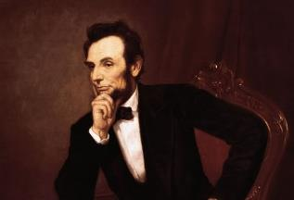
Cited in Mark A. Beliles and Stephen K. McDowell, America's Providential History (Charlottesville, VA: Providence, 1989), 95.
“The philosophy of the school room in one generation will be the philosophy of government in the next.”

Slide 37
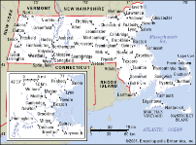
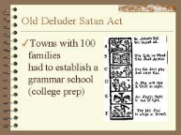
Old Satan Deluder Law
“It being one chief project of that old deluder, Satan, to keep men from the knowledge of the Scriptures, as in former time…It is therefore ordered…that after the Lord hath increased the settlement…they shall…appoint one within their town, to teach all such children to read…they shall set up a grammar school to instruct youths…”
Church of the Holy Trinity v. U.S., 143 U.S. 457, 467 (1892)

Slide 38
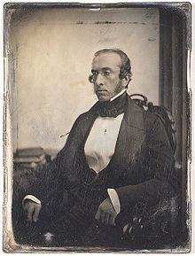

Robert Charles Winthrop
“All societies of men must be governed in some way or other. The less they may have of stringent State Government, the more they must have of individual self-government. The less they rely on public law or physical force, the more they must rely on private moral restraint. Men, in a word, must necessarily be controlled, either by a power within them, or by a power without them; either by the Word of God, or by the strong arm of man; either by the Bible, or by the bayonet. It may do for other countries and other governments to talk about the State supporting religion. Here, under our own free institutions, it is Religion which must support the State.”
Robert Winthrop, Addresses and Speeches on Various Occasions (Boston, MA: Little, Brown, 1852), 172. Speech to the Massachusetts Bible Society (1849-05-28).

Slide 39
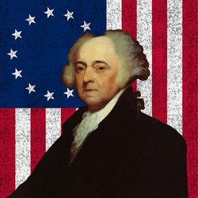
John Adams, Second President of the United States
"We have no government armed with power capable of contending with human passions unbridled by morality and religion. Avarice, ambition, revenge, or gallantry, would break the strongest cords of our Constitution as a whale goes through a net. Our Constitution was made only for a moral and religious people. It is wholly inadequate to the government of any other.”
Letter to the Officers of the First Brigade of the Third Division of the Militia of Massachusetts, 11 October 1798, in Revolutionary Services and Civil life of General William Hull (New York, 1848), pp 265-6. There are some differences in the version that appeared in The Works of John Adams (Boston, 1854), vol. 9. pp. 228-29.

Slide 40
Karl Marx’s Communist Manifesto 1848
Abolish private property.
Heavy progressive income tax.
Abolish rights of inheritance.
Confiscation of property rights.
Central Bank.
Government ownership of communication and transportation.
Government ownership of factories and agriculture.
Government control of labor.
Corporate farms, regional planning.
Free Education for All Children in Public Schools. Combination of Education with Industrial Production.

Slide 41
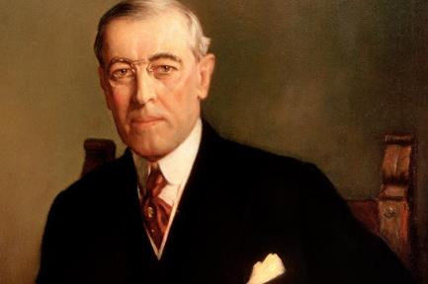
President Woodrow Wilson
“I have often said that the use of a university is to make young gentlemen as unlike their fathers as possible.”
Woodrow Wilson, "The Power of Christian Young Men," in Selected Adresses and Papers of Woodrow Wilson(New York: Boni and Liverlight, 1918), 49.

Slide 42

Humanist Beliefs
The non-existence or irrelevancy of God
Man as the center of all things
The reality of evolution
Man as an evolved animal rather than a special creature made in the image of his creator
The absence of any absolute morals or values
Confidence in the scientific method to solve the world’s problems.
The goal of humanity is a one-world government
Eidsmoe, The Christian Legal Advisor, 180-87.

Slide 43
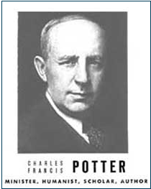
Humanist Proselytizing
“Education is thus a most powerful ally of Humanism, and every public school is a school of Humanism. What can the theistic Sunday-schools, meeting for an hour once a week, and teaching only a fraction of the children, do to stem the tide of a five-day program of humanistic teaching?”
Charles Francis Potter, Humanism: A New Religion (New York: Simon and Schuster, 1930), 128

Slide 44


Humanist Proselytizing
“I am convinced that the battle for humankind’s future must be waged and won in the public school classrooms by teachers who correctly perceive their role as proselytizers of a new faith: a religion of humanity that recognizes and respects the spark of what theologians call the Divinity in every human being. These teachers must embody the same selfless dedication as the most rabid fundamentalist preachers.”
John Dunphy, “A Religion for the New Age,” The Humanist (January/February 1983): 26

Slide 45
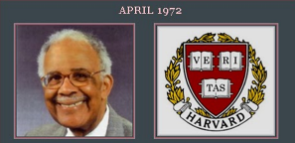
Humanist Proselytizing
“Every child in America entering school at the age of five is mentally ill because he comes to school with certain allegiances to our founding fathers, toward our elected officials, toward his parents, toward a belief in a supernatural being, and toward the sovereignty of this nation as a separate entity. It's up to you as teachers to make all these sick children well by creating the international child of the future.”
Chester M. Pierce, Harvard psychiatrist, speaking as an expert in public education at the 1973 International Education Seminar.

Slide 46
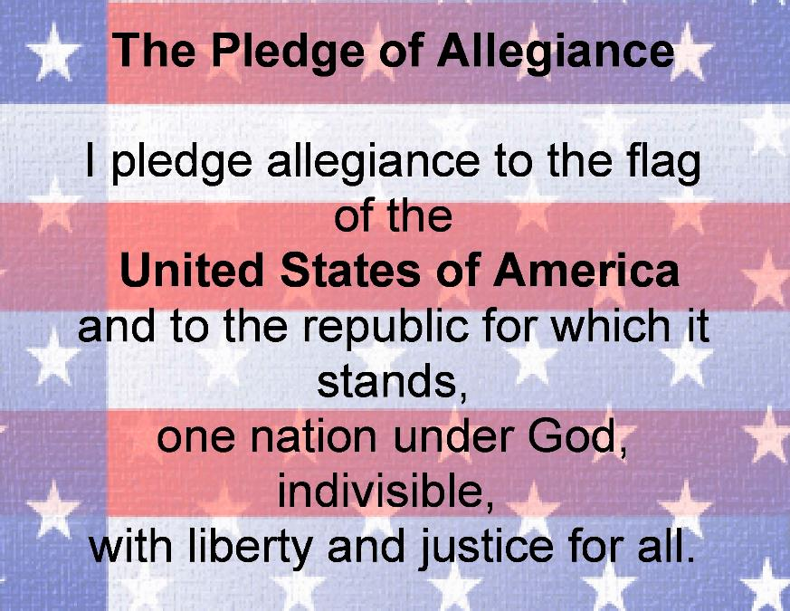

Slide 47

A New Pledge of Allegiance?
“I pledge allegiance to the flag and my constitutional rights with which it comes. And to the diversity, in which our nation stands, one nation, part of one planet, with liberty, freedom, choice and justice for all.”
Globalist Pledge of Allegiance in U.S. School, Boulder High School, October 2007, Kerby Anderson

Slide 48
Social Issues
Legal protection for the unborn? (Gen. 25:23)
Legal protection for the elderly? (Lev. 19:32)
Hetero-sexual monogamous marriage as the standard for society? (Gen. 2:18-25)
Advocacy capital punishment? (Gen. 9:6)
The right to restrict alcohol, pornography, & gambling? (Lev. 10:9; Matt. 5:27-28; Prov. 13:11)
Parental authority over children? (Eph. 6:4)
Public expressions of Christianity? (Mark 16:15)
Right to keep and bear arms? (Luke 22:36)

Slide 49
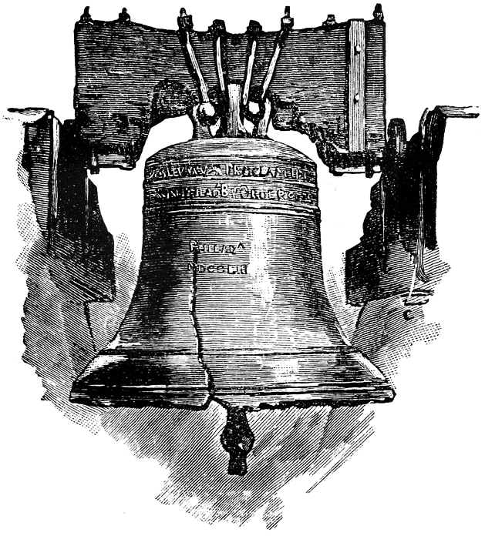
Leviticus 25:10
“And you shall consecrate the fiftieth year, and proclaim liberty throughout [all] the land to all its inhabitants. It shall be a Jubilee for you; and each of you shall return to his possession, and each of you shall return to his family.”
.

Slide 50
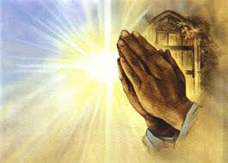
Engle v. Vitale, 370 U.S. 421-22 (1962).
“Almighty God, we acknowledge our dependence upon Thee, and we beg thy blessings upon us, our parents, our teachers, and our country.”

Slide 51

Scripture and Psychological Damage
“But if portions of the New Testament were read without explanation, they could be, and in his specific experience with children Dr. Grayzel observed, had been, psychologically harmful to the child and had caused a divisive force within the social media of the school.”
School District of Abington Township v. Schempp, 374 U.S. 203, 209 (1963).

Slide 52
First Amendment
“Congress shall make no law respecting an establishment of religion, or prohibiting the free exercise there of.”

Slide 53

Baer v. Kolmorgen
181 NYS 2d. 230, 237 (1958).
“Much has been written in recent years concerning Thomas Jefferson’s reference in 1802 to ‘a wall of separation between church and state...’ [It] has received so much attention that one would almost think at times that it is to be found somewhere in our Constitution.”

Slide 54

Article 124 of the Soviet Union Constitution
“In order to ensure to citizens freedom of conscience, the church in the USSR is separated from the state, and the school from the church” (italics added).
Amos J. Peaslee, Constitutions of Nations (Concord, NH: Rumford, 1950), 3:280.

Slide 55
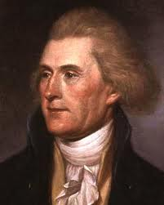
Thomas Jefferson
“One passage, in the paper you enclosed me, must be corrected. It is the following, ‘and all say it was yourself more than any other individual, that planned and established it,’ i.e., the Constitution. I was in Europe when the Constitution was planned, and never saw it till after it was established.”
Thomas Jefferson, The Writings of Thomas Jefferson, 20 vols., ed. Albert Ellery Bergh (Washington D.C: Thomas Jefferson Memorial Association, 1904), 10:325, to Dr. Joseph Priestly on June 19, 1802.

Slide 56

No Precedent
“Finally, in Engel v. Vitale, only last year, these principles were so universally recognized that the court, without the citation of a single case… reaffirmed them” (italics added).
School District of Abington Township v. Schempp, 374 U.S. 203, 220-21 (1963).

Slide 57
Lack of Pre-1947 Precedent
case | date | pre 1947 citations | post 1947 citations
Levitt v. Committee | 1973 | 0 | 18
Committee v. Nyquist | 1973 | 1 | 99
Stone v. Graham | 1980 | 0 | 9
Marsh v. Chambers | 1982 | 1 | 32
Barton, Myth of Separation, 163-66.

Slide 58

Dr. James Dobson
“I have to be honest. It’s a very scary time for our nation right now. We’re kind of at a watershed moment...We’re just trampling the Constitution. It’s bulling. It’s just a straight bully tactic…that’s not the country our forefathers foresaw.”
http://www.theblaze.com/stories/2013/05/17/trampling-the-constitution-famed-christian-claims-irs-bullied-ministry-threatened-to-deny-tax-application-over-criticism-of-obama/

Slide 59
Social Issues
Legal protection for the unborn? (Gen. 25:23)
Legal protection for the elderly? (Lev. 19:32)
Hetero-sexual monogamous marriage as the standard for society? (Gen. 2:18-25)
Advocacy capital punishment? (Gen. 9:6)
The right to restrict alcohol, pornography, & gambling? (Lev. 10:9; Matt. 5:27-28; Prov. 13:11)
Parental authority over children? (Eph. 6:4)
Public expressions of Christianity? (Mark 16:15)
Right to keep and bear arms? (Luke 22:36)

Slide 60
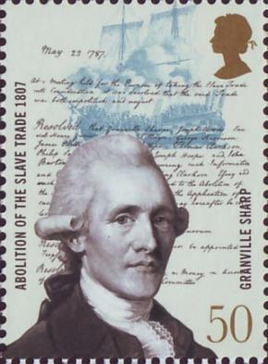
Granville Sharpe
"No Englishman can be truly loyal who opposed the principles of English law whereby the people are required to have arms of defence in peace, for mutual as well as private defence…The laws of England always required the people to be armed, and not only armed, but to be expert in arms."
Les Adams, The Second Amendment Primer: A Citizen’s Guidebook to the History, Sources, and Authorities for the Constitutional Guarantee of the Right to Keep and Bear Arms (NY: Skyhorse, 2013), 63.

Slide 61
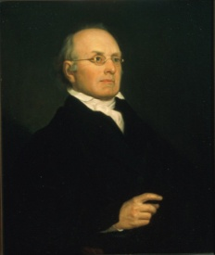
Joseph Story
"The next amendment is: ‘A well regulated militia being necessary to the security of a free state, the right of the people to keep and bear arms shall not be infringed.’ The importance of this article will scarcely be doubted by any persons, who have duly reflected upon the subject…The right of the citizens to keep and bear arms has justly been considered, as the palladium of the liberties of a republic; since it offers a strong moral check against the usurpation and arbitrary power of rulers; and will generally, even if these are successful in the first instance, enable the people to resist and triumph over them…There is certainly no small danger, that indifference may lead to disgust, and disgust to contempt; and thus gradually undermine all the protection intended by this clause of our national bill of rights."
Joseph Story, Commentaries on the Constitution of the United States (Boston, MA: Hilliard, Gray, 1833), 3:746-747, sections 1889-1890.

Slide 62


Slide 63
Social Issues
Legal protection for the unborn? (Gen. 25:23)
Legal protection for the elderly? (Lev. 19:32)
Hetero-sexual monogamous marriage as the standard for society? (Gen. 2:18-25)
Advocacy capital punishment? (Gen. 9:6)
The right to restrict alcohol, pornography, & gambling? (Lev. 10:9; Matt. 5:27-28; Prov. 13:11)
Parental authority over children? (Eph. 6:4)
Public expressions of Christianity? (Mark 16:15)
Right to keep and bear arms? (Luke 22:36)

Slide 64
The Bible and Voting
Economic issues
Social issues
Foreign affairs

Slide 65
Foreign Affairs
Favor national sovereignty above global governance? (Gen. 11:1-9)
Favor the reality and enforceability of our national borders? (Acts 17:26)
Support for the nation of Israel? (Gen. 12:3)
Pursuit of peace though strength? (Jer. 17:9)

Slide 66
Foreign Affairs
Favor national sovereignty above global governance? (Gen. 11:1-9)
Favor the reality and enforceability of our national borders? (Acts 17:26)
Support for the nation of Israel? (Gen. 12:3)
Pursuit of peace though strength? (Jer. 17:9)

Slide 67
Genesis 11:1-4
¹ Now the whole earth used the same language and the same words. ² It came about as they journeyed east, that they found a plain in the land of Shinar and settled there. ³ They said to one another, “Come, let us make bricks and burn them thoroughly.” And they used brick for stone, and they used tar for mortar. ⁴ They said, “Come, let us build for ourselves a city, and a tower whose top will reach into heaven, and let us make for ourselves a name, otherwise we will be scattered abroad over the face of the whole earth.”

Slide 68
Genesis 11:5-7
⁵ The Lord came down to see the city and the tower which the sons of men had built. ⁶ The Lord said, “Behold, they are one people, and they all have the same language. And this is what they began to do, and now nothing which they purpose to do will be impossible for them. ⁷ “Come, let Us go down and there confuse their language, so that they will not understand one another’s speech.”

Slide 69
Genesis 11:8-9
⁸ So the Lord scattered them abroad from there over the face of the whole earth; and they stopped building the city. ⁹ Therefore its name was called Babel, because there the Lord confused the language of the whole earth; and from there the Lord scattered them abroad over the face of the whole earth.

Slide 70
Genesis 11:6
The Lord said, “Behold, they are one people, and they all have the same language. And this is what they began to do, and now nothing which they purpose to do will be impossible for them.”

Slide 71
Genesis 8:21
The Lord smelled the soothing aroma; and the Lord said to Himself, “I will never again curse the ground on account of man, for the intent of man’s heart is evil from his youth; and I will never again destroy every living thing, as I have done.[emphasis mine].

Slide 72
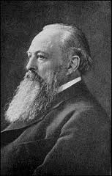
Lord Acton
“All power tends to corrupt and absolute power corrupts absolutely.”

Slide 73
God’s Doctrine of Nations
Since Babel | Deut. 32:8; Acts 17:26
Millennium | Isaiah 2:4; 66:18; Zech. 14:16-18 Rev.12:5; 20:3
Eternal State | Rev. 21:24, 26

Slide 74
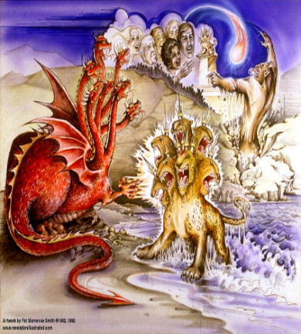
Satan’s Goal of Globalism
  Dan. 7:23
  Rev. 13:7-8; Rev. 5:9
  Rev. 17:15
Notes:
That’s good enough

Slide 75
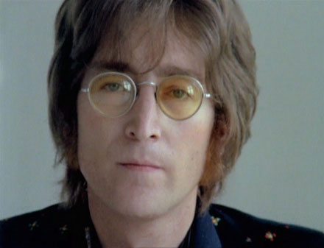
John Lennon
Song “Imagine”
…imagine a time when there will be “no countries,” “no religion,” “no heaven,” “no hell,” “no possessions,” everyone “living for today,” and the world “as one.”

Slide 76
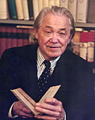
Henry Steele Commager cited in The New World Order, page 147
The inescapable fact, traumatized by the energy crisis, the population crisis, armaments race, and so forth, is that nationalism as we have noted in the 19th and much of the 20th century is as much of an anachronism today as with States Rights when Calhoun preached it and Jefferson Davis fought for it.

Slide 77
Henry Steele Commager cited in The New World Order, page 147
“Just as we know, or should know, that none of our domestic problems can be solved within the artificial boundaries of the states, so none of our global problems can be solved within the largely artificial boundaries of the nations.”

Slide 78

David Rockefeller cited in Memoirs, page 405.
“For more than a century ideological extremists…have seized upon well-publicized incidents…to attack the Rockefeller family for the inordinate influence they claim we wield over American political and economic institutions. Some even believe we are part of a secret cabal working against the best interests of the United States, characterizing my family and me as 'internationalists' and of conspiring with others around the world to build a more integrated global political and economic structure--one world, if you will. If that's the charge, I stand guilty, and I am proud of it.”

Slide 79
Humanist Manifesto II (1973)
We deplore the division of humankind on nationalistic grounds. We have reached a turning point in human history where the best option is to transcend the limits of national sovereignty and to move toward the building of a world community… a system of world law and world order based upon transnational federal government.

Slide 80

March 7, 2013—Question for Defense Secretary Leon Panetta from Sen. Jeff Sessions at a Senate Armed Services Committee.
Sessions asked Panetta if he could "initiate a no-fly zone in Syria "without Congressional approval. "Again, our goal would be to seek international permission and we would ...come to the Congress and inform you and determine how best to approach this, whether or not we would want to get permission from the Congress…," Panetta said. "I'm almost breathless about that," Sessions responded. "What I heard you say is, we're going to seek international approval and then we'll come and tell the Congress what we might do and we might seek Congressional approval."

Slide 81
March 7, 2013—Question for Defense Secretary Leon Panetta from Sen. Jeff Sessions at a Senate Armed Services Committee.
Panetta explained that if U.S. forces are working as part of an international coalition, then the administration would want "to get the appropriate permissions," which he said is something "all of these countries would want." Sessions pressed the issue and asked "what entity" the administration would seek permission from. Sessions said he was all in favor of international support, but added that he was "baffled by the idea that somehow, an international assembly" would provide a legal basis for the deployment of the U.S. military. Sessions responded that international bodies "provide no legal authority" to deploy U.S. military into combat operations.

Slide 82

Alphabet Soup?
GATT | WHO
NAFTA | ICC
WTO | LOST
NATO | ISA
UN | EEC
IMF | ECM
WSSD | NAU

Slide 83
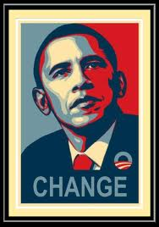
American Exceptionalism?
“I believe in American exceptionalism, just as I suspect that the Brits believe in British exceptionalism and the Greeks believe in Greek exceptionalism."
www.youtube.com/watch?v=c15wk3InDws

Slide 84
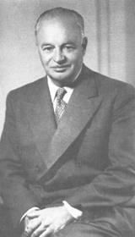
American Exceptionalism?
“To achieve world government, it is necessary to remove from the minds of men their individualism, loyalty to family tradition, national patriotism, and religious dogmas.”
SOURCE: George Brock Chisholm, First Director of the World Health Organization (WHO), Speech, Conference on Education, Asilomar, California, September 11, 1954

Slide 85
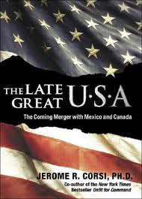
Regionalism
European Common Market
North American Union
Notes:
Outline

Slide 86
A New Pledge of Allegiance?
“I pledge allegiance to the flag and my constitutional rights with which it comes. And to the diversity, in which our nation stands, one nation, part of one planet, with liberty, freedom, choice and justice for all.”
Globalist Pledge of Allegiance in U.S. School, Boulder High School, October 2007, Kerby Anderson

Slide 87
Foreign Affairs
Favor national sovereignty above global governance? (Gen. 11:1-9)
Favor the reality and enforceability of our national borders? (Acts 17:26)
Support for the nation of Israel? (Gen. 12:3)
Pursuit of peace though strength? (Jer. 17:9)

Slide 88
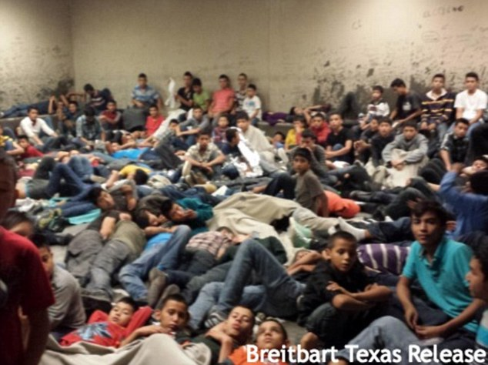

Slide 89
Foreign Affairs
Favor national sovereignty above global governance? (Gen. 11:1-9)
Favor the reality and enforceability of our national borders? (Acts 17:26)
Support for the nation of Israel? (Gen. 12:3)
Pursuit of peace though strength? (Jer. 17:9)

Slide 90
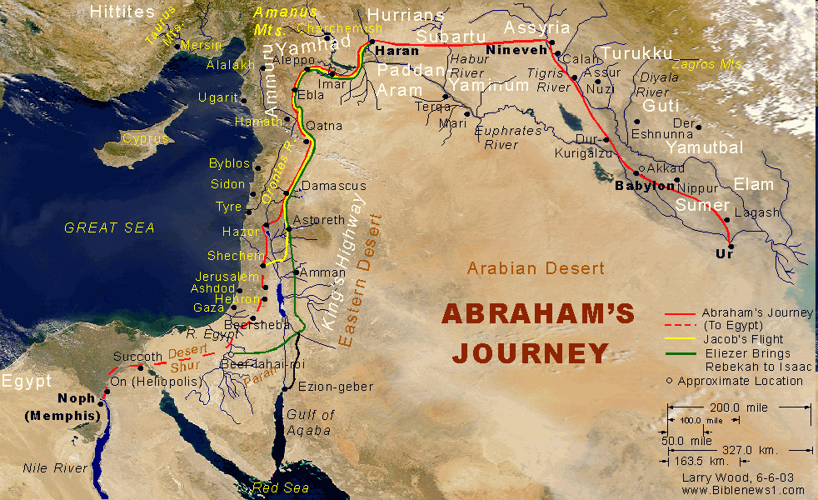

Slide 92
How Israel Has Blessed the World
(Gen 12:3; Rom 9:4-5)
Patriarchs
Law
Prophets
Messiah (John 4:22; Rom 9:5)
Apostles
Biblical writers
Early church
Early Christian martyrs
Paul
Future kingdom

Slide 93

Israel’s Three Blessings to the World
(Gen 12:3b)
Scripture (Rom 3:2)
Savior (John 4:22)
Kingdom (Isa 2:2-3)

Slide 94
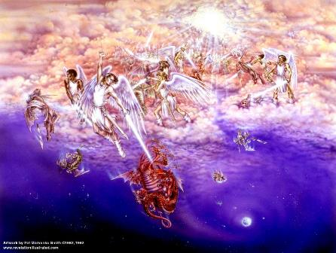
Biblical Reality of the Angelic World
Job 1:12
2 Kings 6:15-17
1 Chron 21:1
Dan 10:12-13, 20
Matt 16:21-23
Eph 6:12

Slide 95
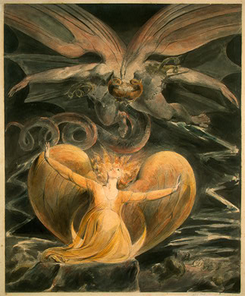
2 CYCLES OF SATANIC PERSECUTION
(Revelation 12:13-16)
“Pursues the woman” = persecution of Israel 12:13-14
“Flood from his mouth” = tries to destroy Israel 12:15-16

Slide 96
Descriptions of Satanic Hatred
(Revelation 12:12-17)
Wrath 12:12
Persecution 12:13
Sweep away 12:15
Enraged 12:17
War 12:17

Slide 97


Slide 98

Statue & Stone

Slide 99
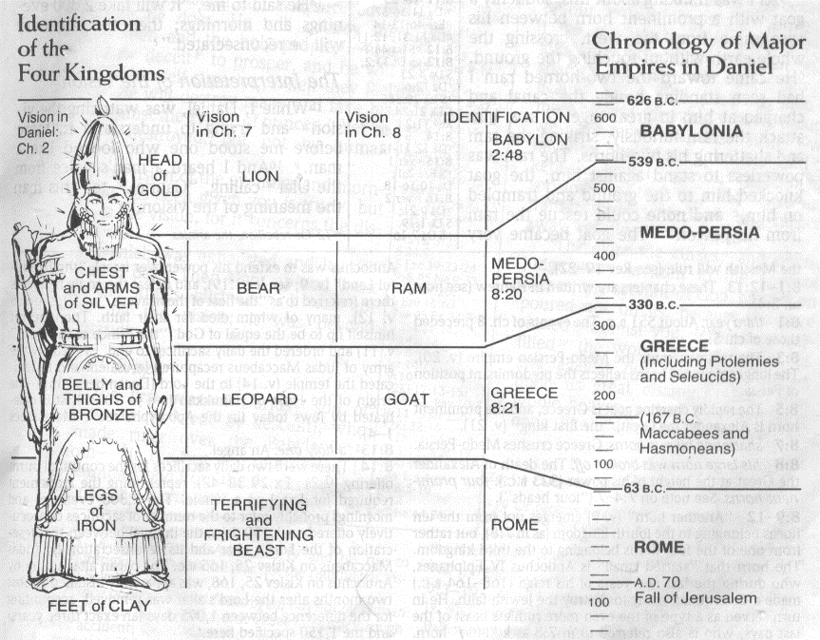

Slide 100
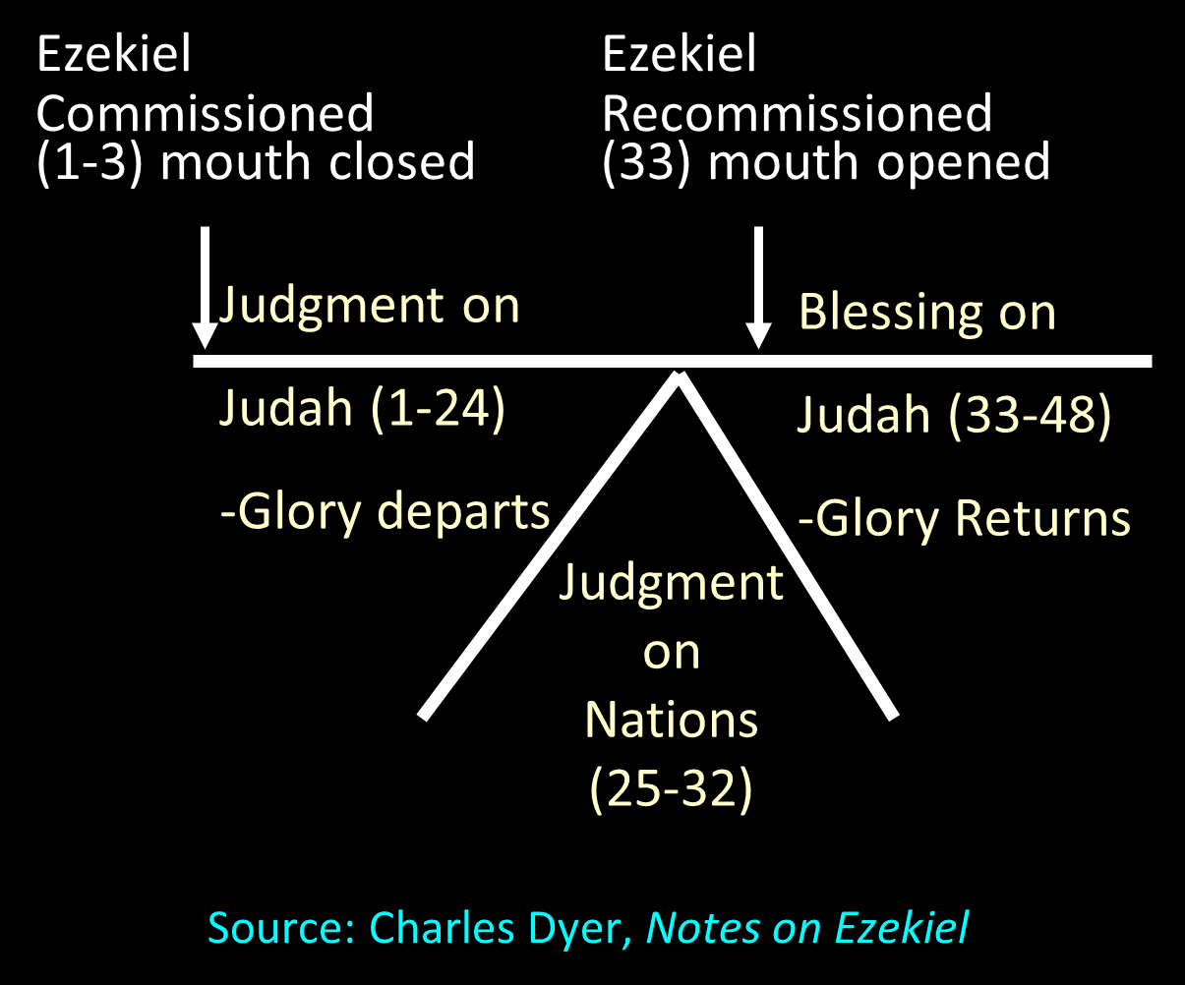

Slide 101
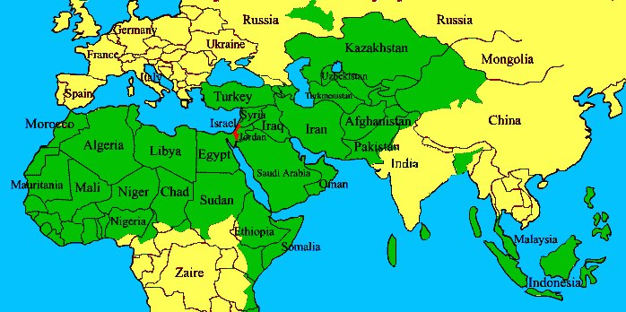

Slide 102
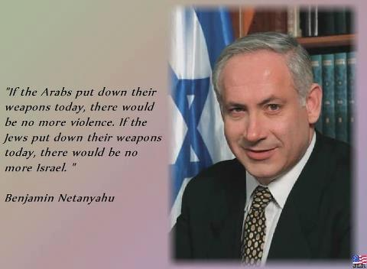

Slide 103
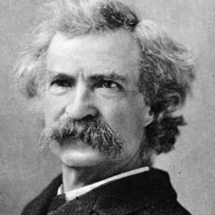
“... A desolate country whose soil is rich enough, but is given over wholly to weeds… a silent mournful expanse…. a desolation is here that not even imagination can grace with the pomp of life and action…. we never saw a human being on the whole route…. there was hardly a tree or shrub anywhere. Even the olive tree and the cactus, those fast friends of a worthless soil, had almost deserted the country.”
Mark Twain, The Innocents Abroad, Complete, 1st ed. (A Public Domain Book, 1869), 267, 285, 302. These quotes can be found in chapters 47, 49, 52.

Slide 104
Foreign Affairs
Favor national sovereignty above global governance? (Gen. 11:1-9)
Favor the reality and enforceability of our national borders? (Acts 17:26)
Support for the nation of Israel? (Gen. 12:3)
Pursuit of peace though strength? (Jer. 17:9)

Slide 105
Genesis 8:21
The Lord smelled the soothing aroma; and the Lord said to Himself, “I will never again curse the ground on account of man, for the intent of man’s heart is evil from his youth; and I will never again destroy every living thing, as I have done.[emphasis mine].

Slide 106
Quran Surah* 24:55
(*chapter)
“Allah has promised those who have believed among you and done righteous deeds that He will surely grant them succession [Caliphate] upon the earth just as He granted it to those before them and that He will surely establish for them [therein] their religion which He has preferred for them and that He will surely substitute for them, after their fear, security, [for] they worship Me, not associating anything with Me. But whoever disbelieves after that - then those are the defiantly disobedient.”

Slide 107
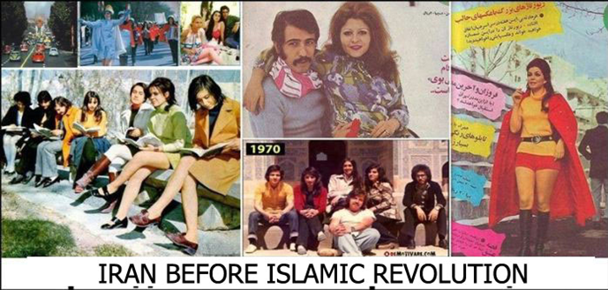
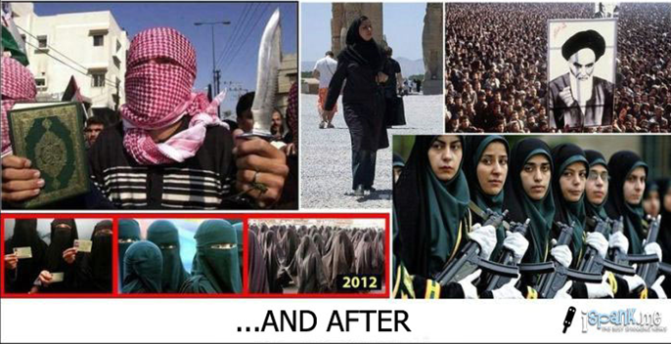

Slide 108
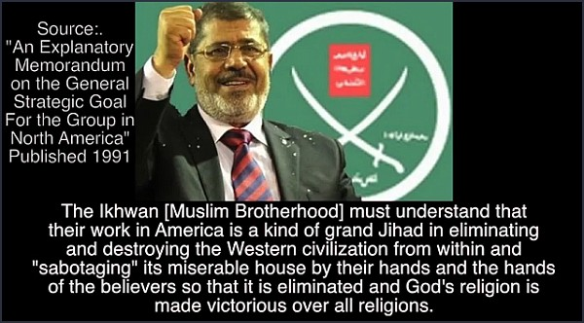

Slide 109
Foreign Affairs
Favor national sovereignty above global governance? (Gen. 11:1-9)
Favor the reality and enforceability of our national borders? (Acts 17:26)
Support for the nation of Israel? (Gen. 12:3)
Pursuit of peace though strength? (Jer. 17:9)

Slide 110
Conclusion

Slide 111
The Bible and Voting
Economic issues
Social issues
Foreign affairs

