Slide 1
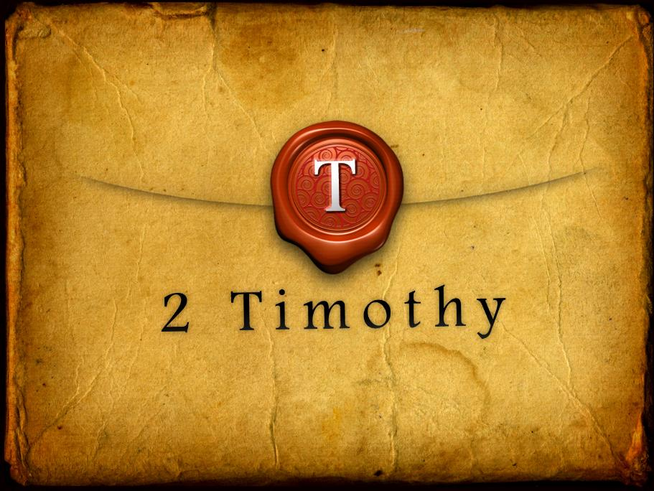

Slide 3
2 Timothy Introduction
The Call to Christian Perseverance

Slide 4
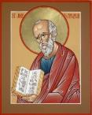
Answering Nine Questions
Who wrote it? – Paul
What do we know about the author? – An Apostle
To whom was it written? – Timothy
When was it written? - A.D. 67
Where was it written from? – Rome
Why was it written? – Timothy’s timidity
What is it about? – Perseverance
What is inside (outline)? – 4 part outline
What makes the book different? – Paul’s final word

Slide 5
Four Part Structure
General call to faithful endurance in the ministry (chapter 1)
Ten metaphors describing what faithful endurance looks like (chapter 2)
What to do in the midst of the coming apostasy (3:1–4:8)
How God met six needs in Paul’s life (4:9-22)

Slide 6
Four Part Structure
General call to faithful endurance in the ministry (chapter 1)
Ten metaphors describing what faithful endurance looks like (chapter 2)
What to do in the midst of the coming apostasy (3:1–4:8)
How God met six needs in Paul’s life (4:9-22)

Slide 7
Four Part Structure
General call to faithful endurance in the ministry (chapter 1)
Ten metaphors describing what faithful endurance looks like (chapter 2)
What to do in the midst of the coming apostasy (3:1–4:8)
How God met six needs in Paul’s life (4:9-22)

Slide 8
2 Timothy 2
Ten Metaphors Illustrating Endurance

Slide 9
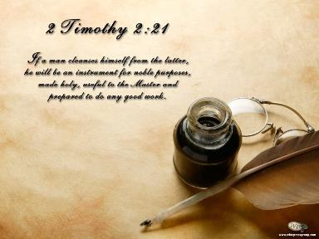
Ten Metaphors
Teacher (2:2)
Soldier (2:3-4)
Athlete (2:5)
Farmer (2:6)
Christ (2:7-8)
Paul (2:9-10)
Trustworthy statement (2:11-13)
Workman (2:14-18)
Vessel (2:19-23)
Servant (2:24-26)

Slide 10
Four Part Structure
General call to faithful endurance in the ministry (chapter 1)
Ten metaphors describing what faithful endurance looks like (chapter 2)
What to do in the midst of the coming apostasy (3:1–4:8)
How God met six needs in Paul’s life (4:9-22)

Slide 11
Definition of Apostasy
apos = away from
histēmi = to stand
Apostasy = to stand away from
Apostasy = a departure from known (or previously embraced) truth

Slide 12
Apostasy (3:1‒4:8)
The Apostasy (3:1-9)
The evil (3:1-7)
The examples (3:8-9)
The Antidote (3:10‒4:8)
Paul’s example (3:10-13)
Preach the Word (3:14‒4:8)

Slide 13
Apostasy (3:1‒4:8)
The Apostasy (3:1-9)
The evil (3:1-7)
The examples (3:8-9)
The Antidote (3:10‒4:8)
Paul’s example (3:10-13)
Preach the Word (3:14‒4:8)

Slide 14
Apostasy (3:1‒4:8)
The Apostasy (3:1-9)
The evil (3:1-7)
The examples (3:8-9)
The Antidote (3:10‒4:8)
Paul’s example (3:10-13)
Preach the Word (3:14‒4:8)

Slide 15
Apostasy (3:1‒4:8)
The Apostasy (3:1-9)
The evil (3:1-7)
The examples (3:8-9)
The Antidote (3:10‒4:8)
Paul’s example (3:10-13)
Preach the Word (3:14‒4:8)

Slide 16
Apostasy (3:1‒4:8)
The Apostasy (3:1-9)
The evil (3:1-7)
The examples (3:8-9)
The Antidote (3:10‒4:8)
Paul’s example (3:10-13)
Preach the Word (3:14‒4:8)

Slide 17
Apostasy (3:1‒4:8)
The Apostasy (3:1-9)
The evil (3:1-7)
The examples (3:8-9)
The Antidote (3:10‒4:8)
Paul’s example (3:10-13)
Preach the Word (3:14‒4:8)

Slide 18
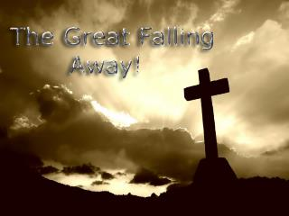
B. Paul’ Example (3:10-13)
Paul’s ministry (10a)
Paul’s character (10b
Paul’s difficulties (11-13)

Slide 19
Apostasy (3:1‒4:8)
The Apostasy (3:1-9)
The evil (3:1-7)
The examples (3:8-9)
The Antidote (3:10‒4:8)
Paul’s example (3:10-13)
Preach the Word (3:14‒4:8)

Slide 20
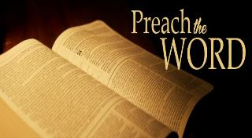
Preach the Word for Nine Reasons
Impact on Paul (2 Tim 3:14)
Impact on salvation (2 Tim 3:15)
Divine origin (2 Tim 3:16a)
Impact on sanctification (2 Tim 3:16b)
Impact on equipping (2 Tim 3:17)
Paul’s charge to Timothy (2 Tim 4:1a, 2)
Timothy’s evaluation at the Bema Seat (2 Tim 4:1b)
Preference of men to avoid the word (2 Tim 4:3-4)
Need to complete Timothy’s ministry (2 Tim 4:5-8)

Slide 21
Preach the Word for Nine Reasons
Impact on Paul (2 Tim 3:14)
Impact on salvation (2 Tim 3:15)
Divine origin (2 Tim 3:16a)
Impact on sanctification (2 Tim 3:16b)
Impact on equipping (2 Tim 3:17)
Paul’s charge to Timothy (2 Tim 4:1a, 2)
Timothy’s evaluation at the Bema Seat (2 Tim 4:1b)
Preference of men to avoid the word (2 Tim 4:3-4)
Need to complete Timothy’s ministry (2 Tim 4:5-8)

Slide 22
Preach the Word for Nine Reasons
Impact on Paul (2 Tim 3:14)
Impact on salvation (2 Tim 3:15)
Divine origin (2 Tim 3:16a)
Impact on sanctification (2 Tim 3:16b)
Impact on equipping (2 Tim 3:17)
Paul’s charge to Timothy (2 Tim 4:1a, 2)
Timothy’s evaluation at the Bema Seat (2 Tim 4:1b)
Preference of men to avoid the word (2 Tim 4:3-4)
Need to complete Timothy’s ministry (2 Tim 4:5-8)

Slide 23
Preach the Word for Nine Reasons
Impact on Paul (2 Tim 3:14)
Impact on salvation (2 Tim 3:15)
Divine origin (2 Tim 3:16a)
Impact on sanctification (2 Tim 3:16b)
Impact on equipping (2 Tim 3:17)
Paul’s charge to Timothy (2 Tim 4:1a, 2)
Timothy’s evaluation at the Bema Seat (2 Tim 4:1b)
Preference of men to avoid the word (2 Tim 4:3-4)
Need to complete Timothy’s ministry (2 Tim 4:5-8)

Slide 24
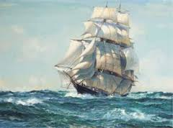
INSPIRATION OF SCRIPTURE 2 Peter 2:20-21
Men Wrote as they were inspired by Holy Spirit “phero” = to carry Acts 27:15,17
Opposite of Knowledge of False Teachers
Which is their own imagination
Jer. 23:16

Slide 25
Preach the Word for Nine Reasons
Impact on Paul (2 Tim 3:14)
Impact on salvation (2 Tim 3:15)
Divine origin (2 Tim 3:16a)
Impact on sanctification (2 Tim 3:16b)
Impact on equipping (2 Tim 3:17)
Paul’s charge to Timothy (2 Tim 4:1a, 2)
Timothy’s evaluation at the Bema Seat (2 Tim 4:1b)
Preference of men to avoid the word (2 Tim 4:3-4)
Need to complete Timothy’s ministry (2 Tim 4:5-8)

Slide 26
Three Tenses of Salvation
Phase | Justification | Sanctification | Glorification
Tense | Past | Present | Future
Saved from sin’s: | Penalty | Power | Presence
Scripture | Eph 2:8-9; Titus 3:5 | Philip 2:12 | Rom 5:10

Slide 27
Preach the Word for Nine Reasons
Impact on Paul (2 Tim 3:14)
Impact on salvation (2 Tim 3:15)
Divine origin (2 Tim 3:16a)
Impact on sanctification (2 Tim 3:16b)
Impact on equipping (2 Tim 3:17)
Paul’s charge to Timothy (2 Tim 4:1a, 2)
Timothy’s evaluation at the Bema Seat (2 Tim 4:1b)
Preference of men to avoid the word (2 Tim 4:3-4)
Need to complete Timothy’s ministry (2 Tim 4:5-8)

Slide 28
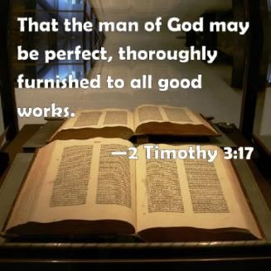
2 Timothy 3:17
“so that the man of God may be adequate, equipped for every good work.”

Slide 29
Preach the Word for Nine Reasons
Impact on Paul (2 Tim 3:14)
Impact on salvation (2 Tim 3:15)
Divine origin (2 Tim 3:16a)
Impact on sanctification (2 Tim 3:16b)
Impact on equipping (2 Tim 3:17)
Paul’s charge to Timothy (2 Tim 4:1a, 2)
Timothy’s evaluation at the Bema Seat (2 Tim 4:1b)
Preference of men to avoid the word (2 Tim 4:3-4)
Need to complete Timothy’s ministry (2 Tim 4:5-8)

Slide 30
Preach the Word for Nine Reasons
Impact on Paul (2 Tim 3:14)
Impact on salvation (2 Tim 3:15)
Divine origin (2 Tim 3:16a)
Impact on sanctification (2 Tim 3:16b)
Impact on equipping (2 Tim 3:17)
Paul’s charge to Timothy (2 Tim 4:1a, 2)
Timothy’s evaluation at the Bema Seat (2 Tim 4:1b)
Preference of men to avoid the word (2 Tim 4:3-4)
Need to complete Timothy’s ministry (2 Tim 4:5-8)

Slide 31
Preach the Word for Nine Reasons
Impact on Paul (2 Tim 3:14)
Impact on salvation (2 Tim 3:15)
Divine origin (2 Tim 3:16a)
Impact on sanctification (2 Tim 3:16b)
Impact on equipping (2 Tim 3:17)
Paul’s charge to Timothy (2 Tim 4:1a, 2)
Timothy’s evaluation at the Bema Seat (2 Tim 4:1b)
Preference of men to avoid the word (2 Tim 4:3-4)
Need to complete Timothy’s ministry (2 Tim 4:5-8)

Slide 32
2 Timothy 4:3-4
“For the time will come when they will not endure sound doctrine; but wanting to have their ears tickled, they will accumulate for themselves teachers in accordance to their own desires, ⁴ and will turn away their ears from the truth and will turn aside to myths.”

Slide 33
Preach the Word for Nine Reasons
Impact on Paul (2 Tim 3:14)
Impact on salvation (2 Tim 3:15)
Divine origin (2 Tim 3:16a)
Impact on sanctification (2 Tim 3:16b)
Impact on equipping (2 Tim 3:17)
Paul’s charge to Timothy (2 Tim 4:1a, 2)
Timothy’s evaluation at the Bema Seat (2 Tim 4:1b)
Preference of men to avoid the word (2 Tim 4:3-4)
Need to complete Timothy’s ministry (2 Tim 4:5-8)

Slide 34
Necessity for Timothy to Complete His Ministry (2 Tim 4:5-8)
Charge (4:5)
Reason (4:6)
Reward (4:7-8)
Satisfaction of a life well spent (4:7)
Bema Seat (4:8)

Slide 35
Necessity for Timothy to Complete His Ministry (2 Tim 4:5-8)
Charge (4:5)
Reason (4:6)
Reward (4:7-8)
Satisfaction of a life well spent (4:7)
Bema Seat (4:8)

Slide 36
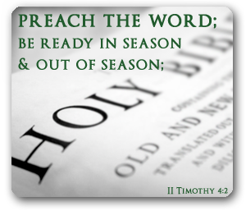
Four Imperatives (4:5)
“Be”
“Endure”
“Do”
“Fulfill”

Slide 37
Four Imperatives (4:5)
“Be”
“Endure”
“Do”
“Fulfill”

Slide 38
Four Imperatives (4:5)
“Be”
“Endure”
“Do”
“Fulfill”

Slide 39
Four Imperatives (4:5)
“Be”
“Endure”
“Do”
“Fulfill”

Slide 40
Four Imperatives (4:5)
“Be”
“Endure”
“Do”
“Fulfill”

Slide 41
Necessity for Timothy to Complete His Ministry (2 Tim 4:5-8)
Charge (4:5)
Reason (4:6)
Reward (4:7-8)
Satisfaction of a life well spent (4:7)
Bema Seat (4:8)

Slide 42
Paul’s Two Roman Imprisonments Contrasted
1ST IMPRISONMENT (ACTS 28:16-31) | 2ND IMPRISONMENT (2 TIM)
Wrote prison epistles Religious charges Local and sporadic persecutions (AD 60-63) Decent conditions (house) Many friends Evangelistic opportunities Optimistic for release (Phil 1:24-26) | Wrote 2 Timothy Political charges Neronian persecution (AD 64-68) Poor conditions (dungeon) Virtually alone Opportunities restricted Execution anticipated (2 Tim 4:6)
Adapted from Nelson's Complete Book of Charts and Maps, 433.

Slide 43
Two images (4:6)
Drink offering
Departure

Slide 44
Two images (4:6)
Drink offering
Departure

Slide 45
Two images (4:6)
Drink offering
Departure

Slide 47
Necessity for Timothy to Complete His Ministry (2 Tim 4:5-8)
Charge (4:5)
Reason (4:6)
Reward (4:7-8)
Satisfaction of a life well spent (4:7)
Bema Seat (4:8)

Slide 48
Necessity for Timothy to Complete His Ministry (2 Tim 4:5-8)
Charge (4:5)
Reason (4:6)
Reward (4:7-8)
Satisfaction of a life well spent (4:7)
Bema Seat (4:8)

Slide 50
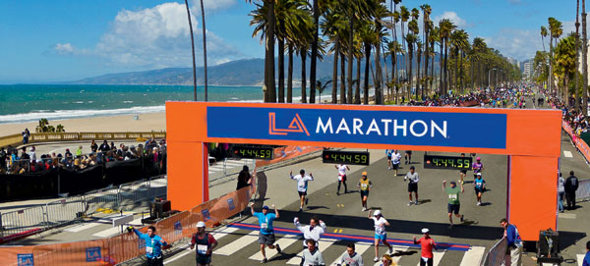

Slide 51
Mark Twain, Autobiography, 2:37
“A myriad of men are born; they labor and sweat and struggle for bread; they squabble and scold and fight; they scramble for little mean advantages over each other. Age creeps upon them and infirmities follow; shames and humiliations bring down their prides and their vanities. Those they love are taken from them, and the joy of life is turned to aching grief. The burden of pain, care, and misery grows heavier year by year. At length ambition is dead, pride is dead, vanity is dead; longing for release is in their place. It comes at last-the only un-poisoned gift earth ever had for them-and they vanish from a world where they were of no consequence; where they achieved nothing, where they were a mistake and a failure and a foolishness; where they left no sign that they have existed-a world that will lament them a day and forget them forever.”

Slide 52
Three Metaphors (4:7)
Boxer/wrestler
Runner
Steward

Slide 53
Three Metaphors (4:7)
Boxer/wrestler
Runner
Steward

Slide 54
Three Metaphors (4:7)
Boxer/wrestler
Runner
Steward

Slide 55
Three Metaphors (4:7)
Boxer/wrestler
Runner
Steward

Slide 56
Necessity for Timothy to Complete His Ministry (2 Tim 4:5-8)
Charge (4:5)
Reason (4:6)
Reward (4:7-8)
Satisfaction of a life well spent (4:7)
Bema Seat (4:8)

Slide 57
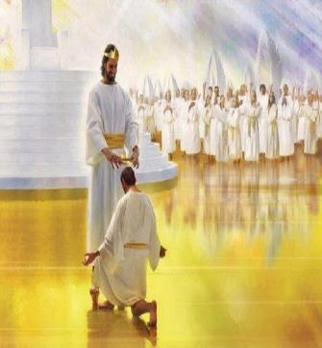
Judgment of Rewards (4:8)
“In the future”
“There is laid up for me the crown of righteousness”
“Which the righteous judge”
“Will award to me”
“On that day”
“Not to me only but to all”
“Who have loved His appearing”

Slide 58
Judgment of Rewards (4:8)
“In the future”
“There is laid up for me the crown of righteousness”
“Which the righteous judge”
“Will award to me”
“On that day”
“Not to me only but to all”
“Who have loved His appearing”

Slide 60
Judgment of Rewards (4:8)
“In the future”
“There is laid up for me the crown of righteousness”
“Which the righteous judge”
“Will award to me”
“On that day”
“Not to me only but to all”
“Who have loved His appearing”

Slide 61
Scripture’s Five Crowns (Rev 4:10: 3:11; 2 John 8)
Scripture | Crown | Purpose
1 Cor 9:24-27 | Incorruptible | Gaining mastery over the flesh
1 Thess 2:19-20 | Rejoicing | Soul winning
Jas 1:12; Rev 2:10 | Life | Enduring trials
1 Pet 5:2-4 | Glory | Shepherding God’s people
2 Tim 4:8 | Righteousness | Longing for His appearing

Slide 62
Judgment of Rewards (4:8)
“In the future”
“There is laid up for me the crown of righteousness”
“Which the righteous judge”
“Will award to me”
“On that day”
“Not to me only but to all”
“Who have loved His appearing”

Slide 63
Judgment of Rewards (4:8)
“In the future”
“There is laid up for me the crown of righteousness”
“Which the righteous judge”
“Will award to me”
“On that day”
“Not to me only but to all”
“Who have loved His appearing”

Slide 64
Judgment of Rewards (4:8)
“In the future”
“There is laid up for me the crown of righteousness”
“Which the righteous judge”
“Will award to me”
“On that day”
“Not to me only but to all”
“Who have loved His appearing”

Slide 65
Judgment of Rewards (4:8)
“In the future”
“There is laid up for me the crown of righteousness”
“Which the righteous judge”
“Will award to me”
“On that day”
“Not to me only but to all”
“Who have loved His appearing”

Slide 66
Judgment of Rewards (4:8)
“In the future”
“There is laid up for me the crown of righteousness”
“Which the righteous judge”
“Will award to me”
“On that day”
“Not to me only but to all”
“Who have loved His appearing”

Slide 67
Ante-Nicene Fathers: “Heavenly and Eschatological" Interpretation of John 14:1-4
“Interestingly, references to John 14:1-3 virtually disappear when perusing the writings of the Nicene and Post-Nicene fathers. This is a bit surprising, given the abundance of material in these later writers when compared with the Ante-Nicenes. I would assume that with the rise of Augustinian amillennialism and its optimistic interpretation regarding the present arrival of the Kingdom of God, the kind of hope held out in John 14:1-3 ceased to hold relevance.”
George Gunn, “John 14:1-3: The Father's House: Are We There Yet?,” 30, n. 24.

Slide 68
Conclusion

Slide 69
Necessity for Timothy to Complete His Ministry (2 Tim 4:5-8)
Charge (4:5)
Reason (4:6)
Reward (4:7-8)
Satisfaction of a life well spent (4:7)
Bema Seat (4:8)

Slide 70
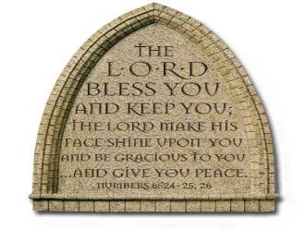
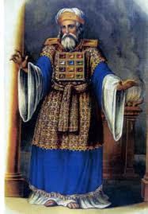
“The Lord bless you and keep you; the Lord make his face shine on you and be gracious to you; the Lord turn his face toward you and give you peace.” (NIV)

