Slide 1
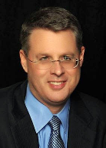
Soteriology Session 20
Dr. Andy Woods
Senior Pastor – Sugar Land Bible Church
Professor of Bible & Theology – College of Biblical Studies

Slide 2
Soteriology Overview
Definition
Election
Atonement
Salvation words
God’s one condition of salvation
Results of salvation
Eternal security
Faulty views of salvation

Slide 3
Soteriology Overview
This Session
VII. Eternal Security

Slide 4
Introduction
Probation?
Wait until the end of his life?
Eph. 4:14
The Bible answers this question
The Bible cannot contradict itself
Definition
Not all who profess faith in Christ actually have it (John 3:18; 5:39-40)
It matters: 1. productivity, 2. motive, 3. joy
Preview

Slide 5
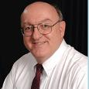
Definition of Eternal Security
“Eternal Security means that those who have been genuinely saved by God’s grace through faith alone in Christ alone shall never be in danger of God’s condemnation or loss of salvation but God’s grace and power keep them forever saved and secure.”
Dennis Rokser, Shall Never Perish Forever, p. 11

Slide 6
Eternal Security Outline
Eternal security arguments
Response to problem passages

Slide 7
Eternal Security Outline
Eternal security arguments
Response to problem passages

Slide 8
Evidence for Eternal Security
Because self-righteousness did not save us it is not a basis upon which salvation can be lost
Salvation is not given or maintained by works
If a believer can lose eternal life, then how can this life be eternal (John 3:16)?
The Bible’s promises guarantee security (John 10:28)
The assurance of salvation is impossible (1 John 5:14)
The believer is predestined for glory (Rom 8:29-30)
The Spirit’s seal cannot be broken (Eph 4:30)

Slide 9
Evidence for Eternal Security
God keeps us from falling (1 Pet 1:4-5)
Christ’s role as intercessor and advocate (John 17:11-12, 20)
Christ’s death perfectly dealt with all sins (Titus 2:14)
A believer cannot be removed from Christ’s body (1 Cor. 12:13)
The Bible does not specify which sins remove salvation
Believers with unfruitful lives still have salvation although lose rewards at the Bema Seat (1 Cor 3:15)

Slide 10
Evidence for Eternal Security
Because self-righteousness did not save us it is not a basis upon which salvation can be lost
Salvation is not given or maintained by works
If a believer can lose eternal life, then how can this life be eternal (John 3:16)?
The Bible’s promises guarantee security (John 10:28)
The assurance of salvation is impossible (1 John 5:14)
The believer is predestined for glory (Rom 8:29-30)
The Spirit’s seal cannot be broken (Eph 4:30)

Slide 11
Evidence for Eternal Security
Because self-righteousness did not save us it is not a basis upon which salvation can be lost
Salvation is not given or maintained by works
If a believer can lose eternal life, then how can this life be eternal (John 3:16)?
The Bible’s promises guarantee security (John 10:28)
The assurance of salvation is impossible (1 John 5:14)
The believer is predestined for glory (Rom 8:29-30)
The Spirit’s seal cannot be broken (Eph 4:30)

Slide 12
Evidence for Eternal Security
Because self-righteousness did not save us it is not a basis upon which salvation can be lost
Salvation is not given or maintained by works
If a believer can lose eternal life, then how can this life be eternal (John 3:16)?
The Bible’s promises guarantee security (John 10:28)
The assurance of salvation is impossible (1 John 5:14)
The believer is predestined for glory (Rom 8:29-30)
The Spirit’s seal cannot be broken (Eph 4:30)

Slide 13
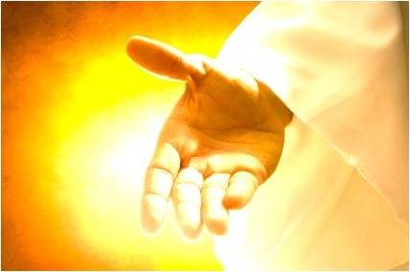
If a believer can lose eternal life, then how can this life be eternal (John 3:16)?
John 3:16
John 5:24
1 John 5:13
“Eternal” (aiōnios) is the same word used to describe God

Slide 14
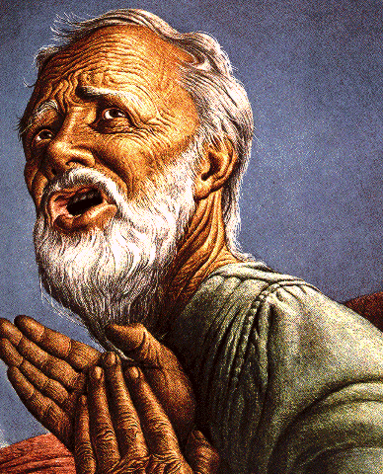
Eternal Life = Eternal Life
John 3:16
For God so loved the world, that He gave His only begotten Son, that whoever believes in Him shall not perish, but have eternal life.

Slide 15
John 5:24
“Truly, truly, I say to you, he who hears My word, and believes Him who sent Me, has eternal life, and does not come into judgment, but has passed out of death into life.” (NASB)

Slide 16
1 John 5:13
“These things I have written to you who believe in the name of the Son of God, so that you may know that you have eternal life.” (NASB)

Slide 17
Romans 16:26
“but now is manifested, and by the Scriptures of the prophets, according to the commandment of the eternal God, has been made known to all the nations, leading to obedience of faith.” (NASB)

Slide 18
Evidence for Eternal Security
Because self-righteousness did not save us it is not a basis upon which salvation can be lost
Salvation is not given or maintained by works
If a believer can lose eternal life, then how can this life be eternal (John 3:16)?
The Bible’s promises guarantee security (John 10:28)
The assurance of salvation is impossible (1 John 5:14)
The believer is predestined for glory (Rom 8:29-30)
The Spirit’s seal cannot be broken (Eph 4:30)

Slide 19
The Bible’s Promises Guarantee Security (John 10:28)
God’s reliability – Num. 23:19; Rom. 3:4a; 2 Cor. 1:20; Titus 1:2; Heb. 6:18; 10:23
John 4:14
John 5:24
John 6:37-40
John 10:27-30
Romans 8:28-38
Heb. 13:5

Slide 20
The Bible’s Promises Guarantee Security (John 10:28)
God’s reliability – Num. 23:19; Rom. 3:4a; 2 Cor. 1:20; Titus 1:2; Heb. 6:18; 10:23
John 4:14
John 5:24
John 6:37-40
John 10:27-30
Romans 8:28-38
Heb. 13:5

Slide 21
The Bible’s Promises Guarantee Security (John 10:28)
God’s reliability – Num. 23:19; Rom. 3:4a; 2 Cor. 1:20; Titus 1:2; Heb. 6:18; 10:23
John 4:14
John 5:24
John 6:37-40
John 10:27-30
Romans 8:28-38
Heb. 13:5

Slide 22
John 4:14
“but whoever drinks of the water that I will give him shall never thirst [ou mē; aiōnia]; but the water that I will give him will become in him a well of water springing up to eternal life.” (NASB)

Slide 23
The Bible’s Promises Guarantee Security (John 10:28)
God’s reliability – Num. 23:19; Rom. 3:4a; 2 Cor. 1:20; Titus 1:2; Heb. 6:18; 10:23
John 4:14
John 5:24
John 6:37-40
John 10:27-30
Romans 8:28-38
Heb. 13:5

Slide 24
John 5:24
“Truly, truly, I say to you, he who hears My word, and believes Him who sent Me, has eternal life, and does not come into judgment, but has passed out of death into life.” (NASB)

Slide 25
The Bible’s Promises Guarantee Security (John 10:28)
God’s reliability – Num. 23:19; Rom. 3:4a; 2 Cor. 1:20; Titus 1:2; Heb. 6:18; 10:23
John 4:14
John 5:24
John 6:37-40
John 10:27-30
Romans 8:28-38
Heb. 13:5

Slide 26
John 6:35, 37-40
“Jesus said to them, “I am the bread of life; he who comes to Me will not [ou mē] hunger, and he who believes in Me will never [ou mē] thirst…All that the Father gives Me will come to Me, and the one who comes to Me I will certainly not [ou mē] cast out. ³⁸ For I have come down from heaven, not to do My own will, but the will of Him who sent Me. ³⁹ This is the will of Him who sent Me, that of all that He has given Me I lose nothing, but raise it up on the last day. ⁴⁰ For this is the will of My Father, that everyone who beholds the Son and believes in Him will have eternal life, and I Myself will raise him up on the last day.” (NASB)

Slide 27
The Bible’s Promises Guarantee Security (John 10:28)
God’s reliability – Num. 23:19; Rom. 3:4a; 2 Cor. 1:20; Titus 1:2; Heb. 6:18; 10:23
John 4:14
John 5:24
John 6:37-40
John 10:27-30
Romans 8:28-38
Heb. 13:5

Slide 28
John 10:27-29
“My sheep hear My voice, and I know them, and they follow Me; ²⁸ and I give eternal life to them, and they will never perish [ou mē; aiōnia]; and no one will snatch them out of My hand. ²⁹ My Father, who has given them to Me, is greater than all; and no one is able to snatch them out of the Father’s hand.” (NASB)

Slide 29
The Bible’s Promises Guarantee Security (John 10:28)
God’s reliability – Num. 23:19; Rom. 3:4a; 2 Cor. 1:20; Titus 1:2; Heb. 6:18; 10:23
John 4:14
John 5:24
John 6:37-40
John 10:27-30
Romans 8:28-38
Heb. 13:5

Slide 30
Romans 8:29–30
²⁹For those whom He foreknew, He also predestined to become conformed to the image of His Son, so that He would be the firstborn among many brethren; ³⁰ and these whom He predestined, He also called; and these whom He called, He also justified; and these whom He justified, He also glorified. (NASB95)

Slide 31
Romans 8:31–33
³¹ “What then shall we say to these things? If God is for us, who is against us? ³² He who did not spare His own Son, but delivered Him over for us all, how will He not also with Him freely give us all things? ³³ Who will bring a charge against God’s elect? God is the one who justifies.” (NASB95)

Slide 32
Romans 8:34–37
³⁴who is the one who condemns? Christ Jesus is He who died, yes, rather who was raised, who is at the right hand of God, who also intercedes for us. ³⁵ Who will separate us from the love of Christ? Will tribulation, or distress, or persecution, or famine, or nakedness, or peril, or sword? ³⁶ Just as it is written, “For Your sake we are being put to death all day long; We were considered as sheep to be slaughtered.”³⁷ But in all these things we overwhelmingly conquer through Him who loved us. (NASB95)

Slide 33
Romans 8:38–39
³⁸ For I am convinced that neither death, nor life, nor angels, nor principalities, nor things present, nor things to come, nor powers, ³⁹ nor height, nor depth, nor any other created thing, will be able to separate us from the love of God, which is in Christ Jesus our Lord. (NASB95)

Slide 34
The Bible’s Promises Guarantee Security (John 10:28)
God’s reliability – Num. 23:19; Rom. 3:4a; 2 Cor. 1:20; Titus 1:2; Heb. 6:18; 10:23
John 4:14
John 5:24
John 6:37-40
John 10:27-30
Romans 8:28-38
Heb. 13:5

Slide 35
Hebrews 13:5
Make sure that your character is free from the love of money, being content with what you have; for He Himself has said,
“I will never desert you, nor will I ever forsake you.”(NASB95)

Slide 36
Hebrews 13:5
οὐ μή σε ἀνῶ οὐδ̓ οὐ μή σε ἐγκαταλίπω
I will never desert you, nor will I ever forsake you
 | ou mē | se | anō
 | not not | you | shall I desert
oud’ | ou mē | sē | egkatalipō
not | not not | you | shall I forsake

Slide 37
Evidence for Eternal Security
Because self-righteousness did not save us it is not a basis upon which salvation can be lost
Salvation is not given or maintained by works
If a believer can lose eternal life, then how can this life be eternal (John 3:16)?
The Bible’s promises guarantee security (John 10:28)
The assurance of salvation is impossible (1 John 5:14)
The believer is predestined for glory (Rom 8:29-30)
The Spirit’s seal cannot be broken (Eph 4:30)

Slide 38
The assurance of salvation is impossible (1 John 5:14)
Biblical examples of assurance
OT – Job 19:25-26; Ps. 23:6
Gospels – John 5:24; 6:47
Acts – Acts 16:30-31
Paul – Rom. 5:2; 8:23-24; Col. 1:27; Titus 2:13; 2 Cor. 5:8; Philip. 1:21-23; 3:20-21; 4:3; Col. 3:4; 2 Tim. 1:12
General letters – 1 Pet. 1:3-5; Heb. 2:14-15; 1 John 3:1-2; 5:13

Slide 39
1 John 5:13
“These things I have written to you who believe in the name of the Son of God, so that you may know that you have eternal life.” (NASB)

Slide 40
DTS Doctrinal Statement Article XI—Assurance
“We believe it is the privilege, not only of some, but of all by the Spirit through faith who are born again in Christ as revealed in the Scriptures, to be assured of their salvation from the very day they take Him to be their Savior and that this assurance is not founded upon any fancied discovery of their own worthiness or fitness, but wholly upon the testimony of God in His written Word, exciting within His children filial love...”

Slide 41
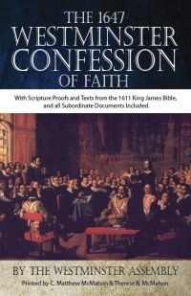
Westminster Confession Chapter XVII, Article III – Of the Assurance of Grace and Salvation
“This infallible assurance doth not so belong to the essence of faith, but that a true believer will wait long, and conflict with many difficulties before he be a partaker of it.”

Slide 42
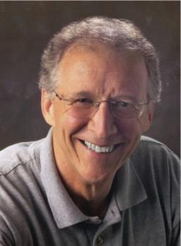
John Piper
“No Christian can be sure that he is a true believer. Hence, there is an ongoing need to be dedicated to the Lord and to deny ourselves so that we might make it.”
John Piper and Pastoral Staff, TULIP: What We Believe about the Five Points of Calvinism: Position Paper of the Pastoral Staff (Desiring God Ministries, 1997), 25, cited in Dave Hunt, What Love is This?, 379.

Slide 43
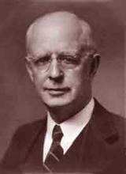
Lewis Sperry Chafer, Salvation: A Clear Doctrinal Analysis (Grand Rapids: Zondervan, 1977), 60. Italics added
Lewis Sperry Chafer
“There is a normal Christian experience. There are new and blessed emotions and desires. Old things do pass away; and behold all things do become new; but all such experiences are but secondary evidences, as to the fact of salvation, in that they grow out of that positive repose of faith which is the primary evidence.”

Slide 44
4 Kinds of People from 1 Corinthians 3:1-3
Spiritual Believers
Infant
Believers
Unbelievers
Carnal
Believers
Notes:
Ray Steadman – “1st Californians”
Unbelievers vs Categories of Believers
Unbelievers – ψυχικός psuchikós; Natural, pertaining to the natural as distinguished from the spiritual
Spiritual Believers – πνευματικός pneumatikós; of persons who are spiritual, enlightened by the Holy Spirit
Infant Believers – σάρκινος sárkinos; with propensities of the flesh unto sin; νήπιος nḗpios; an infant, child, baby without any definite limitation of age. (This relates to immaturity and lack of instruction)
Carnal Believers – σαρκικός sarkikós; tendency to satisfy the flesh, implying sinfulness, sinful propensity, carnal (This relates to disobedience and open rebellion)

Slide 45
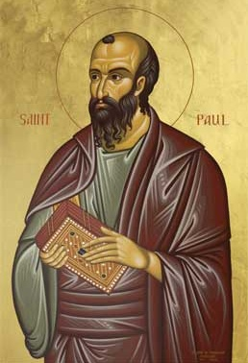
4 Kinds of People from 1 Corinthians 3:1-3
¹ And I, brethren, could not speak to you as to spiritual people but as to carnal, as to babes in Christ. ² I fed you with milk and not with solid food; for until now you were not able to receive it, and even now you are still not able; ³ for you are still carnal. For where there are envy, strife, and divisions among you, are you not carnal and behaving like mere men? (NKJV)

Slide 46
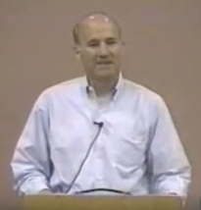
Joseph Dillow
“Nowhere in the Bible is a Christian asked to examine either his faith or his life to find out if he is a Christian. He is told only to look outside of himself to Christ alone for his assurance that he is a Christian. The Christian is, however, often told to examine his walk of faith and life to see if he is walking in fellowship and in conformity to God's commands.”
Joseph Dillow, Final Destiny: The Future Reign of the Servant Kings (Monument, CO: Panyim, 2012), 454.

Slide 47
Evidence for Eternal Security
Because self-righteousness did not save us it is not a basis upon which salvation can be lost
Salvation is not given or maintained by works
If a believer can lose eternal life, then how can this life be eternal (John 3:16)?
The Bible’s promises guarantee security (John 10:28)
The assurance of salvation is impossible (1 John 5:14)
The believer is predestined for glory (Rom 8:29-30)
The Spirit’s seal cannot be broken (Eph 4:30)

Slide 48
Romans 8:29–30
²⁹For those whom He foreknew, He also predestined to become conformed to the image of His Son, so that He would be the firstborn among many brethren; ³⁰ and these whom He predestined, He also called; and these whom He called, He also justified; and these whom He justified, He also glorified. (NASB95)

Slide 49
CONCLUSION

Slide 50
Evidence for Eternal Security
Because self-righteousness did not save us it is not a basis upon which salvation can be lost
Salvation is not given or maintained by works
If a believer can lose eternal life, then how can this life be eternal (John 3:16)?
The Bible’s promises guarantee security (John 10:28)
The assurance of salvation is impossible (1 John 5:14)
The believer is predestined for glory (Rom 8:29-30)
The Spirit’s seal cannot be broken (Eph 4:30)

Slide 51
Evidence for Eternal Security
God keeps us from falling (1 Pet 1:4-5)
Christ’s role as intercessor and advocate (John 17:11-12, 20)
Christ’s death perfectly dealt with all sins (Titus 2:14)
A believer cannot be removed from Christ’s body (1 Cor. 12:13)
The Bible does not specify which sins remove salvation
Believers with unfruitful lives still have salvation although lose rewards at the Bema Seat (1 Cor 3:15)

