Slide 1

“Identification Truth”
The Foundation for
Eternal Security
Jim McGowan, Th.D.
Sugar Land Bible Church
June 19, 2016
This presentation was compiled using excerpts from the Complete Works of Miles J. Stanford, resources obtained from Duluth Bible Church’s website, and resources obtained from Dr. Vern Peterman, Holly Hills Bible Church – Used with permission.
Notes:
“Identification Truth” The Foundation for Growth Part 1

Slide 2
Outline
Our Personal History in the First Adam
  Problem (position, nature, practice)
  Solution (position, nature, practice)
Summation

Slide 3
  Psalm 11:3
  “If the foundations are destroyed, What can the righteous do?”
Let’s Start with 2 foundational Axioms
Axiom - a self-evident truth...common sense.
We cannot become what we already are “in Christ”, until we know what we were “in Adam”.
Everything “in Adam” is the ground of sin and death, everything “in the Lord Jesus” is the ground of growth and life.
Notes:
Axiom - a self-evident truth that requires no proof.
Axiom #1
We cannot become what we already are in Christ, until we know what we were in Adam.
Since this is true, it is important that as we consider the following facts, we personalize them because this is our history!
Axiom #2
Everything in Adam is the ground of sin and death, everything in the Lord Jesus is the ground of growth and life.
Our responsibility is to keep off Adam’s old ground, and to live on the new ground which is —our position in Christ.

Slide 4
Outline
Our Personal History in the First Adam
  Problem (position, nature, practice)
  Solution (position, nature, practice)
Summation

Slide 5
Our Personal History in the First Adam – The Problem
WHO AND WHAT WAS ADAM?
He was the first man and the seminal head of the human race into which we were born.
    Since all humanity was “seminally present” in Adam, when Adam sinned, each person of the entire human race to the end of time was judged guilty as having individually participated in the first sin (cf. Rom. 5:12; Heb. 7:9–10).
    The Moody Handbook of Theology (424).
Notes:
Our Personal History in the First Adam – The Problem
Who and what was Adam?
He was the first man and the seminal head of the human race into which we were born.
Since all humanity was “seminally present” in Adam, when Adam sinned, each person of the entire human race to the end of time was judged guilty as having individually participated in the first sin (cf. Rom. 5:12; Heb. 7:9–10).
The Moody Handbook of Theology (424).

Slide 6

            Rom. 5:12
            “Therefore, just as through one man (the First Adam) sin* entered the world, and death through sin; and thus death spread to all men, because all sinned” (in Adam). (NASB)
            Heb. 7:9–10
    ⁹ Even Levi, who receives tithes, paid tithes through Abraham, so to speak, ¹⁰ for he was still in the loins of his father when Melchizedek met him. (NASB)
*ἡ ἁμαρτία
(the sin nature)
Notes:
“Therefore, just as through one man (the First Adam) sin (the sin nature) entered the world, and death through sin, and thus death spread to all men, because all sinned” (in Adam). (Rom. 5:12)
⁹ Even Levi, who receives tithes, paid tithes through Abraham, so to speak, ¹⁰ for he was still in the loins of his father when Melchizedek met him. (Heb. 7:9–10)

Slide 7
Our Personal History in the First Adam – The Problem
Adam is the one from whom humanity has inherited it’s sinful self oriented nature and condition of life – and this nature and condition continually war against the Holy Spirit for control (even over believers).
Through Adam we were all born into sin, judgment, condemnation, and death.
This death not only entered the world and the human race, but it reigned as a tyrant king. (Rom. 5:17-18)
*ἡ ἁμαρτία
Notes:
Adam is the one from whom humanity has inherited it’s sinful self oriented nature and condition of life – and this nature and condition continually war against the Holy Spirit for control even over believers.
Through Adam we were all born into sin, judgment, condemnation, and death.
This death not only entered the world and the human race, but it reigned as a tyrant king. (Rom. 5:17-18)

Slide 8
            Rom. 5:17-18
        “By one man’s offense (the First Adam) death reigned by one … Therefore as by the offense of one (the First Adam) judgment came upon all men to condemnation”. (NASB)
Notes:
Rom. 5:17-18 - “By one man’s offense (the First Adam) death reigned by one … Therefore as by the offense of one (the First Adam) judgment came upon all men to condemnation”. (NASB)

Slide 9

Our Personal History in the First Adam – The Problem
OUR HISTORICAL RELATIONSHIP IN ADAM – 3 FUNDAMENTAL ASPECTS
Our POSITION in sin (ADAM–SOURCE )
Our NATURE of sin (ADAM–NATURE)
Our PERSONAL sins (ADAM–PRACTICE)
Understanding these 3 facts is the essential key to progressing in spiritual growth. Ignorance or neglect of these 3 facts guarantees spiritual defeat throughout the life of the believer.
Notes:
Our Personal History in the First Adam – The Problem
B. Our Historical Relationship in Adam – 3 Basic Aspects
With this information, we can now make note of three basic aspects of our historical relationship in Adam. They are:
Our position in sin (Adam-source);
Our nature of sin (Adam-nature);
Our personal sins (Adam-practice).
“Identification Truth” – The Foundation for Growth
Understanding the facts concerning the position and condition of our old life in Adam is the essential key to progressing in spiritual growth. Ignorance or neglect of these facts will guarantee defeat throughout the life of the believer.

Slide 10
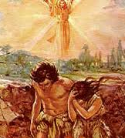
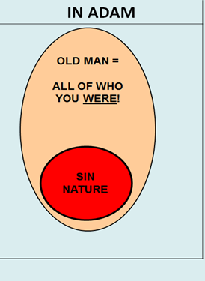
Our Personal History in the First Adam – The Problem
Notes:
Our Personal History in the First Adam – The Problem
B. Our Historical Relationship in Adam – 3 Basic Aspects
With this information, we can now make note of three basic aspects of our historical relationship in Adam. They are:
Our position in sin (Adam-source);
Our nature of sin (Adam-nature);
Our personal sins (Adam-practice).
“Identification Truth” – The Foundation for Growth
Understanding the facts concerning the position and condition of our old life in Adam is the essential key to progressing in spiritual growth. Ignorance or neglect of these facts will guarantee defeat throughout the life of the believer.

Slide 11

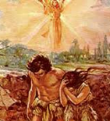
Our Personal History in the First Adam – The Problem
OUR HISTORICAL RELATIONSHIP IN ADAM – 3 FUNDAMENTAL ASPECTS
Our Position in Sin (Adam-source)
      Born into a doomed humanity (Ps. 51:5)
      We are dead unto God, and alive unto sin (Eph.2:1; 1Cor. 15:22)
Notes:
Our Historical Relationship in Adam – 3 Basic Aspects
Our Position in Sin (Adam-source)
Born into a doomed humanity
“ …in sin my mother conceived me”. (Ps. 51:5)
We are dead unto God, and alive unto sin.
“dead in trespasses and sins” (Eph. 2:1)
“in Adam all die” (1 Cor. 15:22)

Slide 12
            Ps. 51:5
      “in sin my mother conceived me” (NASB)
      Eph. 2:1
      “dead in trespasses and sins” (NASB)
      1 Cor. 15:22
      “in Adam all die” (NASB)
Notes:
Ps. 51:5 - …in sin my mother conceived me”.
Eph. 2:1 - “dead in trespasses and sins”
1 Cor. 15:22 - “in Adam all die”

Slide 13
Our Personal History in the First Adam – The Problem
OUR HISTORICAL RELATIONSHIP IN ADAM – 3 FUNDAMENTAL ASPECTS
Our Nature of Sin (Adam-nature)
      Our position in Adam resulted in our being sinful beings by nature, with a natural inclination or tendency for a life that is sinful.
      “in Adam”, we are – natural, fleshly, and carnal, separated from God.
Notes:
Our Nature of Sin (Adam-nature)
Our position in Adam resulted in our being sinful beings by nature, with a propensity for a life that is sinful
“in Adam”, we are “by nature the children of wrath (Eph. 2:3)

Slide 14
Our Personal History in the First Adam – The Problem
OUR HISTORICAL RELATIONSHIP IN ADAM – 3 FUNDAMENTAL ASPECTS
Our Nature of Sin (Adam-nature)
      Our Adamic nature can NEVER change, NEVER be improved, NEVER be reformed, NEVER be rehabilitated because “in Adam”, we are entirely self-centered; totally and irreparably against God.
Notes:
Our Nature of Sin (Adam-nature) – cont’d
Our Adamic nature can NEVER change, NEVER be improved, NEVER be reformed, NEVER be rehabilitated because:
“That which is born of the flesh is flesh” (John 3:6).
“in Adam”, we are entirely self-centered; totally and irreparably against God.

Slide 15
            Eph. 2:3
            [in Adam], we are “by nature the children of wrath (NASB)
            1 Cor. 2:14
            “…the natural man (the “in Adam” man) does not receive the things of the Spirit of God, for they are foolishness to him; nor can he know them, because they are spiritually discerned.” (NASB)
            John 3:6
            “That which is born of the flesh is flesh” (NASB)
Notes:
Eph. 2:3 - “in Adam”, we are “by nature the children of wrath (NASB)
1 Cor. 2:14 - “…the natural man* (the “in Adam” man) does not receive the things of the Spirit of God, for they are foolishness to him; nor can he know them, because they are spiritually discerned.” (NASB)
John 3:6 - “That which is born of the flesh is flesh” (NASB)

Slide 16
      Rom. 7:14
      I am carnal [in Adam], sold under sin” (NASB)
      Rom. 8:5
      For those who live according to the flesh* set their minds on the things of the flesh …” (NASB)
      Rom. 8:7-8
      ⁷ Because the carnal mind (the Adamic thinking process) is enmity against God; for it is not subject to the law of God, nor indeed can be. ⁸ So then, those who are in the flesh cannot please God. (NASB)
*flesh = Adamic, sin nature
Notes:
Rom. 7:14 - I am carnal [in Adam], sold under sin” (NASB)
Rom. 8:5 - For those who live according to the flesh* set their minds on the things of the flesh …” (NASB)
Rom. 8:7-8 - ⁷ Because the carnal mind** (the Adamic thinking process) is enmity against God; for it is not subject to the law of God, nor indeed can be. ⁸ So then, those who are in the flesh cannot please God. (NASB)

Slide 17
Our Personal History in the First Adam – The Problem
OUR HISTORICAL RELATIONSHIP IN ADAM – 3 FUNDAMENTAL ASPECTS
Our Personal Sins (Adam-practice)
      “In Adam”, we have grown up to be sinners by CHOICE and PRACTICE because the inherent product of a sinful nature is sinful behavior. The practical result of our being “in Adam” is stated in Scripture:
Notes:
The natural product of a sinful nature is sinful behavior. The practical result of our being “in Adam” is stated in Scripture:
Rom. 3:23 “All have sinned, and come short of the glory of God”.
In Adam, we have grown up to be sinners by choice and practice.
As we continue to think in terms of our personal history, in Adam, let’s see exactly what our Heavenly Father did to rectify this terrible relationship and condition.

Slide 18


ROMANS 3:23
“FOR ALL HAVE SINNED AND FALL SHORT OF THE GLORY OF GOD” (NASB95)

Slide 19
That’s the “Bad News…” but, here comes the “Good News!”
Notes:
Our Personal History in the First Adam - God’s Solution

Slide 20
Outline
Our Personal History in the First Adam
  Problem (position, nature, practice)
  Solution (position, nature, practice)
Summation

Slide 21
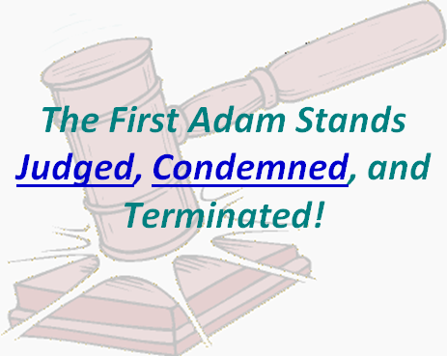

Slide 22

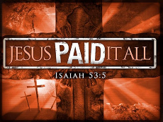
Our Personal History in the First Adam - God’s Solution
ADAM IS JUDGED AND CONDEMNED
  Our POSITION in Sin (ADAM-SOURCE).
      Our “position in sin” COULD NOT BE FORGIVEN (Eph. 2:1; 1 Cor. 15:22). On the Cross, in the person of His Son, our Heavenly Father ONCE AND FOREVER CANCELED our “position in sin”.
Notes:
Adam is Condemned
Our POSITION in Sin (Adam-source).
God did not forgive the principle of Satan-injected sin (the sin nature) that dealt the death-blow to the human race through Adam. God did not forgive the principle of SIN (we are not talking about personal sins!!!).
On the contrary, on the Cross, in the person of His Son, our Heavenly Father once and forever dealt with the principle of sin, thereby canceling our position of sin.

Slide 23
      Rom. 8:3
      “For what the law could not do in that it was weak through the flesh, God did by sending His own Son in the likeness of sinful flesh, on account of sin: HE [God] CONDEMNED SIN (Adam-source) in [Christ’s] flesh…” (NASB)
      2 Cor. 5:21
      “For [God] made Him who knew no sin [Christ Jesus] to be sin for us…” (NASB)
Notes:
Rom. 8:3 - “For what the law could not do in that it was weak through the flesh, God did by sending His own Son in the likeness of sinful flesh, on account of sin: HE [God] CONDEMNED SIN (Adam-source) in [Christ’s] flesh…” (NASB)
2 Cor. 5:21 - “For [God] made Him who knew no sin [Christ Jesus] to be sin for us…” (NASB)
***KEY POINT*** Far from merely being forgiven, our position in Adam (as the source of sin), was JUDGED AND CONDEMNED in and through Christ’s death.

Slide 24
Our Personal History in the First Adam - God’s Solution
ADAM IS JUDGED AND CONDEMNED
  Our NATURE of Sin (ADAM-NATURE)
      As our “position in sin” could not be forgiven, neither could our sinful life and nature be forgiven. They too were taken into the judgment–death of the Cross.
*ἡ ἁμαρτία
(the sin nature)
Notes:
Adam is Condemned
Our NATURE of Sin (Adam-nature)
As our position in sin could not be forgiven, neither could our sinful life and nature be forgiven. They too were taken into the judgment – death of the Cross. In fact, all that we inherited from Adam suffered this same fate.
“…knowing this, that our old man was crucified with [Christ]…. (Rom. 6:6)

Slide 25
      Romans 6:11 (NASB95)
      Even so consider (KJV reckon) yourselves to be dead to sin, but alive to God in Christ Jesus.
λογίζομαι logídzomai; a mathematical and accounting term, of cognitive processes; to reckon, to value or esteem, put down to one’s account;

Slide 26
Kenneth Wuest
Rom 6:11
Here Paul is exhorting the saints that in their endeavor to live a life in accordance with the Word of God, they should take into account the fact that they are dead to sin, that they have been disengaged from the evil nature, that it has no power over them anymore, that they are scot free from it and can say a point blank NO to it, also to take into account the fact that they are alive to God, that is, that the divine nature has been imparted with the result that that nature gives them both the desire and the power to regulate their lives in accordance with the Word of God. Now, reckoning one’s self dead to sin and alive to God does not make one so, God constituted the saint so when He saved him. But the act of reckoning brings into better operation with beneficial
Notes:
Adam is Condemned
Our NATURE of Sin (Adam-nature)
As our position in sin could not be forgiven, neither could our sinful life and nature be forgiven. They too were taken into the judgment – death of the Cross. In fact, all that we inherited from Adam suffered this same fate.
“…knowing this, that our old man was crucified with [Christ]…. (Rom. 6:6)

Slide 27
results, the working of this inner spiritual machinery…The Christian who does not count upon the fact that the divine nature is implanted in his inner being, goes on living his Christian life as best he can more or less in the energy of his own strength, with the result that he exhibits a mediocre Christian experience. But the believer who counts upon the fact that he is a possessor of the divine nature, ceases from his own struggles at living a Christian life, and avails himself of the life of God supplied in the divine nature. So the first adjustment the Christian should make is that of counting upon the fact that the power of the indwelling sinful nature is broken and the divine nature imparted, and order his life on that principle.
Wuest, K. S. (1997). Wuest’s Word Studies from the Greek New Testament: for the English reader (Ro 6:11). Grand Rapids: Eerdmans.
Notes:
Adam is Condemned
Our NATURE of Sin (Adam-nature)
As our position in sin could not be forgiven, neither could our sinful life and nature be forgiven. They too were taken into the judgment – death of the Cross. In fact, all that we inherited from Adam suffered this same fate.
“…knowing this, that our old man was crucified with [Christ]…. (Rom. 6:6)

Slide 28
Our Personal History in the First Adam - God’s Solution
ADAM IS JUDGED AND CONDEMNED
  Our PERSONAL SINS (ADAM-PRACTICE)
      Once our sinful position and nature had been condemned and judged, God was then justified in forgiving our personal sins—past, present, and future—by means of the shed blood of Christ on Calvary’s cross.
      In fact, all that we inherited from Adam suffered this same fate – death at the Cross!
Notes:
Adam is Condemned
Our PERSONAL Sins (Adam-practice)
Once our sinful position and nature had been condemned and judged, God was then justified in forgiving our personal sins—past, present, and future— by means of the shed blood of Christ on Calvary’s cross.

Slide 29
      1 Pet. 2:24
      “[Christ] Himself bore our sins* in His own body on the tree…”
      Rev. 1:5
      “To Him who loved us and washed us from our sins* in His own blood,”
      Col. 1:20
      “[Christ] …having made peace through the blood of His cross.”
*plural

Slide 30
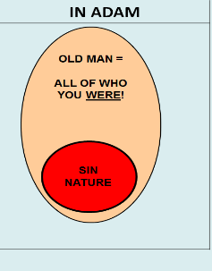

Our Personal History in the First Adam - God’s Solution
OUR POSITIONAL RELATIONSHIP TO ADAM IS TERMINATED!
      AT THE CROSS WE FINALLY COME TO THE VERY END OF OUR SPIRITUAL HISTORY “IN ADAM”.
Notes:
Our Personal History in the First Adam - God’s Solution
Judged, Condemned, and Terminated
Our POSITION in Sin (Adam-source).
Our NATURE of Sin (Adam-nature)
Our PERSONAL Sins (Adam-practice)

Slide 31
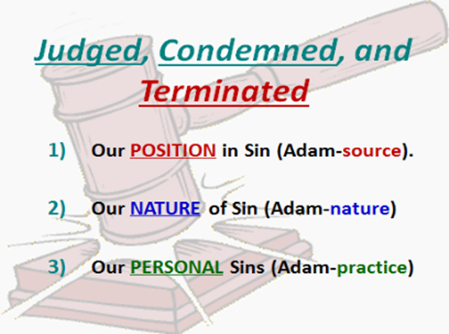

Slide 32

Definition of Eternal Security
“Eternal Security means that those who have been genuinely saved by God’s grace through faith alone in Christ alone shall never be in danger of God’s condemnation or loss of salvation but God’s grace and power keep them forever saved and secure.”
Dennis Rokser, Shall Never Perish Forever, p. 11

Slide 33

      John 3:16
      For God so loved the world, that He gave His only begotten Son, that whoever believes in Him shall not perish, but have eternal life.
      John 5:24
      “Truly, truly, I say to you, he who hears My word, and believes Him who sent Me, has eternal life, and does not come into judgment, but has passed out of death into life.” (NASB)

Slide 34
      John 10:28a
      and I give eternal life to them, and they will never perish… (NASB95)
καγὼ δίδωμι αὐτοῖς ζωὴν αἰώνιον καὶ οὐ μὴ ἀπόλωνται* εἰς τὸν αἰῶνα…
*3rd Person Plural Aorist Middle Subjunctive

Slide 35
      Emphatic Negation Subjunctive - Definition
      Emphatic negation is indicated by οὐ μή plus the aorist subjunctive...This is the strongest way to negate something in Greek……οὐ μή + the subjunctive denies a potentiality.…οὐ μή rules out even the idea as being a possibility: “ου μή is the most decisive way of negativing someth. in the future.”
      Emphatic negation is found primarily in the reported sayings of Jesus (both in the Gospels and in the Apocalypse);…a soteriological theme is frequently found in such statements, especially in John: what is negatived is the possibility of the loss of salvation.
      Wallace, D. B. (1996). Greek Grammar beyond the Basics: An Exegetical Syntax of the New Testament (p. 468). Grand Rapids, MI: Zondervan.

Slide 36
Middle Voice
The Middle Voice depicts the subject as participating in the action, either directly or indirectly, and yet the action is also upon the subject itself.
Summers, R., & Sawyer, T. (1995). Essentials of New Testament Greek (Rev. ed., p. 49). Nashville, TN: Broadman & Holman.
The Middle Voice emphasizes the actor [subject] of the verb.
Wallace, D. B. (1996). Greek Grammar beyond the Basics: An Exegetical Syntax of the New Testament (p. 415). Grand Rapids, MI: Zondervan.
Notes:
“…when God writes one’s name in the Book of Life even before the foundation of the world, there is no one on earth who can erase it. Our Lord confirmed this in John 10:28: “And I give unto them eternal life, and they shall never perish, neither shall any man pluck them out of my hand.” Zodhiates, S. (2000). The complete word study dictionary: New Testament (electronic ed.). Chattanooga, TN: AMG Publishers.

Slide 37
      John 10:28-30
And they shall positively not perish, never. And no one will snatch them by force out of my hand. My Father who gave them to me as a permanent gift is greater than all. And no one is able to be snatching them by force out of the hand of my Father. I and the Father are one in essence.
Wuest, K. S. (1961). The New Testament: an expanded translation (Jn 10:27–33). Grand Rapids, MI: Eerdmans.
Notes:
And they shall in no way and by no means destroy themselves for ever…

Slide 38
Summation

Slide 39
  Psalm 11:3
  “If the foundations are destroyed, What can the righteous do?”
Remember our 2 foundational Axioms?
We cannot become what we already are “in Christ”, until we know what we were “in Adam”.
Everything “in Adam” is the ground of sin and death, everything “in the Lord Jesus” is the ground of growth and life.
Notes:
Axiom - a self-evident truth that requires no proof.
Axiom #1
We cannot become what we already are in Christ, until we know what we were in Adam.
Since this is true, it is important that as we consider the following facts, we personalize them because this is our history!
Axiom #2
Everything in Adam is the ground of sin and death, everything in the Lord Jesus is the ground of growth and life.
Our responsibility is to keep off Adam’s old ground, and to live on the new ground which is —our position in Christ.

Slide 40
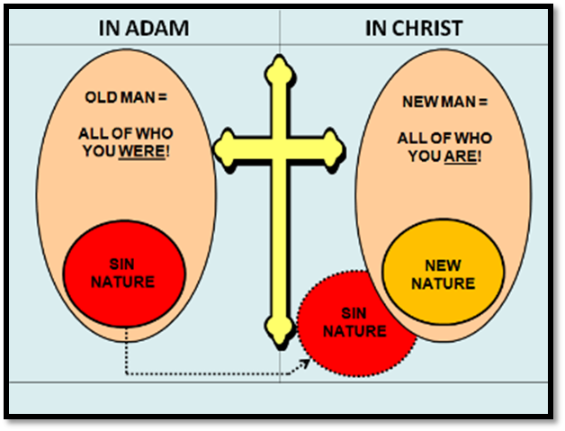
      AT THE CROSS WE FINALLY COME TO THE VERY END OF OUR SPIRITUAL HISTORY “IN ADAM”.

Slide 41
