Slide 1
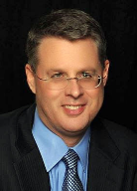
Soteriology Session 21
Dr. Andy Woods
Senior Pastor – Sugar Land Bible Church
Professor of Bible & Theology – College of Biblical Studies

Slide 2
Soteriology Overview
Definition
Election
Atonement
Salvation words
God’s one condition of salvation
Results of salvation
Eternal security
Faulty views of salvation

Slide 3
Soteriology Overview
This Session
VII. Eternal Security

Slide 4
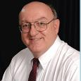
Definition of Eternal Security
“Eternal Security means that those who have been genuinely saved by God’s grace through faith alone in Christ alone shall never be in danger of God’s condemnation or loss of salvation but God’s grace and power keep them forever saved and secure.”
Dennis Rokser, Shall Never Perish Forever, p. 11

Slide 5
Introduction
Probation?
Wait until the end of his life?
Eph. 4:14
The Bible answers this question
The Bible cannot contradict itself
Definition
Not all who profess faith in Christ actually have it (John 3:18; 5:39-40)
It matters: 1. productivity, 2. motive, 3. joy
Preview

Slide 6
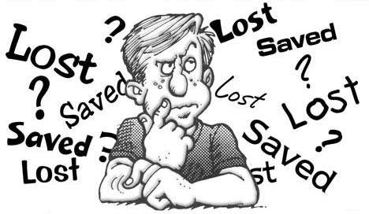
Eternal Security Outline
Eternal security arguments
Response to problem passages

Slide 7
Eternal Security Outline
Eternal security arguments
Response to problem passages

Slide 8
Evidence for Eternal Security
Because self-righteousness did not save us it is not a basis upon which salvation can be lost
Salvation is not given or maintained by works
If a believer can lose eternal life, then how can this life be eternal (John 3:16)?
The Bible’s promises guarantee security (John 10:28)
The assurance of salvation is impossible (1 John 5:14)
The believer is predestined for glory (Rom 8:29-30)
The Spirit’s seal cannot be broken (Eph 4:30)

Slide 9
Evidence for Eternal Security
God keeps us from falling (1 Pet 1:4-5)
Christ’s role as intercessor and advocate (John 17:11-12, 20)
Christ’s death perfectly dealt with all sins (Titus 2:14)
A believer cannot be removed from Christ’s body (1 Cor. 12:13)
The Bible does not specify which sins remove salvation
Believers with unfruitful lives still have salvation although lose rewards at the Bema Seat (1 Cor 3:15)

Slide 10
Evidence for Eternal Security
Because self-righteousness did not save us it is not a basis upon which salvation can be lost
Salvation is not given or maintained by works
If a believer can lose eternal life, then how can this life be eternal (John 3:16)?
The Bible’s promises guarantee security (John 10:28)
The assurance of salvation is impossible (1 John 5:14)
The believer is predestined for glory (Rom 8:29-30)
The Spirit’s seal cannot be broken (Eph 4:30)

Slide 11
Evidence for Eternal Security
Because self-righteousness did not save us it is not a basis upon which salvation can be lost
Salvation is not given or maintained by works
If a believer can lose eternal life, then how can this life be eternal (John 3:16)?
The Bible’s promises guarantee security (John 10:28)
The assurance of salvation is impossible (1 John 5:14)
The believer is predestined for glory (Rom 8:29-30)
The Spirit’s seal cannot be broken (Eph 4:30)

Slide 12
Evidence for Eternal Security
Because self-righteousness did not save us it is not a basis upon which salvation can be lost
Salvation is not given or maintained by works
If a believer can lose eternal life, then how can this life be eternal (John 3:16)?
The Bible’s promises guarantee security (John 10:28)
The assurance of salvation is impossible (1 John 5:14)
The believer is predestined for glory (Rom 8:29-30)
The Spirit’s seal cannot be broken (Eph 4:30)

Slide 13
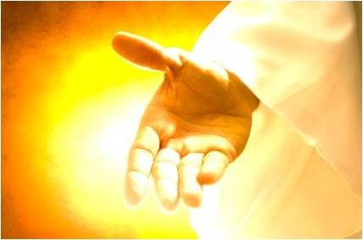
If a believer can lose eternal life, then how can this life be eternal (John 3:16)?
John 3:16
John 5:24
1 John 5:13
“Eternal” (aiōnios) is the same word used to describe God

Slide 14
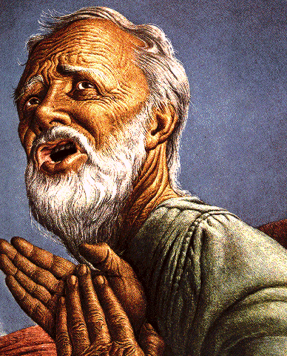
Eternal Life = Eternal Life
John 3:16
For God so loved the world, that He gave His only begotten Son, that whoever believes in Him shall not perish, but have eternal life.

Slide 15
Evidence for Eternal Security
Because self-righteousness did not save us it is not a basis upon which salvation can be lost
Salvation is not given or maintained by works
If a believer can lose eternal life, then how can this life be eternal (John 3:16)?
The Bible’s promises guarantee security (John 10:28)
The assurance of salvation is impossible (1 John 5:14)
The believer is predestined for glory (Rom 8:29-30)
The Spirit’s seal cannot be broken (Eph 4:30)

Slide 16
The Bible’s Promises Guarantee Security (John 10:28)
God’s reliability – Num. 23:19; Rom. 3:4a; 2 Cor. 1:20; Titus 1:2; Heb. 6:18; 10:23
John 4:14
John 5:24
John 6:37-40
John 10:27-30
Romans 8:28-38
Heb. 13:5

Slide 17
Evidence for Eternal Security
Because self-righteousness did not save us it is not a basis upon which salvation can be lost
Salvation is not given or maintained by works
If a believer can lose eternal life, then how can this life be eternal (John 3:16)?
The Bible’s promises guarantee security (John 10:28)
The assurance of salvation is impossible (1 John 5:14)
The believer is predestined for glory (Rom 8:29-30)
The Spirit’s seal cannot be broken (Eph 4:30)

Slide 18
Assurance of Salvation Verses (1 John 5:14)
Biblical examples of assurance
OT – Job 19:25-26; Ps. 23:6
Gospels – John 5:24; 6:47
Acts – Acts 16:30-31
Paul – Rom. 5:2; 8:23-24; Col. 1:27; Titus 2:13; 2 Cor. 5:8; Philip. 1:21-23; 3:20-21; 4:3; Col. 3:4; 2 Tim. 1:12
General letters – 1 Pet. 1:3-5; Heb. 2:14-15; 1 John 3:1-2; 5:13

Slide 19
Assurance of Salvation Verses (1 John 5:14)
Biblical examples of assurance
OT – Job 19:25-26; Ps. 23:6
Gospels – John 5:24; 6:47
Acts – Acts 16:30-31
Paul – Rom. 5:2; 8:23-24; Col. 1:27; Titus 2:13; 2 Cor. 5:8; Philip. 1:21-23; 3:20-21; 4:3; Col. 3:4; 2 Tim. 1:12
General letters – 1 Pet. 1:3-5; Heb. 2:14-15; 1 John 3:1-2; 5:13

Slide 20
Assurance of Salvation Verses (1 John 5:14)
Biblical examples of assurance
OT – Job 19:25-26; Ps. 23:6
Gospels – John 5:24; 6:47
Acts – Acts 16:30-31
Paul – Rom. 5:2; 8:23-24; Col. 1:27; Titus 2:13; 2 Cor. 5:8; Philip. 1:21-23; 3:20-21; 4:3; Col. 3:4; 2 Tim. 1:12
General letters – 1 Pet. 1:3-5; Heb. 2:14-15; 1 John 3:1-2; 5:13

Slide 21
John 5:24
“Truly, truly, I say to you, he who hears My word, and believes Him who sent Me, has eternal life, and does not come into judgment, but has passed out of death into life.” (NASB)

Slide 22
Assurance of Salvation Verses (1 John 5:14)
Biblical examples of assurance
OT – Job 19:25-26; Ps. 23:6
Gospels – John 5:24; 6:47
Acts – Acts 16:30-31
Paul – Rom. 5:2; 8:23-24; Col. 1:27; Titus 2:13; 2 Cor. 5:8; Philip. 1:21-23; 3:20-21; 4:3; Col. 3:4; 2 Tim. 1:12
General letters – 1 Pet. 1:3-5; Heb. 2:14-15; 1 John 3:1-2; 5:13

Slide 23
Assurance of Salvation Verses (1 John 5:14)
Biblical examples of assurance
OT – Job 19:25-26; Ps. 23:6
Gospels – John 5:24; 6:47
Acts – Acts 16:30-31
Paul – Rom. 5:2; 8:23-24; Col. 1:27; Titus 2:13; 2 Cor. 5:8; Philip. 1:20-23; 3:20-21; 4:3; Col. 3:4; 2 Tim. 1:12
General letters – 1 Pet. 1:3-5; Heb. 2:14-15; 1 John 3:1-2; 5:13

Slide 24
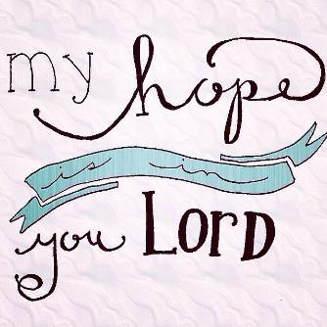
Biblical Hope
ἐλπίς elpís – Not anxious wishing or uncertainty but rather confident assurance of something yet future.
Not an “I hope so” mentality but rather an “I know so” mindset.

Slide 25
Assurance of Salvation Verses (1 John 5:14)
Biblical examples of assurance
OT – Job 19:25-26; Ps. 23:6
Gospels – John 5:24; 6:47
Acts – Acts 16:30-31
Paul – Rom. 5:2; 8:23-24; Col. 1:27; Titus 2:13; 2 Cor. 5:8; Philip. 1:21-23; 3:20-21; 4:3; Col. 3:4; 2 Tim. 1:12
General letters – 1 Pet. 1:3-5; Heb. 2:14-15; 1 John 3:1-2; 5:13

Slide 26
1 John 5:13
“These things I have written to you who believe in the name of the Son of God, so that you may know that you have eternal life.” (NASB)

Slide 27
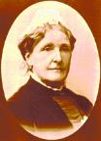
Hannah Whitall Smith
Every-Day Religion: The Common Sense Teaching of the Bible (1893), p. 5.
“In the first chapter of Numbers we are told that only those Israelites who could ‘declare their pedigree’ might be numbered among the men of war; and in the second chapter of Ezra no one who could not ‘find his register’ and ‘reckon his genealogy,’ was allowed to exercise the office of priest. Any doubts and uncertainties on these points made them ‘as polluted,’ and consequently unfit to serve (see Num. 1:2, 17, 18; 2:2; Ezra 2:62, 63). I believe the same thing is also true of Christians now. We can neither be numbered among the Lord's soldiers, nor enter into priestly relations with Him, until we also can ‘declare our pedigree’ as children of God, and ‘reckon our genealogy’ as being born of Him.”

Slide 28
DTS Doctrinal Statement Article XI—Assurance
“We believe it is the privilege, not only of some, but of all by the Spirit through faith who are born again in Christ as revealed in the Scriptures, to be assured of their salvation from the very day they take Him to be their Savior and that this assurance is not founded upon any fancied discovery of their own worthiness or fitness, but wholly upon the testimony of God in His written Word, exciting within His children filial love...”

Slide 29
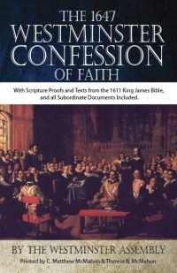
Westminster Confession Chapter XVII, Article III – Of the Assurance of Grace and Salvation
“This infallible assurance doth not so belong to the essence of faith, but that a true believer will wait long, and conflict with many difficulties before he be a partaker of it.”

Slide 30
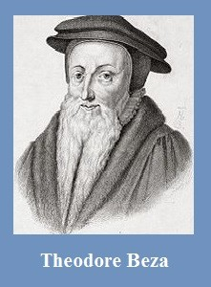
Theodore Beza
(1519‒1605)
A Little Book of Christian Questions and Responses, pp. 96-97
“Therefore, I am elect, is first perceived from sanctification begun in me, that is, by my hating of sin and my loving of righteousness.”

Slide 31
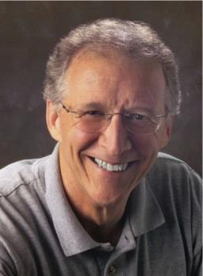
John Piper
“No Christian can be sure that he is a true believer. Hence, there is an ongoing need to be dedicated to the Lord and to deny ourselves so that we might make it.”
John Piper and Pastoral Staff, TULIP: What We Believe about the Five Points of Calvinism: Position Paper of the Pastoral Staff (Desiring God Ministries, 1997), 25, cited in Dave Hunt, What Love is This?, 379.

Slide 32
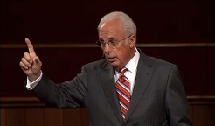
John MacArthur
Saved Without A Doubt, p. 177
“If a person fails to love and obey the Lord through the trials of life, then there is no evidence that he possesses saving faith. How many people do you know who came to church for a while, had a little trouble in their lives, and left? Although they may have made a profession of faith in Christ, they cannot be identified as those who love Him because their lives are not characterized by enduring obedience.”

Slide 33
John MacArthur
The Gospel According to Jesus, p. 23
“Genuine assurance comes from seeing the Holy Spirit’s transforming work in one’s life.”

Slide 34
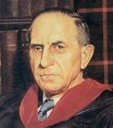
John Murray
Redemption Accomplished and Applied, pp. 152, 154-55.
“The crucial test of true faith is endurance to the end, abiding in Christ, and continuance in the Word…He cannot abandon himself to sin; he cannot come under the domination of sin; he cannot be guilty of certain kinds of unfaithfulness…Let us appreciate the doctrine of the perseverance of the saints and recognize that we may entertain the faith of our security in Christ only as we persevere in faith and holiness to the end.”

Slide 35
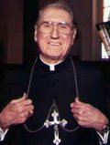
Cardinal John O’Connor of NY
quoted in Samuel Howe Verhovek, Cardinal Defends a Jailed Bishop Who Warned Cuomo on Abortion, New York Times, February 1, 1990.
“Church teaching is that I don't know, at any given moment, what my eternal future will be…I can hope, pray, do my very best – but I still don't know. Pope John II doesn't absolutely know that he will go to heaven, nor does mother Theresa of Calcutta, unless either has had a special divine revelation.”

Slide 36
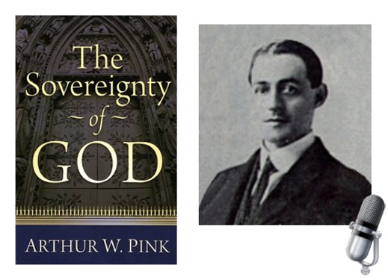
A. W. Pink
Practical Christianity, p. 16.
“Readers, if there is a reserve in your obedience, you are on your way to hell.”

Slide 37
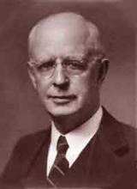
Lewis Sperry Chafer, Salvation: A Clear Doctrinal Analysis (Grand Rapids: Zondervan, 1977), 60. Italics added
Lewis Sperry Chafer
“There is a normal Christian experience. There are new and blessed emotions and desires. Old things do pass away; and behold all things do become new; but all such experiences are but secondary evidences, as to the fact of salvation, in that they grow out of that positive repose of faith which is the primary evidence.”

Slide 38
4 Kinds of People from 1 Corinthians 3:1-3
Spiritual Believers
Infant
Believers
Unbelievers
Carnal
Believers
Notes:
Ray Steadman – “1st Californians”
Unbelievers vs Categories of Believers
Unbelievers – ψυχικός psuchikós; Natural, pertaining to the natural as distinguished from the spiritual
Spiritual Believers – πνευματικός pneumatikós; of persons who are spiritual, enlightened by the Holy Spirit
Infant Believers – σάρκινος sárkinos; with propensities of the flesh unto sin; νήπιος nḗpios; an infant, child, baby without any definite limitation of age. (This relates to immaturity and lack of instruction)
Carnal Believers – σαρκικός sarkikós; tendency to satisfy the flesh, implying sinfulness, sinful propensity, carnal (This relates to disobedience and open rebellion)

Slide 39
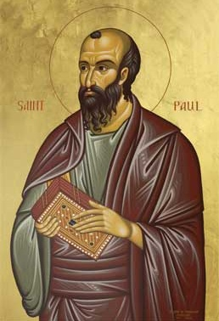
4 Kinds of People from 1 Corinthians 3:1-3
¹ And I, brethren, could not speak to you as to spiritual people but as to carnal, as to babes in Christ. ² I fed you with milk and not with solid food; for until now you were not able to receive it, and even now you are still not able; ³ for you are still carnal. For where there are envy, strife, and divisions among you, are you not carnal and behaving like mere men? (NKJV)

Slide 40
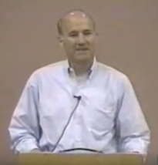
Joseph Dillow
“Nowhere in the Bible is a Christian asked to examine either his faith or his life to find out if he is a Christian. He is told only to look outside of himself to Christ alone for his assurance that he is a Christian. The Christian is, however, often told to examine his walk of faith and life to see if he is walking in fellowship and in conformity to God's commands.”
Joseph Dillow, Final Destiny: The Future Reign of the Servant Kings (Monument, CO: Panyim, 2012), 454.

Slide 41
Evidence for Eternal Security
Because self-righteousness did not save us it is not a basis upon which salvation can be lost
Salvation is not given or maintained by works
If a believer can lose eternal life, then how can this life be eternal (John 3:16)?
The Bible’s promises guarantee security (John 10:28)
The assurance of salvation is impossible (1 John 5:14)
The believer is predestined for glory (Rom 8:29-30)
The Spirit’s seal cannot be broken (Eph 4:30)

Slide 42
Romans 8:29–30
²⁹For those whom He foreknew, He also predestined to become conformed to the image of His Son, so that He would be the firstborn among many brethren; ³⁰ and these whom He predestined, He also called; and these whom He called, He also justified; and these whom He justified, He also glorified. (NASB95)

Slide 43
CONCLUSION

Slide 44
Evidence for Eternal Security
Because self-righteousness did not save us it is not a basis upon which salvation can be lost
Salvation is not given or maintained by works
If a believer can lose eternal life, then how can this life be eternal (John 3:16)?
The Bible’s promises guarantee security (John 10:28)
The assurance of salvation is impossible (1 John 5:14)
The believer is predestined for glory (Rom 8:29-30)
The Spirit’s seal cannot be broken (Eph 4:30)

Slide 45
Evidence for Eternal Security
God keeps us from falling (1 Pet 1:4-5)
Christ’s role as intercessor and advocate (John 17:11-12, 20)
Christ’s death perfectly dealt with all sins (Titus 2:14)
A believer cannot be removed from Christ’s body (1 Cor. 12:13)
The Bible does not specify which sins remove salvation
Believers with unfruitful lives still have salvation although lose rewards at the Bema Seat (1 Cor 3:15)

