Slide 3
2 Timothy Introduction
The Call to Christian Perseverance

Slide 4
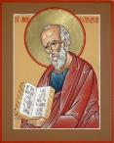
Answering Nine Questions
Who wrote it? – Paul
What do we know about the author? – An Apostle
To whom was it written? – Timothy
When was it written? - A.D. 67
Where was it written from? – Rome
Why was it written? – Timothy’s timidity
What is it about? – Perseverance
What is inside (outline)? – 4 part outline
What makes the book different? – Paul’s final word

Slide 5
Four Part Structure
General call to faithful endurance in the ministry (chapter 1)
Ten metaphors describing what faithful endurance looks like (chapter 2)
What to do in the midst of the coming apostasy (3:1–4:8)
How God met six needs in Paul’s life (4:9-22)

Slide 6
Four Part Structure
General call to faithful endurance in the ministry (chapter 1)
Ten metaphors describing what faithful endurance looks like (chapter 2)
What to do in the midst of the coming apostasy (3:1–4:8)
How God met six needs in Paul’s life (4:9-22)

Slide 7
Four Part Structure
General call to faithful endurance in the ministry (chapter 1)
Ten metaphors describing what faithful endurance looks like (chapter 2)
What to do in the midst of the coming apostasy (3:1–4:8)
How God met six needs in Paul’s life (4:9-22)

Slide 8
2 Timothy 2
Ten Metaphors Illustrating Endurance

Slide 9
Ten Metaphors
Teacher (2:2)
Soldier (2:3-4)
Athlete (2:5)
Farmer (2:6)
Christ (2:7-8)
Paul (2:9-10)
Trustworthy statement (2:11-13)
Workman (2:14-18)
Vessel (2:19-23)
Servant (2:24-26)

Slide 10
Four Part Structure
General call to faithful endurance in the ministry (chapter 1)
Ten metaphors describing what faithful endurance looks like (chapter 2)
What to do in the midst of the coming apostasy (3:1–4:8)
How God met six needs in Paul’s life (4:9-22)

Slide 11
Definition of Apostasy
apos = away from
histēmi = to stand
Apostasy = to stand away from
Apostasy = a departure from known (or previously embraced) truth

Slide 12
Apostasy (3:1‒4:8)
The Apostasy (3:1-9)
The evil (3:1-7)
The examples (3:8-9)
The Antidote (3:10‒4:8)
Paul’s example (3:10-13)
Preach the Word (3:14‒4:8)

Slide 13
Apostasy (3:1‒4:8)
The Apostasy (3:1-9)
The evil (3:1-7)
The examples (3:8-9)
The Antidote (3:10‒4:8)
Paul’s example (3:10-13)
Preach the Word (3:14‒4:8)

Slide 14
Apostasy (3:1‒4:8)
The Apostasy (3:1-9)
The evil (3:1-7)
The examples (3:8-9)
The Antidote (3:10‒4:8)
Paul’s example (3:10-13)
Preach the Word (3:14‒4:8)

Slide 15
Apostasy (3:1‒4:8)
The Apostasy (3:1-9)
The evil (3:1-7)
The examples (3:8-9)
The Antidote (3:10‒4:8)
Paul’s example (3:10-13)
Preach the Word (3:14‒4:8)

Slide 16
Apostasy (3:1‒4:8)
The Apostasy (3:1-9)
The evil (3:1-7)
The examples (3:8-9)
The Antidote (3:10‒4:8)
Paul’s example (3:10-13)
Preach the Word (3:14‒4:8)

Slide 17
Apostasy (3:1‒4:8)
The Apostasy (3:1-9)
The evil (3:1-7)
The examples (3:8-9)
The Antidote (3:10‒4:8)
Paul’s example (3:10-13)
Preach the Word (3:14‒4:8)

Slide 18
B. Paul’ Example (3:10-13)
Paul’s ministry (10a)
Paul’s character (10b
Paul’s difficulties (11-13)

Slide 19
Apostasy (3:1‒4:8)
The Apostasy (3:1-9)
The evil (3:1-7)
The examples (3:8-9)
The Antidote (3:10‒4:8)
Paul’s example (3:10-13)
Preach the Word (3:14‒4:8)

Slide 20
Preach the Word for Nine Reasons
Impact on Paul (2 Tim 3:14)
Impact on salvation (2 Tim 3:15)
Divine origin (2 Tim 3:16a)
Impact on sanctification (2 Tim 3:16b)
Impact on equipping (2 Tim 3:17)
Paul’s charge to Timothy (2 Tim 4:1a, 2)
Timothy’s evaluation at the Bema Seat (2 Tim 4:1b)
Preference of men to avoid the word (2 Tim 4:3-4)
Need to complete Timothy’s ministry (2 Tim 4:5-8)

Slide 21
Preach the Word for Nine Reasons
Impact on Paul (2 Tim 3:14)
Impact on salvation (2 Tim 3:15)
Divine origin (2 Tim 3:16a)
Impact on sanctification (2 Tim 3:16b)
Impact on equipping (2 Tim 3:17)
Paul’s charge to Timothy (2 Tim 4:1a, 2)
Timothy’s evaluation at the Bema Seat (2 Tim 4:1b)
Preference of men to avoid the word (2 Tim 4:3-4)
Need to complete Timothy’s ministry (2 Tim 4:5-8)

Slide 22
Preach the Word for Nine Reasons
Impact on Paul (2 Tim 3:14)
Impact on salvation (2 Tim 3:15)
Divine origin (2 Tim 3:16a)
Impact on sanctification (2 Tim 3:16b)
Impact on equipping (2 Tim 3:17)
Paul’s charge to Timothy (2 Tim 4:1a, 2)
Timothy’s evaluation at the Bema Seat (2 Tim 4:1b)
Preference of men to avoid the word (2 Tim 4:3-4)
Need to complete Timothy’s ministry (2 Tim 4:5-8)

Slide 23
Preach the Word for Nine Reasons
Impact on Paul (2 Tim 3:14)
Impact on salvation (2 Tim 3:15)
Divine origin (2 Tim 3:16a)
Impact on sanctification (2 Tim 3:16b)
Impact on equipping (2 Tim 3:17)
Paul’s charge to Timothy (2 Tim 4:1a, 2)
Timothy’s evaluation at the Bema Seat (2 Tim 4:1b)
Preference of men to avoid the word (2 Tim 4:3-4)
Need to complete Timothy’s ministry (2 Tim 4:5-8)

Slide 24
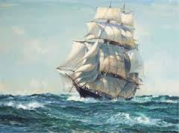
INSPIRATION OF SCRIPTURE 2 Peter 2:20-21
Men Wrote as they were inspired by Holy Spirit “phero” = to carry Acts 27:15,17
Opposite of Knowledge of False Teachers
Which is their own imagination
Jer. 23:16

Slide 25
Preach the Word for Nine Reasons
Impact on Paul (2 Tim 3:14)
Impact on salvation (2 Tim 3:15)
Divine origin (2 Tim 3:16a)
Impact on sanctification (2 Tim 3:16b)
Impact on equipping (2 Tim 3:17)
Paul’s charge to Timothy (2 Tim 4:1a, 2)
Timothy’s evaluation at the Bema Seat (2 Tim 4:1b)
Preference of men to avoid the word (2 Tim 4:3-4)
Need to complete Timothy’s ministry (2 Tim 4:5-8)

Slide 26
Three Tenses of Salvation
Phase | Justification | Sanctification | Glorification
Tense | Past | Present | Future
Saved from sin’s: | Penalty | Power | Presence
Scripture | Eph 2:8-9; Titus 3:5 | Philip 2:12 | Rom 5:10

Slide 27
Preach the Word for Nine Reasons
Impact on Paul (2 Tim 3:14)
Impact on salvation (2 Tim 3:15)
Divine origin (2 Tim 3:16a)
Impact on sanctification (2 Tim 3:16b)
Impact on equipping (2 Tim 3:17)
Paul’s charge to Timothy (2 Tim 4:1a, 2)
Timothy’s evaluation at the Bema Seat (2 Tim 4:1b)
Preference of men to avoid the word (2 Tim 4:3-4)
Need to complete Timothy’s ministry (2 Tim 4:5-8)

Slide 28
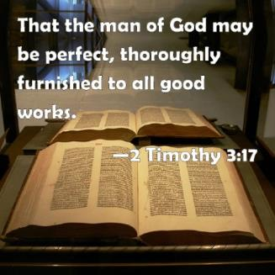
2 Timothy 3:17
“so that the man of God may be adequate, equipped for every good work.”

Slide 29
Preach the Word for Nine Reasons
Impact on Paul (2 Tim 3:14)
Impact on salvation (2 Tim 3:15)
Divine origin (2 Tim 3:16a)
Impact on sanctification (2 Tim 3:16b)
Impact on equipping (2 Tim 3:17)
Paul’s charge to Timothy (2 Tim 4:1a, 2)
Timothy’s evaluation at the Bema Seat (2 Tim 4:1b)
Preference of men to avoid the word (2 Tim 4:3-4)
Need to complete Timothy’s ministry (2 Tim 4:5-8)

Slide 30
Preach the Word for Nine Reasons
Impact on Paul (2 Tim 3:14)
Impact on salvation (2 Tim 3:15)
Divine origin (2 Tim 3:16a)
Impact on sanctification (2 Tim 3:16b)
Impact on equipping (2 Tim 3:17)
Paul’s charge to Timothy (2 Tim 4:1a, 2)
Timothy’s evaluation at the Bema Seat (2 Tim 4:1b)
Preference of men to avoid the word (2 Tim 4:3-4)
Need to complete Timothy’s ministry (2 Tim 4:5-8)

Slide 31
Preach the Word for Nine Reasons
Impact on Paul (2 Tim 3:14)
Impact on salvation (2 Tim 3:15)
Divine origin (2 Tim 3:16a)
Impact on sanctification (2 Tim 3:16b)
Impact on equipping (2 Tim 3:17)
Paul’s charge to Timothy (2 Tim 4:1a, 2)
Timothy’s evaluation at the Bema Seat (2 Tim 4:1b)
Preference of men to avoid the word (2 Tim 4:3-4)
Need to complete Timothy’s ministry (2 Tim 4:5-8)

Slide 32
2 Timothy 4:3-4
“For the time will come when they will not endure sound doctrine; but wanting to have their ears tickled, they will accumulate for themselves teachers in accordance to their own desires, ⁴ and will turn away their ears from the truth and will turn aside to myths.”

Slide 33
Preach the Word for Nine Reasons
Impact on Paul (2 Tim 3:14)
Impact on salvation (2 Tim 3:15)
Divine origin (2 Tim 3:16a)
Impact on sanctification (2 Tim 3:16b)
Impact on equipping (2 Tim 3:17)
Paul’s charge to Timothy (2 Tim 4:1a, 2)
Timothy’s evaluation at the Bema Seat (2 Tim 4:1b)
Preference of men to avoid the word (2 Tim 4:3-4)
Need to complete Timothy’s ministry (2 Tim 4:5-8)

Slide 34
Necessity for Timothy to Complete His Ministry (2 Tim 4:5-8)
Charge (4:5)
Reason (4:6)
Reward (4:7-8)
Satisfaction of a life well spent (4:7)
Bema Seat (4:8)

Slide 35
Four Part Structure
General call to faithful endurance in the ministry (chapter 1)
Ten metaphors describing what faithful endurance looks like (chapter 2)
What to do in the midst of the coming apostasy (3:1–4:8)
How God met six needs in Paul’s life (4:9-22)

Slide 36
2 Timothy 4:9-22
God Meets Needs

Slide 37
Paul’s Two Roman Imprisonments Contrasted
First Imprisonment (Acts 28:16-31) | Second Imprisonment (2 Tim)
Wrote prison epistles | Wrote 2 Timothy
Religious charges | Political charges
Local and sporadic persecutions (AD 60-63) | Neronian persecution (AD 64-68)
Decent conditions (house) | Poor conditions (dungeon)
Many friends | Virtually alone
Evangelistic opportunities | Opportunities restricted
Optimistic for release (Phil 1:24-26) | Execution anticipated (2 Tim 4:6)
Adapted from Nelson's Complete Book of Charts and Maps, 433.

Slide 38
God Met Paul’s Needs
Loneliness
Deliverance
Persecution
Spiritual hunger
Physical needs
Relational needs

Slide 39
God Met Paul’s Needs
Loneliness
Deliverance
Persecution
Spiritual hunger
Physical needs
Relational needs

Slide 40
Loneliness
Need: fellowship in the midst of loneliness (2 Tim 4:9-12, 16)
Met: God ministered to Paul (2 Tim 4:17a)

Slide 41
God Met Paul’s Needs
Loneliness
Deliverance
Persecution
Spiritual hunger
Physical needs
Relational needs

Slide 42
Deliverance
Need: deliverance from an impossible situation (2 Tim 4:17b)
Met: divine deliverance (2 Tim 4:17b-18)

Slide 43
OT PROPHETS DESCRIBE THE KINGDOM
Kingdom Characteristics
Is. 2:1-4; 11:6-9
Jerusalem = center of world spiritual and political authority
Perfect justice
World peace
Peace in the animal kingdom
Universal spiritual knowledge.

Slide 44
Prophecy Panorama
Great White Throne Judgment
Rapture
Messiah’s Coming & Death
Second Advent
CHURCH AGE
Eternal State
Old Testament
Tribulation Kingdom
Dan. 9:27
Rev. 6-19
Rev. 20
Rev. 21-22

Slide 45
God Met Paul’s Needs
Loneliness
Deliverance
Persecution
Spiritual hunger
Physical needs
Relational needs

Slide 46
Persecution
Need: to be ministered to in the midst of persecution (4:14a, 15)
Met: God will repay the believer's enemies (4:14b)

Slide 47
God Met Paul’s Needs
Loneliness
Deliverance
Persecution
Spiritual hunger
Physical needs
Relational needs

Slide 48
Spiritual Hunger
Need: to be spiritually fed (4:13b)
Met: Timothy to bring Paul the Scriptures (4:13b)

Slide 49
God Met Paul’s Needs
Loneliness
Deliverance
Persecution
Spiritual hunger
Physical needs
Relational needs

Slide 50
Physical Needs
Need: warmth (4:13a)
Met: Timothy to bring Paul’s cloak (4:13a)

Slide 51
God Met Paul’s Needs
Loneliness
Deliverance
Persecution
Spiritual hunger
Physical needs
Relational needs

Slide 52
Relational Needs
Need: Estrangement from Mark (Acts 13:13; 15:36-40)
Met: Mark and Paul reconciled (2 Tim 4:11)

Slide 53
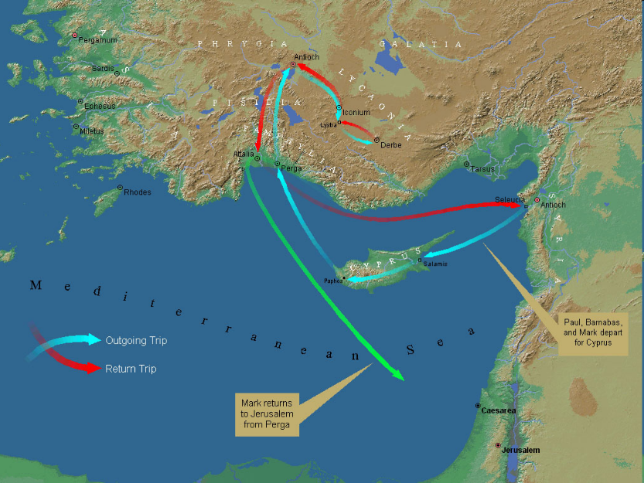
First Missionary Journey

Slide 54
Relational Needs
Need: Estrangement from Mark (Acts 13:13; 15:36-40)
Met: Mark and Paul reconciled (2 Tim 4:11)

Slide 55
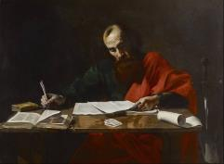
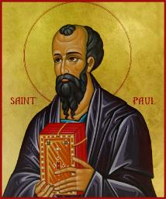
Grace for Today In Paul’s Teaching
Ministry effectiveness (1 Cor. 15:10)
Church growth (1 Cor. 3:6)
Preaching (1 Cor. 2:4)
Gifting (1 Cor. 12:4, 11)
Living above the sin nature (Gal. 5:16)
Christ-like character (Gal. 5:22-23)
Overcoming fear (2 Tim. 1:7)
Suffering (2 Cor. 12:9; 2 Tim. 1:8)
Paul’s conclusion (Gal. 3:3; 5:4)

Slide 56
Conclusion

Slide 57
God Met Paul’s Needs
Loneliness
Deliverance
Persecution
Spiritual hunger
Physical needs
Relational needs

Slide 58
Message
Faithful endurance in the ministry, even in the midst of encroaching persecution and apostasy, so that the Christian message will be preserved for the next generation

Slide 59
Four Part Structure
General call to faithful endurance in the ministry (chapter 1)
Ten metaphors describing what faithful endurance looks like (chapter 2)
What to do in the midst of the coming apostasy (3:1–4:8)
How God met six needs in Paul’s life (4:9-22)

Slide 60
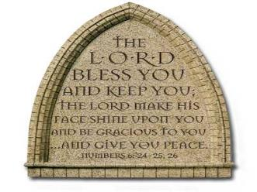
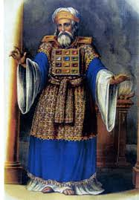
“The Lord bless you and keep you; the Lord make his face shine on you and be gracious to you; the Lord turn his face toward you and give you peace.” (NIV)

