Slide 1
Law vs. Grace: An Overview Jim McGowan, Th.D. Sugar Land Bible Church 05-15-2016.
Special thanks to Dr. Vern Peterman for access to his insights and resources.
Notes:
Law vs. Grace: An Overview

Slide 2
Outline
Our Purpose, Aim, and Objective
Points of Contrast and Comparison
Critical Insights into Christ’s 1st Coming
Misunderstanding The Law & Christ’s Earthly Ministry
A Proper Response to the Grace Gift
Conclusion

Slide 3
I. OUR PURPOSE, AIM, AND OBJECTIVE
Law vs. Grace: An Overview
…is to Compare and Contrast Law and Grace so as to properly understand these two important themes and how they are related to the life of the New Testament Believer.

Slide 4
2 Corinthians 3:6–11
⁶ [God] also made us adequate as servants of a new covenant, not of the letter but of the Spirit; for the letter kills, but the Spirit gives life. ⁷ But if the ministry of death, in letters engraved on stones, came with glory, so that the sons of Israel could not look intently at the face of Moses because of the glory of his face, fading as it was, ⁸ how will the ministry of the Spirit fail to be even more with glory? ⁹ For if the ministry of condemnation has glory, much more does the ministry of righteousness abound in glory. ¹⁰ For indeed what had glory, in this case has no glory because of the glory that surpasses it. ¹¹ For if that which fades away was with glory, much more that which remains is in glory. (NASB95)
Notes:
Paul introduces 7 contrasts between the Law of Moses and Grace in 2 Cor. 3.

Slide 5
Disclaimer: NOT an Extreme Teaching!
Law vs. Grace: An Overview
Looking at things in opposite ways
Notes:
Disclaimer: NOT an Extreme Bible Study!
There is often a tendency among some Christians to go to extremes or to polarize what they see in Scripture so that either Israel and the Church are not that much different, or they are so very different that there is nothing in common.
Looking at things in opposite ways

Slide 6
Law vs. Grace: An Overview
Biblical!
Notes:
Disclaimer: NOT an Extreme Bible Study!

Slide 7
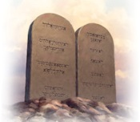
A. Why Compare and Contrast?
Law vs. Grace: An Overview
Israel under the Law
The Church under Grace
Notes:
Comparing and Contrasting
As we go through portions of these three sections of Scripture, we’ll be comparing and contrasting Israel under the Law and the Church under Grace.

Slide 8
A. Why Compare and Contrast?
Law vs. Grace: An Overview
As we compare and contrast, we’ll discover that there are indeed:
similarities between Israel & the Church…
Exodus 7:4
“…My people the sons of Israel…”
1 Peter 2:10
“…now you [the Body of Christ] are the people of God…”
Notes:
Comparing and Contrasting
As we compare and contrast, we’ll discover that there are indeed:
similarities between Israel & the Church, and…
Exodus 7:4
“…My people the sons of Israel…”
1 Peter 2:10 “…now you [the Body of Christ] are the people of God…”

Slide 9
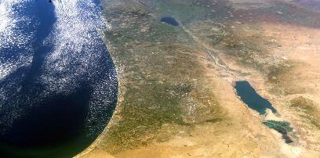
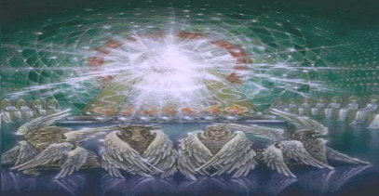
A. Why Compare and Contrast?
Law vs. Grace: An Overview
but there are also important differences between Israel under the Law and the Church under Grace.
Where are you blessed?
Notes:
Comparing and Contrasting
and there are also important differences between Israel under the Law and the Church under Grace.
Where are you blessed?

Slide 10
A. Why Compare and Contrast?
Law vs. Grace: An Overview
As we compare and contrast, we will avoid extremes simply by observing:
what is the same or similar between Israel and the Church?
what is different between them.
Fortunately, God’s Holy Word clearly spells out these things.
Notes:
Comparing and Contrasting
We will avoid those extremes by simply observing:
What is the same or similar between Israel and the Church?
We will also observe what is different between them.
Fortunately, God’s Holy Word reveals these things.

Slide 11
B. Does This Really Matter?
Law vs. Grace: An Overview
Why would we consider it so important to compare and contrast Law and Grace – Israel and the Church?
Isn’t this all just much to do about nothing?
Notes:
B. Does This Really Matter?
Why would we consider it so important to compare and contrast Law vs. Grace: An Overview, Israel & the Church?
Isn’t this all just much to do about nothing?

Slide 12
B. Does This Really Matter?
Law vs. Grace: An Overview
“There is a tendency, however, for dispensationalists to get carried away with compartmentalizing truth to the point that they make unbiblical differentiations. An almost obsessive desire to categorize and contrast related truths has carried various dispensationalist interpreters (Chafer, Ryrie, Hodges, etc.) far beyond the legitimate distinctions between Israel and the Church. Many would also draw hard lines between salvation and discipleship (justification and sanctification), the church and the kingdom, Christ's preaching and the apostolic message, faith and repentance, and the age of law and the age of grace." (bold & emphasis mine) John MacArthur Jr., The Gospel According to Jesus, page 31
Notes:
B. Does This Really Matter?
“There is a tendency, however, for dispensationalists to get carried away with compartmentalizing truth to the point that they make unbiblical differentiations. An almost obsessive desire to categorize and contrast related truths has carried various dispensationalist interpreters (Chafer, Ryrie, Hodges, etc.) far beyond the legitimate distinctions between Israel and the Church. Many would also draw hard lines between salvation and discipleship (justification and sanctification), the church and the kingdom, Christ's preaching and the apostolic message, faith and repentance, and the age of law and the age of grace." (bold & emphasis mine) John MacArthur Jr., The Gospel According to Jesus, page 31

Slide 13
B. Does This Really Matter?
Law vs. Grace: An Overview
For one thing, it is a matter of what the Bible actually says!
1 Corinthians 10:11
¹¹ Now these things happened to them as an example, and they were written for our instruction…
Notes:
B. Does This Really Matter?
For one thing, it is a matter of what the Bible actually says.
Secondly, making a distinction impacts relationships & identities.
God designed life & eternity so as to require clarity of identities & relationships.
NEXT SLIDE

Slide 14
B. Does This Really Matter?
Law vs. Grace: An Overview
Secondly, properly understanding these distinction impacts relationships and identities.
God designed this life and eternity so as to require clarity of identities and relationships.
Notes:
B. Does This Really Matter?
Secondly, making a distinction impacts relationships & identities.
God designed life & eternity so as to require clarity of identities & relationships.
NEXT SLIDE

Slide 15
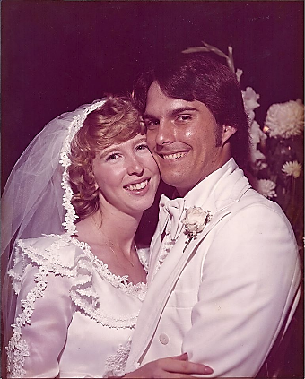
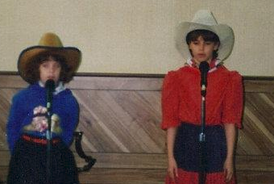
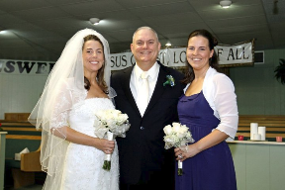
B. Does This Really Matter? Clarity of Identities and Relationships
Law vs. Grace: An Overview
My Wife
My Daughters.
Notes:
B. Does This Really Matter?
Clarity of Identities & Relationships
My wife and my daughters. Wife born in Houston, TX – Two daughters born in Houston, TX
Three females… one’s a wife, and two are daughters.
All born in the same city and state
All a part of the same family
All at one point had the same last name.
There’s a lot alike here isn’t there? And I love all three of them.
But it’s very important that I make a distinction regardless of what I see in common! If I fail to make the appropriate distinctions in spite of what is in common between my wife and my daughters, a lot of people would get very upset. Not the least of whom would be my daughters’ husbands and certainly my wife!!! How about making proper distinctions with other women? Is that important? It is for me! My dear, sweet, kind, gentle, wife has clearly indicated the ramifications of not maintaining appropriate distinctions…I believe she has expressed it this way, “I’ll snatch another woman bald-headed”!!! She didn’t articulate what she would do to me and I didn’t ask!
It is very important then, in spite of what is in common, to see the distinctions. It matters greatly in regards to identities and relationships not only in our present earthly existence, but also in eternity. It matters that we understand identities and relationships.
NEXT SLIDE

Slide 16
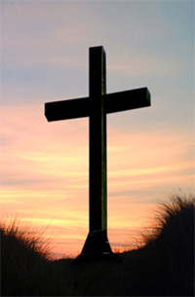
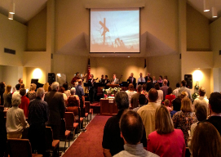
B. Does This Really Matter?
Law vs. Grace: An Overview
YES! IT’S A MATTER OF LIFE & DEATH!
Notes:
B. Does This Really Matter?
YES! IT’S A MATTER OF LIFE & DEATH!
We in the Church have been crucified with Christ so as to die to the Law, so that Christ would do the living through us (Gal. 2:19-20)…
NEXT SLIDE

Slide 17
Numbers 15:32–36 ³²
Now while the sons of Israel were in the wilderness, they found a man gathering wood on the sabbath day. ³³ Those who found him gathering wood brought him to Moses and Aaron and to all the congregation; ³⁴ and they put him in custody because it had not been declared what should be done to him. ³⁵ Then the Lord said to Moses, “The man shall surely be put to death; all the congregation shall stone him with stones outside the camp.” ³⁶ So all the congregation brought him outside the camp and stoned him to death with stones, just as the Lord had commanded Moses. (NASB95)
Notes:
Numbers 15:32–36
³² Now while the sons of Israel were in the wilderness, they found a man gathering wood on the sabbath day. ³³ Those who found him gathering wood brought him to Moses and Aaron and to all the congregation; ³⁴ and they put him in custody because it had not been declared what should be done to him. ³⁵ Then the Lord said to Moses, “The man shall surely be put to death; all the congregation shall stone him with stones outside the camp.” ³⁶ So all the congregation brought him outside the camp and stoned him to death with stones, just as the Lord had commanded Moses. (NASB95)
NEXT SLIDE

Slide 18
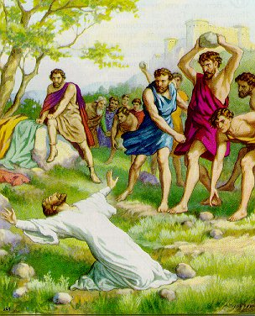
B. Does This Really Matter?
Law vs. Grace: An Overview
YES! IT’S A MATTER OF LIFE & DEATH!
Notes:
B. Does This Really Matter?
YES! IT’S A MATTER OF LIFE & DEATH!
…but if we insist on living under the Law (and there are Christians who do) then we’ll be trying to be blessed by a ministry of death and condemnation (2 Cor. 3:7, 9). Many Christians today are trying to be blessed by a ministry of death and condemnation!!!
These are not my words, they’re the Apostle Paul’s words given under the inspiration of the Holy Spirit. Can you imagine trying to be blessed under a ministry characterized by death and condemnation?!
NEXT SLIDE

Slide 19
2 Corinthians 3:7–9
⁷ But if the ministry of death, in letters engraved on stones, came with glory, so that the sons of Israel could not look intently at the face of Moses because of the glory of his face, fading as it was, ⁸ how will the ministry of the Spirit fail to be even more with glory? ⁹ For if the ministry of condemnation has glory, much more does the ministry of righteousness abound in glory. (NASB95)
Notes:
2 Corinthians 3:7–9
⁷ But if the ministry of death, in letters engraved on stones, came with glory, so that the sons of Israel could not look intently at the face of Moses because of the glory of his face, fading as it was, ⁸ how will the ministry of the Spirit fail to be even more with glory? ⁹ For if the ministry of condemnation has glory, much more does the ministry of righteousness abound in glory. (NASB95)
NEXT SLIDE

Slide 20
B. Does This Really Matter?
Law vs. Grace: An Overview
YES! IT’S A MATTER OF LIFE & DEATH!
God never intended that we in the Church live that way!
We’re already blessed, so why would we strive and work under a ministry of death and condemnation in order to be blessed?
Notes:
B. Does This Really Matter?
YES! IT’S A MATTER OF LIFE & DEATH!
God never intended that we in the Church live that way!
We’re already blessed, so why would we strive and work under a ministry of death and condemnation in order to be blessed?
NEXT SLIDE

Slide 21
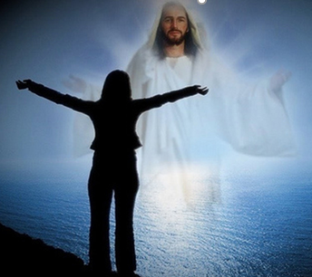
B. Does This Really Matter?
Law vs. Grace: An Overview
YES! IT’S A MATTER OF LIFE & DEATH!
Because of our “identification in Christ,” we died to the Law.
Christ is now our life and our righteousness so we don’t have to try to FIND life or try to STAY ALIVE.
Notes:
B. Does This Really Matter?
YES! IT’S A MATTER OF LIFE & DEATH!
Because of our “identification in Christ,” we died to the Law.
Christ is now our life and our righteousness so we don’t have to try to FIND life or try to STAY ALIVE.
NEXT SLIDE

Slide 22
B. Does This Really Matter?
Law vs. Grace: An Overview
YES! IT’S A MATTER OF LIFE & DEATH!
Galatians 2:19–20
¹⁹ “For through the Law I died to the Law, so that I might live to God. ²⁰ “I have been crucified with Christ; and it is no longer I who live, but Christ lives in me; and the life which I now live in the flesh I live by faith in the Son of God, who loved me and gave Himself up for me. (NASB95)
Notes:
B. Does This Really Matter?
YES! IT’S A MATTER OF LIFE & DEATH!
Galatians 2:19–20 (NASB95)
19 “For through the Law I died to the Law, so that I might live to God. 20 “I have been crucified with Christ; and it is no longer I who live, but Christ lives in me; and the life which I now live in the flesh I live by faith in the Son of God, who loved me and gave Himself up for me.
It’s no longer I who does the living, it is Christ who does the living!!!
NEXT SLIDE

Slide 23
B. Does This Really Matter?
Law vs. Grace: An Overview
YES! IT’S A MATTER OF LIFE & DEATH!
Romans 7:4
⁴ Therefore, my brethren, you also were made to die to the Law through the body of Christ, so that you might be joined to another, to Him who was raised from the dead, in order that we might bear fruit for God. (NASB95)
Notes:
B. Does This Really Matter?
YES! IT’S A MATTER OF LIFE & DEATH!
Romans 7:4 - ⁴ Therefore, my brethren, you also were made to die to the Law through the body of Christ, so that you might be joined to another, to Him who was raised from the dead, in order that we might bear fruit for God. (NASB95)

Slide 24
Outline
Our Purpose, Aim, and Objective
Points of Contrast and Comparison
Critical Insights into Christ’s 1st Coming
Misunderstanding The Law & Christ’s Earthly Ministry
A Proper Response to the Grace Gift
Conclusion

Slide 25
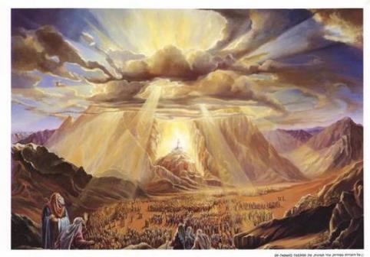
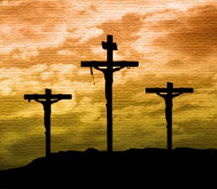
II. Points of Contrast and Comparison
Law vs. Grace: An Overview
Mt. Sinai
Mt. Calvary
Notes:
Contrasts and Comparison
Mt. Sinai and Mt. Calvary
So we can already see that we have important Contrasts and Comparison to make.
As we will see shortly, there are very clear contrasts between Mt. Sinai and Mt. Calvary.
The Law was given at Mt. Sinai but it was given the Israelites were told, “Don’t you dare come close to the mountain! If you do, you must be killed! As the Law is being given, don’t come close!”
The other mountain is Mt. Calvary (Golgotha), this other mountain is where Grace was shown.
NEXT SLIDE

Slide 26
II. Points of Contrast and Comparison
Law vs. Grace: An Overview
Steward | MOSES | CHRIST
Governing Principle | Law | Grace
Who’s Works are you depending on? | Self | Christ
People Group | ISRAEL | CHURCH
Baptism | Into Moses | Into Christ
Ministry Characteristic | Death / Condemnation | Spirit / Righteousness
Nature of Blessings | Conditional (If) / Earthly | Unconditional / Heavenly
Earthly Difficulties | Curses for disobedience | Growth or discipline
Notes:
Points of Comparison & Contrast
Steward MOSES CHRIST
Scripture portrays both Moses and Christ as Stewards. Each was entrusted by God with the establishment of something.
Principle Israel under Law The Church under Grace
The principle of Law reigns over Israel while the principle of Grace reigns over the Church.
Who’s Works are you depending on? Self Christ
Under the Law – Do’s and Don’ts to be blessed or cursed. Under Grace we rely on Christ’s works! It is His works that save and make me who I am “In Christ”.
People Group ISRAEL CHURCH
Baptism Into Moses Into Christ
The people groups mentioned above are spoken of as having been baptized into (identified with and joined to) either Moses (LAW) or Christ (GRACE). We as believers have been baptized into Christ which has great significance for us.
Ministry Characteristic Death Condemnation Spirit Righteousness
2 Cor. 3
Nature of Blessings Conditional (If) / Earthly Unconditional / Heavenly
Deut. 28:1-14 (Blessings) 15-68 (Curses) Eph. 1:3; 4 (practical implications)
Earthly Difficulties Curses for disobedience Growth or discipline
NEXT SLIDE

Slide 27
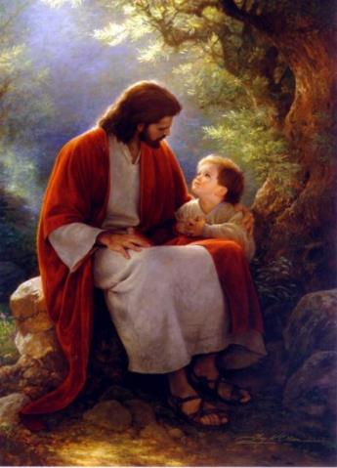
A. Distance and Intimacy
Law vs. Grace: An Overview
A significant point of contrast between Law and Grace is in our access to and our intimacy with God:
Notes:
Distance and Intimacy
A significant point of contrast between Law vs. Grace: An Overview is in our access to and our intimacy with God:
Law - Do not come near!!! Grace – draw near!
NEXT SLIDE

Slide 28
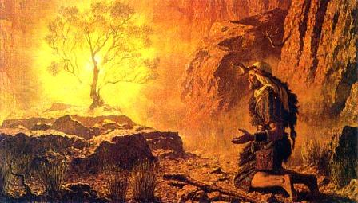
A. Distance and Intimacy
Law vs. Grace: An Overview
Under the Law of Moses, distance from God was a LEGAL REQUIREMENT.
Exodus 3:4–5
⁴ When the Lord saw that he turned aside to look, God called to him from the midst of the bush and said, “Moses, Moses!” And he said, “Here I am.” ⁵ Then He said, “Do not come near here; remove your sandals from your feet, for the place on which you are standing is holy ground.”
Notes:
Distance and Intimacy
Under the Law of Moses, distance from God was a legal requirement (cf. Exo. 19:12-13).
Exodus 3:4–5 - ⁴ When the Lord saw that he turned aside to look, God called to him from the midst of the bush and said, “Moses, Moses!” And he said, “Here I am.” ⁵ Then He said, “Do not come near here; remove your sandals from your feet, for the place on which you are standing is holy ground.”
Legal requirement. Moses at the burning bush!
NEXT SLIDE

Slide 29
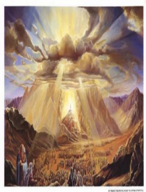
A. Distance and Intimacy
Law vs. Grace: An Overview
Exodus 19:12-13
¹² "You shall set bounds for the people all around, saying, 'Beware that you do not go up on the mountain or touch the border of it; whoever touches the mountain shall surely be put to death. ¹³ 'No hand shall touch him, but he shall surely be stoned or shot through; whether beast or man, he shall not live…"
Notes:
Distance in Exodus 19:12-13
¹² "You shall set bounds for the people all around, saying, 'Beware that you do not go up on the mountain or touch the border of it; whoever touches the mountain shall surely be put to death. ¹³ 'No hand shall touch him, but he shall surely be stoned or shot through; whether beast or man, he shall not live…"
NEXT SLIDE

Slide 30
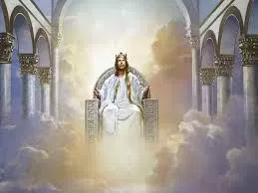
A. Distance and Intimacy
Law vs. Grace: An Overview
Isaiah 6:5
⁵ Then I said, “Woe is me, for I am ruined! Because I am a man of unclean lips, And I live among a people of unclean lips; For my eyes have seen the King, the Lord of hosts.” (NASB95)
Notes:
Distance and Intimacy
Isaiah 6:5 - ⁵ Then I said, “Woe is me, for I am ruined! Because I am a man of unclean lips, And I live among a people of unclean lips; For my eyes have seen the King, the Lord of hosts.” (NASB95)
NEXT SLIDE

Slide 31
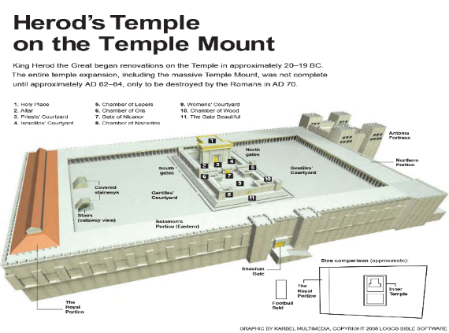
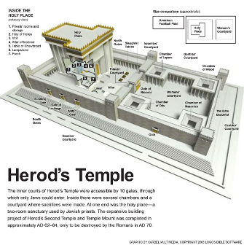
A. Distance and Intimacy
Law vs. Grace: An Overview
Notes:
Distance and Intimacy
NEXT SLIDE

Slide 32
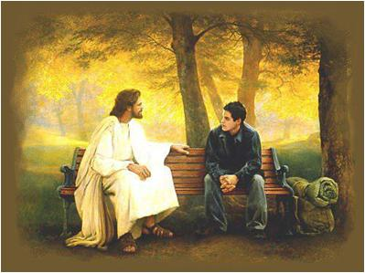
Law vs. Grace: An Overview
B. Access
Notes:
Distance and Intimacy
But under grace we have access to God, are called to draw near to Him, and to know Christ deeply and intimately (Eph. 2:18; 3:11-12).
NEXT SLIDE

Slide 33
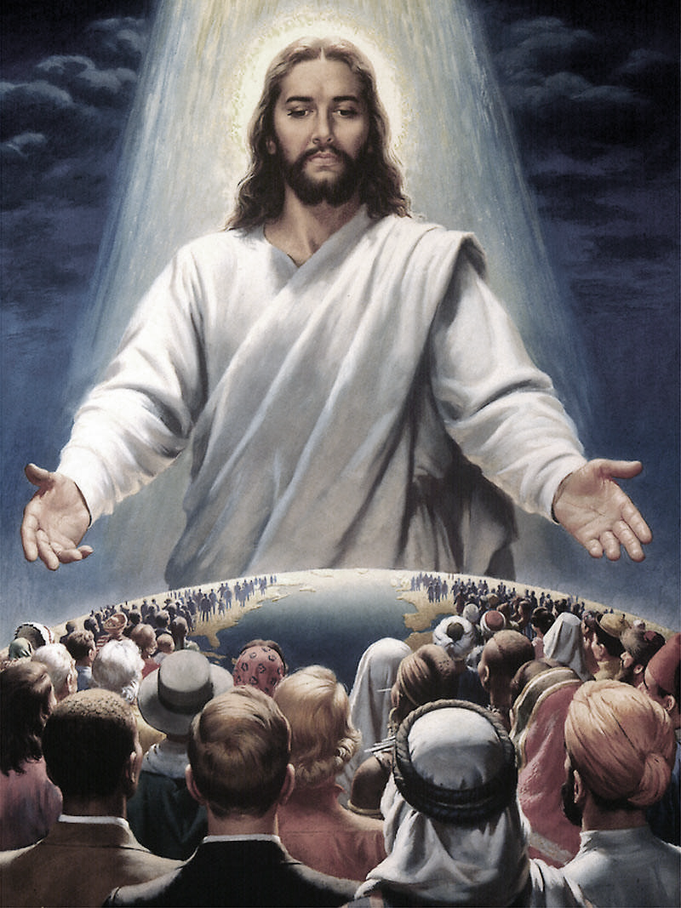
B. Access
Law vs. Grace: An Overview
Ephesians 2:18 & 3:11-12
^{2:18} …for through Him [Christ] we both have our access in one Spirit to the Father…^{3:11}…Christ Jesus our Lord, ¹² in whom we have boldness and confident access through faith in Him. (NASB)
Notes:
Access in Ephesians 2:18 & 3:11-12
^{2:18} …for through Him [Christ] we both have our access in one Spirit to the Father…^{3:11}…Christ Jesus our Lord, ¹² in whom we have boldness and confident access through faith in Him.
Come Near and Stay Near!!!
NEXT SLIDE

Slide 34
B. Access
Law vs. Grace: An Overview
Hebrews 4:15–16
¹⁵ For we do not have a high priest who cannot sympathize with our weaknesses, but One who has been tempted in all things as we are, yet without sin.¹⁶ Let us therefore draw near with confidence to the throne of grace, that we may receive mercy and may find grace to help in time of need. (NASB)
Notes:
Access in Hebrews 4:15–16
¹⁵ For we do not have a high priest who cannot sympathize with our weaknesses, but One who has been tempted in all things as we are, yet without sin.¹⁶ Let us therefore draw near with confidence to the throne of grace, that we may receive mercy and may find grace to help in time of need. (NASB)
NEXT SLIDE

Slide 35
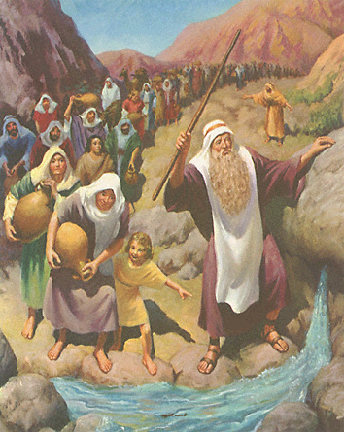
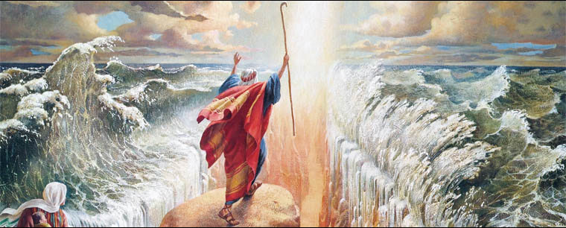
C. The Law Looks Ahead to Grace
Law vs. Grace: An Overview
Moses recorded the things that happened to the Israelites for our benefit and for our instruction.
Notes:
C. The Law Looks Ahead to Grace
Moses recorded the things that happened to the Israelites for our benefit and for our instruction (Rom. 15:4; 1 Cor. 10:11).
NEXT SLIDE

Slide 36
C. The Law Looks Ahead to Grace
Law vs. Grace: An Overview
Romans 15:4
⁴ For whatever was written in earlier times was written for our instruction, that through perseverance and the encouragement of the Scriptures we might have hope.
1 Corinthians 10:11
¹¹ Now these things happened to them as an example, and they were written for our instruction, upon whom the ends of the ages have come.
Notes:
C. The Law Looks Ahead to Grace
Romans 15:4 - ⁴ For whatever was written in earlier times was written for our instruction, that through perseverance and the encouragement of the Scriptures we might have hope.
1 Corinthians 10:11 - ¹¹ Now these things happened to them as an example, and they were written for our instruction, upon whom the ends of the ages have come.
NEXT SLIDE

Slide 37
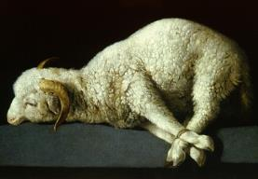
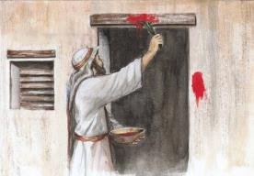
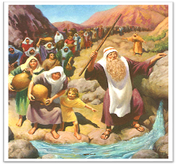
C. The Law Looks Ahead to Grace
Law vs. Grace: An Overview
And among those benefits and things written for our instruction is that THE LAW POINTS TO WHO CHRIST IS AND WHAT HE DID FOR US.
Grace also looks back on the Law.
Notes:
The Law Looks Ahead to Grace
And among those benefits and things written for our instruction is that the Law points to who Christ is and what He did for us.
Christ our Passover - 1 Cor. 5:7
Christ the Lamb of God. John 1 – John the Baptist…Behold the Lamb!
Christ is the Rock Who provides Spiritual drink – 1 Cor. 10
Grace also looks back on the Law.
Christ the Lamb of God! - John 1:29; 36
Christ our Passover! - 1 Corinthians 5:7
Christ the Giver of Living Water! - John 4:7–14

Slide 38
Outline
Our Purpose, Aim, and Objective
Points of Contrast and Comparison
Critical Insights into Christ’s 1st Coming
Misunderstanding The Law & Christ’s Earthly Ministry
A Proper Response to the Grace Gift
Conclusion

Slide 39
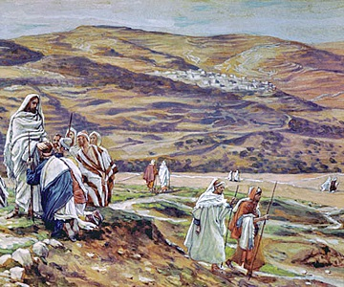
III. Critical Insights into Christ’s 1st Coming
Law vs. Grace: An Overview
While Christ was the steward who initiated the Church through the apostles in His first coming, His 3 years of ministry are often misunderstood by Christians.
Notes:
III. Critical Insights into Christ’s 1st Coming
While Christ was the steward who initiated the Church through the apostles in His first coming, His 3 years of ministry are often misunderstood by Christians.

Slide 40
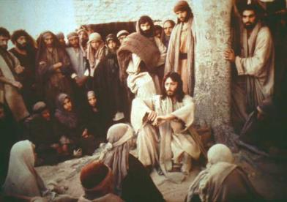
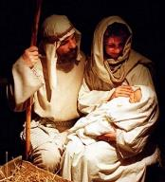
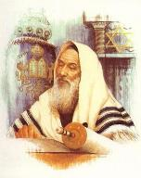
III. Critical Insights into Christ’s 1st Coming
Law vs. Grace: An Overview
Christ was first sent to earth to be born a Jew, in the land of Israel, TO APPEAL ONLY TO THE JEWS to receive Him as their King and Messiah – by preaching the Gospel of the Kingdom of God.
Notes:
III. Critical Insights into Christ’s 1st Coming
Christ was first sent to earth to be born a Jew, in the land of Israel, to appeal only to the Jews to receive Him as their King and Messiah, by preaching the Gospel of the Kingdom of God.
NEXT SLIDE

Slide 41
III. Critical Insights into Christ’s 1st Coming
Law vs. Grace: An Overview
Matthew 10:5–6
“…Do not go in the way of the Gentiles, and do not enter any city of the Samaritans; ⁶ but rather go to the lost sheep of the house of Israel.” (NASB95)
Matthew 15:24
“…I was sent only to the lost sheep of the house of Israel.” (NASB95)
Notes:
III. Critical Insights into Christ’s 1st Coming
Matthew 10:5–6 - “…Do not go in the way of the Gentiles, and do not enter any city of the Samaritans; ⁶ but rather go to the lost sheep of the house of Israel.” (NASB95)
Matthew 15:24 - “…I was sent only to the lost sheep of the house of Israel.” (NASB95)
NEXT SLIDE

Slide 42
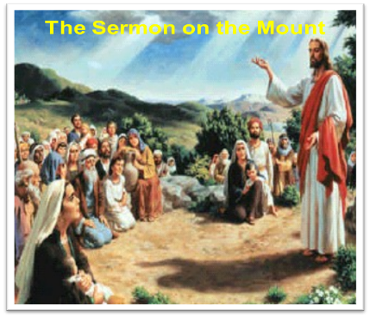
III. Critical Insights into Christ’s 1st Coming
Law vs. Grace: An Overview
All but the very last part of the earthly ministry of Christ was TO JEWS IN THE LAND OF ISRAEL, as an appeal TO LIVE UNDER THE LAW and to accept Him as their King.
Notes:
III. Critical Insights into Christ’s 1st Coming
All but the very last part of the earthly ministry of Christ was to Jews in the land of Israel, as an appeal to live under the Law and to accept Him as their King.
Matthew 23:1–3 (NASB95) - ¹ Then Jesus spoke to the crowds and to His disciples, ² saying: “The scribes and the Pharisees have seated themselves in the chair of Moses; ³ therefore all that they tell you, do and observe, but do not do according to their deeds; for they say things and do not do them.
“Jesus was not telling the people to follow and observe everything the Pharisees taught, but rather those teachings that were faithful to the Law of Moses.”

Slide 43
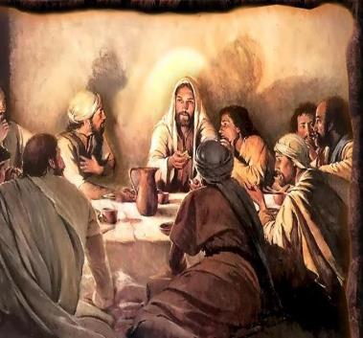
III. Critical Insights into Christ’s 1st Coming
Law vs. Grace: An Overview
Only after it was abundantly clear that the Jews had rejected Him as their King, “UNDER THE LAW OF MOSES”, did Jesus begin to introduce to His disciples the mystery of the Church.
Notes:
III. Critical Insights into Christ’s 1st Coming
Only after it was abundantly clear that the Jews had rejected Him as their King, “under the Law of Moses”, did Jesus begin to tell those disciples about the Church.
It was only after the Jews had purposefully rejected Jesus as their King and Messiah under the Law of Moses, that He began to teach His disciples about the never before seen or understood, mystery of the Church.

Slide 44
III. Critical Insights into Christ’s 1st Coming
Law vs. Grace: An Overview
Matthew 23:37–39
³⁷ “O Jerusalem, Jerusalem, who kills the prophets and stones those who are sent to her! How often I wanted to gather your children together, the way a hen gathers her chicks under her wings, and you were unwilling.³⁸ “Behold, your house is being left to you desolate! ³⁹ “For I say to you, from now on you shall not see Me until you say, ‘Blessed is He who comes in the name of the Lord!’” (NASB)
Notes:
III. Critical Insights into Christ’s 1st Coming
Matthew 23:37–39 - ³⁷ “O Jerusalem, Jerusalem, who kills the prophets and stones those who are sent to her! How often I wanted to gather your children together, the way a hen gathers her chicks under her wings, and you were unwilling.³⁸ “Behold, your house is being left to you desolate! ³⁹ “For I say to you, from now on you shall not see Me until you say, ‘Blessed is He who comes in the name of the Lord!’” (NASB)

Slide 45
Outline
Our Purpose, Aim, and Objective
Points of Contrast and Comparison
Critical Insights into Christ’s 1st Coming
Misunderstanding The Law & Christ’s Earthly Ministry
A Proper Response to the Grace Gift
Conclusion

Slide 46
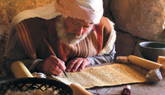
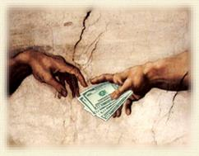
IV. Misunderstanding The Law & Christ’s Earthly Ministry
Law vs. Grace: An Overview
Many believers in the Church now are trying to carry out parts of the Law:
seeking its Jewish earthly blessings
forgiving so that they can be forgiven by God
striving to imitate the earthly life of Christ.
Notes:
IV. MANY MISUNDERSTAND THE LAW AND CHRIST’S EARTHLY MINISTRY
Many believers in the Church now trying to carry out parts of the Law:
seeking its earthly blessings (Health and Wealth Gospel – Prosperity Movement) or
forgiving so that they can be forgiven by God, (instead of recognizing that we forgive because we ARE forgiven) or
striving to imitate the earthly life of Christ (most of Christ’s ministry was to the Jews under Law to prove and demonstrate who He was as part of His offer of the Kingdom to them – Dominion Theology - the duty of Christians is to create a worldwide kingdom patterned after the Mosaic Law).

Slide 47
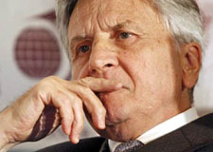
IV. Misunderstanding The Law & Christ’s Earthly Ministry
Law vs. Grace: An Overview
These theological misunderstandings cause many Christians to misinterpret Grace as well, leading them to think that they must do or not do things by living “under the Law” in order to be blessed and have spiritual victory.
Notes:
IV. MANY MISUNDERSTAND THE LAW AND CHRIST’S EARTHLY MINISTRY
These Misunderstandings cause many Christians to misunderstand Grace as well, leading them to think that they must do or not do things “under the Law” in order to be blessed, but “under Grace” we rely on what Christ has already done.
If I don’t understand the Law and God’s purpose for it, and if I don’t understand what Jesus came to do in presenting the Gospel of the Kingdom to the Jews, then I will have a perverted understanding of God’s grace. A misunderstanding of the Law leads to a misunderstanding of Grace. Failure to understand the Law causes Believers to find ways to “trim it down” so they can handle it. Those 10 commandments are great, but that Sabbath thing bothers me so I just take 9! But wait, I really like the idea of tithing so let’s bump it back up to 10. And, you know we can’t stone people in the church today so let’s just remove all discipline.
“Our obedience to God’s will cannot be on a selective basis; we cannot choose that part that is to our liking and disregard the rest…In Galatians 5:3 Paul declares that those who place themselves under the law are obligated to obey the whole law.” Hiebert, D. E. (1997). James (Revised Edition., p. 148-149). Winona Lake, IN: BMH Books.
NEXT SLIDE

Slide 48
IV. Misunderstanding The Law & Christ’s Earthly Ministry
Law vs. Grace: An Overview
Romans 3:20
“²⁰…by the works of the Law no flesh will be justified in His sight...” NASB
Notes:
IV. MANY MISUNDERSTAND THE LAW AND CHRIST’S EARTHLY MINISTRY
Romans 3:19–20 (NASB95) - ¹⁹ Now we know that whatever the Law says, it speaks to those who are under the Law, so that every mouth may be closed and all the world may become accountable to God; ²⁰ because by the works of the Law no flesh will be justified in His sight; for through the Law comes the knowledge of sin.

Slide 49
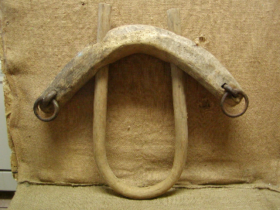
IV. Misunderstanding The Law & Christ’s Earthly Ministry
Law vs. Grace: An Overview
Acts 15:10
¹⁰ “Now therefore why do you put God to the test by placing upon the neck of the disciples a yoke which neither our fathers nor we have been able to bear? (NASB95)
Notes:
IV. MANY MISUNDERSTAND THE LAW AND CHRIST’S EARTHLY MINISTRY
Acts 15:10 - ¹⁰ “Now therefore why do you put God to the test by placing upon the neck of the disciples a yoke which neither our fathers nor we have been able to bear? (NASB95)

Slide 50
IV. Misunderstanding The Law & Christ’s Earthly Ministry
Law vs. Grace: An Overview
Galatians 5:1
¹ It was for freedom that Christ set us free; therefore keep standing firm and do not be subject again to a yoke of slavery. (NASB95)
Notes:
IV. MANY MISUNDERSTAND THE LAW AND CHRIST’S EARTHLY MINISTRY
Galatians 5:1 - ¹ It was for freedom that Christ set us free; therefore keep standing firm and do not be subject again to a yoke of slavery. (NASB95)

Slide 51
IV. Misunderstanding The Law & Christ’s Earthly Ministry
Law vs. Grace: An Overview
Living “under Grace” it is not what we do or don’t do, rather it is our reliance upon what Christ has already done that determines our blessings and spiritual victory.
We do or don’t do things, not in order to be blessed, but because we already are blessed.
Notes:
IV. MANY MISUNDERSTAND THE LAW AND CHRIST’S EARTHLY MINISTRY
Living “under Grace” it is not what we do or don’t do, rather it is our reliance upon what Christ has already done that determines our blessings and spiritual victory.
We do or don’t do things, not in order to be blessed, but because we already are blessed.
NEXT SLIDE

Slide 52
IV. Misunderstanding The Law & Christ’s Earthly Ministry
Law vs. Grace: An Overview
Ephesians 1:3
³ Blessed be the God and Father of our Lord Jesus Christ, who has blessed us with every spiritual blessing in the heavenly places in Christ, (NASB95)
Notes:
IV. MANY MISUNDERSTAND THE LAW AND CHRIST’S EARTHLY MINISTRY
Ephesians 1:3 - ³ Blessed be the God and Father of our Lord Jesus Christ, who has blessed us with every spiritual blessing in the heavenly places in Christ, (NASB95)
NEXT SLIDE

Slide 53
IV. Misunderstanding The Law & Christ’s Earthly Ministry
Law vs. Grace: An Overview
2 Peter 1:2–4
³seeing that [God’s] divine power has granted to us everything pertaining to life and godliness, through the true knowledge of Him who called us by His own glory and excellence. ⁴ For by these He has granted to us His precious and magnificent promises, so that by them you may become partakers of the divine nature, having escaped the corruption that is in the world by lust. (NASB95)
Notes:
IV. MANY MISUNDERSTAND THE LAW AND CHRIST’S EARTHLY MINISTRY
2 Peter 1:2–4 - ³seeing that [God’s] divine power has granted to us everything pertaining to life and godliness, through the true knowledge of Him who called us by His own glory and excellence. ⁴ For by these He has granted to us His precious and magnificent promises, so that by them you may become partakers of the divine nature, having escaped the corruption that is in the world by lust. (NASB95)
“. . . one of the great lessons of 2 Peter is that to maintain a holy life in a world like ours, we must be deeply rooted in the prophetic promises of God’s word. Above all, we must hold fast to that ‘blessed hope’ of the coming again of our Lord and Savior Jesus Christ [cf. Matt. 24:48–50].” Zane C. Hodges, Exposition of Second Peter, The KERUGMA Message 1:2 (July-August 1991):4.
NEXT SLIDE

Slide 54
Outline
Our Purpose, Aim, and Objective
Points of Contrast and Comparison
Critical Insights into Christ’s 1st Coming
Misunderstanding The Law & Christ’s Earthly Ministry
A Proper Response to the Grace Gift
Conclusion
Notes:
NEXT SLIDE

Slide 55
V. A Proper Response to the Grace Gift
Law vs. Grace: An Overview
The Old Covenant (LAW) was very specific concerning human responsibilities. It was essentially an objective, external standard that God revealed for His people Israel without any special enabling grace. However the New Covenant (GRACE) rests on promises that include the indwelling and empowering presence of God’s Holy Spirit who enables the believer to obey (John 14:17; 16:13; Acts 1:4, 8; Rom. 8:4). Emphasis mine.
Constable, T. (2003). Tom Constables Expository Notes on the Bible (2 Co 3:6). Galaxie Software.
Notes:
V. A Proper Response to the Grace Gift
The Old Covenant (LAW) was very specific concerning human responsibilities. It was essentially an objective, external standard that God revealed for His people Israel without any special enabling grace. However the New Covenant (GRACE) rests on promises that include the indwelling and empowering presence of God’s Holy Spirit who enables the believer to obey (John 14:17; 16:13; Acts 1:4, 8; Rom. 8:4). Emphasis mine.
Constable, T. (2003). Tom Constables Expository Notes on the Bible (2 Co 3:6). Galaxie Software.
NEXT SLIDE

Slide 56
V. A Proper Response to the Grace Gift
Law vs. Grace: An Overview
Grace is a gift in the fullest sense therefore, there is no paying God back for the gift – it is given freely out of His love. What God expects is a response of thankfulness.
Notes:
V. A Proper Response to the Grace Gift
Grace is a gift in the fullest sense therefore, there is no paying God back for the gift – it is given freely out of His love.
What God expects is a response of thankfulness.
NEXT SLIDE

Slide 57
V. A Proper Response to the Grace Gift
Law vs. Grace: An Overview
Colossians 3:15–17
¹⁵ Let the peace of Christ rule in your hearts, to which indeed you were called in one body; and be thankful. ¹⁶ Let the word of Christ richly dwell within you, with all wisdom teaching and admonishing one another with psalms and hymns and spiritual songs, singing with thankfulness in your hearts to God. ¹⁷ Whatever you do in word or deed, do all in the name of the Lord Jesus, giving thanks through Him to God the Father. (NASB)
Notes:
V. A Proper Response to the Grace Gift
Colossians 3:15–17 - ¹⁵ Let the peace of Christ rule in your hearts, to which indeed you were called in one body; and be thankful. ¹⁶ Let the word of Christ richly dwell within you, with all wisdom teaching and admonishing one another with psalms and hymns and spiritual songs, singing with thankfulness in your hearts to God. ¹⁷ Whatever you do in word or deed, do all in the name of the Lord Jesus, giving thanks through Him to God the Father.
NEXT SLIDE

Slide 58
Outline
Our Purpose, Aim, and Objective
Points of Contrast and Comparison
Critical Insights into Christ’s 1st Coming
Misunderstanding The Law & Christ’s Earthly Ministry
A Proper Response to the Grace Gift
Conclusion
Notes:
NEXT SLIDE

Slide 59
VI. Conclusion
Notes:
NEXT SLIDE

Slide 60
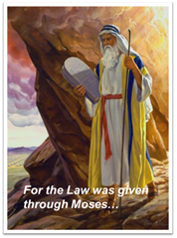
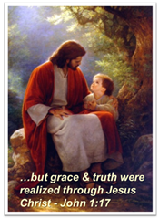
VI. Conclusion
Law vs. Grace: An Overview
If we don’t understand how overwhelmingly, earth-shakingly, awesome the Law is…
…we won’t understand how overwhelmingly, heavenly-shaking, Grace is!
Notes:
Conclusion
If we don’t understand how overwhelmingly, earth-shakingly, awesome the Law is, we won’t understand how overwhelmingly, heavenly-shaking, Grace is!
NEXT SLIDE

Slide 61
What Should I Take Away From This?
Law vs. Grace: An Overview
For the Believer:
Misunderstanding the clear distinctions between Law and Grace causes them:
to incorrectly seek Israel’s earthly blessings or
come under bondage - forgiving in order to be forgiven by God and,
To be burdened with striving to imitate the earthly life of Christ.
It was for freedom that Christ set us free; therefore keep standing firm and do not be subject again to a yoke of slavery. Galatians 5:1 (NASB95)
Notes:
Conclusion
For the Believer:
Misunderstanding the clear distinctions between Law and Grace causes them:
to incorrectly seek Israel’s earthly blessings or
come under bondage - forgiving in order to be forgiven by God and,
To be burdened with striving to imitate the earthly life of Christ.
It was for freedom that Christ set us free; therefore keep standing firm and do not be subject again to a yoke of slavery. Galatians 5:1 (NASB95)
NEXT SLIDE

Slide 62
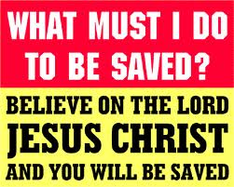
What Should I Take Away From This?
Law vs. Grace: An Overview
For the Non-Believer:
The admonition to those present who are unbelievers is: Today is the Day of Salvation.
You can place your faith in Christ’s promises right now.
Notes:
Conclusion
The admonition to those present who are unbelievers is: Today is the Day of Salvation.
You can place your faith in Christ’s promises right now.
There are no magical incantations, no secret handshakes, no promise to do good deeds, no commitment to church membership, no emotional, pressure induced assurances, no hand raising, and no aisle walking required.
The one condition of salvation is simple faith, (which is trust in or confidence in or reliance upon), Christ’s promise to give New Life to all those who come to Him for salvation.
If this is something you have done or are doing right now, God’s Word authoritatively declares that you are a Child of God and you have access to all of God’s Divine Riches of Grace. God now wants you to grow and mature spiritually, and I can of no better place to do so than here at SLBC.
If you would like more information, the Elders, Deacons, Pastoral staff, and members would be happy to talk with your immediately after the service.
PRAYER - Father, thank you for the convicting power of the Holy Spirit. May we all be sensitive to heed His voice as He draws us to the Lord Jesus Christ for salvation, restoration of fellowship, or spiritual growth. Amen!

Slide 63
VI. Conclusion
Law vs. Grace: An Overview
Numbers 6:24–26
²⁴ The Lord bless you, and keep you; ²⁵ The Lord make His face shine on you, And be gracious to you; ²⁶ The Lord lift up His countenance on you, And give you peace.’

