Slide 1
Soteriology Session 18
Dr. Andy Woods
Senior Pastor – Sugar Land Bible Church
Professor of Bible & Theology – College of Biblical Studies

Slide 2
Soteriology Overview
Definition
Election
Atonement
Salvation words
God’s one condition of salvation
Results of salvation
Eternal security
Faulty views of salvation

Slide 3
Soteriology Overview
This Session
VI. Results of Salvation, (cont’d)

Slide 4
Results of Salvation
Sonship/adoption (Gal 4:5-7; Rom 8:14-17)
Eternal life (John 3:16)
Regeneration (John 3:5; Titus 3:5)
Justification (Rom 8:33-34)
Forgiveness of all pre-cross sins (Acts 17:30; Rom 3:25)
Good works (Eph 2:8-10)
Sanctification (John 17:17)
Glorification (Rom 8:30)
End of the Law (Rom 10:4)
Miscellaneous privileges (Philip 3:20; 1 Pet 2:5, 9; Rev 19:7; 1 Pet 1:4; Rom 5:1)

Slide 5
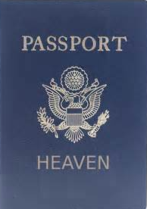
Miscellaneous Privileges
Heavenly citizenship – Philip. 3:20
Membership in a priesthood – Rev. 1:6
Engaged & soon to be married – Eph. 5:22-33; Rev. 19:7
Inheritance – 1 Pet. 1:4
Peace – Rom 5:1 ; 8:1

Slide 6
Miscellaneous Privileges
Heavenly citizenship – Philip. 3:20
Membership in a priesthood – Rev. 1:6
Engaged & soon to be married – Eph. 5:22-33; Rev. 19:7
Inheritance – 1 Pet. 1:4
Peace – Rom 5:1; 8:1

Slide 7
Heavenly Citizenship
Philip. 3:20
Special privileges
Italic right
Dejure/defacto
Eph. 2:6
Ambassadors (2 Cor. 5:20)
Sons (Matt. 13:38; Heb. 12:5,7; Gal. 4:7)
Representing heavenly values
Dual citizenship
Citizenship confusion

Slide 8
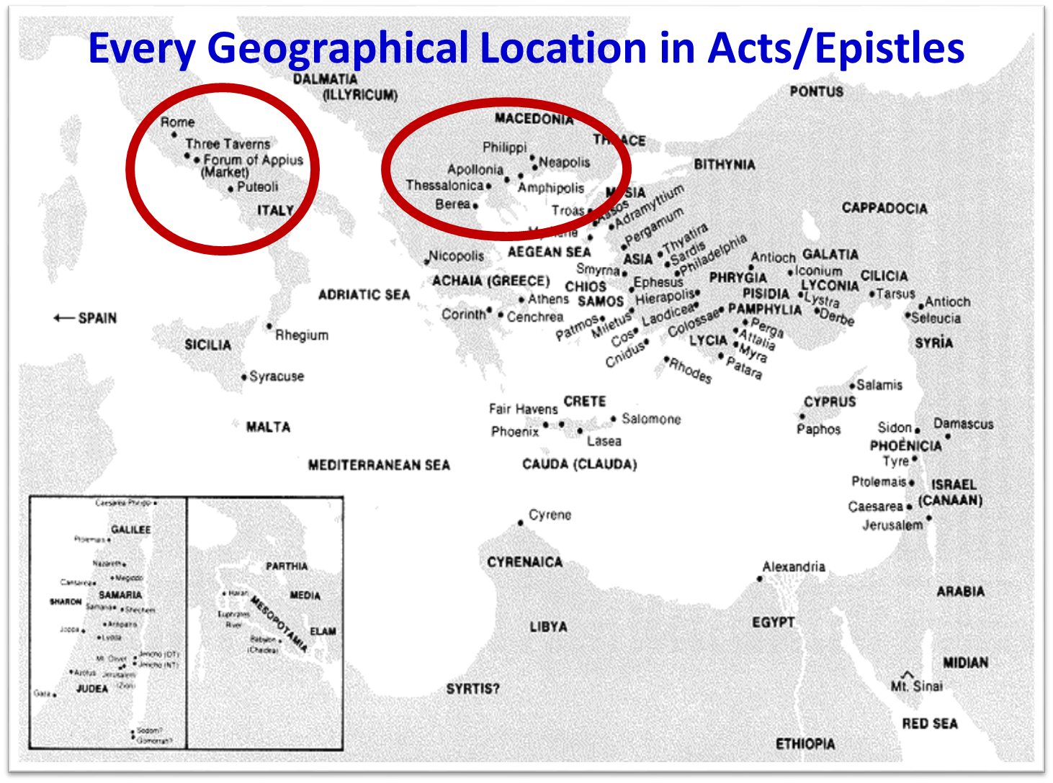

Slide 9
Heavenly Citizenship
Philip. 3:20
Special privileges
Italic right
Dejure/defacto
Eph. 2:6
Ambassadors (2 Cor. 5:20)
Sons (Matt. 13:38; Heb. 12:5,7; Gal. 4:7)
Representing heavenly values
Dual citizenship
Citizenship confusion

Slide 10
Miscellaneous Privileges
Heavenly citizenship – Philip. 3:20
Membership in a priesthood – Rev. 1:6
Engaged & soon to be married – Eph. 5:22-33; Rev. 19:7
Inheritance – 1 Pet. 1:4
Peace – Rom 5:1 ; 8:1

Slide 11
Membership in a Priesthood
1 Peter 2:5-9?
1 Peter 1:1; James 1:1
Singular nouns
Gal. 2:7-9
6 Hebrew-Christian letters
Rev. 1:6
Reign? Rev. 5:10
The church is not Israel (Levi, Aaron)
Definition of a priest

Slide 12
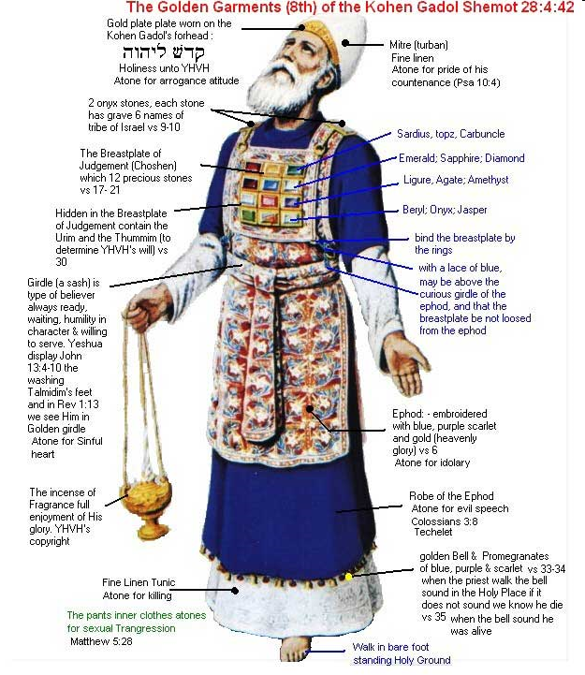

Slide 13
Miscellaneous Privileges
Heavenly citizenship – Philip. 3:20
Membership in a priesthood – Rev. 1:6
Engaged & soon to be married – Eph. 5:22-33; Rev. 19:7
Inheritance – 1 Pet. 1:4
Peace – Rom 5:1 ; 8:1

Slide 14
Engaged to be Married
Eph. 5:22-33
Rev. 19:7
Betrothal period
White dress
Matthew 1:18-20
Orthodoxy/orthopraxy
2 Cor. 11:3
Steps of a Hebrew Marriage

Slide 15
Betrothal Period
2 Cor. 11:2-3
“ For I am jealous for you with a godly jealousy; for I betrothed you to one husband, so that to Christ I might present you as a pure virgin. But I fear, lest somehow, as the serpent deceived Eve by his craftiness, so your minds may be corrupted by from the simplicity that is in Christ.”

Slide 16
Engaged to be Married
Eph. 5:22-33
Rev. 19:7
Betrothal period
White dress
Matthew 1:18-20
Orthodoxy/orthopraxy
2 Cor. 11:3
Steps of a Hebrew Marriage

Slide 17
Jewish Marriage Analogy
STEP | JEWISH MARRIAGE | CHURCH ANALOGY
1. Marriage covenant | Groom initiated; Covenant established upon payment for bride; drank same cup | Christ initiated; Christ’s sacrificial death (1 Cor. 6:19-20; 11:25)
2. Bride set apart | Bride set apart exclusively for groom | Church’s positionally sanctified (1 Cor. 1:2; 6:9-11)
3. Bridal chamber prepared | Groom separates from bride and returns to his father’s house to prepare bridal chamber | Christ’s 2000 year separation from church; Ascension; return to heaven to prepare dwellings (John 14:2; Acts 1:9-11)
4. Betrothal period | Loyalty test | Reward determined by orthodoxy and orthopraxy (Jas. 4:4)
5. Bride retrieved | Groom returns at unknown time preceded by a shout with escorts to retrieve bride | Rapture at unknown time (John 14:3; 1 Thess. 4:16-17)
Showers, Maranatha Our Lord, Come!, 164-69.

Slide 18
Jewish Marriage Analogy
STEP | JEWISH MARRIAGE | CHURCH ANALOGY
6. Bride and groom hidden in Father’s house for seven days | Hidden in the Father’s house for seven days: three events transpire | Church hidden from world during Daniel’s 70th Week
7. Bride cleansed | Bride undergoes ritual cleansing prior to wedding ceremony | Bema Seat Judgment (1 Cor 3:10-15; 2 Cor 5:10)
8. Wedding ceremony | Meeting with the Father’s assembled wedding guests; Private wedding ceremony | Meeting with OT saints; Rev 19:7
9. Consummation | Bride and groom consummate the marriage | Eph 5:27
10. Marriage feast | Public presentation; Bride unveiled; marriage feast | Col 3:3-4; Rev 19:9
Showers, Maranatha Our Lord, Come!, 164-69.

Slide 19
Miscellaneous Privileges
Heavenly citizenship – Philip. 3:20
Membership in a priesthood – Rev. 1:6
Engaged & soon to be married – Eph. 5:22-33; Rev. 19:7
Inheritance – 1 Pet. 1:4
Peace – Rom 5:1; 8:1

Slide 20
Inheritance
Col. 1:12-13
Dejure/defacto
1 Pet. 1:4
Matt. 6:19-20
Inheritance vs. reward

Slide 21
Inheritance vs. Reward
 | Gift | Reward
Received by? | All believers | Some believers
Basis? | God’s child | Faithfulness
Contingency? | No | Yes
Example? | Inheritance | Crown
Scripture? | Colossians 1:12; 1 Peter 1:4 | 1 Cor. 3:15 1 Cor. 9:24-27 2 John 8 Rev. 3:11
Dennis Rokser, UNRAVELING A CONFUSING VERSE: ANOTHER LOOK AT “INHERITING THE KINGDOM OF GOD, p. 4.

Slide 22
Miscellaneous Privileges
Heavenly citizenship – Philip. 3:20
Membership in a priesthood – Rev. 1:6
Engaged & soon to be married – Eph. 5:22-33; Rev. 19:7
Inheritance – 1 Pet. 1:4
Peace – Rom 5:1; 8:1

Slide 23
Peace
Positional peace
Presupposes enmity (John 3:36; Rom 1:18; 5:10; 8:7; 12:19; Eph. 5:6; 2 Thess. 1:7-8; Rev. 6:16)
Rom. 5:1; 8:1
Eirēnē
Basis-salvation words
Dysfunction?
Experiential peace
Philip. 4:6-7
John 14:27
Matt. 8:23-27; Gal 2:20

Slide 24
Salvation Words
Redemption – payment of a purchase price in order to release from bondage (apolútrōsis, Rom. 3:24)
Reconciliation – change of relationship from one of hostility to one of peace (katallássō, Rom. 5:10)
Expiation – removal of sin’s eternal penalty (Ps. 103:11-12)
Propitiation – satisfaction of divine wrath (hilasmós, 1 John 2:2)
Imputation – Christ’s righteousness is transferred to us at the point of faith (Philip. 3:9)

Slide 25
Peace
Positional peace
Presupposes enmity (John 3:36; Rom 1:18; 5:10; 8:7; 12:19; Eph. 5:6; 2 Thess. 1:7-8; Rev. 6:16)
Rom. 5:1; 8:1
Eirēnē
Basis-salvation words
Dysfunction?
Experiential peace
Philip. 4:6-7
John 14:27
Matt. 8:23-27; Gal 2:20

Slide 26
CONCLUSION

Slide 27
Miscellaneous Privileges
Heavenly citizenship – Philip. 3:20
Membership in a priesthood – Rev. 1:6
Engaged & soon to be married – Eph. 5:22-33; Rev. 19:7
Inheritance – 1 Pet. 1:4
Peace – Rom 5:1; 8:1

Slide 28
Soteriology Overview
Definition
Election
Atonement
Salvation words
God’s one condition of salvation
Results of salvation
Eternal security
Faulty views of salvation

Slide 29
Soteriology Overview
Next Session
VII. Eternal security

