Slide 1
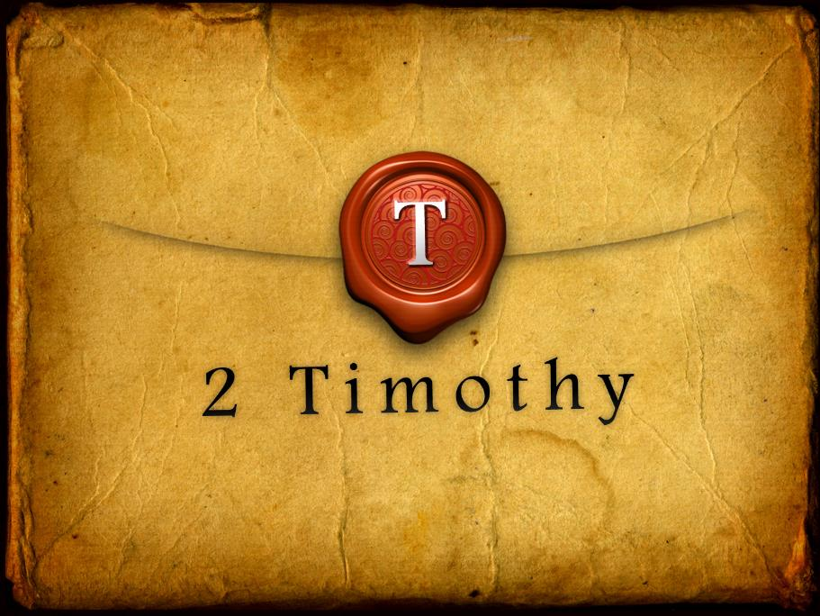

Slide 3
2 Timothy Introduction
The Call to Christian Perseverance

Slide 4
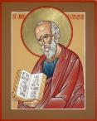
Answering Nine Questions
Who wrote it? – Paul
What do we know about the author? – An Apostle
To whom was it written? – Timothy
When was it written? - A.D. 67
Where was it written from? – Rome
Why was it written? – Timothy’s timidity
What is it about? – Perseverance
What is inside (outline)? – 4 part outline
What makes the book different? – Paul’s final word

Slide 5
Four Part Structure
General call to faithful endurance in the ministry (chapter 1)
Ten metaphors describing what faithful endurance looks like (chapter 2)
What to do in the midst of the coming apostasy (3:1–4:8)
How God met six needs in Paul’s life (4:9-22)

Slide 6
Four Part Structure
General call to faithful endurance in the ministry (chapter 1)
Ten metaphors describing what faithful endurance looks like (chapter 2)
What to do in the midst of the coming apostasy (3:1–4:8)
How God met six needs in Paul’s life (4:9-22)

Slide 7
Four Part Structure
General call to faithful endurance in the ministry (chapter 1)
Ten metaphors describing what faithful endurance looks like (chapter 2)
What to do in the midst of the coming apostasy (3:1–4:8)
How God met six needs in Paul’s life (4:9-22)

Slide 8
2 Timothy 2
Ten Metaphors Illustrating Endurance

Slide 9
Ten Metaphors
Teacher (2:2)
Soldier (2:3-4)
Athlete (2:5)
Farmer (2:6)
Christ (2:7-8)
Paul (2:9-10)
Trustworthy statement (2:11-13)
Workman (2:14-18)
Vessel (2:19-23)
Servant (2:24-26)

Slide 10
Four Part Structure
General call to faithful endurance in the ministry (chapter 1)
Ten metaphors describing what faithful endurance looks like (chapter 2)
What to do in the midst of the coming apostasy (3:1–4:8)
How God met six needs in Paul’s life (4:9-22)

Slide 11
Definition of Apostasy
apos = away from
histēmi = to stand
Apostasy = to stand away from
Apostasy = a departure from known (or previously embraced) truth

Slide 12
Apostasy (3:1‒4:8)
The Apostasy (3:1-9)
The evil (3:1-7)
The examples (3:8-9)
The Antidote (3:10‒4:8)
Paul’s example (3:10-13)
Preach the Word (3:14‒4:8)

Slide 13
Apostasy (3:1‒4:8)
The Apostasy (3:1-9)
The evil (3:1-7)
The examples (3:8-9)
The Antidote (3:10‒4:8)
Paul’s example (3:10-13)
Preach the Word (3:14‒4:8)

Slide 14
Apostasy (3:1‒4:8)
The Apostasy (3:1-9)
The evil (3:1-7)
The examples (3:8-9)
The Antidote (3:10‒4:8)
Paul’s example (3:10-13)
Preach the Word (3:14‒4:8)

Slide 15
Apostasy (3:1‒4:8)
The Apostasy (3:1-9)
The evil (3:1-7)
The examples (3:8-9)
The Antidote (3:10‒4:8)
Paul’s example (3:10-13)
Preach the Word (3:14‒4:8)

Slide 16
Apostasy (3:1‒4:8)
The Apostasy (3:1-9)
The evil (3:1-7)
The examples (3:8-9)
The Antidote (3:10‒4:8)
Paul’s example (3:10-13)
Preach the Word (3:14‒4:8)

Slide 17
Apostasy (3:1‒4:8)
The Apostasy (3:1-9)
The evil (3:1-7)
The examples (3:8-9)
The Antidote (3:10‒4:8)
Paul’s example (3:10-13)
Preach the Word (3:14‒4:8)

Slide 18
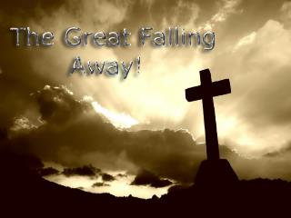
B. Paul’ Example (3:10-13)
Paul’s ministry (10a)
Paul’s character (10b
Paul’s difficulties (11-13)

Slide 19
Apostasy (3:1‒4:8)
The Apostasy (3:1-9)
The evil (3:1-7)
The examples (3:8-9)
The Antidote (3:10‒4:8)
Paul’s example (3:10-13)
Preach the Word (3:14‒4:8)

Slide 20
Preach the Word for Nine Reasons
Impact on Paul (2 Tim 3:14)
Impact on salvation (2 Tim 3:15)
Divine origin (2 Tim 3:16a)
Impact on sanctification (2 Tim 3:16b)
Impact on equipping (2 Tim 3:17)
Paul’s charge to Timothy (2 Tim 4:1a, 2)
Timothy’s evaluation at the Bema Seat (2 Tim 4:1b)
Preference of men to avoid the word (2 Tim 4:3-4)
Need to complete Timothy’s ministry (2 Tim 4:5-8)

Slide 21
Preach the Word for Nine Reasons
Impact on Paul (2 Tim 3:14)
Impact on salvation (2 Tim 3:15)
Divine origin (2 Tim 3:16a)
Impact on sanctification (2 Tim 3:16b)
Impact on equipping (2 Tim 3:17)
Paul’s charge to Timothy (2 Tim 4:1a, 2)
Timothy’s evaluation at the Bema Seat (2 Tim 4:1b)
Preference of men to avoid the word (2 Tim 4:3-4)
Need to complete Timothy’s ministry (2 Tim 4:5-8)

Slide 22
Preach the Word for Nine Reasons
Impact on Paul (2 Tim 3:14)
Impact on salvation (2 Tim 3:15)
Divine origin (2 Tim 3:16a)
Impact on sanctification (2 Tim 3:16b)
Impact on equipping (2 Tim 3:17)
Paul’s charge to Timothy (2 Tim 4:1a, 2)
Timothy’s evaluation at the Bema Seat (2 Tim 4:1b)
Preference of men to avoid the word (2 Tim 4:3-4)
Need to complete Timothy’s ministry (2 Tim 4:5-8)

Slide 23
Preach the Word for Nine Reasons
Impact on Paul (2 Tim 3:14)
Impact on salvation (2 Tim 3:15)
Divine origin (2 Tim 3:16a)
Impact on sanctification (2 Tim 3:16b)
Impact on equipping (2 Tim 3:17)
Paul’s charge to Timothy (2 Tim 4:1a, 2)
Timothy’s evaluation at the Bema Seat (2 Tim 4:1b)
Preference of men to avoid the word (2 Tim 4:3-4)
Need to complete Timothy’s ministry (2 Tim 4:5-8)

Slide 24
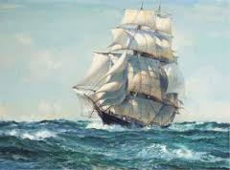
INSPIRATION OF SCRIPTURE 2 Peter 2:20-21
Men Wrote as they were inspired by Holy Spirit “phero” = to carry Acts 27:15,17
Opposite of Knowledge of False Teachers
Which is their own imagination
Jer. 23:16

Slide 25
Preach the Word for Nine Reasons
Impact on Paul (2 Tim 3:14)
Impact on salvation (2 Tim 3:15)
Divine origin (2 Tim 3:16a)
Impact on sanctification (2 Tim 3:16b)
Impact on equipping (2 Tim 3:17)
Paul’s charge to Timothy (2 Tim 4:1a, 2)
Timothy’s evaluation at the Bema Seat (2 Tim 4:1b)
Preference of men to avoid the word (2 Tim 4:3-4)
Need to complete Timothy’s ministry (2 Tim 4:5-8)

Slide 26
Three Tenses of Salvation
Phase | Justification | Sanctification | Glorification
Tense | Past | Present | Future
Saved from sin’s: | Penalty | Power | Presence
Scripture | Eph 2:8-9; Titus 3:5 | Philip 2:12 | Rom 5:10

Slide 27
Preach the Word for Nine Reasons
Impact on Paul (2 Tim 3:14)
Impact on salvation (2 Tim 3:15)
Divine origin (2 Tim 3:16a)
Impact on sanctification (2 Tim 3:16b)
Impact on equipping (2 Tim 3:17)
Paul’s charge to Timothy (2 Tim 4:1a, 2)
Timothy’s evaluation at the Bema Seat (2 Tim 4:1b)
Preference of men to avoid the word (2 Tim 4:3-4)
Need to complete Timothy’s ministry (2 Tim 4:5-8)

Slide 28
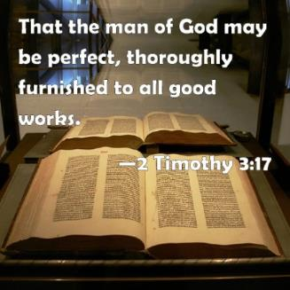
2 Timothy 3:17
“so that the man of God may be adequate, equipped for every good work.”

Slide 29
Preach the Word for Nine Reasons
Impact on Paul (2 Tim 3:14)
Impact on salvation (2 Tim 3:15)
Divine origin (2 Tim 3:16a)
Impact on sanctification (2 Tim 3:16b)
Impact on equipping (2 Tim 3:17)
Paul’s charge to Timothy (2 Tim 4:1a, 2)
Timothy’s evaluation at the Bema Seat (2 Tim 4:1b)
Preference of men to avoid the word (2 Tim 4:3-4)
Need to complete Timothy’s ministry (2 Tim 4:5-8)

Slide 30
Preach the Word for Nine Reasons
Impact on Paul (2 Tim 3:14)
Impact on salvation (2 Tim 3:15)
Divine origin (2 Tim 3:16a)
Impact on sanctification (2 Tim 3:16b)
Impact on equipping (2 Tim 3:17)
Paul’s charge to Timothy (2 Tim 4:1a, 2)
Timothy’s evaluation at the Bema Seat (2 Tim 4:1b)
Preference of men to avoid the word (2 Tim 4:3-4)
Need to complete Timothy’s ministry (2 Tim 4:5-8)

Slide 31
Preach the Word for Nine Reasons
Impact on Paul (2 Tim 3:14)
Impact on salvation (2 Tim 3:15)
Divine origin (2 Tim 3:16a)
Impact on sanctification (2 Tim 3:16b)
Impact on equipping (2 Tim 3:17)
Paul’s charge to Timothy (2 Tim 4:1a, 2)
Timothy’s evaluation at the Bema Seat (2 Tim 4:1b)
Preference of men to avoid the word (2 Tim 4:3-4)
Need to complete Timothy’s ministry (2 Tim 4:5-8)

Slide 32
2 Timothy 4:3-4
“For the time will come when they will not endure sound doctrine; but wanting to have their ears tickled, they will accumulate for themselves teachers in accordance to their own desires, ⁴ and will turn away their ears from the truth and will turn aside to myths.”

Slide 33
Outline (2 Tim. 4:3-4)
They will turn away from sound doctrine (3)
They will turn toward false doctrine (4)

Slide 34
Outline (2 Tim. 4:3-4)
They will turn away from sound doctrine (3)
They will turn toward false doctrine (4)

Slide 35
2 Timothy 4:3-4
“For the time will come when they will not endure sound doctrine; but wanting to have their ears tickled, they will accumulate for themselves teachers in accordance to their own desires, ⁴ and will turn away their ears from the truth and will turn aside to myths.”

Slide 36
2 Timothy 4:3-4
“For the time will come when they will not endure sound doctrine; but wanting to have their ears tickled, they will accumulate for themselves teachers in accordance to their own desires, ⁴ and will turn away their ears from the truth and will turn aside to myths.”

Slide 37
2 Timothy 4:3-4
“For the time will come when they will not endure sound doctrine; but wanting to have their ears tickled, they will accumulate for themselves teachers in accordance to their own desires, ⁴ and will turn away their ears from the truth and will turn aside to myths.”

Slide 38
2 Timothy 4:3-4
“For the time will come when they will not endure sound doctrine; but wanting to have their ears tickled, they will accumulate for themselves teachers in accordance to their own desires, ⁴ and will turn away their ears from the truth and will turn aside to myths.”

Slide 39
2 Timothy 4:3-4
“For the time will come when they will not endure sound doctrine; but wanting to have their ears tickled, they will accumulate for themselves teachers in accordance to their own desires, ⁴ and will turn away their ears from the truth and will turn aside to myths.”

Slide 40
2 Timothy 4:3-4
“For the time will come when they will not endure sound doctrine; but wanting to have their ears tickled, they will accumulate for themselves teachers in accordance to their own desires, ⁴ and will turn away their ears from the truth and will turn aside to myths.”

Slide 41
2 Timothy 4:3-4
“For the time will come when they will not endure sound doctrine; but wanting to have their ears tickled, they will accumulate for themselves teachers in accordance to their own desires, ⁴ and will turn away their ears from the truth and will turn aside to myths.”

Slide 42
2 Timothy 4:3-4
“For the time will come when they will not endure sound doctrine; but wanting to have their ears tickled, they will accumulate for themselves teachers in accordance to their own desires, ⁴ and will turn away their ears from the truth and will turn aside to myths.”

Slide 43
2 Timothy 4:3-4
“For the time will come when they will not endure sound doctrine; but wanting to have their ears tickled, they will accumulate for themselves teachers in accordance to their own desires, ⁴ and will turn away their ears from the truth and will turn aside to myths.”

Slide 44
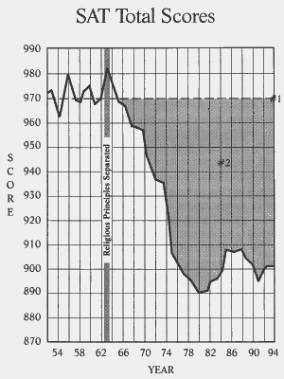

Slide 45
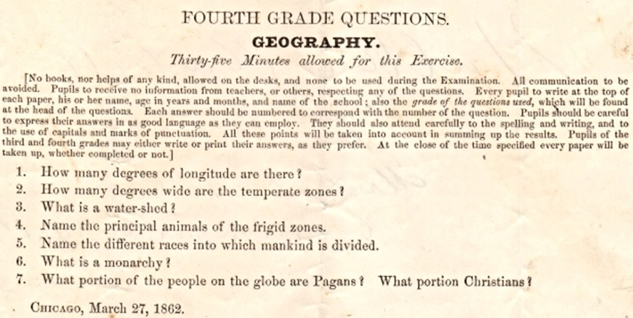
Geography Quiz that was given to Fourth Graders in 1862 (from the Wall Builders' library)

Slide 46
2 Timothy 4:3-4
“For the time will come when they will not endure sound doctrine; but wanting to have their ears tickled, they will accumulate for themselves teachers in accordance to their own desires, ⁴ and will turn away their ears from the truth and will turn aside to myths.”

Slide 47
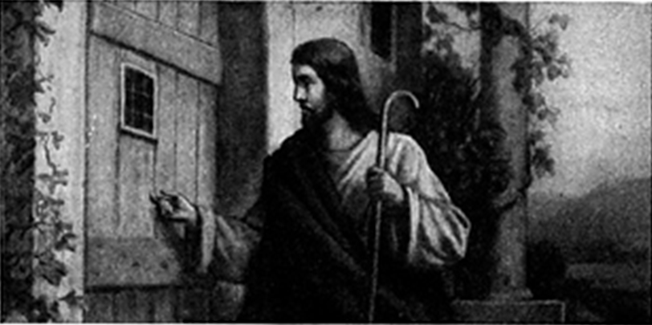

Slide 48
2 Timothy 4:3-4
“For the time will come when they will not endure sound doctrine; but wanting to have their ears tickled, they will accumulate for themselves teachers in accordance to their own desires, ⁴ and will turn away their ears from the truth and will turn aside to myths.”

Slide 49
2 Timothy 4:3-4
“For the time will come when they will not endure sound doctrine; but wanting to have their ears tickled, themselves teachers in accordthey will accumulate for ance to their own desires, ⁴ and will turn away their ears from the truth and will turn aside to myths.”

Slide 50
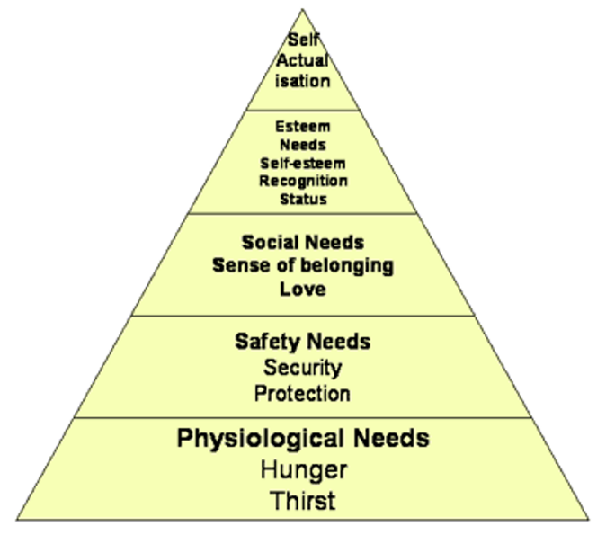
Maslow’s Hierarchy of Needs

Slide 51
Outline (2 Tim. 4:3-4)
They will turn away from sound doctrine (3)
They will turn toward false doctrine (4)

Slide 52
2 Timothy 4:3-4
“For the time will come when they will not endure sound doctrine; but wanting to have their ears tickled, themselves teachers in accordthey will accumulate for ance to their own desires, ⁴ and will turn away their ears from the truth and will turn aside to myths.”

Slide 53
2 Timothy 4:3-4
“For the time will come when they will not endure sound doctrine; but wanting to have their ears tickled, themselves teachers in accordthey will accumulate for ance to their own desires, ⁴ and will turn away their ears from the truth and will turn aside to myths.”

Slide 54
2 Timothy 4:3-4
“For the time will come when they will not endure sound doctrine; but wanting to have their ears tickled, themselves teachers in accordthey will accumulate for ance to their own desires, ⁴ and will turn away their ears from the truth and will turn aside to myths.”

Slide 55
2 Timothy 4:3-4
“For the time will come when they will not endure sound doctrine; but wanting to have their ears tickled, themselves teachers in accordthey will accumulate for ance to their own desires, ⁴ and will turn away their ears from the truth and will turn aside to myths.”

Slide 56
2 Timothy 4:3-4
“For the time will come when they will not endure sound doctrine; but wanting to have their ears tickled, themselves teachers in accordthey will accumulate for ance to their own desires, ⁴ and will turn away their ears from the truth and will turn aside to myths.”

Slide 57
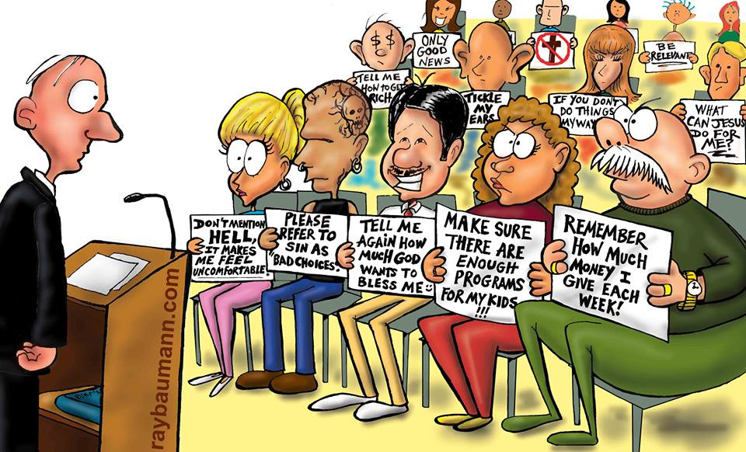

Slide 58
Conclusion

Slide 59
Outline (2 Tim. 4:3-4)
They will turn away from sound doctrine (3)
They will turn toward false doctrine (4)

Slide 60
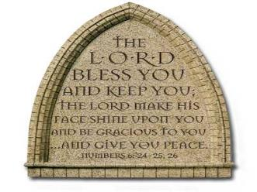
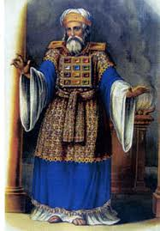
“The Lord bless you and keep you; the Lord make his face shine on you and be gracious to you; the Lord turn his face toward you and give you peace.” (NIV)

