Slide 2
Persecution & the Christian

Slide 3
Persecution
Introduction
4 Characteristics of Persecution
A Christian’s Attitude towards Persecution

Slide 4
2 Timothy 3:12
Indeed, all who desire to live godly in Christ Jesus will be persecuted.

Slide 5
Matthew 16:24

Slide 6
Matthew 16:24
Matthew 10:38-39

Slide 7
Crowns found in the Bible
Crown | Reference | Description
The Incorruptible Crown | 1 Cor. 9:24,25 | For the one who masters the old nature
The crown of rejoicing | 1 Thess. 2:19 – 20; Dan 12:3 | For the one who leads people to Christ
The crown of life (or crown of Martyrs – Rev 2:8-11) | James 1:12 | For those who endure trials, tribulations, and severe suffering, even unto death
The crown of righteousness | 2 Tim. 4:8 | For those who love and anxiously wait and look forward to the day of His return at the Rapture.
The crown of glory | 1 Pet. 5:1 – 4 | For those who faithfully teach the flock.

Slide 12
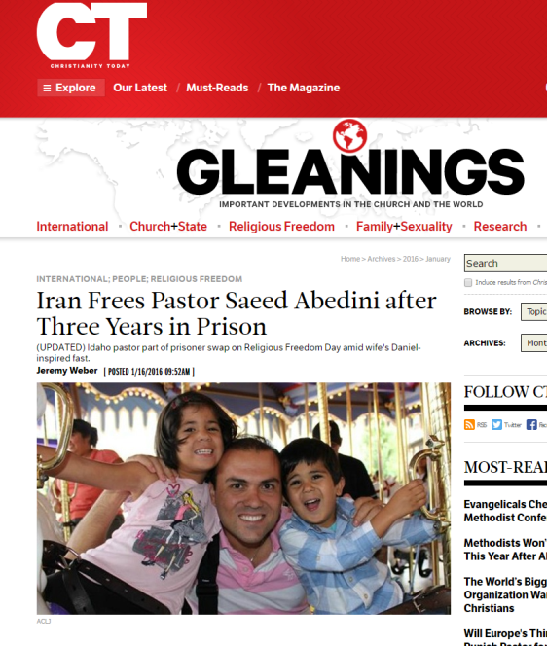

Slide 16
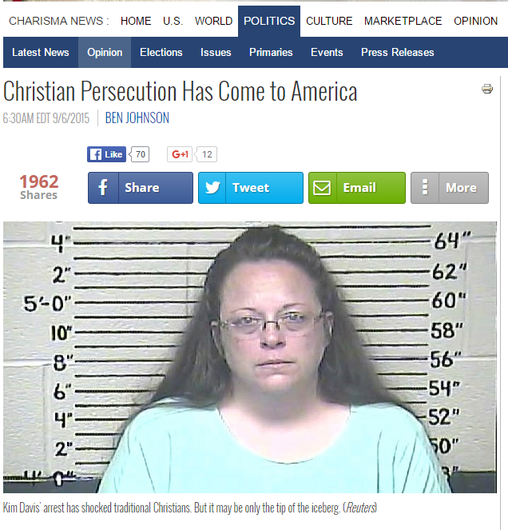

Slide 17
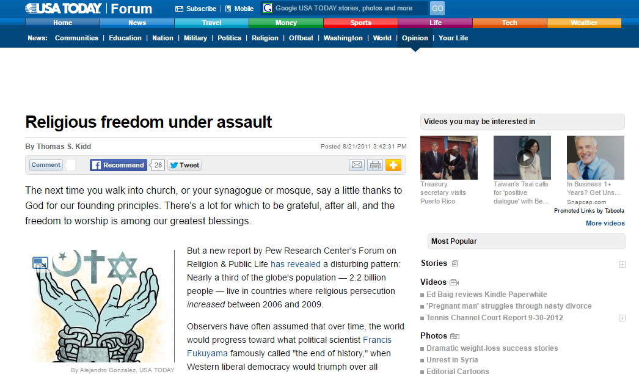

Slide 19
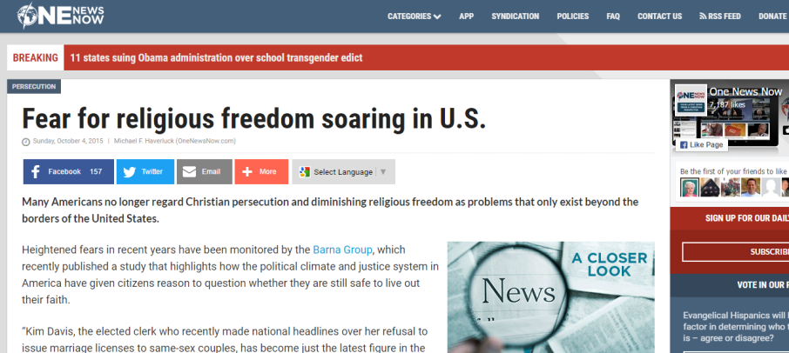

Slide 21
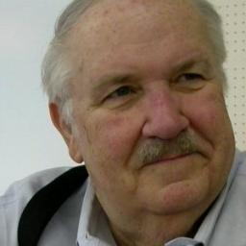
Preparing For Persecution
It is my firm conviction that the modern Evangelical church will soon face direct persecution in America. It has already begun in other parts of the world. In fact, some have estimated that more believers have died for their faith in Christ in this century than in the era of the early church. But such physical martyrdom has not often taken place in the U.S. Though no one prays for martyrdom [,] physical persecution in this country would rejuvenate the witness of the body of Christ.
Mal Couch

Slide 22
It is interesting to note that the recent killings in the high school in Colorado and the shootings in a Ft. Worth, Texas church had some elements of martyrdom. When one of the killers learned he was pointing his weapon at a Christian teenager, with great glee and relish he dispatched her out of this life. In a more direct way, the killings in the Ft. Worth church were fueled by a clear hatred of Christianity. Though some may argue that the killers in both cases were mentally unstable, nevertheless their anti-God sentiments were expressed long before these terrible events took place.
Mal Couch

Slide 23
Though I’m certainly not a prophet, I predict that within ten years American Christians will be facing a much more widespread baptism of fire. It may begin with more intense legal and religious ostracizations in order to smother our witness. It will then move to persecutions on the job. More public expressions of Christianity, such as take place around Christmas, will be limited. And finally, though we say this will never happen in America, outright physical suffering may come about.
Mal Couch

Slide 24
If we but look back at how quickly the influence of Christianity has been curtailed, I believe we all will have to ponder, could such persecution actually happen to us? Looking at the New Testament and the history of the early church, we see that persecution was normative and not unusual. For believers in Christ, it was expected. Before the rapture of the church to glory, I believe hatred and persecution against believers will sharply increase.
Mal Couch

Slide 25
Peter reminds us to expect fiery ordeals and testing (1 Pet. 4:12–14, 19). He adds that such trials are not to be taken as strange “but to the degree that you share the sufferings of Christ, keep on rejoicing.” Further, “If you are reviled for the name of Christ, you are blessed, because the Spirit of glory and of God rests upon you.”
Mal Couch

Slide 26
It must be remembered that God is sovereign in history. If these things come upon us, we are but one of many generations that will have so suffered for our Lord. Peter reminds us of His providence concerning this bitter cup that may be our lot here at the end of the church age: “Therefore let those also who suffer according to the will of God entrust their souls to a faithful Creator in doing what is right.
Mal Couch
Mal Couch, “Preparing for Persecution,” Conservative Theological Journal, CTJ 03:10 (Dec 1999).

Slide 27
4 Characteristics of Persecution
1. Persecution is a characteristic of this world. (Psalm 10:2)
See also Am 1:6; 1:9 ; 2:1 ; Hab 1:6–11 ; 1 John 3:13; 2 Cor 4:4; Rev 6:8 ; 9:7–10

Slide 28
5 Characteristics of Persecution
2. Satan is the arch-persecutor of God’s people. (Gen 3:15)
See also Job 2:6–7 ; Zec 3:1 ; Lk 22:3–4 ; 1 Pe 5:8 ; Re 2:10; 2:13

Slide 29
5 Characteristics of Persecution
3. Agencies of Persecution
a. The world (John 15:18; 1 John 3:13)

Slide 30
5 Characteristics of Persecution
3. Agencies of Persecution
a. The world (John 15:18; 1 John 3:13)
b. Earthly Governments (Mark 13:9; Ps 119:161)

Slide 31
5 Characteristics of Persecution
3. Agencies of Persecution
a. The world (John 15:18; 1 John 3:13)
b. Earthly Governments (Mark 13:9; Ps 119:161)
c. Religious Authorities (Acts 5:17-18; Acts 3-4)

Slide 32
5 Characteristics of Persecution
3. Agencies of Persecution
a. The world (John 15:18; 1 John 3:13)
b. Earthly Governments (Mark 13:9; Ps 119:161)
c. Religious Authorities (Acts 5:17-18; Acts 3-4) & Other Religions

Slide 33
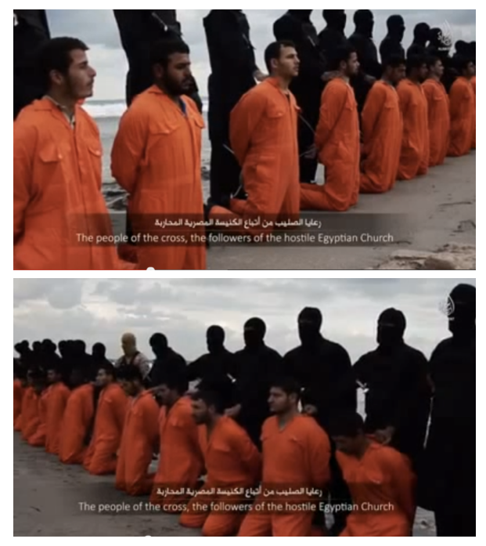

Slide 34
5 Characteristics of Persecution
3. Agencies of Persecution
a. The world (John 15:18; 1 John 3:13)
b. Earthly Governments (Mark 13:9; Ps 119:161)
c. Religious Authorities (Acts 5:17-18; Acts 3-4) & Other Religions

Slide 35
5 Characteristics of Persecution
Agencies of Persecution
a. The world (John 15:18; 1 John 3:13)
b. Earthly Governments (Mark 13:9; Ps 119:161)
c. Religious Authorities (Acts 5:17-18; Acts 3-4) & Other Religions
d. Family and Friends (Matt 10:36; Gen 4:8; Mark 3:21; Gal 4:29)

Slide 36
5 Characteristics of Persecution
4. Believers Must Expect Persecution (John 15:20; 1 Thess 3:4; 2 Tim 3:12)

Slide 37
Believers
disciples

Slide 38
A Christian’s attitude towards persecution

Slide 39
“Blessed are those who have been persecuted for the sake of righteousness, for theirs is the kingdom of heaven.
“Blessed are you when people insult you and persecute you, and falsely say all kinds of evil against you because of Me.
“Rejoice and be glad, for your reward in heaven is great; for in the same way they persecuted the prophets who were before you.
Matt 5:10–12.

