Slide 3
2 Timothy Introduction
The Call to Christian Perseverance

Slide 4
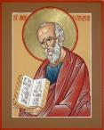
Answering Nine Questions
Who wrote it? – Paul
What do we know about the author? – An Apostle
To whom was it written? – Timothy
When was it written? - A.D. 67
Where was it written from? – Rome
Why was it written? – Timothy’s timidity
What is it about? – Perseverance
What is inside (outline)? – 4 part outline
What makes the book different? – Paul’s final word

Slide 5
Four Part Structure
General call to faithful endurance in the ministry (chapter 1)
Ten metaphors describing what faithful endurance looks like (chapter 2)
What to do in the midst of the coming apostasy (3:1–4:8)
How God met six needs in Paul’s life (4:9-22)

Slide 6
Four Part Structure
General call to faithful endurance in the ministry (chapter 1)
Ten metaphors describing what faithful endurance looks like (chapter 2)
What to do in the midst of the coming apostasy (3:1–4:8)
How God met six needs in Paul’s life (4:9-22)

Slide 7
Four Part Structure
General call to faithful endurance in the ministry (chapter 1)
Ten metaphors describing what faithful endurance looks like (chapter 2)
What to do in the midst of the coming apostasy (3:1–4:8)
How God met six needs in Paul’s life (4:9-22)

Slide 8
2 Timothy 2
Ten Metaphors Illustrating Endurance

Slide 9
Ten Metaphors
Teacher (2:2)
Soldier (2:3-4)
Athlete (2:5)
Farmer (2:6)
Christ (2:7-8)
Paul (2:9-10)
Trustworthy statement (2:11-13)
Workman (2:14-18)
Vessel (2:19-23)
Servant (2:24-26)

Slide 10
Four Part Structure
General call to faithful endurance in the ministry (chapter 1)
Ten metaphors describing what faithful endurance looks like (chapter 2)
What to do in the midst of the coming apostasy (3:1–4:8)
How God met six needs in Paul’s life (4:9-22)

Slide 11
Definition of Apostasy
apos = away from
histēmi = to stand
Apostasy = to stand away from
Apostasy = a departure from known (or previously embraced) truth

Slide 12
Apostasy (3:1‒4:8)
The Apostasy (3:1-9)
The evil (3:1-7)
The examples (3:8-9)
The Antidote (3:10‒4:8)
Paul’s example (3:10-13)
Preach the Word (3:14‒4:8)

Slide 13
Apostasy (3:1‒4:8)
The Apostasy (3:1-9)
The evil (3:1-7)
The examples (3:8-9)
The Antidote (3:10‒4:8)
Paul’s example (3:10-13)
Preach the Word (3:14‒4:8)

Slide 14
Apostasy (3:1‒4:8)
The Apostasy (3:1-9)
The evil (3:1-7)
The examples (3:8-9)
The Antidote (3:10‒4:8)
Paul’s example (3:10-13)
Preach the Word (3:14‒4:8)

Slide 15
Apostasy (3:1‒4:8)
The Apostasy (3:1-9)
The evil (3:1-7)
The examples (3:8-9)
The Antidote (3:10‒4:8)
Paul’s example (3:10-13)
Preach the Word (3:14‒4:8)

Slide 16
Apostasy (3:1‒4:8)
The Apostasy (3:1-9)
The evil (3:1-7)
The examples (3:8-9)
The Antidote (3:10‒4:8)
Paul’s example (3:10-13)
Preach the Word (3:14‒4:8)

Slide 17
Apostasy (3:1‒4:8)
The Apostasy (3:1-9)
The evil (3:1-7)
The examples (3:8-9)
The Antidote (3:10‒4:8)
Paul’s example (3:10-13)
Preach the Word (3:14‒4:8)

Slide 18
B. Paul’ Example (3:10-13)
Paul’s ministry (10a)
Paul’s character (10b
Paul’s difficulties (11-13)

Slide 19
B. Paul’ Example (3:10-13)
Paul’s ministry (10a)
Paul’s character (10b
Paul’s difficulties (11-13)

Slide 20
1. Paul’ Ministry (3:10a)
Teaching
Conduct
Purpose

Slide 21
B. Paul’ Example (3:10-13)
Paul’s ministry (10a)
Paul’s character (10b
Paul’s difficulties (11-13)

Slide 22
2. Paul’ Character (3:10b)
Faith
Patience
Love
Perseverance

Slide 23
B. Paul’ Example (3:10-13)
Paul’s ministry (10a)
Paul’s character (10b
Paul’s difficulties (11-13)

Slide 24
3. Paul’ Difficulties (3:11-13)
Persecutions (11a)
Sufferings (11b)
An example (11c)
A promise (12)
A reason (13)

Slide 25
3. Paul’ Difficulties (3:11-13)
Persecutions (11a)
Sufferings (11b)
An example (11c)
A promise (12)
A reason (13)

Slide 26
3. Paul’ Difficulties (3:11-13)
Persecutions (11a)
Sufferings (11b)
An example (11c)
A promise (12)
A reason (13)

Slide 27
3. Paul’ Difficulties (3:11-13)
Persecutions (11a)
Sufferings (11b)
An example (11c)
A promise (12)
A reason (13)

Slide 28
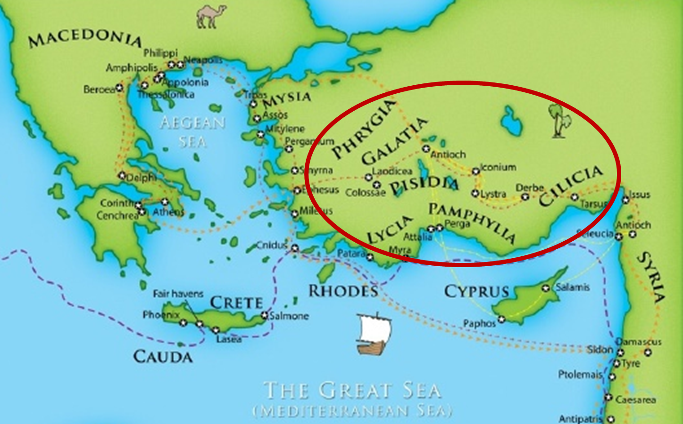

Slide 29
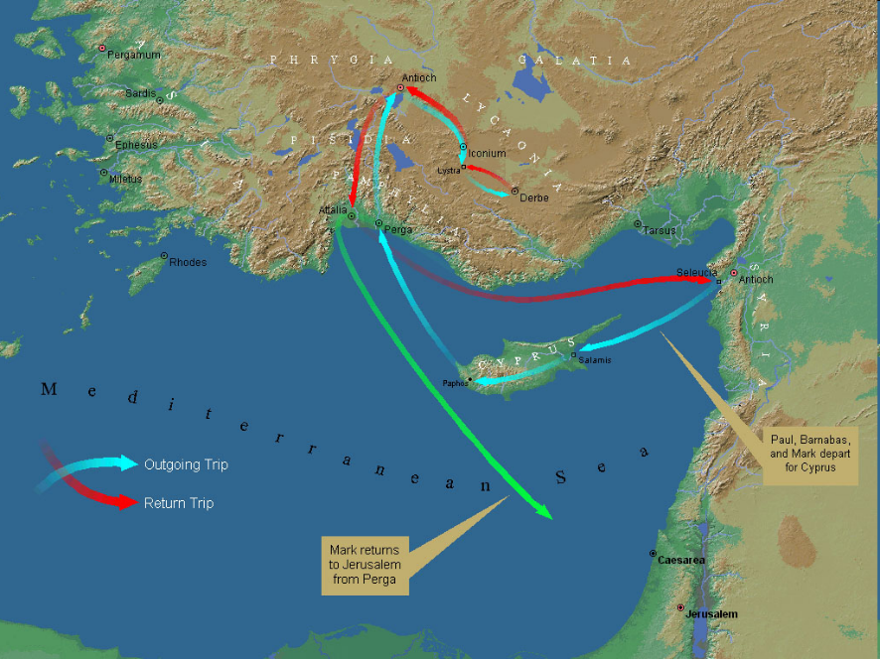
First Missionary Journey

Slide 30
3. Paul’ Difficulties (3:11-13)
Persecutions (11a)
Sufferings (11b)
An example (11c)
A promise (12)
A reason (13)

Slide 31
3. Paul’ Difficulties (3:11-13)
Persecutions (11a)
Sufferings (11b)
An example (11c)
A promise (12)
A reason (13)

Slide 32
4. Alpha Privitives (2-3)
Disobedient to parents (2)
Ungrateful (2)
Unholy (2)
Unloving (3)
Irreconcilable (3)
Break up – Malicious gossips (3)
Without self control (3)
Brutal (3)
Haters of good (3)

Slide 33
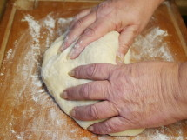
Matthew 13 Parables
Yeast in the Dough:
Christendom will experience internal corruption throughout the age

Slide 34
Conclusion

Slide 35
3. Paul’ Difficulties (3:11-13)
Persecutions (11a)
Sufferings (11b)
An example (11c)
A promise (12)
A reason (13)

Slide 36
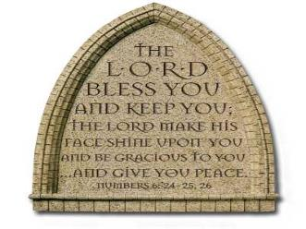
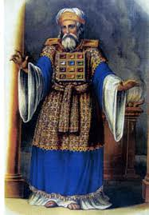
“The Lord bless you and keep you; the Lord make his face shine on you and be gracious to you; the Lord turn his face toward you and give you peace.” (NIV)

