Slide 1
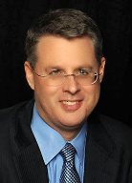
Soteriology Session 12
Dr. Andy Woods
Senior Pastor – Sugar Land Bible Church
Professor of Bible & Theology – College of Biblical Studies

Slide 2
Soteriology Overview
Definition
Election
Atonement
Salvation words
God’s one condition of salvation
Results of salvation
Eternal security
Faulty views of salvation

Slide 3
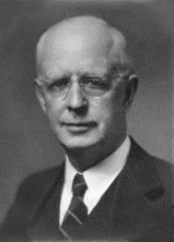
Soteriology Overview
This Session
V. God’s One Condition of Salvation
(Continued)

Slide 4
Response to Problem Passages
Repent (Acts 2:38; 3:19; 17:30; 2 Pet 3:9)? Change of mind
Lordship (Matt 16:24-25)? Discipleship vs. justification
Receive/Accept Christ? – Synonym of faith (John 1:12)
Believe and work (Eph 2:8-10; Jas 2:14-26)? Sanctification
Believe and be baptized (Mark 16:15-16; John 3:5; Acts 2:38; Col 2:11-12; 1 Pet 3:21)? Context

Slide 5
Response to Problem Passages
Confession of Christ before man (Rom 10:9-10; Matt 10:32-33)? Context
Ask Jesus into your heart (Rev 3:20)? Context
Confess your sins (Matt 6:12; 1 John 1:9)? Context
Forgive others (Matt 6:14-15)? Father (6:9) vs. judge
Sell your possessions (Matt 19:21-22)? Unique situation
Prayer and saving faith? Faith expressed by the prayer saves and not merely the prayer

Slide 6
Revelation 3:20 (NASB)
“Behold, I stand at the door and knock; if anyone hears My voice and opens the door, I will come in to him and will dine with him, and he with Me.”

Slide 7
Ask Jesus into Your Heart?
Fellowship context
Rev. 3:19 (Heb. 12:5-11)
Rev. 3:14
Eiserchomai = “in with” (Mk. 15:43) not “inside of”
200 clear passages

Slide 8
Ask Jesus into Your Heart?
Fellowship context
Rev. 3:19 (Heb. 12:5-11)
Rev. 3:14
Eiserchomai = “in with” (Mk. 15:43) not “inside of”
200 clear passages

Slide 9
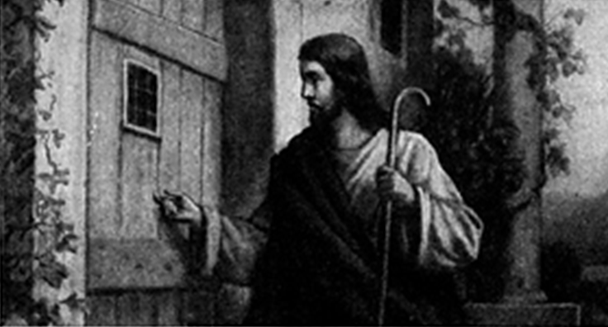
Revelation 3:20
Notes:
Imminency?
Ethnocentricity
Does not exactly fit church history
Allegorical

Slide 10
Ask Jesus into Your Heart?
Fellowship context
Rev. 3:19 (Heb. 12:5-11)
Rev. 3:14
Eiserchomai = “in with” (Mk. 15:43) not “inside of”
200 clear passages

Slide 11
Mark 15:43 (NASB)
“Joseph of Arimathea came, a prominent member of the Council, who himself was waiting for the kingdom of God; and he gathered up courage and went in before Pilate, and asked for the body of Jesus.”

Slide 12
Ask Jesus into Your Heart?
Fellowship context
Rev. 3:19 (Heb. 12:5-11)
Rev. 3:14
Eiserchomai = “in with” (Mk. 15:43) not “inside of”
200 clear passages

Slide 13
Response to Problem Passages
Confession of Christ before man (Rom 10:9-10; Matt 10:32-33)? Context
Ask Jesus into your heart (Rev 3:20)? Context
Confess your sins (Matt 6:12; 1 John 1:9)? Context
Forgive others (Matt 6:14-15)? Father (6:9) vs. judge
Sell your possessions (Matt 19:21-22)? Unique situation
Prayer and saving faith? Faith expressed by the prayer saves and not merely the prayer

Slide 14
Matthew 6:9, 12 (NASB)
“Our Father who is in heaven, Hallowed be Your name…And forgive us our debts, as we also have forgiven our debtors.”

Slide 15
Matthew 6:9, 12 (NASB)
“Our Father who is in heaven, Hallowed be Your name…And forgive us our debts, as we also have forgiven our debtors.”

Slide 16
1 John 1:9; 2:1-2 (NASB)
“If we confess our sins, He is faithful and righteous to forgive us our sins and to cleanse us from all unrighteousness…My little children, I am writing these things to you so that you may not sin. And if anyone sins, we have an Advocate with the Father, Jesus Christ the righteous; ² and He Himself is the propitiation for our sins; and not for ours only, but also for those of the whole world.”

Slide 17
1 John 1:9; 2:1-2 (NASB)
“If we confess our sins, He is faithful and righteous to forgive us our sins and to cleanse us from all unrighteousness…^{2:1} My little children, I am writing these things to you so that you may not sin. And if anyone sins, we have an Advocate with the Father, Jesus Christ the righteous; ² and He Himself is the propitiation for our sins; and not for ours only, but also for those of the whole world.”

Slide 18
Response to Problem Passages
Confession of Christ before man (Rom 10:9-10; Matt 10:32-33)? Context
Ask Jesus into your heart (Rev 3:20)? Context
Confess your sins (Matt 6:12; 1 John 1:9)? Context
Forgive others (Matt 6:14-15)? Father (6:9) vs. judge
Sell your possessions (Matt 19:21-22)? Unique situation
Prayer and saving faith? Faith expressed by the prayer saves and not merely the prayer

Slide 19
Matthew 6:9, 14-15 (NASB)
“⁶ Our Father who is in heaven, Hallowed be Your name… ¹⁴ For if you forgive others for their transgressions, your heavenly Father will also forgive you. ¹⁵ But if you do not forgive others, then your Father will not forgive your transgressions.”

Slide 20
Matthew 6:9, 14-15 (NASB)
“⁶ Our Father who is in heaven, Hallowed be Your name… ¹⁴ For if you forgive others for their transgressions, your heavenly Father will also forgive you. ¹⁵ But if you do not forgive others, then your Father will not forgive your transgressions.”

Slide 21
Response to Problem Passages
Confession of Christ before man (Rom 10:9-10; Matt 10:32-33)? Context
Ask Jesus into your heart (Rev 3:20)? Context
Confess your sins (Matt 6:12; 1 John 1:9)? Context
Forgive others (Matt 6:14-15)? Father (6:9) vs. judge
Sell your possessions (Matt 19:21-22)? Unique situation
Prayer and saving faith? Faith expressed by the prayer saves and not merely the prayer

Slide 22
Matthew 19:21-22 (NASB)
“Jesus said to him, “If you wish to be complete, go and sell your possessions and give to the poor, and you will have treasure in heaven; and come, follow Me.” But when the young man heard this statement, he went away grieving; for he was one who owned much property.”

Slide 23
1 Timothy 6:10 (NASB)
“For the love of money is a root of all sorts of evil, and some by longing for it have wandered away from the faith and pierced themselves with many griefs.”

Slide 24
Matthew 27:57 (NASB)
“When it was evening, there came a rich man from Arimathea, named Joseph, who himself had also become a disciple of Jesus .”

Slide 25
Response to Problem Passages
Confession of Christ before man (Rom 10:9-10; Matt 10:32-33)? Context
Ask Jesus into your heart (Rev 3:20)? Context
Confess your sins (Matt 6:12; 1 John 1:9)? Context
Forgive others (Matt 6:14-15)? Father (6:9) vs. judge
Sell your possessions (Matt 19:21-22)? Unique situation
Prayer and saving faith? Faith expressed by the prayer saves and not merely the prayer

Slide 26
CONCLUSION

Slide 27
Response to Problem Passages
Confession of Christ before man (Rom 10:9-10; Matt 10:32-33)? Context
Ask Jesus into your heart (Rev 3:20)? Context
Confess your sins (Matt 6:12; 1 John 1:9)? Context
Forgive others (Matt 6:14-15)? Father (6:9) vs. judge
Sell your possessions (Matt 19:21-22)? Unique situation
Prayer and saving faith? Faith expressed by the prayer saves and not merely the prayer

Slide 28
Soteriology Overview
Next Session
VI. Results of Salvation

