Slide 1
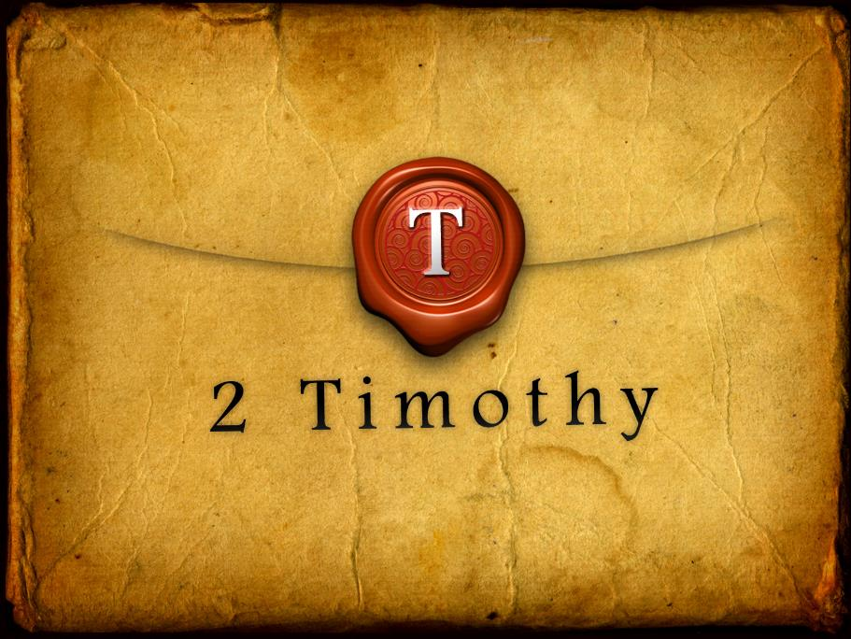

Slide 3
2 Timothy Introduction
The Call to Christian Perseverance

Slide 4
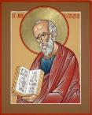
Answering Nine Questions
Who wrote it? – Paul
What do we know about the author? – An Apostle
To whom was it written? – Timothy
When was it written? - A.D. 67
Where was it written from? – Rome
Why was it written? – Timothy’s timidity
What is it about? – Perseverance
What is inside (outline)? – 4 part outline
What makes the book different? – Paul’s final word

Slide 5
Four Part Structure
General call to faithful endurance in the ministry (chapter 1)
Ten metaphors describing what faithful endurance looks like (chapter 2)
What to do in the midst of the coming apostasy (3:1–4:8)
How God met six needs in Paul’s life (4:9-22)

Slide 6
Four Part Structure
General call to faithful endurance in the ministry (chapter 1)
Ten metaphors describing what faithful endurance looks like (chapter 2)
What to do in the midst of the coming apostasy (3:1–4:8)
How God met six needs in Paul’s life (4:9-22)

Slide 7
Four Part Structure
General call to faithful endurance in the ministry (chapter 1)
Ten metaphors describing what faithful endurance looks like (chapter 2)
What to do in the midst of the coming apostasy (3:1–4:8)
How God met six needs in Paul’s life (4:9-22)

Slide 8
2 Timothy 2
Ten Metaphors Illustrating Endurance

Slide 9
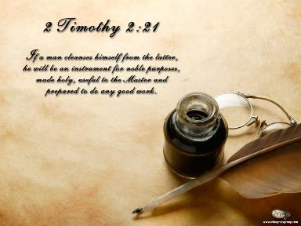
Ten Metaphors
Teacher (2:2)
Soldier (2:3-4)
Athlete (2:5)
Farmer (2:6)
Christ (2:7-8)
Paul (2:9-10)
Trustworthy statement (2:11-13)
Workman (2:14-18)
Vessel (2:19-23)
Servant (2:24-26)

Slide 10
Four Part Structure
General call to faithful endurance in the ministry (chapter 1)
Ten metaphors describing what faithful endurance looks like (chapter 2)
What to do in the midst of the coming apostasy (3:1–4:8)
How God met six needs in Paul’s life (4:9-22)

Slide 11
Definition of Apostasy
apos = away from
histēmi = to stand
Apostasy = to stand away from
Apostasy = a departure from known (or previously embraced) truth

Slide 12
Apostasy (3:1‒4:8)
The Apostasy (3:1-9)
The evil (3:1-7)
The examples (3:8-9)
The Antidote (3:10‒4:8)
Paul’s example (3:10-13)
Preach the Word (3:14‒4:8)

Slide 13
Apostasy (3:1‒4:8)
The Apostasy (3:1-9)
The evil (3:1-7)
The examples (3:8-9)
The Antidote (3:10‒4:8)
Paul’s example (3:10-13)
Preach the Word (3:14‒4:8)

Slide 14
Apostasy (3:1‒4:8)
The Apostasy (3:1-9)
The evil (3:1-7)
The examples (3:8-9)
The Antidote (3:10‒4:8)
Paul’s example (3:10-13)
Preach the Word (3:14‒4:8)

Slide 15
Apostasy (3:1‒4:8)
The Apostasy (3:1-9)
The evil (3:1-7)
The examples (3:8-9)
The Antidote (3:10‒4:8)
Paul’s example (3:10-13)
Preach the Word (3:14‒4:8)

Slide 16
Apostasy (3:1‒4:8)
The Apostasy (3:1-9)
The evil (3:1-7)
The examples (3:8-9)
The Antidote (3:10‒4:8)
Paul’s example (3:10-13)
Preach the Word (3:14‒4:8)

Slide 17
Apostasy (3:1‒4:8)
The Apostasy (3:1-9)
The evil (3:1-7)
The examples (3:8-9)
The Antidote (3:10‒4:8)
Paul’s example (3:10-13)
Preach the Word (3:14‒4:8)

Slide 18
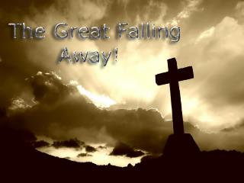
B. Paul’ Example (3:10-13)
Paul’s ministry (10a)
Paul’s character (10b
Paul’s difficulties (11-13)

Slide 19
Apostasy (3:1‒4:8)
The Apostasy (3:1-9)
The evil (3:1-7)
The examples (3:8-9)
The Antidote (3:10‒4:8)
Paul’s example (3:10-13)
Preach the Word (3:14‒4:8)

Slide 20
Preach the Word for Nine Reasons
Impact on Paul (2 Tim 3:14)
Impact on salvation (2 Tim 3:15)
Divine origin (2 Tim 3:16a)
Impact on sanctification (2 Tim 3:16b)
Impact on equipping (2 Tim 3:17)
Paul’s charge to Timothy (2 Tim 4:1a, 2)
Timothy’s evaluation at the Bema Seat (2 Tim 4:1b)
Preference of men to avoid the word (2 Tim 4:3-4)
Need to complete Timothy’s ministry (2 Tim 4:5-8)

Slide 21
Preach the Word for Nine Reasons
Impact on Paul (2 Tim 3:14)
Impact on salvation (2 Tim 3:15)
Divine origin (2 Tim 3:16a)
Impact on sanctification (2 Tim 3:16b)
Impact on equipping (2 Tim 3:17)
Paul’s charge to Timothy (2 Tim 4:1a, 2)
Timothy’s evaluation at the Bema Seat (2 Tim 4:1b)
Preference of men to avoid the word (2 Tim 4:3-4)
Need to complete Timothy’s ministry (2 Tim 4:5-8)

Slide 22
Preach the Word for Nine Reasons
Impact on Paul (2 Tim 3:14)
Impact on salvation (2 Tim 3:15)
Divine origin (2 Tim 3:16a)
Impact on sanctification (2 Tim 3:16b)
Impact on equipping (2 Tim 3:17)
Paul’s charge to Timothy (2 Tim 4:1a, 2)
Timothy’s evaluation at the Bema Seat (2 Tim 4:1b)
Preference of men to avoid the word (2 Tim 4:3-4)
Need to complete Timothy’s ministry (2 Tim 4:5-8)

Slide 23
“Believe” Defined
pisteuō…“to believe,” also “to be persuaded of,” and hence, “to place confidence in, to trust,” signifies, in this sense of the word, reliance upon, not mere credence. It is most frequent in the writings of the apostle John, especially the Gospel. He does not use the noun…Of the writers of the Gospels…uses of the verb…John ninety-nine.
W. E. Vine, Merrill F. Unger, and William White, Vine's Complete Expository Dictionary of the Old and New Testament Words (Nashville: Nelson, 1996), 61.

Slide 24
Preach the Word for Nine Reasons
Impact on Paul (2 Tim 3:14)
Impact on salvation (2 Tim 3:15)
Divine origin (2 Tim 3:16a)
Impact on sanctification (2 Tim 3:16b)
Impact on equipping (2 Tim 3:17)
Paul’s charge to Timothy (2 Tim 4:1a, 2)
Timothy’s evaluation at the Bema Seat (2 Tim 4:1b)
Preference of men to avoid the word (2 Tim 4:3-4)
Need to complete Timothy’s ministry (2 Tim 4:5-8)

Slide 25
INSPIRATION OF SCRIPTURE 2 Peter 2:20-21
Men Wrote as they were inspired by Holy Spirit “phero” = to carry Acts 27:15,17
Opposite of Knowledge of False Teachers
Which is their own imagination
Jer. 23:16

Slide 26
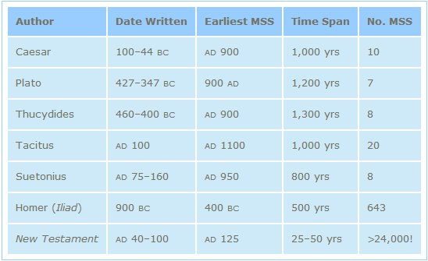
http://creationrevolution.com/2012/05/should-we-trust-the-bible/

Slide 27
Preach the Word for Nine Reasons
Impact on Paul (2 Tim 3:14)
Impact on salvation (2 Tim 3:15)
Divine origin (2 Tim 3:16a)
Impact on sanctification (2 Tim 3:16b)
Impact on equipping (2 Tim 3:17)
Paul’s charge to Timothy (2 Tim 4:1a, 2)
Timothy’s evaluation at the Bema Seat (2 Tim 4:1b)
Preference of men to avoid the word (2 Tim 4:3-4)
Need to complete Timothy’s ministry (2 Tim 4:5-8)

Slide 28
Preach the Word for Nine Reasons
Impact on Paul (2 Tim 3:14)
Impact on salvation (2 Tim 3:15)
Divine origin (2 Tim 3:16a)
Impact on sanctification (2 Tim 3:16b)
Impact on equipping (2 Tim 3:17)
Paul’s charge to Timothy (2 Tim 4:1a, 2)
Timothy’s evaluation at the Bema Seat (2 Tim 4:1b)
Preference of men to avoid the word (2 Tim 4:3-4)
Need to complete Timothy’s ministry (2 Tim 4:5-8)

Slide 29
Preach the Word for Nine Reasons
Impact on Paul (2 Tim 3:14)
Impact on salvation (2 Tim 3:15)
Divine origin (2 Tim 3:16a)
Impact on sanctification (2 Tim 3:16b)
Impact on equipping (2 Tim 3:17)
Paul’s charge to Timothy (2 Tim 4:1a, 2)
Timothy’s evaluation at the Bema Seat (2 Tim 4:1b)
Preference of men to avoid the word (2 Tim 4:3-4)
Need to complete Timothy’s ministry (2 Tim 4:5-8)

Slide 30
Preach the Word for Nine Reasons
Impact on Paul (2 Tim 3:14)
Impact on salvation (2 Tim 3:15)
Divine origin (2 Tim 3:16a)
Impact on sanctification (2 Tim 3:16b)
Impact on equipping (2 Tim 3:17)
Paul’s charge to Timothy (2 Tim 4:1a, 2)
Timothy’s evaluation at the Bema Seat (2 Tim 4:1b)
Preference of men to avoid the word (2 Tim 4:3-4)
Need to complete Timothy’s ministry (2 Tim 4:5-8)

Slide 31
Preach the Word for Nine Reasons
Impact on Paul (2 Tim 3:14)
Impact on salvation (2 Tim 3:15)
Divine origin (2 Tim 3:16a)
Impact on sanctification (2 Tim 3:16b)
Impact on equipping (2 Tim 3:17)
Paul’s charge to Timothy (2 Tim 4:1a, 2)
Timothy’s evaluation at the Bema Seat (2 Tim 4:1b)
Preference of men to avoid the word (2 Tim 4:3-4)
Need to complete Timothy’s ministry (2 Tim 4:5-8)

Slide 32
Preach the Word for Nine Reasons
Impact on Paul (2 Tim 3:14)
Impact on salvation (2 Tim 3:15)
Divine origin (2 Tim 3:16a)
Impact on sanctification (2 Tim 3:16b)
Impact on equipping (2 Tim 3:17)
Paul’s charge to Timothy (2 Tim 4:1a, 2)
Timothy’s evaluation at the Bema Seat (2 Tim 4:1b)
Preference of men to avoid the word (2 Tim 4:3-4)
Need to complete Timothy’s ministry (2 Tim 4:5-8)

Slide 33
Conclusion

Slide 34
Preach the Word for Nine Reasons
Impact on Paul (2 Tim 3:14)
Impact on salvation (2 Tim 3:15)
Divine origin (2 Tim 3:16a)
Impact on sanctification (2 Tim 3:16b)
Impact on equipping (2 Tim 3:17)
Paul’s charge to Timothy (2 Tim 4:1a, 2)
Timothy’s evaluation at the Bema Seat (2 Tim 4:1b)
Preference of men to avoid the word (2 Tim 4:3-4)
Need to complete Timothy’s ministry (2 Tim 4:5-8)

Slide 35
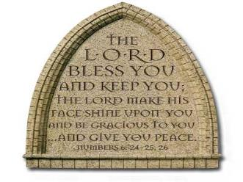
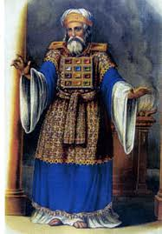
“The Lord bless you and keep you; the Lord make his face shine on you and be gracious to you; the Lord turn his face toward you and give you peace.” (NIV)

