Slide 3
2 Timothy Introduction
The Call to Christian Perseverance

Slide 4
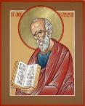
Answering Nine Questions
Who wrote it? – Paul
What do we know about the author? – An Apostle
To whom was it written? – Timothy
When was it written? - A.D. 67
Where was it written from? – Rome
Why was it written? – Timothy’s timidity
What is it about? – Perseverance
What is inside (outline)? – 4 part outline
What makes the book different? – Paul’s final word

Slide 5
Four Part Structure
General call to faithful endurance in the ministry (chapter 1)
Ten metaphors describing what faithful endurance looks like (chapter 2)
What to do in the midst of the coming apostasy (3:1–4:8)
How God met six needs in Paul’s life (4:9-22)

Slide 6
Four Part Structure
General call to faithful endurance in the ministry (chapter 1)
Ten metaphors describing what faithful endurance looks like (chapter 2)
What to do in the midst of the coming apostasy (3:1–4:8)
How God met six needs in Paul’s life (4:9-22)

Slide 7
Four Part Structure
General call to faithful endurance in the ministry (chapter 1)
Ten metaphors describing what faithful endurance looks like (chapter 2)
What to do in the midst of the coming apostasy (3:1–4:8)
How God met six needs in Paul’s life (4:9-22)

Slide 8
2 Timothy 2
Ten Metaphors Illustrating Endurance

Slide 9
Ten Metaphors
Teacher (2:2)
Soldier (2:3-4)
Athlete (2:5)
Farmer (2:6)
Christ (2:7-8)
Paul (2:9-10)
Trustworthy statement (2:11-13)
Workman (2:14-18)
Vessel (2:19-23)
Servant (2:24-26)

Slide 10
Four Part Structure
General call to faithful endurance in the ministry (chapter 1)
Ten metaphors describing what faithful endurance looks like (chapter 2)
What to do in the midst of the coming apostasy (3:1–4:8)
How God met six needs in Paul’s life (4:9-22)

Slide 11
Definition of Apostasy
apos = away from
histēmi = to stand
Apostasy = to stand away from
Apostasy = a departure from known (or previously embraced) truth

Slide 12
Apostasy (3:1‒4:8)
The Apostasy (3:1-9)
The evil (3:1-7)
The examples (3:8-9)
The Antidote (3:10‒4:8)
Paul’s example (3:10-13)
Preach the Word (3:14‒4:8)

Slide 13
Apostasy (3:1‒4:8)
The Apostasy (3:1-9)
The evil (3:1-7)
The examples (3:8-9)
The Antidote (3:10‒4:8)
Paul’s example (3:10-13)
Preach the Word (3:14‒4:8)

Slide 14
Apostasy (3:1‒4:8)
The Apostasy (3:1-9)
The evil (3:1-7)
The examples (3:8-9)
The Antidote (3:10‒4:8)
Paul’s example (3:10-13)
Preach the Word (3:14‒4:8)

Slide 15
Apostasy (3:1‒4:8)
The Apostasy (3:1-9)
The evil (3:1-7)
The examples (3:8-9)
The Antidote (3:10‒4:8)
Paul’s example (3:10-13)
Preach the Word (3:14‒4:8)

Slide 16
Apostasy (3:1‒4:8)
The Apostasy (3:1-9)
The evil (3:1-7)
The examples (3:8-9)
The Antidote (3:10‒4:8)
Paul’s example (3:10-13)
Preach the Word (3:14‒4:8)

Slide 17
Apostasy (3:1‒4:8)
The Apostasy (3:1-9)
The evil (3:1-7)
The examples (3:8-9)
The Antidote (3:10‒4:8)
Paul’s example (3:10-13)
Preach the Word (3:14‒4:8)

Slide 18
B. Paul’ Example (3:10-13)
Paul’s ministry (10a)
Paul’s character (10b
Paul’s difficulties (11-13)

Slide 19
Apostasy (3:1‒4:8)
The Apostasy (3:1-9)
The evil (3:1-7)
The examples (3:8-9)
The Antidote (3:10‒4:8)
Paul’s example (3:10-13)
Preach the Word (3:14‒4:8)

Slide 20
Preach the Word for Nine Reasons
Impact on Paul (2 Tim 3:14)
Impact on salvation (2 Tim 3:15)
Divine origin (2 Tim 3:16a)
Impact on sanctification (2 Tim 3:16b)
Impact on equipping (2 Tim 3:17)
Paul’s charge to Timothy (2 Tim 4:1a, 2)
Timothy’s evaluation at the Bema Seat (2 Tim 4:1b)
Preference of men to avoid the word (2 Tim 4:3-4)
Need to complete Timothy’s ministry (2 Tim 4:5-8)

Slide 21
Preach the Word for Nine Reasons
Impact on Paul (2 Tim 3:14)
Impact on salvation (2 Tim 3:15)
Divine origin (2 Tim 3:16a)
Impact on sanctification (2 Tim 3:16b)
Impact on equipping (2 Tim 3:17)
Paul’s charge to Timothy (2 Tim 4:1a, 2)
Timothy’s evaluation at the Bema Seat (2 Tim 4:1b)
Preference of men to avoid the word (2 Tim 4:3-4)
Need to complete Timothy’s ministry (2 Tim 4:5-8)

Slide 22
Preach the Word for Nine Reasons
Impact on Paul (2 Tim 3:14)
Impact on salvation (2 Tim 3:15)
Divine origin (2 Tim 3:16a)
Impact on sanctification (2 Tim 3:16b)
Impact on equipping (2 Tim 3:17)
Paul’s charge to Timothy (2 Tim 4:1a, 2)
Timothy’s evaluation at the Bema Seat (2 Tim 4:1b)
Preference of men to avoid the word (2 Tim 4:3-4)
Need to complete Timothy’s ministry (2 Tim 4:5-8)

Slide 23
Preach the Word for Nine Reasons
Impact on Paul (2 Tim 3:14)
Impact on salvation (2 Tim 3:15)
Divine origin (2 Tim 3:16a)
Impact on sanctification (2 Tim 3:16b)
Impact on equipping (2 Tim 3:17)
Paul’s charge to Timothy (2 Tim 4:1a, 2)
Timothy’s evaluation at the Bema Seat (2 Tim 4:1b)
Preference of men to avoid the word (2 Tim 4:3-4)
Need to complete Timothy’s ministry (2 Tim 4:5-8)

Slide 24
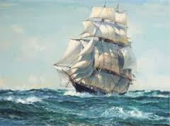
INSPIRATION OF SCRIPTURE 2 Peter 2:20-21
Men Wrote as they were inspired by Holy Spirit “phero” = to carry Acts 27:15,17
Opposite of Knowledge of False Teachers
Which is their own imagination
Jer. 23:16

Slide 25
Preach the Word for Nine Reasons
Impact on Paul (2 Tim 3:14)
Impact on salvation (2 Tim 3:15)
Divine origin (2 Tim 3:16a)
Impact on sanctification (2 Tim 3:16b)
Impact on equipping (2 Tim 3:17)
Paul’s charge to Timothy (2 Tim 4:1a, 2)
Timothy’s evaluation at the Bema Seat (2 Tim 4:1b)
Preference of men to avoid the word (2 Tim 4:3-4)
Need to complete Timothy’s ministry (2 Tim 4:5-8)

Slide 26
Three Tenses of Salvation
Phase | Justification | Sanctification | Glorification
Tense | Past | Present | Future
Saved from sin’s: | Penalty | Power | Presence
Scripture | Eph 2:8-9; Titus 3:5 | Philip 2:12 | Rom 5:10

Slide 27
Preach the Word for Nine Reasons
Impact on Paul (2 Tim 3:14)
Impact on salvation (2 Tim 3:15)
Divine origin (2 Tim 3:16a)
Impact on sanctification (2 Tim 3:16b)
Impact on equipping (2 Tim 3:17)
Paul’s charge to Timothy (2 Tim 4:1a, 2)
Timothy’s evaluation at the Bema Seat (2 Tim 4:1b)
Preference of men to avoid the word (2 Tim 4:3-4)
Need to complete Timothy’s ministry (2 Tim 4:5-8)

Slide 28
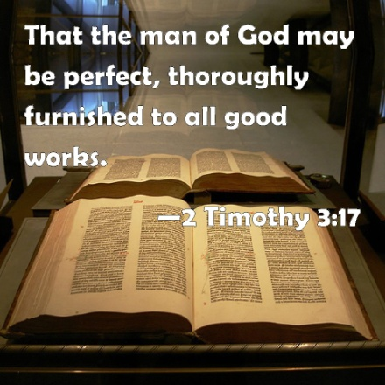
2 Timothy 3:17
“so that the man of God may be adequate, equipped for every good work.”

Slide 29
Scripture’s Impact Upon Equipping (3:17)
“in order that”
“the man of God”
“may be”
“adequate”
“good work”
“equipped”
“every”

Slide 30
Scripture’s Impact Upon Equipping (3:17)
“in order that”
“the man of God”
“may be”
“adequate”
“good work”
“equipped”
“every”

Slide 31
2 Timothy 3:17
“so that the man of God may be adequate, equipped for every good work.”

Slide 32
Scripture’s Impact Upon Equipping (3:17)
“in order that”
“the man of God”
“may be”
“adequate”
“good work”
“equipped”
“every”

Slide 33
2 Timothy 3:17
“so that the man of God may be adequate, equipped for every good work.”

Slide 34
Scripture’s Impact Upon Equipping (3:17)
“in order that”
“the man of God”
“may be”
“adequate”
“good work”
“equipped”
“every”

Slide 35
2 Timothy 3:17
“so that the man of God may be adequate, equipped for every good work.”

Slide 36
Scripture’s Impact Upon Equipping (3:17)
“in order that”
“the man of God”
“may be”
“adequate”
“good work”
“equipped”
“every”

Slide 37
2 Timothy 3:17
“so that the man of God may be adequate, equipped for every good work.”

Slide 38
Scripture’s Impact Upon Equipping (3:17)
“in order that”
“the man of God”
“may be”
“adequate”
“good work”
“equipped”
“every”

Slide 39
2 Timothy 3:17
“so that the man of God may be adequate, equipped for every good work.”

Slide 40
Scripture’s Impact Upon Equipping (3:17)
“in order that”
“the man of God”
“may be”
“adequate”
“good work”
“equipped”
“every”

Slide 41
2 Timothy 3:17
“so that the man of God may be adequate, equipped for every good work.”

Slide 42
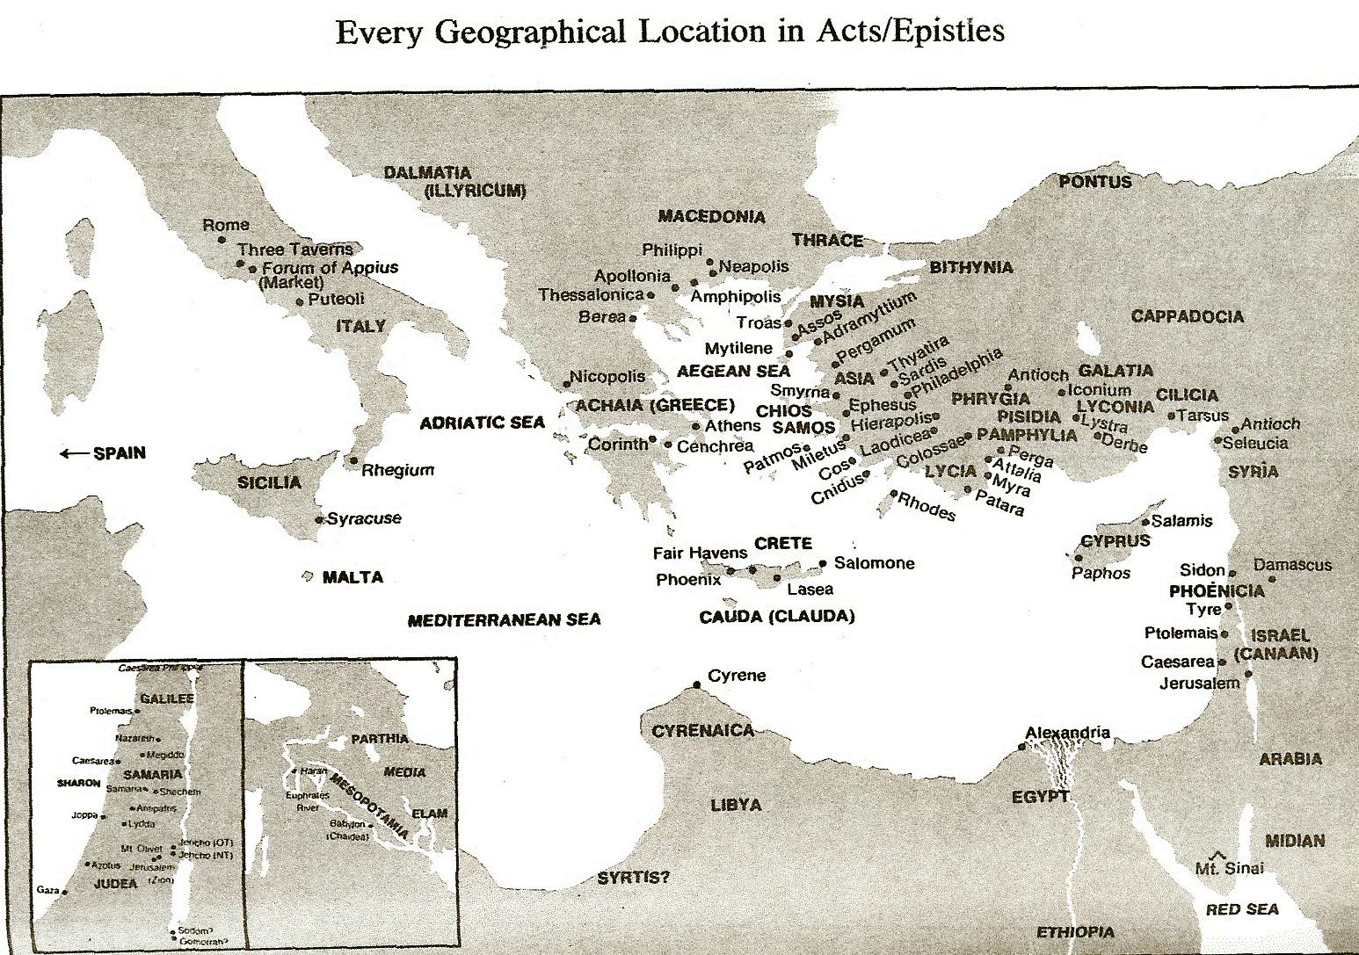
Ephesus

Slide 43
Scripture’s Impact Upon Equipping (3:17)
“in order that”
“the man of God”
“may be”
“adequate”
“good work”
“equipped”
“every”

Slide 44
2 Timothy 3:17
“so that the man of God may be adequate, equipped for every good work.”

Slide 46
2 Peter 1:3-4
Seeing that His divine power has granted to us everything pertaining to life and godliness, through the true knowledge of Him who called us by His own glory and excellence. For by these He has granted to us His precious and magnificent promises, so that by them you may become partakers of the divine nature, having escaped the corruption that is in the world by lust.

Slide 47
Maslow’s Hierarchy of Needs

Slide 48
Conclusion

Slide 49
Scripture’s Impact Upon Equipping (3:17)
“in order that”
“the man of God”
“may be”
“adequate”
“good work”
“equipped”
“every”

Slide 50
2 Timothy 3:17
“so that the man of God may be adequate, equipped for every good work.”

Slide 51
Preach the Word for Nine Reasons
Impact on Paul (2 Tim 3:14)
Impact on salvation (2 Tim 3:15)
Divine origin (2 Tim 3:16a)
Impact on sanctification (2 Tim 3:16b)
Impact on equipping (2 Tim 3:17)
Paul’s charge to Timothy (2 Tim 4:1a, 2)
Timothy’s evaluation at the Bema Seat (2 Tim 4:1b)
Preference of men to avoid the word (2 Tim 4:3-4)
Need to complete Timothy’s ministry (2 Tim 4:5-8)

Slide 52
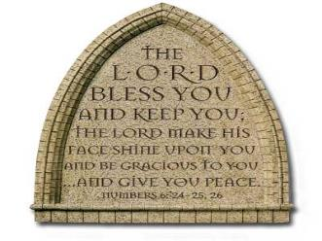
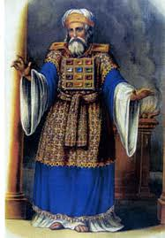
“The Lord bless you and keep you; the Lord make his face shine on you and be gracious to you; the Lord turn his face toward you and give you peace.” (NIV)

Slide 53
Preach the Word for Nine Reasons
Impact on Paul (2 Tim 3:14)
Impact on salvation (2 Tim 3:15)
Divine origin (2 Tim 3:16a)
Impact on sanctification (2 Tim 3:16b)
Impact on equipping (2 Tim 3:17)
Paul’s charge to Timothy (2 Tim 4:1a, 2)
Timothy’s evaluation at the Bema Seat (2 Tim 4:1b)
Preference of men to avoid the word (2 Tim 4:3-4)
Need to complete Timothy’s ministry (2 Tim 4:5-8)

Slide 54
Preach the Word for Nine Reasons
Impact on Paul (2 Tim 3:14)
Impact on salvation (2 Tim 3:15)
Divine origin (2 Tim 3:16a)
Impact on sanctification (2 Tim 3:16b)
Impact on equipping (2 Tim 3:17)
Paul’s charge to Timothy (2 Tim 4:1a, 2)
Timothy’s evaluation at the Bema Seat (2 Tim 4:1b)
Preference of men to avoid the word (2 Tim 4:3-4)
Need to complete Timothy’s ministry (2 Tim 4:5-8)

Slide 55
Preach the Word for Nine Reasons
Impact on Paul (2 Tim 3:14)
Impact on salvation (2 Tim 3:15)
Divine origin (2 Tim 3:16a)
Impact on sanctification (2 Tim 3:16b)
Impact on equipping (2 Tim 3:17)
Paul’s charge to Timothy (2 Tim 4:1a, 2)
Timothy’s evaluation at the Bema Seat (2 Tim 4:1b)
Preference of men to avoid the word (2 Tim 4:3-4)
Need to complete Timothy’s ministry (2 Tim 4:5-8)

Slide 56
Preach the Word for Nine Reasons
Impact on Paul (2 Tim 3:14)
Impact on salvation (2 Tim 3:15)
Divine origin (2 Tim 3:16a)
Impact on sanctification (2 Tim 3:16b)
Impact on equipping (2 Tim 3:17)
Paul’s charge to Timothy (2 Tim 4:1a, 2)
Timothy’s evaluation at the Bema Seat (2 Tim 4:1b)
Preference of men to avoid the word (2 Tim 4:3-4)
Need to complete Timothy’s ministry (2 Tim 4:5-8)

Slide 57
Preach the Word for Nine Reasons
Impact on Paul (2 Tim 3:14)
Impact on salvation (2 Tim 3:15)
Divine origin (2 Tim 3:16a)
Impact on sanctification (2 Tim 3:16b)
Impact on equipping (2 Tim 3:17)
Paul’s charge to Timothy (2 Tim 4:1a, 2)
Timothy’s evaluation at the Bema Seat (2 Tim 4:1b)
Preference of men to avoid the word (2 Tim 4:3-4)
Need to complete Timothy’s ministry (2 Tim 4:5-8)

