Slide 1

Soteriology
Session 8
Dr. Andy Woods
Senior Pastor – Sugar Land Bible Church
Professor of Bible & Theology – College of Biblical Studies

Slide 2
Soteriology Overview
Definition
Election
Atonement
Salvation words
God’s one condition of salvation
Results of salvation
Eternal security
Faulty views of salvation

Slide 3
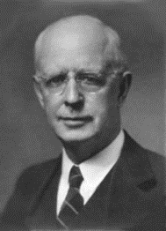
Soteriology Overview
This Session
V. God’s One Condition of Salvation
(Continued)

Slide 4
Response to Problem Passages
Repent (Acts 2:38; 3:19; 17:30; 2 Pet 3:9)? Change of mind
Lordship (Matt 16:24-25)? Discipleship vs. justification
Receive/Accept Christ? – Synonym of faith (John 1:12)
Believe and work (Eph 2:8-10; Jas 2:14-26)? Sanctification
Believe and be baptized (Mark 16:15-16; John 3:5; Acts 2:38; Col 2:11-12; 1 Pet 3:21)? Context

Slide 5


Lordship Salvation Defined
“Lordship Salvation refers to the belief which says the sinner who wants to be saved must not only trust Christ as his substitute for sin, but must also surrender every area of his life to the complete control of Christ.”
Lightner, Sin, the Savior, and Salvation, 202

Slide 6
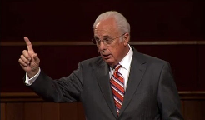
John MacArthur, The Gospel According to Jesus, p. 140
"Eternal life is indeed a free gift (Rom. 6:23). Salvation cannot be earned with good deeds or purchased with money. It has already been bought by Christ, who paid the ransom with His blood. But that does not mean there is no cost in terms of salvation's impact on the sinner's life. This paradox may be difficult but it is nevertheless true: salvation is both free and costly. Eternal life brings immediate death to self. 'Knowing this, that our old self was crucified with Him, that our body of sin might be done away with, that we should no longer be slaves to sin' (Rom 6:6). Thus in a sense we pay the ultimate price for salvation when our sinful self is nailed to a cross. It is a total abandonment of self-will, like the grain of wheat that falls to the ground and dies so that it can bear much fruit (cf. John 12:24). It is an exchange of all that we are for all that Christ is. And it denotes implicit obedience, full surrender to the lordship of Christ. Nothing less can qualify as saving faith.”

Slide 7
John MacArthur, Faith Works, p. 25
“Jesus is Lord of all, and the faith He demands involves unconditional surrender…He does not bestow eternal life on those whose hearts remain set against Him.”

Slide 8
John MacArthur, Transcription of The Art of Self-Discipline, part 2, www.gty.org.
“Self discipline comes when you look back to the covenant of your salvation…that is to say when you remember that at the point of your salvation you made a promise to submit to the Lord. You made a pledge at that time to be obedient to Christ. You confessed Him as Lord…And Lord means that He is above all. It’s essential then as believers to remember that we made a covenant of obedience when we confessed Jesus as Lord. We were saved unto obedience which God had before ordained that we should walk…and obedience characterized by good works…and obedience to God's Word. That pledge was inherent in salvation. God at the time you came to Him for salvation promised you forgiveness and eternal life and all the grace necessary to fulfill His will, and the Holy Spirit, and you pledged obedience. And you need to go back and remember that and have the integrity to be faithful to your original promise…”

Slide 9

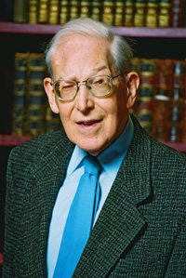
Dr. Jim McGowan – Dispensationalism and the Nature of the Church: Are Repentance and Confession “Requirements” for Salvation?
Lordship advocates consistently declare that repentance and faith are two distinct and necessary requirements for salvation. Note for example this statement made by a prominent Reformed Theologian:
“The demand is for repentance as well as faith. It is not enough to believe that only through Christ and His death are sinners justified and accepted.... Knowledge of the gospel, and orthodox belief of it, is no substitute for repentance.... Where there is ... no realistic recognition of the real claims that Christ makes, there can be no repentance, and therefore no salvation.” (bold mine)
J. I. Packer, Evangelism and the Sovereignty of God
(Downers Grove, Ill: InterVaristy, 1961), 72-73

Slide 10
Lordship Salvation Defined
Definition – If Jesus Christ is not Lord of all then He is not Lord at all
Motive – Counter superficial conversions
Right diagnosis but the wrong cure

Slide 11
Dr. Jim McGowan – Dispensationalism and the Nature of the Church: Are Repentance and Confession “Requirements” for Salvation?
According to Lordship Theology, these, “real claims that Christ makes” refers to a repentance which is a commitment to, or at least a sincere willingness to:
  Obey Christ’s commands
  Take up one’s cross
  Forsake sin, etc.,
The failure of one witnessing, to declare these precursors in a gospel presentation, and a failure on the part of the sinner to willingly commit to them, means that the sinner CAN NOT be saved!

Slide 12

Lordship Salvation 7 Problems
Changes the gospel
Places an impossible burden upon the unsaved
Confuses justification with sanctification
Confuses the result of with requirement for salvation
Fails to make basic dispensational distinctions
Ignores the reality of a carnal Christian
Destroys the assurance of salvation

Slide 13
Lordship Salvation 7 Problems
Changes the gospel
Places an impossible burden upon the unsaved
Confuses justification with sanctification
Confuses the result of with requirement for salvation
Fails to make basic dispensational distinctions
Ignores the reality of a carnal Christian
Destroys the assurance of salvation

Slide 14
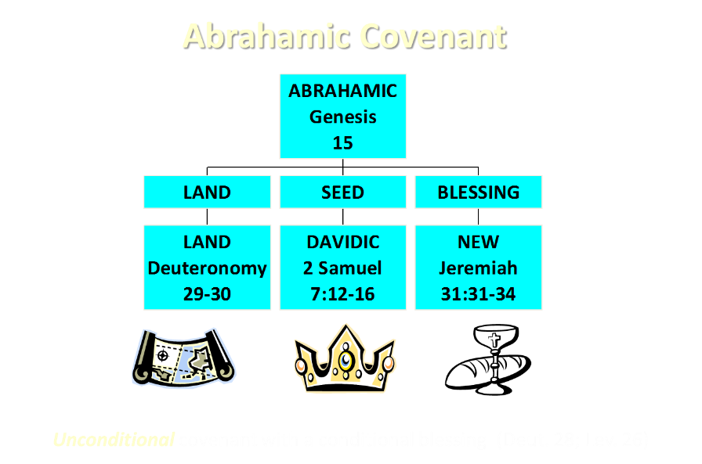

Slide 15
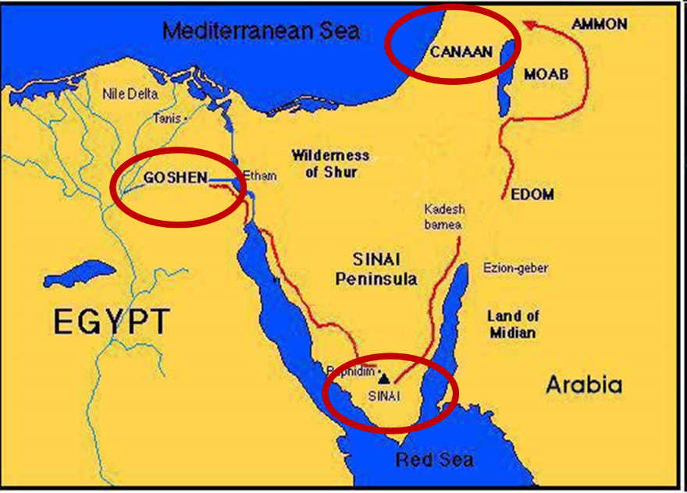

Slide 16

Exodus 19:5-6
“Now then, if you will indeed obey My voice and keep My covenant, then you shall be My own possession among all the peoples, for all the earth is Mine; and you shall be to Me a kingdom of priests and a holy nation.’ These are the words that you shall speak to the sons of Israel.”

Slide 17

Matthew and the Kingdom
Kingdom predicted (Isa 11:6-9)
Kingdom offered (Matt. 3:2; 4:17; 10:5-7)
Kingdom rejected (Matt. 12:24)
Kingdom postponed (Matt. 13)
Interim program? (Matt. 16:18; 28:18-20)
Kingdom ultimately accepted (Matt. 24:14; 25:31)
Toussaint, Behold the King, 18-20

Slide 18
MESSENGERS OF THE KINGDOM
John the Baptist – 3:2
Jesus Christ – 4:17
12 Apostles – 10:5, 7
Toussaint, Behold the King, 18-20

Slide 19
Transition from Public to Private Ministry
 | PUBLIC | PRIVATE
Scripture | 1–12 | 13–28
Focus | Nation | Remnant
Miracles | Proof to nation | Training for remnant
Offer | Prominent | Disappears
Teaching | Discourse | Parabolic
Interim program | Not mentioned | Prominent
Toussaint, Behold the King, 18-20

Slide 20

Dr. Jim McGowan – Dispensationalism and the Nature of the Church: Are Repentance and Confession “Requirements” for Salvation?
The problem arises from the fact that Lordship Theology (a distinctly Reformed structure), presupposes a theological construct which in turn dictates to the text! For example, notice John MacArthur’s response when asked about his “personal theology”:

Slide 21
Dr. Jim McGowan – Dispensationalism and the Nature of the Church: Are Repentance and Confession “Requirements” for Salvation?
“I was raised in a dispensational environment; there’s no question… But, as I got into seminary, I began to test some of those things. I have been perhaps aptly designated as a leaky dispensationalist…. Here’s my dispensationalism – I’ll give it to you in one sentence: there’s a difference between the church and Israel – period!...
At the same time in seminary, I began to be exposed to reading among more Reformed theologians… And over the years of exegeting the scripture, it has again yielded to me a Reformed theology….”

Slide 22
Dr. Jim McGowan – Dispensationalism and the Nature of the Church: Are Repentance and Confession “Requirements” for Salvation?
“I was convinced of it (Reformed theology) when I started and I’m more convinced of it now as I’ve gone through the text. I was convinced of it when I started because I read so many noble men who have held that view (Reformed Theology). It was more at that point hero worship, and now it’s become my own.” (bold mine)
Transcribed from tape, #GC 70-15, entitled "Bible Questions and Answers." A copy of the tape can be obtained by writing, Word of Grace, P.O. Box 4000, Panorama City, CA 91412. Copyright 1994 by John MacArthur Jr., All Rights Reserved.
(My point here is only to demonstrate how John MacArthur, who claims to be a dispensationalist, has arrived at his position on Lordship salvation.)

Slide 23
Dr. Jim McGowan – Dispensationalism and the Nature of the Church: Are Repentance and Confession “Requirements” for Salvation?
Incredibly, due to this imposed perspective, Lordship adherents, like John MacArthur, in spite of the undisputed lexical meaning of the word, insist on changing the basic meaning of “μετανοέω” (and it’s derivatives) to include concepts beyond it’s clear meaning.

Slide 24

Dr. Jim McGowan – Dispensationalism and the Nature of the Church: Are Repentance and Confession “Requirements” for Salvation?
John MacArthur Jr. writes:
“There is a tendency, however, for dispensationalists to get carried away with compartmentalizing truth to the point that they make unbiblical differentiations. An almost obsessive desire to categorize and contrast related truths has carried various dispensationalist interpreters (Chafer, Ryrie, Hodges, etc.) far beyond the legitimate distinctions between Israel and the Church. Many would also draw hard lines between salvation and discipleship (justification and sanctification), the church and the kingdom, Christ's preaching and the apostolic message, faith and repentance, and the age of law and the age of grace." (bold & emphasis mine) The Gospel According to Jesus, page 31

Slide 25
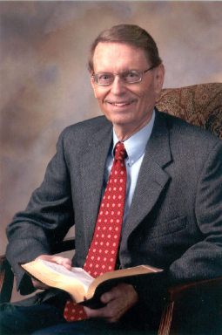
Dr. Jim McGowan – Dispensationalism and the Nature of the Church: Are Repentance and Confession “Requirements” for Salvation?
A most critical point in the discussion of dispensational distinctions has to do with the use of the term “Good News” in the New Testament. Ryrie points out the important dispensational distinctions when he writes:
“Even the New testament uses the word gospel to mean various types of good news, so one has to describe what good news is in view.” So Great Salvation, page 36

Slide 26
Dr. Jim McGowan – Dispensationalism and the Nature of the Church: Are Repentance and Confession “Requirements” for Salvation?
A distinctive feature of Normative – Classical – Traditional Dispensationalism is that it has always held to the inherent differences between:
The Gospel of the Kingdom – (Mt. 3:1-2; 4:17; 10:5-7)
The Gospel of Grace – (1 Cor. 15:3-8)
LORDSHIP ADVOCATES DENY THESE CLEAR DISPENSATIONAL DISTINCTIONS RESULTING IN A COALESCING OF LAW AND GRACE.

Slide 27
Dr. Jim McGowan – Dispensationalism and the Nature of the Church: Are Repentance and Confession “Requirements” for Salvation?
As has been stated above, Lordship proponents insist that repentance is always presented as the resolve to forsake sins, or the actual turning from sins, and that this in fact, is prerequisite to salvation.
They seek to find support for this in the preaching of John the Baptist, Jesus, and the Apostles. Lewis Sperry Chafer however, points out that:

Slide 28
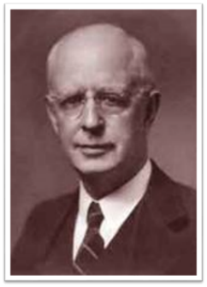
Dr. Jim McGowan – Dispensationalism and the Nature of the Church: Are Repentance and Confession “Requirements” for Salvation?
“It is an error to require repentance as a preliminary act preceding and separate from believing. Such insistence is too often based on Scripture which is addressed to the covenant people, Israel. They, like Christians, being covenant people, are privileged to return to God on the grounds of their covenant by repentance. There is much Scripture both in the Old Testament and in the New that calls this one nation to its long-predicted repentance, and it is usually placed before them as a separate unrelated act that is required.”

Slide 29
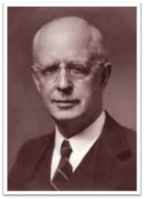
Dr. Jim McGowan – Dispensationalism and the Nature of the Church: Are Repentance and Confession “Requirements” for Salvation?
“The preaching of John the Baptist, of Jesus and the early message of the disciples, was, ‘repent for the kingdom of heaven is at hand’; but it was addressed only to Israel (Matt. 10:5, 6).” Salvation: God’s Marvelous Work of Grace, pg. 49-50
A cursory look at a few pertinent passages will assist the student of the Bible in determining whether the claims of the Lordship proponents are justified and will in fact, reveal that this is not the case.

Slide 30
Dr. Jim McGowan – Dispensationalism and the Nature of the Church: Are Repentance and Confession “Requirements” for Salvation?
Theological Wordbook of the Old Testament
“In Matthew 3:2, we are told that John came preaching ‘Repent, for the kingdom of heaven is at hand!’ and also that he preached a ‘baptism of repentance’ (Mark 1:4/Luke 3:3; Acts 13:24; cf. Matt. 3:11).
It is noteworthy that most, if not all commentators and scholars, understand John's preaching of repentance as parallel with the Old Testament preaching of שׁוּב (šûb), resulting in the force of ‘turn away from sin.’”
Theological Wordbook of the Old Testament, 2 vols., eds.
R. Laird Harris, Gleason L. Archer, and Bruce K. Waltke
(Chicago: Moody Press, 1981), 2:909-10.

Slide 31
Dr. Jim McGowan – Dispensationalism and the Nature of the Church: Are Repentance and Confession “Requirements” for Salvation?
Theological Wordbook of the Old Testament (cont’d)
This is significant because according to the Theological Wordbook of the Old Testament the theological uses of šûb in the Old Testament were expressed in the context of the “covenant community and their return to God” and were thus non-soteriological.
Theological Wordbook of the Old Testament, 2 vols., eds.
R. Laird Harris, Gleason L. Archer, and Bruce K. Waltke
(Chicago: Moody Press, 1981), 2:909-10.

Slide 32
Lordship Salvation 7 Problems
Changes the gospel
Places an impossible burden upon the unsaved
Confuses justification with sanctification
Confuses the result of with requirement for salvation
Fails to make basic dispensational distinctions
Ignores the reality of a carnal Christian
Destroys the assurance of salvation

Slide 33
4 Kinds of People from 1 Corinthians 3:1-3
Spiritual Believers
Infant
Believers
Unbelievers
Carnal
Believers
Notes:
Ray Steadman – “1st Californians”
Unbelievers vs Categories of Believers
Unbelievers – ψυχικός psuchikós; Natural, pertaining to the natural as distinguished from the spiritual
Spiritual Believers – πνευματικός pneumatikós; of persons who are spiritual, enlightened by the Holy Spirit
Infant Believers – σάρκινος sárkinos; with propensities of the flesh unto sin; νήπιος nḗpios; an infant, child, baby without any definite limitation of age. (This relates to immaturity and lack of instruction)
Carnal Believers – σαρκικός sarkikós; tendency to satisfy the flesh, implying sinfulness, sinful propensity, carnal (This relates to disobedience and open rebellion)

Slide 34
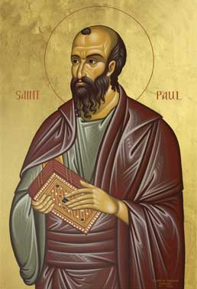
4 KINDS OF PEOPLE
1 Corinthians 3:1-3
¹ And I, brethren, could not speak to you as to spiritual people but as to carnal, as to babes in Christ. ² I fed you with milk and not with solid food; for until now you were not able to receive it, and even now you are still not able; ³ for you are still carnal. For where there are envy, strife, and divisions among you, are you not carnal and behaving like mere men? (NKJV)

Slide 35

Carnal Christianity
“an unfortunate possibility”
Exod. 19:1ff Acts 10:14 Gal. 2:11-14 Acts 19:18-19 1 Cor. 1:2, 7 | 1 Cor. 3:15 1 Cor. 6:19 1 Cor. 9:24-27 Philip. 4:2-3 Lot-Gen. 13:12; 19:4-8, 14, 30-38 vs. Gen 19:22; 2 Pet. 2:7-8

Slide 36
Lordship Salvation 7 Problems
Changes the gospel
Places an impossible burden upon the unsaved
Confuses justification with sanctification
Confuses the result of with requirement for salvation
Fails to make basic dispensational distinctions
Ignores the reality of a carnal Christian
Destroys the assurance of salvation

Slide 37
Assurance of Salvation in Lordship Salvation?
TULIP
How much & how fast?
Bondage
Weather report
John 5:24; 6;47; 1 John 5:13
Bridge example

Slide 38
Assurance of Salvation in Lordship Salvation?
TULIP
How much & how fast?
Bondage
Weather report
John 5:24; 6;47; 1 John 5:13
Bridge example

Slide 39
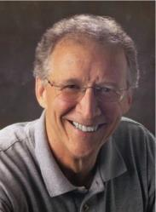
John Piper
“No Christian can be sure that he is a true believer. Hence, there is an ongoing need to be dedicated to the Lord and to deny ourselves so that we might make it.”
John Piper and Pastoral Staff, TULIP: What We Believe about the Five Points of Calvinism: Position Paper of the Pastoral Staff (Desiring God Ministries, 1997), 25, cited in Dave Hunt, What Love is This?, 379.

Slide 40
Assurance of Salvation in Lordship Salvation?
TULIP
How much & how fast?
Bondage
Weather report
John 5:24; 6;47; 1 John 5:13
Bridge example

Slide 41

John 5:24 (NASB)
“Truly, truly, I say to you, he who hears My word, and believes Him who sent Me, has eternal life, and does not come into judgment, but has passed out of death into life.”

Slide 42
DTS Doctrinal Statement
Article XI—Assurance
We believe it is the privilege, not only of some, but of all by the Spirit through faith who are born again in Christ as revealed in the Scriptures, to be assured of their salvation from the very day they take Him to be their Savior and that this assurance is not founded upon any fancied discovery of their own worthiness or fitness, but wholly upon the testimony of God in His written Word, exciting within His children filial love...

Slide 43
Assurance of Salvation in Lordship Salvation?
TULIP
How much & how fast?
Bondage
Weather report
John 5:24; 6;47; 1 John 5:13
Bridge example

Slide 44
CONCLUSION

Slide 45
Lordship Salvation 7 Problems
Changes the gospel
Places an impossible burden upon the unsaved
Confuses justification with sanctification
Confuses the result of with requirement for salvation
Fails to make basic dispensational distinctions
Ignores the reality of a carnal Christian
Destroys the assurance of salvation

Slide 46
Soteriology Overview
Next Session
V. More Problem Passages

Slide 47
Response to Problem Passages
Repent (Acts 2:38; 3:19; 17:30; 2 Pet 3:9)? Change of mind
Lordship (Matt 16:24-25)? Discipleship vs. justification
Receive/Accept Christ? – Synonym of faith (John 1:12)
Believe and work (Eph 2:8-10; Jas 2:14-26)? Sanctification
Believe and be baptized (Mark 16:15-16; John 3:5; Acts 2:38; Col 2:11-12; 1 Pet 3:21)? Context

