Slide 1
FEAR
And the
Believer

Slide 2
Outline
Study of:
Fear
Anxiety
Worry
Biblical provision to deal with fear
Conclusion

Slide 3
FEAR

Slide 4
FEAR, anxiety worry

Slide 5
A distressing emotion aroused by impending danger, evil, pain, etc., whether the threat is real or imagined; the feeling or condition of being afraid, lack of courage or resolution.
FEAR
An attitude of anxiety or distress, caused by concern over a threat to one’s future.
Manser, Martin H. Dictionary of Bible Themes: The Accessible and Comprehensive Tool for Topical Studies. London: Martin Manser, 2009.

Slide 6
Full of mental distress or uneasiness because of fear of danger or misfortune; greatly worried; solicitous.
Anxiety
Intense worry or concern
Lawrence O. Richards, Richards Complete Bible Dictionary (Iowa Falls, Iowa: World Bible Publishers, Inc, 2002), 74.

Slide 7
Worry
To torment or plague oneself with or suffer from disturbing thoughts; to fret.
A sense of uneasiness and anxiety about the future.
Manser, Martin H. Dictionary of Bible Themes: The Accessible and Comprehensive Tool for Topical Studies. London: Martin Manser, 2009.

Slide 8
Phobias
Acrophobia - Fear of heights.
Aerophobia - Fear of flying.
Arachnophobia - Fear of spiders.
Claustrophobia - Fear of confined spaces.
Glossophobia – Fear of speaking in public

Slide 9
Phobias
Acrophobia - Fear of heights.
Aerophobia - Fear of flying.
Arachnophobia - Fear of spiders.
Claustrophobia - Fear of confined spaces.
Glossophobia – Fear of speaking in public
Pentheraphobia –

Slide 10
Phobias
Acrophobia - Fear of heights.
Aerophobia - Fear of flying.
Arachnophobia - Fear of spiders.
Claustrophobia - Fear of confined spaces.
Glossophobia – Fear of speaking in public
Pentheraphobia – Fear of your mother-in-law.

Slide 11
Phobias
Acrophobia - Fear of heights.
Aerophobia - Fear of flying.
Arachnophobia - Fear of spiders.
Claustrophobia - Fear of confined spaces.
Glossophobia – Fear of speaking in public
Pentheraphobia – Fear of your mother-in-law.
Hippopotomonstrosesquippedaliophobia –

Slide 12
Phobias
Acrophobia - Fear of heights.
Aerophobia - Fear of flying.
Arachnophobia - Fear of spiders.
Claustrophobia - Fear of confined spaces.
Glossophobia – Fear of speaking in public
Pentheraphobia – Fear of your mother-in-law.
Hippopotomonstrosesquippedaliophobia – Fear of long words.

Slide 13
Phobias
Ecclesiophobia: Fear of Church
Homilophobia: Fear of Sermons
Staurophobia: Fear of the Cross/Crucifix
Dikephobia: Fear of Justice
Eleutherophobia: Fear of freedom
Gamophobia: Fear of Marriage
Pedophobia: Fear of Children
Hypegiaphobia: Fear of Responsibility
Satanophobia: Fear of Satan
Ouranophobia: Fear of Heaven
Zeusophobia: Fear of God or gods

Slide 14
The fear of man brings a snare…
Proverbs 29:25a

Slide 15
1 Tim 3:7 – And he must have a good reputation with those outside the church, so that he will not fall into reproach and the snare of the devil.
1 Tim 6:9 – But those who want to get rich fall into temptation and a snare and many foolish and harmful desires which plunge men into ruin and destruction.
2 Tim 2:26 - and they may come to their senses and escape from the snare of the devil, having been held captive by him to do his will.

Slide 16
Do not fret; it leads only to evildoing.
Psalm 37:8.

Slide 17
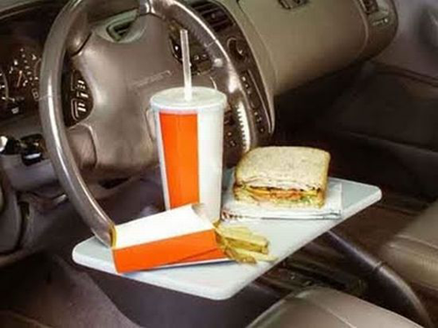

Slide 18
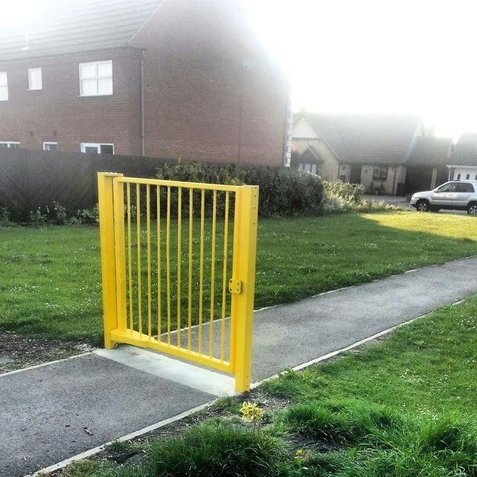

Slide 20
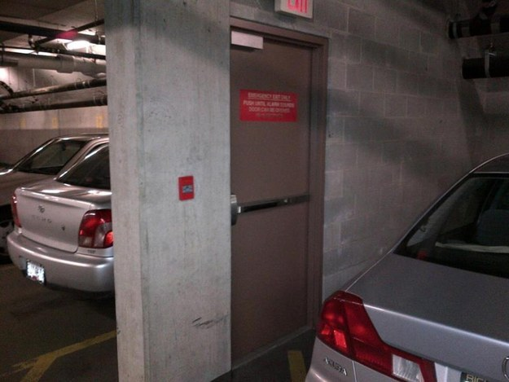

Slide 21
Anxiety in a man’s heart weighs it down
Proverbs 12:25a

Slide 22
“Of whom were you worried and fearful when you lied, and did not remember Me nor give Me a thought?
Isaiah 57:11

Slide 23
538-515 BC | 483-473 BC | 457 BC | 444-c. 425 BC
Zerubbabel | Esther | Ezra | Nehemiah
Ezra 1 – 6 | Book of Esther | Ezra 7-10 | Book of Nehemiah
Ruler: Darius | Ahasuerus | Artaxerxes | Artaxerxes
1st Return | --- | 2nd Return | 3rd Return
Restoration of Temple |  | Reformation of People | Reconstruction of Walls
Adapted from chart found in Bruce Wilkinson and Kenneth Boa, Talk Thru the Bible (Nashville, TN: Thomas Nelson Publishers, 1980), 118, 126.

Slide 24
Joshua 1.9 - “Have I not commanded you? Be strong and courageous! Do not tremble or be dismayed, for the LORD your God is with you wherever you go.”
Psalm 27.1 - The LORD is my light and my salvation; Whom shall I fear? The LORD is the defense of my life; Whom shall I dread?
Psalm 27.3 - Though a host encamp against me, My heart will not fear; Though war arise against me, In spite of this I shall be confident.

Slide 25
Ps 34:4 - I sought the Lord, and He answered me, And delivered me from all my fears.
Ps 56:4 - In God, whose word I praise, In God I have put my trust; I shall not be afraid. What can mere man do to me?
Isaiah 41:10. ‘Do not fear, for I am with you; Do not anxiously look about you, for I am your God. I will strengthen you, surely I will help you, Surely I will uphold you with My righteous right hand.’

Slide 26
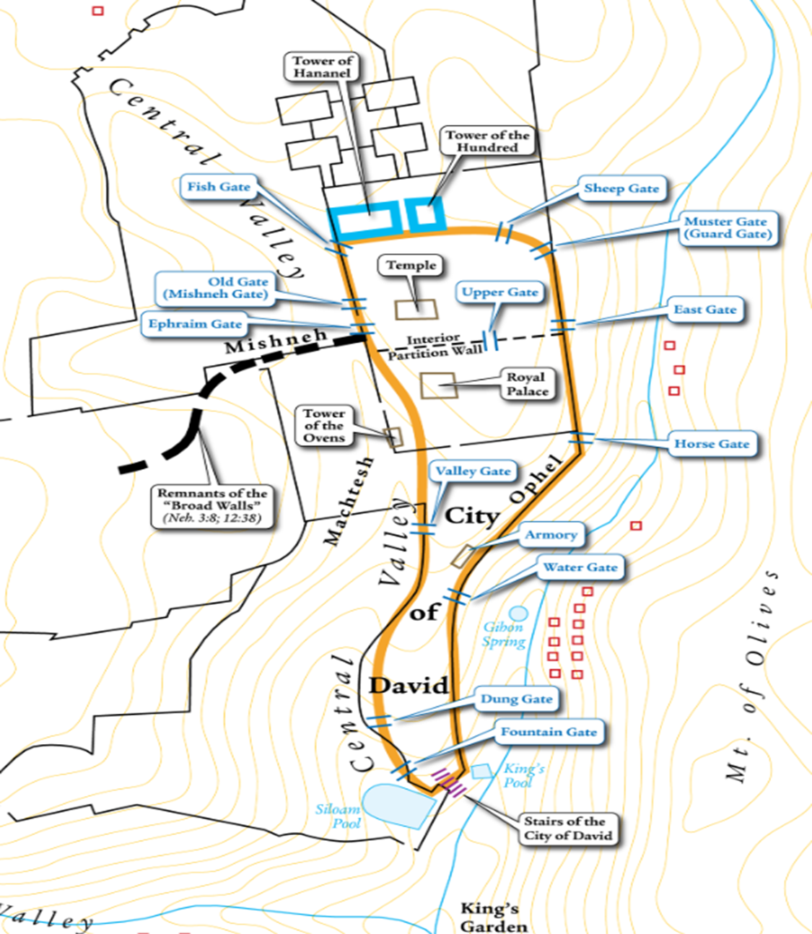
Image source: Logos Bible Software

Slide 27
Conclusion

