Slide 1
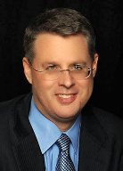
Soteriology Session 10
Dr. Andy Woods
Senior Pastor – Sugar Land Bible Church
Professor of Bible & Theology – College of Biblical Studies

Slide 2
Soteriology Overview
Definition
Election
Atonement
Salvation words
God’s one condition of salvation
Results of salvation
Eternal security
Faulty views of salvation

Slide 3
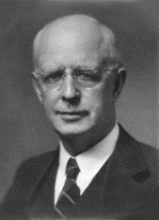
Soteriology Overview
This Session
V. God’s One Condition of Salvation
(Continued)

Slide 4
Response to Problem Passages
Repent (Acts 2:38; 3:19; 17:30; 2 Pet 3:9)? Change of mind
Lordship (Matt 16:24-25)? Discipleship vs. justification
Receive/Accept Christ? – Synonym of faith (John 1:12)
Believe and work (Eph 2:8-10; Jas 2:14-26)? Sanctification
Believe and be baptized (Mark 16:15-16; John 3:5; Acts 2:38; Col 2:11-12; 1 Pet 3:21)? Context

Slide 5
Believe and Be Baptized?
200 clear verses
Baptism is a work (Eph. 2:8-9)
Baptism comes after justification-Matt. 28:19; Acts 8:12; 10:45-47; 16:14-15; 16:30-34; 18:8
Thief on the cross (Luke 23:43)
Paul’s de-emphasis on baptism (1 Cor. 1:14-17)
Wedding ring illustration

Slide 6
Believe and Be Baptized?
200 clear verses
Baptism is a work (Eph. 2:8-9)
Baptism comes after justification-Matt. 28:19; Acts 8;12; 10:45-47; 16:14-15; 16:30-34; 18:8
Thief on the cross (Luke 23:43)
Paul’s de-emphasis on baptism (1 Cor. 1:14-17)
Wedding ring illustration

Slide 7
Believe and Be Baptized?
200 clear verses
Baptism is a work (Eph. 2:8-9)
Baptism comes after justification-Matt. 28:19; Acts 8:12; 10:45-47; 16:14-15; 16:30-34; 18:8
Thief on the cross (Luke 23:43)
Paul’s de-emphasis on baptism (1 Cor. 1:14-17)
Wedding ring illustration

Slide 8
Believe and Be Baptized?
200 clear verses
Baptism is a work (Eph. 2:8-9)
Baptism comes after justification-Matt. 28:19; Acts 8:12; 10:45-47; 16:14-15; 16:30-34; 18:8
Thief on the cross (Luke 23:43)
Paul’s de-emphasis on baptism (1 Cor. 1:14-17)
Wedding ring illustration

Slide 9
Believe and Be Baptized?
200 clear verses
Baptism is a work (Eph. 2:8-9)
Baptism comes after justification-Matt. 28:19; Acts 8:12; 10:45-47; 16:14-15; 16:30-34; 18:8
Thief on the cross (Luke 23:43)
Paul’s de-emphasis on baptism (1 Cor. 1:14-17)
Wedding ring illustration

Slide 10
Believe and Be Baptized?
200 clear verses
Baptism is a work (Eph. 2:8-9)
Baptism comes after justification-Matt. 28:19; Acts 8:12; 10:45-47; 16:14-15; 16:30-34; 18:8
Thief on the cross (Luke 23:43)
Paul’s de-emphasis on baptism (1 Cor. 1:14-17)
Wedding ring illustration

Slide 11
Believe and Be Baptized?
200 clear verses
Baptism is a work (Eph. 2:8-9)
Baptism comes after justification-Matt. 28:19; Acts 8:12; 10:45-47; 16:14-15; 16:30-34; 18:8
Thief on the cross (Luke 23:43)
Paul’s de-emphasis on baptism (1 Cor. 1:14-17)
Wedding ring illustration

Slide 12
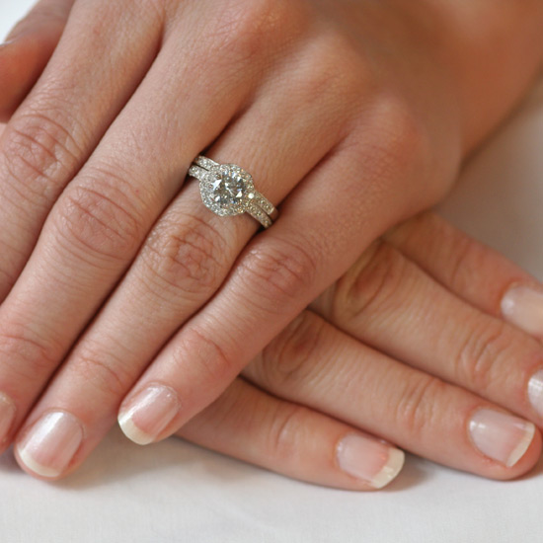
Wedding Ring Illustration

Slide 13
Believe and Be Baptized? Problem Passages
Mark 16:15-16
John 3:5
Acts 2:38
Rom. 6:3-4 & Col. 2:11-12
1 Pet. 3:20-21

Slide 14
Believe and Be Baptized? Problem Passages
Mark 16:15-16
John 3:5
Acts 2:38
Rom. 6:3-4 & Col. 2:11-12
1 Pet. 3:20-21

Slide 15
Mark 16:15-16 (NASB)
“And He said to them, “Go into all the world and preach the gospel to all creation. He who has believed and has been baptized shall be saved; but he who has disbelieved shall be condemned.”

Slide 16
Mark 16:15-16 (NASB)
“And He said to them, “Go into all the world and preach the gospel to all creation. He who has believed and has been baptized shall be saved; but he who has disbelieved shall be condemned.”

Slide 17
Believe and Be Baptized? Problem Passages
Mark 16:15-16
John 3:5
Acts 2:38
Rom. 6:3-4 & Col. 2:11-12
1 Pet. 3:20-21

Slide 18
John 3:5 (NASB)
“Jesus answered, “Truly, truly, I say to you, unless one is born of water and the Spirit he cannot enter into the kingdom of God.”

Slide 19
Believe and Be Baptized? Problem Passages
Mark 16:15-16
John 3:5
Acts 2:38
Rom. 6:3-4 & Col. 2:11-12
1 Pet. 3:20-21

Slide 20
Acts 2:38 (NASB)
“Peter said to them, “Repent, and each of you be baptized in the name of Jesus Christ for (eis) the forgiveness of your sins; and you will receive the gift of the Holy Spirit.”

Slide 21
Matthew 12:41 (NASB)
“The men of Nineveh will stand up with this generation at the judgment, and will condemn it because they repented at [in the face of/because of] (eis) the preaching of Jonah; and behold, something greater than Jonah is here.”

Slide 22
Believe and Be Baptized? Problem Passages
Mark 16:15-16
John 3:5
Acts 2:38
Rom. 6:3-4 & Col. 2:11-12
1 Pet. 3:20-21

Slide 23
Colossian 2:11-12 (NASB)
“and in Him you were also circumcised with a circumcision made without hands, in the removal of the body of the flesh by the circumcision of Christ; ¹² having been buried with Him in baptism, in which you were also raised up with Him through faith in the working of God, who raised Him from the dead.”

Slide 24
1 Cor. 12:13 (NASB)
“For by one Spirit we were all baptized into one body, whether Jews or Greeks, whether slaves or free, and we were all made to drink of one Spirit.”

Slide 25
Believe and Be Baptized? Problem Passages
Mark 16:15-16
John 3:5
Acts 2:38
Rom. 6:3-4 & Col. 2:11-12
1 Pet. 3:20-21

Slide 26
1 Pet. 3:20-21 (NASB)
“who once were disobedient, when the patience of God kept waiting in the days of Noah, during the construction of the ark, in which a few, that is, eight persons, were brought safely through the water. Corresponding to that, baptism now saves you—not the removal of dirt from the flesh, but an appeal to God for a good conscience—through the resurrection of Jesus Christ.”

Slide 27
1 Pet. 3:20-21 (NASB)
“who once were disobedient, when the patience of God kept waiting in the days of Noah, during the construction of the ark, in which a few, that is, eight persons, were brought safely through the water. Corresponding to that, baptism now saves you—not the removal of dirt from the flesh, but an appeal to God for a good conscience—through the resurrection of Jesus Christ.”

Slide 28
Three Tenses of Salvation
Phase | Justification | Sanctification | Glorification
Tense | Past | Present | Future
Saved from sin’s: | Penalty | Power | Presence
Scripture | Eph 2:8-9; Titus 3:5 | Philip 2:12 | Rom 5:10

Slide 29
CONCLUSION

Slide 30
Soteriology Overview
Next Session
VI. Results of Salvation

Slide 31
Soteriology Overview
Definition
Election
Atonement
Salvation words
God’s one condition of salvation
Results of salvation
Eternal security
Faulty views of salvation

