Slide 1

Soteriology
Session 11
Dr. Andy Woods
Senior Pastor – Sugar Land Bible Church
Professor of Bible & Theology – College of Biblical Studies

Slide 2
Soteriology Overview
Definition
Election
Atonement
Salvation words
God’s one condition of salvation
Results of salvation
Eternal security
Faulty views of salvation

Slide 3
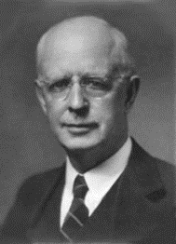
Soteriology Overview
This Session
V. God’s One Condition of Salvation
(Continued)

Slide 4
Response to Problem Passages
Repent (Acts 2:38; 3:19; 17:30; 2 Pet 3:9)? Change of mind
Lordship (Matt 16:24-25)? Discipleship vs. justification
Receive/Accept Christ? – Synonym of faith (John 1:12)
Believe and work (Eph 2:8-10; Jas 2:14-26)? Sanctification
Believe and be baptized (Mark 16:15-16; John 3:5; Acts 2:38; Col 2:11-12; 1 Pet 3:21)? Context

Slide 5
Response to Problem Passages
Confession of Christ before man (Rom 10:9-10; Matt 10:32-33)? Context
Ask Jesus into your heart (Rev 3:20)? Context
Confess your sins (Matt 6:12; 1 John 1:9)? Context
Forgive others (Matt 6:14-15)? Father (6:9) vs. judge
Sell your possessions (Matt 19:21-22)? Unique situation
Prayer and saving faith? Faith expressed by the prayer saves and not merely the prayer

Slide 6
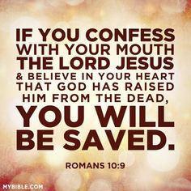
Believe and Confess
ABC method – Admit, Believe, Confess
Two or more steps
Impractical (mute, alone, oppression)
John 12:42; 19:38
Rom. 10:9-10
Matt. 10:32-33

Slide 7
Believe and Confess
ABC method – Admit, Believe, Confess
Two or more steps
Impractical (mute, alone, oppression)
John 12:42; 19:38
Rom. 10:9-10
Matt. 10:32-33

Slide 8
Believe and Confess
ABC method – Admit, Believe, Confess
Two or more steps
Impractical (mute, alone, oppression)
John 12:42; 19:38
Rom. 10:9-10
Matt. 10:32-33

Slide 9
Believe and Confess
ABC method – Admit, Believe, Confess
Two or more steps
Impractical (mute, alone, oppression)
John 12:42; 19:38
Rom. 10:9-10
Matt. 10:32-33

Slide 10
Believe and Confess
ABC method – Admit, Believe, Confess
Two or more steps
Impractical (mute, alone, oppression)
John 12:42; 19:38
Rom. 10:9-10
Matt. 10:32-33

Slide 11

John 12:42 (NASB)
“Nevertheless many even of the rulers believed in Him, but because of the Pharisees they were not confessing Him, for fear that they would be put out of the synagogue.”

Slide 12


John 20:30-31
³⁰ “Therefore many other signs Jesus also performed in the presence of the disciples, which are not written in this book; ³¹ but these have been written so that you may believe that Jesus is the Christ, the Son of God; and that believing you may have life in His name.”

Slide 13
John 19:38 (NASB)
“After these things Joseph of Arimathea, being a disciple of Jesus, but a secret one for fear of the Jews, asked Pilate that he might take away the body of Jesus; and Pilate granted permission. So he came and took away His body.”

Slide 14
Believe and Confess
ABC method – Admit, Believe, Confess
Two or more steps
Impractical (mute, alone, oppression)
John 12:42; 19:38
Rom. 10:9-10
Matt. 10:32-33

Slide 15
Rom. 10:9-10 (NASB)
“That if you confess with your mouth Jesus as Lord, and believe in your heart that God raised Him from the dead, you will be saved; for with the heart a person believes, resulting in righteousness, and with the mouth he confesses, resulting in salvation.”

Slide 16
Romans Outline
Salutation (1:1-17)
Sin (1:18–3:20)
Salvation (3:21–5:21)
Sanctification (6–8)
Sovereignty (9–11)
Service (12:1–15:13)
Summation (15:14–16:27)

Slide 17
Sovereignty (Rom 9–11)
Israel in the past: elected (Rom 9)
Israel in the present: rejected (Rom 10)
Israel in the future: accepted (Rom 11)

Slide 18
Believe and Confess
ABC method – Admit, Believe, Confess
Two or more steps
Impractical (mute, alone, oppression)
John 12:42; 19:38
Rom. 10:9-10
Matt. 10:32-33

Slide 19
Matt. 10:32-33 (NASB)
“Therefore everyone who confesses Me before men, I will also confess him before My Father who is in heaven. But whoever denies Me before men, I will also deny him before My Father who is in heaven.”

Slide 20
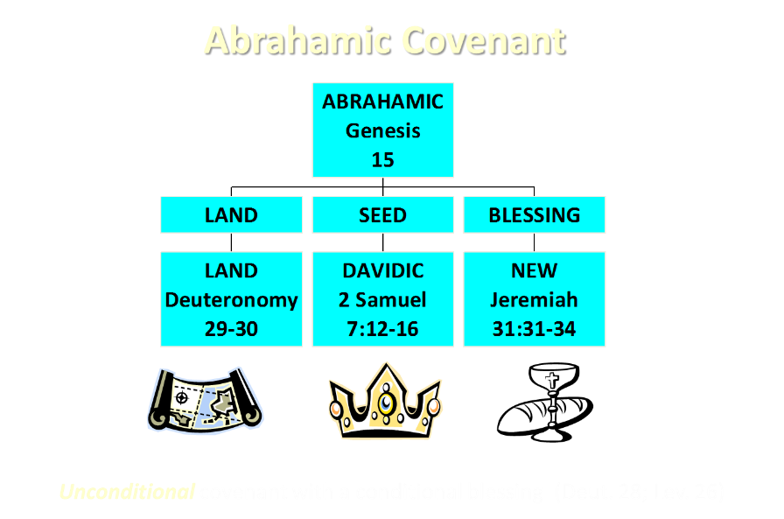

Slide 21
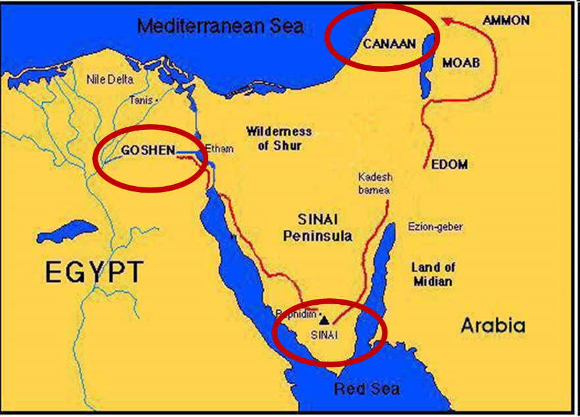

Slide 22

Exodus 19:5-6
“Now then, if you will indeed obey My voice and keep My covenant, then you shall be My own possession among all the peoples, for all the earth is Mine; and you shall be to Me a kingdom of priests and a holy nation.’ These are the words that you shall speak to the sons of Israel.”

Slide 23

Matthew and the Kingdom
Kingdom predicted (Isa 11:6-9)
Kingdom offered (Matt. 3:2; 4:17; 10:5-7)
Kingdom rejected (Matt. 12:24)
Kingdom postponed (Matt. 13)
Interim program? (Matt. 16:18; 28:18-20)
Kingdom ultimately accepted (Matt. 24:14; 25:31)
Toussaint, Behold the King, 18-20

Slide 24
Matthew and the Kingdom
Kingdom predicted (Isa 11:6-9)
Kingdom offered (Matt. 3:2; 4:17; 10:5-7)
Kingdom rejected (Matt. 12:24)
Kingdom postponed (Matt. 13)
Interim program? (Matt. 16:18; 28:18-20)
Kingdom ultimately accepted (Matt. 24:14; 25:31)
Toussaint, Behold the King, 18-20

Slide 25
OT PROPHETS DESCRIBE THE KINGDOM
Kingdom Characteristics
Is. 2:1-4; 11:6-9
  Jerusalem = center of world spiritual and political authority
  Perfect justice
  World peace
  Peace in the animal kingdom
  Universal spiritual knowledge.

Slide 26
Matthew and the Kingdom
Kingdom predicted (Isa 11:6-9)
Kingdom offered (Matt. 3:2; 4:17; 10:5-7)
Kingdom rejected (Matt. 12:24)
Kingdom postponed (Matt. 13)
Interim program? (Matt. 16:18; 28:18-20)
Kingdom ultimately accepted (Matt. 24:14; 25:31)
Toussaint, Behold the King, 18-20

Slide 27
MESSENGERS OF THE KINGDOM
John the Baptist – 3:2
Jesus Christ – 4:17
12 Apostles – 10:5, 7
Toussaint, Behold the King, 18-20

Slide 28
Matthew and the Kingdom
Kingdom predicted (Isa 11:6-9)
Kingdom offered (Matt. 3:2; 4:17; 10:5-7)
Kingdom rejected (Matt. 12:24)
Kingdom postponed (Matt. 13)
Interim program? (Matt. 16:18; 28:18-20)
Kingdom ultimately accepted (Matt. 24:14; 25:31)
Toussaint, Behold the King, 18-20

Slide 29
Matthew and the Kingdom
Kingdom predicted (Isa 11:6-9)
Kingdom offered (Matt. 3:2; 4:17; 10:5-7)
Kingdom rejected (Matt. 12:24)
Kingdom postponed (Matt. 13)
Interim program? (Matt. 16:18; 28:18-20)
Kingdom ultimately accepted (Matt. 24:14; 25:31)
Toussaint, Behold the King, 18-20

Slide 30
Matthew and the Kingdom
Kingdom predicted (Isa 11:6-9)
Kingdom offered (Matt. 3:2; 4:17; 10:5-7)
Kingdom rejected (Matt. 12:24)
Kingdom postponed (Matt. 13)
Interim program? (Matt. 16:18; 28:18-20)
Kingdom ultimately accepted (Matt. 24:14; 25:31)
Toussaint, Behold the King, 18-20

Slide 31
Transition from Public to Private Ministry
 | PUBLIC | PRIVATE
Scripture | 1–12 | 13–28
Focus | Nation | Remnant
Miracles | Proof to nation | Training for remnant
Offer | Prominent | Disappears
Teaching | Discourse | Parabolic
Interim program | Not mentioned | Prominent
Toussaint, Behold the King, 18-20

Slide 32
Matthew and the Kingdom
Kingdom predicted (Isa 11:6-9)
Kingdom offered (Matt. 3:2; 4:17; 10:5-7)
Kingdom rejected (Matt. 12:24)
Kingdom postponed (Matt. 13)
Interim program? (Matt. 16:18; 28:18-20)
Kingdom ultimately accepted (Matt. 24:14; 25:31)
Toussaint, Behold the King, 18-20

Slide 33
Matthew 10:5-7 (NASB)
“These twelve Jesus sent out after instructing them: “Do not go in the way of the Gentiles, and do not enter any city of the Samaritans; ⁶ but rather go to the lost sheep of the house of Israel.⁷ And as you go, preach, saying, ‘The kingdom of heaven is at hand.’.”

Slide 34
Response to Problem Passages
Confession of Christ before man (Rom 10:9-10; Matt 10:32-33)? Context
Ask Jesus into your heart (Rev 3:20)? Context
Confess your sins (Matt 6:12; 1 John 1:9)? Context
Forgive others (Matt 6:14-15)? Father (6:9) vs. judge
Sell your possessions (Matt 19:21-22)? Unique situation
Prayer and saving faith? Faith expressed by the prayer saves and not merely the prayer

Slide 35
Revelation 3:20 (NASB)
“Behold, I stand at the door and knock; if anyone hears My voice and opens the door, I will come in to him and will dine with him, and he with Me.”

Slide 36

Ask Jesus into Your Heart?
Fellowship context
  Rev. 3:19 (Heb. 12:5-11)
  Rev. 3:14
Eiserchomai = “in with” (Mk. 15:43) not “inside of”
200 clear passages

Slide 37
Ask Jesus into Your Heart?
Fellowship context
  Rev. 3:19 (Heb. 12:5-11)
  Rev. 3:14
Eiserchomai = “in with” (Mk. 15:43) not “inside of”
200 clear passages

Slide 38
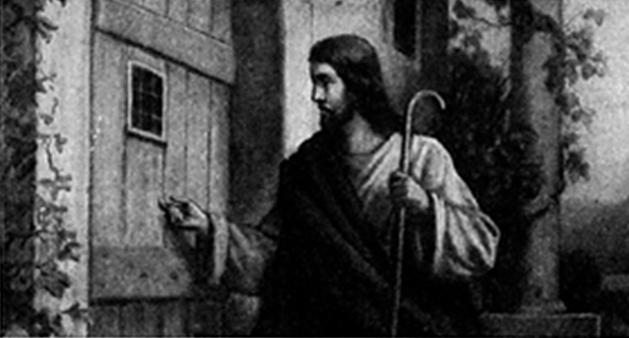
Revelation 3:20
Notes:
Imminency?
Ethnocentricity
Does not exactly fit church history
Allegorical

Slide 39
Ask Jesus into Your Heart?
Fellowship context
  Rev. 3:19 (Heb. 12:5-11)
  Rev. 3:14
Eiserchomai = “in with” (Mk. 15:43) not “inside of”
200 clear passages

Slide 40
Mark 15:43 (NASB)
“Joseph of Arimathea came, a prominent member of the Council, who himself was waiting for the kingdom of God; and he gathered up courage and went in before Pilate, and asked for the body of Jesus.”

Slide 41
Ask Jesus into Your Heart?
Fellowship context
  Rev. 3:19 (Heb. 12:5-11)
  Rev. 3:14
Eiserchomai = “in with” (Mk. 15:43) not “inside of”
200 clear passages

Slide 42
Response to Problem Passages
Confession of Christ before man (Rom 10:9-10; Matt 10:32-33)? Context
Ask Jesus into your heart (Rev 3:20)? Context
Confess your sins (Matt 6:12; 1 John 1:9)? Context
Forgive others (Matt 6:14-15)? Father (6:9) vs. judge
Sell your possessions (Matt 19:21-22)? Unique situation
Prayer and saving faith? Faith expressed by the prayer saves and not merely the prayer

Slide 43
Matthew 6:9, 12 (NASB)
“Our Father who is in heaven,
Hallowed be Your name…And forgive us our debts, as we also have forgiven our debtors.”

Slide 44
Matthew 6:9, 12 (NASB)
“Our Father who is in heaven,
Hallowed be Your name…And forgive us our debts, as we also have forgiven our debtors.”

Slide 45
1 John 1:9; 2:1-2 (NASB)
“If we confess our sins, He is faithful and righteous to forgive us our sins and to cleanse us from all unrighteousness…My little children, I am writing these things to you so that you may not sin. And if anyone sins, we have an Advocate with the Father, Jesus Christ the righteous; ² and He Himself is the propitiation for our sins; and not for ours only, but also for those of the whole world.”

Slide 46
1 John 1:9; 2:1-2 (NASB)
“If we confess our sins, He is faithful and righteous to forgive us our sins and to cleanse us from all unrighteousness…My little children, I am writing these things to you so that you may not sin. And if anyone sins, we have an Advocate with the Father, Jesus Christ the righteous; ² and He Himself is the propitiation for our sins; and not for ours only, but also for those of the whole world.”

Slide 47
Response to Problem Passages
Confession of Christ before man (Rom 10:9-10; Matt 10:32-33)? Context
Ask Jesus into your heart (Rev 3:20)? Context
Confess your sins (Matt 6:12; 1 John 1:9)? Context
Forgive others (Matt 6:14-15)? Father (6:9) vs. judge
Sell your possessions (Matt 19:21-22)? Unique situation
Prayer and saving faith? Faith expressed by the prayer saves and not merely the prayer

Slide 48
Matthew 6:9, 14-15 (NASB)
“Our Father who is in heaven,
Hallowed be Your name…For if you forgive others for their transgressions, your heavenly Father will also forgive you. ¹⁵ But if you do not forgive others, then your Father will not forgive your transgressions.”

Slide 49
Matthew 6:9, 14-15 (NASB)
“Our Father who is in heaven,
Hallowed be Your name…For if you forgive others for their transgressions, your heavenly Father will also forgive you. ¹⁵ But if you do not forgive others, then your Father will not forgive your transgressions.”

Slide 50
Response to Problem Passages
Confession of Christ before man (Rom 10:9-10; Matt 10:32-33)? Context
Ask Jesus into your heart (Rev 3:20)? Context
Confess your sins (Matt 6:12; 1 John 1:9)? Context
Forgive others (Matt 6:14-15)? Father (6:9) vs. judge
Sell your possessions (Matt 19:21-22)? Unique situation
Prayer and saving faith? Faith expressed by the prayer saves and not merely the prayer

Slide 51
Matthew 19:21-22 (NASB)
“Jesus said to him, “If you wish to be complete, go and sell your possessions and give to the poor, and you will have treasure in heaven; and come, follow Me.” But when the young man heard this statement, he went away grieving; for he was one who owned much property.”

Slide 52
1 Timothy 6:10 (NASB)
“For the love of money is a root of all sorts of evil, and some by longing for it have wandered away from the faith and pierced themselves with many griefs.”

Slide 53
Matthew 27:57 (NASB)
“When it was evening, there came a rich man from Arimathea, named Joseph, who himself had also become a disciple of Jesus .”

Slide 54
Response to Problem Passages
Confession of Christ before man (Rom 10:9-10; Matt 10:32-33)? Context
Ask Jesus into your heart (Rev 3:20)? Context
Confess your sins (Matt 6:12; 1 John 1:9)? Context
Forgive others (Matt 6:14-15)? Father (6:9) vs. judge
Sell your possessions (Matt 19:21-22)? Unique situation
Prayer and saving faith? Faith expressed by the prayer saves and not merely the prayer

Slide 55
CONCLUSION

Slide 56
Soteriology Overview
Next Session
VI. Results of Salvation

Slide 57
Soteriology Overview
Definition
Election
Atonement
Salvation words
God’s one condition of salvation
Results of salvation
Eternal security
Faulty views of salvation

