Slide 1

The Riches
of Divine Grace
Jim McGowan, Th.D.
Sugar Land Bible Church
02-07-2016
Resources used with permission from Dr. Vern Peterman, Holly Hills Bible Church.
Notes:
This session we are going to consider the Riches of Divine Grace. Since this is an expansive topic, I will only be able to introduce it, but comprehending the Riches of Divine Grace is the God intended means to entering into and enjoying a consistent, victorious Christian walk through out our earth bound pilgrimage. Everyone wants to be a winner. We as a society are obsessed with be winners. So let’s start with that in mind.

Slide 2
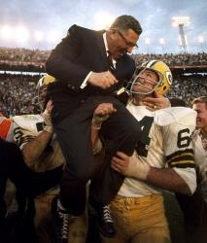
Introduction
VINCE LOMBARDI ON WINNING
“Winning is not a sometime thing; it's an all-time thing. You don't win once in a while, you don't do things right once in a while, you do the right all the time. Winning is a habit. Unfortunately, so is losing.”
“Perfection is not attainable, but if we chase perfection we can catch excellence.”
“The quality of a person's life is in direct proportion to their commitment to excellence, regardless of their chosen field of endeavor.”

Slide 3

JOHN WOODEN ON WINNING
Introduction
“Remember, results aren't the criteria for success — it's the effort made for achievement that is most important.”
“It is most difficult, in my mind, to separate any success, whether it be in your profession, your family, or as in my case, in basketball, from religion.”

Slide 4

Introduction

Slide 5
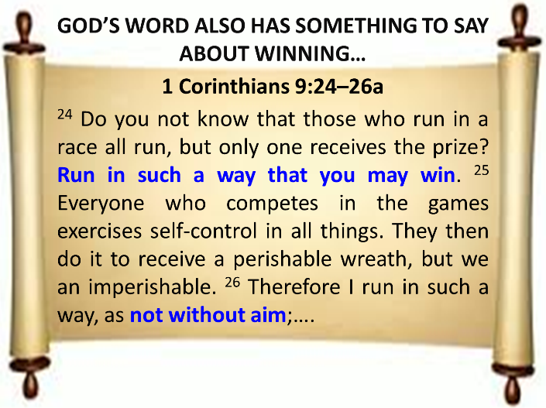
Introduction

Slide 6
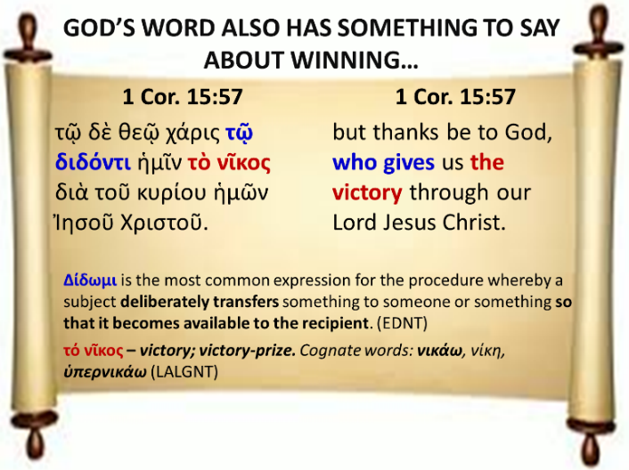
Introduction

Slide 7
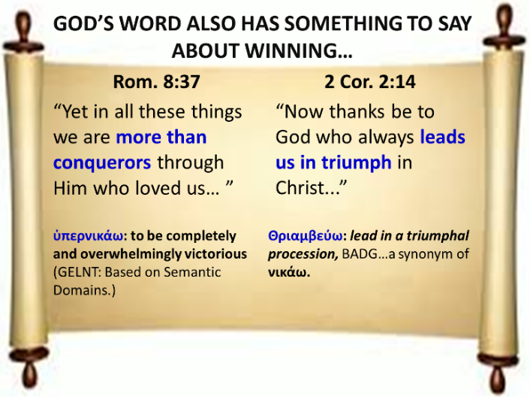
Introduction

Slide 8
SO WHY AREN‘T WE ENJOYING CONTINUOUS SPIRITUAL VICTORY IN OUR LIVES?
Introduction
We aren’t competing according to the set rules.
We’re aren’t competing to win because our aim is off.
We aren’t prepared to receive Christ’s victory baton.
In our ignorance, we attempt to secure our own victory by means of the Law and the Flesh.
We do not sufficiently understand what Christ’s victory at the Cross secured for us.

Slide 9
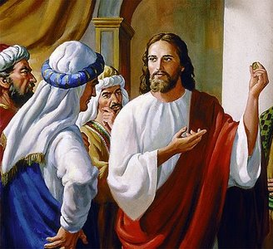
THE DILEMMA – NO ENABLEMENT UNDER THE LAW!
Introduction
Luke 10:25–28
²⁵And a lawyer stood up and put Him to the test, saying, “Teacher, what shall I do to inherit eternal life?” ²⁶And [Jesus] said to him, “What is written in the Law? How does it read to you?” ²⁷And he answered, “You shall love the Lord your God with all your heart, and with all your soul, and with all your strength, and with all your mind; and your neighbor as yourself.” ²⁸And [Jesus] said to him, “You have answered correctly; do this and you will live.”
Notes:
THE DILEMMA – NO ENABLEMENT UNDER THE LAW!
The lawyer was an insincere seeker of truth. He wanted to test Jesus’ commitment to the established legal system, but he also wanted to justify his own piety and religious zeal for the Law, as his way into eternal life. He quotes the Great or Foremost command, and the Second most important command. Jesus, knowing his heart, used his own words to reveal his hypocrisy. The Law could justify no man for “by the works of the Law no flesh will be justified in His sight” Romans 3:20 (NASB95)

Slide 10

THE DILEMMA – NO ENABLEMENT TROUGH THE FLESH!
Introduction
Romans 7:18
For I know that nothing good dwells in me, that is, in my flesh; for the willing is present in me, but the doing of the good is not.
Notes:
THE DILEMMA – NO ENABLEMENT UNDER THE LAW!
When the Apostle Paul use the term “flesh” in Romans, he usually means, the Sin Nature as it seeks to express itself though the as yet unredeemed physical body of the believer.

Slide 11
THE DILEMMA – NO ENABLEMENT TROUGH THE FLESH!
Introduction
Romans 8:6–8
⁶ For the mind set on the flesh is death, but the mind set on the Spirit is life and peace, ⁷ because the mind set on the flesh is hostile toward God; for it does not subject itself to the law of God, for it is not even able to do so, ⁸ and those who are in the flesh cannot please God.
Notes:
THE DILEMMA – NO ENABLEMENT UNDER THE LAW!

Slide 12

THE DILEMMA – NO ENABLEMENT TROUGH THE FLESH!
Introduction
“As long as we think lightly of the fact of the presence with us of the fallen nature, (I speak of Christians) we are far from deliverance….It is because people do not recognize their all-badness that they do not find Christ all in all to them….those who have received a knowledge of the truth and are addressed by the apostle as among God’s people, may yet be choosing a flesh-walk…”.
Newell, W. R. (n.d.). Romans Verse-by-Verse (p. 194). Grand Rapids, MI: Christian Classics Ethereal Library.
Notes:
THE DILEMMA – NO ENABLEMENT UNDER THE LAW!
So there’s no enablement either through the Law or the Flesh. But we also fail to find consistent victory in our lives because we do not sufficiently understand what Christ’s victory at the Cross secured for us.
The Sad Case of the Ill-informed Passenger

Slide 13
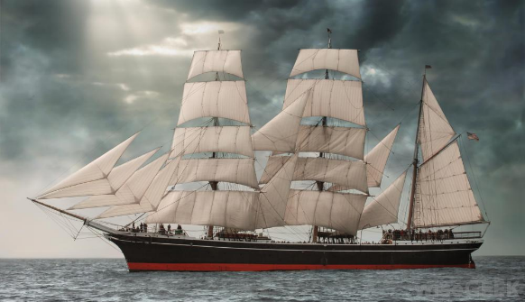

The Sad Case of the Ill-informed Passenger
Introduction

Slide 14
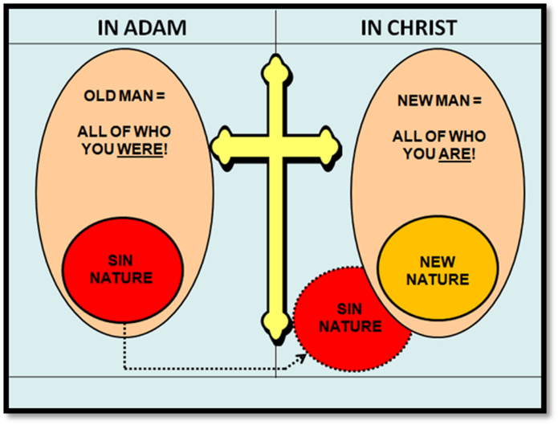
Introduction
ILLITERATE BELIEVERS?
Notes:
Many believers, like the ill-informed passenger in my illustration, suffer from biblical illiteracy and so are not informed as to what it means to be “in Christ”. There ignorance hinders their spiritual growth and maturity and resultant consistent spiritual victory, because they never acquire the knowledge and understanding of “who they are in Christ, nor of what they have “in Christ”.
What we have in Christ is what we mean by the expression, the Riches of Divine Grace, my topic for this morning.

Slide 15

The Riches of Divine Grace
Definition
The Three Tenses of Salvation
Position vs. Condition
The Essential Character of the Riches of Divine Grace
33 Riches of Divine Grace

Slide 16
Defining the Riches of Divine Grace
The Riches of Divine Grace:
comprehend the Doctrine of Salvation (Soteriology) and are the sum total of those things divinely accomplished for the individual at the instant of belief alone.
form that aspect of salvation which is already accomplished in and for the one who believes.
illustrate and illuminate the N.T. teaching on the believer’s “position in Christ”.

Slide 17
THE THREE TENSES OF SALVATION
Past Tense
Justification
Present Tense
Sanctification
Future Tense
Glorification
Time

Slide 18
THE THREE TENSES OF SALVATION
Past Tense
Justification
What has
occurred here?
salvation from the penalty of sin
refers to salvation as being wholly past
completed (unchanging) for one who has believed
from what ? – to what ?
  from eternal death to eternal life
Notes:
Ephesians 2:8 – For by grace you have been saved through faith; and that not of yourselves, it is the gift of God;
Titus 3:5 – He saved us, not on the basis of deeds which we have done in righteousness, but according to His mercy, by the washing of regeneration and renewing by the Holy Spirit,
John 5:24 – “Truly, truly, I say to you, he who hears My word, and believes Him who sent Me, has eternal life, and does not come into judgment, but has passed out of death into life.
1 John 5:11 – And the testimony is this, that God has given us eternal life, and this life is in His Son.
Jn. 10:28 – and I give eternal life to them, and they will never perish; and no one will snatch them out of My hand.
Rom. 8:1 – Therefore there is now no condemnation for those who are in Christ Jesus.

Slide 19
THE THREE TENSES OF SALVATION
Phase | Justification | Sanctification | Glorification
Tense | Past | Present | Future
Saved from sin’s: | Penalty | Power | Presence
Scripture | Eph 2:8-9; Titus 3:5 | Philip 2:12 | Rom 5:10

Slide 20
THE THREE TENSES OF SALVATION
Justification
Past
Penalty
Eph 2:8-9; Titus 3:5

Slide 21
THE THREE TENSES OF SALVATION
Justification
Past
Penalty
Eph 2:8-9; Titus 3:5
Ephesians 2:8–9
⁸ For by grace you have been saved through faith; and that not of yourselves, it is the gift of God; ⁹ not as a result of works, so that no one may boast.
Titus 3:5
⁵ He saved us, not on the basis of deeds which we have done in righteousness, but according to His mercy, by the washing of regeneration and renewing by the Holy Spirit,

Slide 22
“Justified from sin” does not mean “sinless perfection,”—but something utterly different, and infinitely beyond that! It is different, in that it does not refer to an “experience” of deliverance from sin, but a passing beyond, in death with
Christ at the cross, the sphere where the former relationship to sin existed! We are justified, accounted wholly righteous, with respect to the thing sin itself! This, therefore, is infinitely beyond any state whatever of experience. It is a newly-established relationship to sin, which the saints have because they died with Christ: in which they stand in Christ as He is toward sin. They are “meet to be partakers of the inheritance of the saints in light.” They are heavenly. Their old relation to sin is over forever. They are justified from it. They rejoice, indeed, and have a most blessed “experience.” But they do not say sin is gone from their flesh: but that they, having died, are declared righteous from it; that they are cleared, before God, of all condemnation because of sin’s presence in this unredeemed body; and delivered from all sin’s former rights and bondage over them.
Newell, W. R. (n.d.). Romans Verse-by-Verse. Grand Rapids, MI: Christian Classics Ethereal Library.

Slide 23
THE THREE TENSES OF SALVATION
Present Tense
Sanctification
What is
occurring here?
salvation from the reigning power of sin
we are to walk by faith (reckon ourselves dead to sin)
from what? – to what?
  from the power of the Sin Nature to being alive to God
Notes:
Philippians 2:12–13 – 12 So then, my beloved, just as you have always obeyed, not as in my presence only, but now much more in my absence, work out your salvation with fear and trembling; 13 for it is God who is at work in you, both to will and to work for His good pleasure.
Rom. 6:6 – Knowing this, that our old self [who we were in and from Adam federally and seminally] was crucified with Him, in order that our body of sin [our bodies as yet unredeemed and susceptible to the Sin Nature] might be done away with, [“put out of business” by the indwelling Holy Spirit], so that we would no longer be slaves to sin
Rom 6:11 – Even so consider yourselves to be dead to sin (Sin Nature) , but alive to God in Christ Jesus
The “Identification Truths” describe the Present Tense of salvation - To be disappointed with yourself, is to have believed in yourself. Newell, W. R. (n.d.). Romans Verse-by-Verse (p. 172). Grand Rapids, MI: Christian Classics Ethereal Library.

Slide 24
THE THREE TENSES OF SALVATION
Phase | Justification | Sanctification | Glorification
Tense | Past | Present | Future
Saved from sin’s: | Penalty | Power | Presence
Scripture | Eph 2:8-9; Titus 3:5 | Philip 2:12 | Rom 5:10

Slide 25
THE THREE TENSES OF SALVATION
Sanctification
Present
Power
Philip 2:12
Philippians 2:12–13
¹² So then, my beloved, just as you have always obeyed, not as in my presence only, but now much more in my absence, work out your salvation with fear and trembling; ¹³ for it is God who is at work in you….

Slide 26
THE THREE TENSES OF SALVATION
Future Tense
Glorification
What will
occur here?
      salvation from the presence of sin
      to Christ
      yet to be saved into full conformity revealed in the last times
      from what? – to what?
  from presence of the Sin Nature to absence of the Sin Nature
Notes:
Romans 5:10 – For if while we were enemies we were reconciled to God through the death of His Son, much more, having been reconciled, we shall be saved by His life.
1 John 3:2 – Beloved, now we are children of God, and it has not appeared as yet what we will be. We know that when He appears, we will be like Him, because we will see Him just as He is.
1 Peter 1:5 –[we] are protected by the power of God through faith for a salvation ready to be revealed in the last time.
Philippians 1:6 – For I am confident of this very thing, that He who began a good work in you will perfect it until the day of Christ Jesus.

Slide 27
THE THREE TENSES OF SALVATION
Phase | Justification | Sanctification | Glorification
Tense | Past | Present | Future
Saved from sin’s: | Penalty | Power | Presence
Scripture | Eph 2:8-9; Titus 3:5 | Philip 2:12 | Rom 5:10

Slide 28
THE THREE TENSES OF SALVATION
Glorification
Future
Presence
Rom 5:10
Romans 5:10
¹⁰ For if while we were enemies we were reconciled to God through the death of His Son, much more, having been reconciled, we shall be saved by His life.

Slide 29
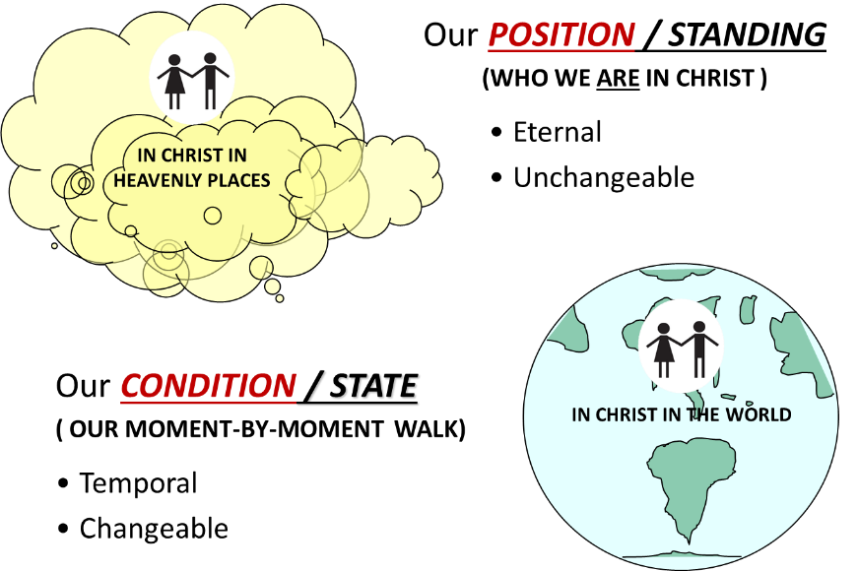
Position vs. Condition

Slide 30
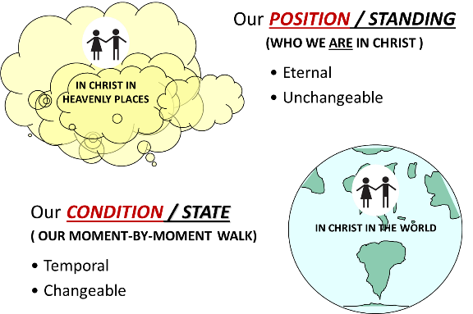
Position vs. Condition
Colossians 2:6
Therefore as you have received Christ Jesus the Lord (Position), so walk in Him (Condition)
Notes:
Positional Truth (Who We Are in Christ) vs Conditional Truth (Our Moment by Moment Walk)
Colossians 2:6 - Therefore as you have received Christ Jesus (Position) the Lord, so walk in Him (Condition)
The Colossians had received Christ in a certain manner: as the Anointed of God (“Christ”), as the historic Savior (“Jesus”), and as the sovereign (“Lord”). Paul’s appeal is that they “continue to live [lit., walk] in him” in the same manner. That is to say, he wants their present and continuous conduct to conform to the doctrine taught them at the beginning, the doctrine they had committed themselves to at conversion. Vaughan, C. (1981). Colossians. In F. E. Gaebelein (Ed.), The Expositor’s Bible Commentary: Ephesians through Philemon (Vol. 11, p. 196). Grand Rapids, MI: Zondervan Publishing House.
Since their faith initially laid hold decisively on the apostolic gospel, Paul exhorted them not to forsake its divine authority for any human sophistry. Geisler, N. L. (1985). Colossians. In J. F. Walvoord & R. B. Zuck (Eds.), The Bible Knowledge Commentary: An Exposition of the Scriptures (Vol. 2, p. 676). Wheaton, IL: Victor Books.

Slide 31

The Essential Character of
The Riches of Divine Grace
Positive Aspects – they are:
wrought of God;
wrought instantaneously;
wrought simultaneously;
grounded on the merit of Christ.
Chafer, L. S. (1993). Systematic Theology (Vol. 3, p. 234). Grand Rapids, MI: Kregel Publications.

Slide 32

The Essential Character of
The Riches of Divine Grace
  Negative Aspects – they are
  not experienced
  not progressive
  in no way related to human merit
  not temporal but eternal in their character
  unknown by any other means than divine revelation of the Word of God

Slide 33


1. They Are Not Experienced
They are POSITIONAL ETERNAL FACTS based in our justification, our new divine life relationship to God, and are not experientially observable.
Notes:
THE RICHES OF DIVINE GRACE THEY ARE NOT EXPERIENCED!

Slide 34
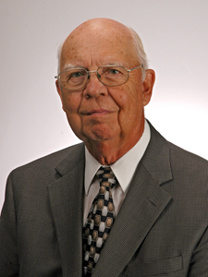
Justification a New Eternal Fact
To be justified means to be declared righteous. Because of our position in Christ (Eph. 2:13), whereby Christ’s righteousness is imputed to us (Rom. 5:17; 2 Cor. 5:21), God declares us righteous because we are clothed with his righteousness (Rom. 5:1). This is of course the work of grace (Rom. 3:24)…Justification is more than simply God viewing the sinner as though he had never sinned. Instead, it is God looking upon the sinner to whom the righteousness of Christ, earned at the cross, has been added.
Lightner, R. P. (1995). Handbook of Evangelical Theology: (p. 203). Grand Rapids, MI: A Historical, Biblical, and Contemporary Survey and Review Kregel Publications.
Notes:
THE RICHES OF DIVINE GRACE THEY ARE NOT EXPERIENCED!

Slide 35
Justification a New Eternal Fact
2 Cor. 5:21
He [God] made Him [Christ] who knew no sin to be sin on our behalf, so that we might become the righteousness of God in Him [Christ].
The glorious purpose of the Father’s act in making Christ “to be sin” was that believers should “become the righteousness of God” in Christ. This is a bold restatement of the nature of justification. Not only does the believer receive from God a right standing before him on the basis of faith in Jesus (Phil. 3:9), but here Paul says that “in Christ” the believer in some sense actually shares the righteousness that characterizes God himself (cf. 1 Cor 1:30).
Harris, M. J. (1976). 2 Corinthians. In F. E. Gaebelein (Ed.), The Expositor’s Bible Commentary: Romans through Galatians (Vol. 10, pp. 354–355). Grand Rapids, MI: Zondervan Publishing House.
Notes:
THE RICHES OF DIVINE GRACE THEY ARE NOT EXPERIENCED!
2 Cor. 5:21 - γίνομαι gínomai – Aorist Middle Subjunctive 1st Plural
“The middle voice shows that the action is performed with special reference to the subject.”14 Smyth, H. W. Greek Grammar. Rev. by G. M. Messing. Cambridge, MA: Harvard University Press, 1956. Quoted in Wallace, D. B. (1996). Greek Grammar beyond the Basics: An Exegetical Syntax of the New Testament. Grand Rapids, MI: Zondervan.
“the subjunctive is used to grammaticalize potentiality.” Wallace, D. B. (1996). Greek Grammar beyond the Basics: An Exegetical Syntax of the New Testament (p. 463). Grand Rapids, MI: Zondervan.
Wallace, D. B. (1996). Greek Grammar beyond the Basics: An Exegetical Syntax of the New Testament (p. 463). Grand Rapids, MI: Zondervan.
“So complete was the identification of the sinless Christ with the sin of the sinner, including its dire guilt and its dread consequence of separation from God, that Paul could say profoundly, ‘God made him . . . to be sin for us.’”195; Constable, T. (2003). Tom Constable’s Expository Notes on the Bible (2 Co 5:21). Galaxie Software.

Slide 36
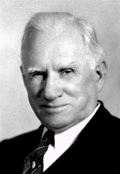
Justification a New Eternal Fact
Rom 5:1
Therefore, having been justified by faith, we have peace with God through our Lord Jesus Christ, (cf. 2 Cor. 5:21)
We must note at once that the Greek form of this verb “declared righteous,” or “justified,” is not the present participle, “being declared righteous,” but rather the aorist participle, “having been declared righteous,” or “justified.” You say. What is the difference? The answer is, “being declared righteous” looks to a state you are in; “having been declared righteous” looks back to a fact that happened.
Newell, W. R. (n.d.). Romans Verse-by-Verse (p. 114). Grand Rapids, MI: Christian Classics Ethereal Library.
Notes:
THE RICHES OF DIVINE GRACE THEY ARE NOT EXPERIENCED!
Rom. 5:1 - δικαιόω dikaióō - Aorist Passive Participle – Plural Nominative Masculine

Slide 37
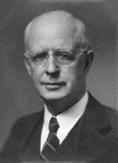
2. They Are Not Progressive
Every divine undertaking is instantly wrought to that degree of infinite perfection which it will exhibit in the eternal ages to come. Sonship well illustrates this truth. There are many features of the relation between father and son
which are subject to progression and change; but sonship itself knows no advancement or development. A child is as much a son at birth as he is at any subsequent point in his existence. Thus it is with every divine accomplishment that enters into the immediate salvation of men.
Chafer, L. S. (1993). Systematic theology (Vol. 3, p. 233). Grand Rapids, MI: Kregel Publications.
Notes:
THE RICHES OF DIVINE GRACE THEY ARE NOT PROGRESSIVE

Slide 38
2. They Are Not Progressive
Gal. 3:26
For you are all sons of God through faith in Christ Jesus.
Rom 8:14, 16
¹⁴ For all who are being led by the Spirit of God, these are sons of God…¹⁶ The Spirit Himself testifies with our spirit that we are children of God…
εἰμί – Present Active Indicative 1st Plural ; to be
Notes:
THE RICHES OF DIVINE GRACE THEY ARE NOT PROGRESSIVE
εἰμί eimí – Present Active Indicative 1st Plural

Slide 39


2. They Are Not Progressive
Notes:
THE RICHES OF DIVINE GRACE THEY ARE NOT PROGRESSIVE

Slide 40
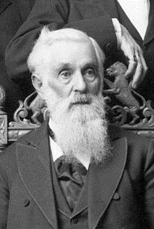
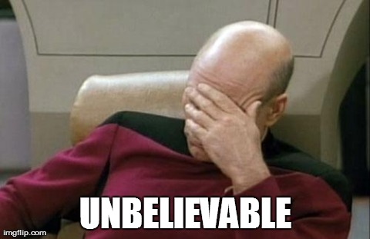
2. They Are Not Progressive
Lorenzo Snow 5th president of The Church of Jesus Christ of Latter-day Saints stated, “As man now is, God once was; As God now is, man may be.”
https://en.wikipedia.org/wiki/Lorenzo_Snow; accessed 01/07/2016
Notes:
THE RICHES OF DIVINE GRACE THEY ARE NOT PROGRESSIVE

Slide 41
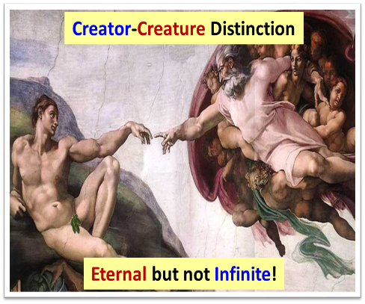

2. They Are Not Progressive
Notes:
THE RICHES OF DIVINE GRACE THEY ARE NOT PROGRESSIVE

Slide 42
3. They Are In No Way
Related To Human Merit
Romans 5:8
But God demonstrates His own love toward us, in that while we were yet sinners, Christ died for us.
Notes:
THE RICHES OF DIVINE GRACE ARE IN NO WAY RELATED TO HUMAN MERIT

Slide 43
3. They Are In No Way
Related To Human Merit
Beneath this truth, which truth is foreign to all human processes of life and experience, is the sovereign purpose of God to do all that He does according to His own good pleasure, and this He is free to do because the believer is seen to be—as
he really is—a member in the Body of Christ, and therefore meet to be blessed with all spiritual blessings in Christ Jesus. Whatever would be accorded the Son of God will be accorded a member in His Body. It is thus that these riches of grace are built solely on the merit of the Son of God, and, for that reason, are as abiding as the merit on which they rest.
Chafer, L. S. (1993). Systematic theology (Vol. 3, p. 233). Grand Rapids, MI: Kregel Publications.
Notes:
THE RICHES OF DIVINE GRACE ARE IN NO WAY RELATED TO HUMAN MERIT

Slide 44
3. They Are In No Way
Related To Human Merit
“…let us avoid the thought that assurance of our sonship is based on our perfect obedience to the Spirit. Nothing is based upon us. If one of God’s true saints disobeys, it is the office of that same Spirit to convict him of his sin, interceding in Him “according to God” (Rom. 8:27), while Christ intercedes for him above (1 John 2:1).
Newell, W. R. (n.d.). Romans Verse-by-Verse (p. 217). Grand Rapids, MI: Christian Classics Ethereal Library.
Notes:
THE RICHES OF DIVINE GRACE ARE IN NO WAY RELATED TO HUMAN MERIT

Slide 45
3. They Are In No Way
Related To Human Merit
HUMAN MERIT MUST BE EXCLUDED:
They are made to stand on the unchanging Person and merit of the eternal Son of God.
The Christian is “highly favored and “accepted (now and forever) in the beloved.”
Eph. 1:6
“…His grace, which He freely bestowed on us in the Beloved.”
Rom 15:7
“…accept one another, just as Christ also accepted us to the glory of God.”
Chafer, L. S. (1922). Salvation (p. 58). Philadelphia, PA: Sunday School Times Company.
Notes:
THE RICHES OF DIVINE GRACE ARE IN NO WAY RELATED TO HUMAN MERIT
χαριτόω - To grace, highly honor or greatly favor. In the NT spoken only of the divine favor, as to the virgin Mary in Luke 1:28; Eph. 1:6.
Προσλαμβάνω - To receive to oneself, admit to one’s society and fellowship, receive and treat with kindness,

Slide 46
4. They Are Eternal In Their Character
HUMAN MERIT MUST BE EXCLUDED:
The imparted life of God is as eternal in its character as its Fountain Head. Hence the Word of His grace: “I give unto them eternal life and they shall never perish.”
The consciousness and personal realization of such relationship to God may vary with the daily walk of the believer; but the abiding facts of the new being are never subject to change in time or eternity.
Chafer, L. S. (1922). Salvation (pp. 58–59). Philadelphia, PA: Sunday School Times Company.
Notes:
THE RICHES OF DIVINE GRACE ARE ETERNAL IN THEIR CHARACTER

Slide 47
4. They Are Eternal In Their Character
John 6:40
“For this is the will of My Father, that everyone who beholds the Son and believes in Him will have eternal life, and I Myself will raise him up on the last day.”
2 Corinthians 4:17
For momentary, light affliction is producing for us an eternal weight of glory far beyond all comparison,
2 Thessalonians 2:16
Now may our Lord Jesus Christ Himself and God our Father, who has loved us and given us eternal comfort and good hope by grace,
Notes:
THE RICHES OF DIVINE GRACE ARE ETERNAL IN THEIR CHARACTER
Jude 24 – Now to Him who is able to keep you from stumbling, and to make you stand in the presence of His glory blameless with great joy,

Slide 48

5. They Are Known Only Through The
Divine Revelation of The Word of God
They defy human imagination, and since they cannot be experienced, their reality can be entered into only by believing the Word of God.
  Chafer, L. S. (1922). Salvation (p. 59). Philadelphia, PA: Sunday School Times Company.
Notes:
THE RICHES OF DIVINE GRACE ARE KNOWN ONLY THROUGH THE DIVINE REVELATION OF THE WORD OF GOD

Slide 49

5. They Are Known Only Through The
Divine Revelation of The Word of God
Romans 12:2
“…be transformed by the renewing of your mind...”
Hebrews 4:12
For the word of God is living and active….
1 Thessalonians 2:13
“…you received the word of God which you heard from us,…not as the word of men, but for what it really is, the word of God, which also performs its work in you who believe.”
Notes:
THE RICHES OF DIVINE GRACE ARE KNOWN ONLY THROUGH THE DIVINE REVELATION OF THE WORD OF GOD

Slide 50
The Essential Character of
The Riches of Divine Grace
  not experienced
  not progressive
  not related to human merit
  not temporal but eternal in their character
  not known by any other means than divine revelation of the Word of God
  So What are the Riches of Divine Grace?
Notes:
THE ESSENTIAL CHARACTER OF THE RICHES OF DIVINE GRACE

Slide 51

What Should I Take Away From This?
The Riches of Divine Grace include all the things which are divinely accomplished in and for the individual at the moment of believing.

Slide 52

The Riches of Divine Grace
33 Riches of Divine Grace

Slide 53

The Riches of Divine Grace
33 Riches of Divine Grace
HANDOUTS ARE AVAILABLE IN THE FOYER

Slide 54
Conclusion

Slide 55
What Should I Take Away From This?
Romans 8:32
He who did not spare His own Son, but delivered Him over for us all, how will He not also with Him freely give us all things?
1 Corinthians 2:12
Now we have received, not the spirit of the world, but the Spirit who is from God, so that we may know the things freely given to us by God,

Slide 56
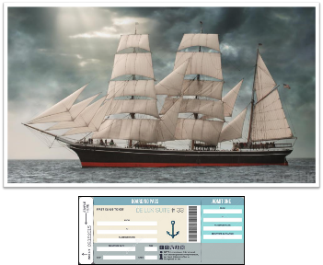
What Should I Take Away From This?
FOR THE BELIEVER
  A consistent, victorious, mirroring of our position in Christ, in our daily, conditional walk is only realized through knowing “Who We Are In Christ” and then allowing the Holy Spirit to manifest that reality in our mortal flesh.
Notes:
The admonition to those believers present is : Check your heart. What is God telling you to do with this message this morning? Whatever it is, respond in faith.

Slide 57
What Should I Take Away From This?
FOR THE UNBELIEVER
  God has provided a Way for you to have and experience New Life in Christ. This New Life in Christ is received as a free gift, by faith alone, and makes available to you all of God’s Divine Riches of Grace.
John 14:6
Jesus said to him, “I am the way, and the truth, and the life; no one comes to the Father but through Me.”
Notes:
The admonition to those present who are unbelievers is: Today is the Day of Salvation.
You can place your faith in Christ’s promises right now.
There are no secret handshakes, no righteous deeds, no church membership, no emotional, pressure induced commitments, no hand raising, and no aisle walking required
Just simple faith, trust, confidence, in God’s offer of New, Eternal, Life to those who have placed their faith in Christ.
If this is something you have done or are doing right now, God’s Word authoritatively declares that you are a Child of God and you have access to all of God’s Divine Riches of Grace.
If you need more information, I along with the other Elders will be available immediately after the service.
PRAYER - Father, thank you for the convicting power of the Holy Spirit. May we all be sensitive to heed His voice as He draws us to the Lord Jesus Christ for salvation, restoration of fellowship, or spiritual growth. Amen!

Slide 58

Numbers 6:24–26
²⁴ The Lord bless you, and keep you; ²⁵ The Lord make His face shine on you, And be gracious to you; ²⁶ The Lord lift up His countenance on you, And give you peace.’

