Slide 3
2 Timothy Introduction
The Call to Christian Perseverance

Slide 4
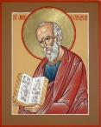
Answering Nine Questions
Who wrote it? – Paul
What do we know about the author? – An Apostle
To whom was it written? – Timothy
When was it written? - A.D. 67
Where was it written from? – Rome
Why was it written? – Timothy’s timidity
What is it about? – Perseverance
What is inside (outline)? – 4 part outline
What makes the book different? – Paul’s final word

Slide 5
Four Part Structure
General call to faithful endurance in the ministry (chapter 1)
Ten metaphors describing what faithful endurance looks like (chapter 2)
What to do in the midst of the coming apostasy (3:1–4:8)
How God met six needs in Paul’s life (4:9-22)

Slide 6
Four Part Structure
General call to faithful endurance in the ministry (chapter 1)
Ten metaphors describing what faithful endurance looks like (chapter 2)
What to do in the midst of the coming apostasy (3:1–4:8)
How God met six needs in Paul’s life (4:9-22)

Slide 7
Four Part Structure
General call to faithful endurance in the ministry (chapter 1)
Ten metaphors describing what faithful endurance looks like (chapter 2)
What to do in the midst of the coming apostasy (3:1–4:8)
How God met six needs in Paul’s life (4:9-22)

Slide 8
2 Timothy 2
Ten Metaphors Illustrating Endurance

Slide 9
Ten Metaphors
Teacher (2:2)
Soldier (2:3-4)
Athlete (2:5)
Farmer (2:6)
Christ (2:7-8)
Paul (2:9-10)
Trustworthy statement (2:11-13)
Workman (2:14-18)
Vessel (2:19-23)
Servant (2:24-26)

Slide 10
Four Part Structure
General call to faithful endurance in the ministry (chapter 1)
Ten metaphors describing what faithful endurance looks like (chapter 2)
What to do in the midst of the coming apostasy (3:1–4:8)
How God met six needs in Paul’s life (4:9-22)

Slide 11
THE LAST DAYS APOSTASY OF THE CHURCH
Dr. Andy Woods

Slide 12
Definition of Apostasy
apos = away from
histēmi = to stand
Apostasy = to stand away from
Apostasy = a departure from known (or previously embraced) truth

Slide 13
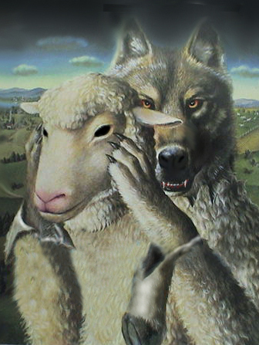
Ten Characteristics of Apostasy
Sign of the last days
A massive NT subject
Impacts every major doctrine
Primarily internal
Knows no limits

Slide 14
Ten Characteristics of Apostasy
Can happen quickly
Satanically energized
Destructive
Makes life difficult for the man of God
Impacts those who have not taken preventive measures

Slide 15
2 Timothy 3:1‒4:6
What to Do in the
Midst of the Apostasy

Slide 16
Apostasy (3:1‒4:8)
The Apostasy (3:1-9)
The evil (3:1-7)
The examples (3:8-9)
The Antidote (3:10‒4:8)
Paul’s example (3:10-13)
Preach the Word (3:14‒4:8)

Slide 17
Apostasy (3:1‒4:8)
The Apostasy (3:1-9)
The evil (3:1-7)
The examples (3:8-9)
The Antidote (3:10‒4:8)
Paul’s example (3:10-13)
Preach the Word (3:14‒4:8)

Slide 18
Apostasy (3:1‒4:8)
The Apostasy (3:1-9)
The evil (3:1-7)
The examples (3:8-9)
The Antidote (3:10‒4:8)
Paul’s example (3:10-13)
Preach the Word (3:14‒4:8)

Slide 19
A. The Evil (3:1-7)
Difficulty & danger (1)
Misplaced Love (2, 4)
Pride (2)
Alpha privitives (2-3)
Four concluding characteristics (5-7)

Slide 20
A. The Evil (3:1-7)
Difficulty & danger (1)
Misplaced Love (2, 4)
Pride (2)
Alpha privitives (2-3)
Four concluding characteristics (5-7)

Slide 21
A. The Evil (3:1-7)
Difficulty & danger (1)
Misplaced Love (2, 4)
Pride (2)
Alpha privitives (2-3)
Four concluding characteristics (5-7)

Slide 22
2. Misplaced love (2, 4)
Lovers of self (2)
Lovers of money (2)
Lovers of pleasure rather than lovers of God (4)

Slide 23
A. The Evil (3:1-7)
Difficulty & danger (1)
Misplaced Love (2, 4)
Pride (2)
Alpha privitives (2-3)
Four concluding characteristics (5-7)

Slide 24
3. Pride (2)
Boastful (2)
Arrogant (2)
Revilers (2)

Slide 25
A. The Evil (3:1-7)
Difficulty & danger (1)
Misplaced Love (2, 4)
Pride (2)
Alpha privitives (2-3)
Four concluding characteristics (5-7)

Slide 26
4. Alpha Privitives (2-3)
Disobedient to parents (2)
Ungrateful (2)
Unholy (2)
Unloving (3)
Irreconcilable (3)
Break up-Malicious gossips (3)
Without self control (3)
Brutal (3)
Haters of good (3)

Slide 27
4. Alpha Privitives (2-3)
Disobedient to parents (2)
Ungrateful (2)
Unholy (2)
Unloving (3)
Irreconcilable (3)
Break up-Malicious gossips (3)
Without self control (3)
Brutal (3)
Haters of good (3)

Slide 28
4. Alpha Privitives (2-3)
Disobedient to parents (2)
Ungrateful (2)
Unholy (2)
Unloving (3)
Irreconcilable (3)
Break up-Malicious gossips (3)
Without self control (3)
Brutal (3)
Haters of good (3)

Slide 29
4. Alpha Privitives (2-3)
Disobedient to parents (2)
Ungrateful (2)
Unholy (2)
Unloving (3)
Irreconcilable (3)
Break up-Malicious gossips (3)
Without self control (3)
Brutal (3)
Haters of good (3)

Slide 30
4. Alpha Privitives (2-3)
Disobedient to parents (2)
Ungrateful (2)
Unholy (2)
Unloving (3)
Irreconcilable (3)
Break up-Malicious gossips (3)
Without self control (3)
Brutal (3)
Haters of good (3)

Slide 31
4. Alpha Privitives (2-3)
Disobedient to parents (2)
Ungrateful (2)
Unholy (2)
Unloving (3)
Irreconcilable (3)
Break up-Malicious gossips (3)
Without self control (3)
Brutal (3)
Haters of good (3)

Slide 32
4. Alpha Privitives (2-3)
Disobedient to parents (2)
Ungrateful (2)
Unholy (2)
Unloving (3)
Irreconcilable (3)
Break up-Malicious gossips (3)
Without self control (3)
Brutal (3)
Haters of good (3)

Slide 33
4. Alpha Privitives (2-3)
Disobedient to parents (2)
Ungrateful (2)
Unholy (2)
Unloving (3)
Irreconcilable (3)
Break up-Malicious gossips (3)
Without self control (3)
Brutal (3)
Haters of good (3)

Slide 34
4. Alpha Privitives (2-3)
Disobedient to parents (2)
Ungrateful (2)
Unholy (2)
Unloving (3)
Irreconcilable (3)
Break up-Malicious gossips (3)
Without self control (3)
Brutal (3)
Haters of good (3)

Slide 36
4. Alpha Privitives (2-3)
Disobedient to parents (2)
Ungrateful (2)
Unholy (2)
Unloving (3)
Irreconcilable (3)
Break up-Malicious gossips (3)
Without self control (3)
Brutal (3)
Haters of good (3)

Slide 37
A. The Evil (3:1-7)
Difficulty & danger (1)
Misplaced Love (2, 4)
Pride (2)
Alpha privitives (2-3)
Four concluding characteristics (5-7)

Slide 38
5. Four Concluding Characteristics (5-7)
Treacherous (4)
Reckless (4)
Conceited (4)
Holding to a form of godliness but denying its power (5-7)

Slide 39
5. Four Concluding Characteristics (5-7)
Treacherous (4)
Reckless (4)
Conceited (4)
Holding to a form of godliness but denying its power (5-7)

Slide 40
5. Four Concluding Characteristics (5-7)
Treacherous (4)
Reckless (4)
Conceited (4)
Holding to a form of godliness but denying its power (5-7)

Slide 41
5. Four Concluding Characteristics (5-7)
Treacherous (4)
Reckless (4)
Conceited (4)
Holding to a form of godliness but denying its power (5-7)

Slide 42
5. Four Concluding Characteristics (5-7)
Treacherous (4)
Reckless (4)
Conceited (4)
Holding to a form of godliness but denying its power (5-7)

Slide 43
Conclusion

Slide 44
A. The Evil (3:1-7)
Difficulty & danger (1)
Misplaced Love (2, 4)
Pride (2)
Alpha privitives (2-3)
Four concluding characteristics (5-7)

Slide 45
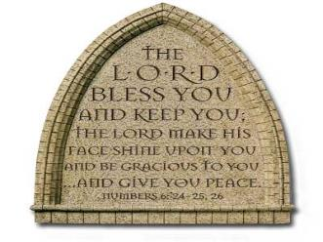
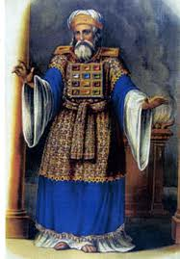
“The Lord bless you and keep you; the Lord make his face shine on you and be gracious to you; the Lord turn his face toward you and give you peace.” (NIV)

