Slide 1
Soteriology Session 7
Dr. Andy Woods
Senior Pastor – Sugar Land Bible Church
Professor of Bible & Theology – College of Biblical Studies

Slide 2
Soteriology Overview
Definition
Election
Atonement
Salvation words
God’s one condition of salvation
Results of salvation
Eternal security
Faulty views of salvation

Slide 3
Soteriology Overview
This Session
V. God’s One Condition of Salvation
(Continued)

Slide 4
Response to Problem Passages
Repent (Acts 2:38; 3:19; 17:30; 2 Pet 3:9)? Change of mind
Lordship (Matt 16:24-25)? Discipleship vs. justification
Receive/Accept Christ? – Synonym of faith (John 1:12)
Believe and work (Eph 2:8-10; Jas 2:14-26)? Sanctification
Believe and be baptized (Mark 16:15-16; John 3:5; Acts 2:38; Col 2:11-12; 1 Pet 3:21)? Context

Slide 5
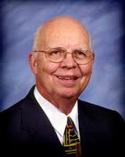
Lordship Salvation Defined
“Lordship Salvation refers to the belief which says the sinner who wants to be saved must not only trust Christ as his substitute for sin, but must also surrender every area of his life to the complete control of Christ.”
Lightner, Sin, the Savior, and Salvation, 202

Slide 6
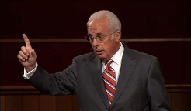
John MacArthur, The Gospel According to Jesus, p. 140
"Eternal life is indeed a free gift (Rom. 6:23). Salvation cannot be earned with good deeds or purchased with money. It has already been bought by Christ, who paid the ransom with His blood. But that does not mean there is no cost in terms of salvation's impact on the sinner's life. This paradox may be difficult but it is nevertheless true: salvation is both free and costly. Eternal life brings immediate death to self. 'Knowing this, that our old self was crucified with Him, that our body of sin might be done away with, that we should no longer be slaves to sin' (Rom 6:6). Thus in a sense we pay the ultimate price for salvation when our sinful self is nailed to a cross. It is a total abandonment of self-will, like the grain of wheat that falls to the ground and dies so that it can bear much fruit (cf. John 12:24). It is an exchange of all that we are for all that Christ is. And it denotes implicit obedience, full surrender to the lordship of Christ. Nothing less can qualify as saving faith.”

Slide 7
John MacArthur, Faith Works, p. 25
“Jesus is Lord of all, and the faith He demands involves unconditional surrender…He does not bestow eternal life on those whose hearts remain set against Him.”

Slide 8
John MacArthur, Transcription of The Art of Self-Discipline, part 2, www.gty.org.
“Self discipline comes when you look back to the covenant of your salvation…that is to say when you remember that at the point of your salvation you made a promise to submit to the Lord. You made a pledge at that time to be obedient to Christ. You confessed Him as Lord…And Lord means that He is above all. It’s essential then as believers to remember that we made a covenant of obedience when we confessed Jesus as Lord. We were saved unto obedience which God had before ordained that we should walk…and obedience characterized by good works…and obedience to God's Word. That pledge was inherent in salvation. God at the time you came to Him for salvation promised you forgiveness and eternal life and all the grace necessary to fulfill His will, and the Holy Spirit, and you pledged obedience. And you need to go back and remember that and have the integrity to be faithful to your original promise…”

Slide 9
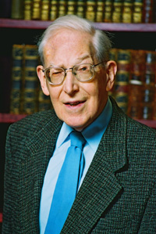
Dr. Jim McGowan – Dispensationalism and the Nature of the Church: Are Repentance and Confession “Requirements” for Salvation?
Lordship advocates consistently declare that repentance and faith are two distinct and necessary requirements for salvation. Note for example this statement made by a prominent Reformed Theologian:
“The demand is for repentance as well as faith. It is not enough to believe that only through Christ and His death are sinners justified and accepted.... Knowledge of the gospel, and orthodox belief of it, is no substitute for repentance.... Where there is ... no realistic recognition of the real claims that Christ makes, there can be no repentance, and therefore no salvation.” (bold mine)
J. I. Packer, Evangelism and the Sovereignty of God
(Downers Grove, Ill: InterVaristy, 1961), 72-73

Slide 10
Lordship Salvation Defined
Definition – If Jesus Christ is not Lord of all then He is not Lord at all
Motive – Counter superficial conversions
Right diagnosis but the wrong cure

Slide 11
Dr. Jim McGowan – Dispensationalism and the Nature of the Church: Are Repentance and Confession “Requirements” for Salvation?
According to Lordship Theology, these, “real claims that Christ makes” refers to a repentance which is a commitment to, or at least a sincere willingness to:
Obey Christ’s commands
Take up one’s cross
Forsake sin, etc.,
The failure of one witnessing, to declare these precursors in a gospel presentation, and a failure on the part of the sinner to willingly commit to them, means that the sinner CAN NOT be saved!

Slide 12
Lordship Salvation 7 Problems
Changes the gospel
Places an impossible burden upon the unsaved
Confuses justification with sanctification
Confuses the result of with requirement for salvation
Fails to make basic dispensational distinctions
Ignores the reality of a carnal Christian
Destroys the assurance of salvation

Slide 13
Lordship Salvation 7 Problems
Changes the gospel
Places an impossible burden upon the unsaved
Confuses justification with sanctification
Confuses the result of with requirement for salvation
Fails to make basic dispensational distinctions
Ignores the reality of a carnal Christian
Destroys the assurance of salvation

Slide 14
John MacArthur, The Gospel According to Jesus, p. 140
"Eternal life is indeed a free gift (Rom. 6:23). Salvation cannot be earned with good deeds or purchased with money. It has already been bought by Christ, who paid the ransom with His blood. But that does not mean there is no cost in terms of salvation's impact on the sinner's life. This paradox may be difficult but it is nevertheless true: salvation is both free and costly. Eternal life brings immediate death to self. 'Knowing this, that our old self was crucified with Him, that our body of sin might be done away with, that we should no longer be slaves to sin' (Rom 6:6). Thus in a sense we pay the ultimate price for salvation when our sinful self is nailed to a cross. It is a total abandonment of self-will, like the grain of wheat that falls to the ground and dies so that it can bear much fruit (cf. John 12:24). It is an exchange of all that we are for all that Christ is. And it denotes implicit obedience, full surrender to the lordship of Christ. Nothing less can qualify as saving faith.”

Slide 15
Revelation 22:17 (NASB)
“The Spirit and the bride say, ‘Come.’ And let the one who hears say, ‘Come.’ And let the one who is thirsty come; let the one who wishes take the water of life without cost” (italics added).

Slide 16
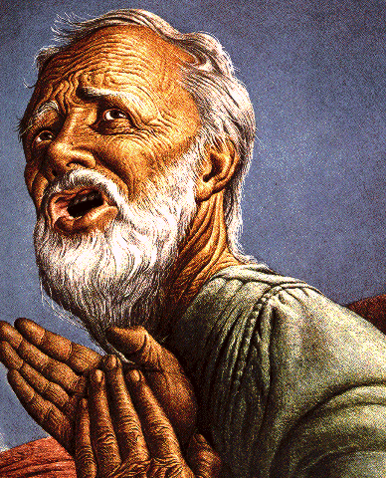
Passage Conditioning Salvation on Faith Alone (Sola Fide)
Genesis 15:6
John 3:16; 5:24; 6:28-29, 47; 16:8-9; 20:30-31
Acts 16:30-31
Romans 1:16; Ephesians 2:8-9
Hebrews 11:6

Slide 17
Belief – God’s One Condition for Justification
Gen 15:6
Then he believed in the LORD; and He reckoned it to him as righteousness.
John 3:16
For God so loved the world, that He gave His only begotten Son, that whoever believes in Him shall not perish, but have eternal life.
Acts 16:30-31
"Sirs, what must I do to be saved?" They said, "Believe in the Lord Jesus, and you will be saved..."

Slide 18
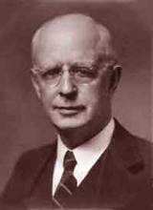
Lewis Sperry Chafer, vol. 7, Systematic Theology^{b} (Grand Rapids, MI: Kregel Publications, 1993), 265-66.
Belief – God’s One Condition for Justification
“…because upwards of 150 passages of Scripture condition salvation upon believing only (cf. John 3:16; Acts 16:31).”

Slide 19
Dr. Jim McGowan – Dispensationalism and the Nature of the Church: Are Repentance and Confession “Requirements” for Salvation?
“Outside the doctrines related to the Person and work of Christ, there is no truth more far-reaching in its implications and no fact more to be defended than that salvation in all its limitless magnitude is secured, so far as human responsibility is concerned, by believing on Christ as Savior. To this one requirement no other obligation may be added without violence to the Scriptures and total disruption of the essential doctrine of salvation by grace alone.
Only ignorance or reprehensible inattention to the structure of a right Soteriology will attempt to intrude some form of human works with its supposed merit into…the principle of…grace.”
Chafer, Systematic Theology, Vol. 3,
Dallas Seminary Press, Dallas, TX, 1948, p. 371.

Slide 20
Lordship Salvation 7 Problems
Changes the gospel
Places an impossible burden upon the unsaved
Confuses justification with sanctification
Confuses the result of with requirement for salvation
Fails to make basic dispensational distinctions
Ignores the reality of a carnal Christian
Destroys the assurance of salvation

Slide 21
Dr. Jim McGowan – Dispensationalism and the Nature of the Church: Are Repentance and Confession “Requirements” for Salvation?
The question that must be laid at the feet of Lordship proponents is: How can one who is unregenerate, dead in trespasses and sins (Eph. 2:1,5), and blinded by the god of this world (2 Cor. 4:4), possibly make such a commitment?! On the contrary, this is an impossibility as Lewis Sperry Chafer correctly points out:
“No unregenerate mind is prepared to deal with the problems of true Christian living. These problems anticipate the new dynamic of the imparted divine nature, and could produce nothing but hopeless discouragement when really contemplated by an unregenerate person.”
Salvation: God’s Marvelous Work of Grace, pg. 48

Slide 22
Lordship Salvation 7 Problems
Changes the gospel
Places an impossible burden upon the unsaved
Confuses justification with sanctification
Confuses the result of with requirement for salvation
Fails to make basic dispensational distinctions
Ignores the reality of a carnal Christian
Destroys the assurance of salvation

Slide 23
Three Tenses of Salvation
Phase | Justification | Sanctification | Glorification
Tense | Past | Present | Future
Saved from sin’s: | Penalty | Power | Presence
Scripture | Eph 2:8-9; Titus 3:5 | Philip 2:12 | Rom 5:10

Slide 24
Three Tenses of Salvation
Phase | Justification | Sanctification | Glorification
Tense | Past | Present | Future
Saved from sin’s: | Penalty | Power | Presence
Scripture | Eph 2:8-9; Titus 3:5 | Philip 2:12 | Rom 5:10

Slide 25
Three Tenses of Salvation
Phase | Justification | Sanctification | Glorification
Tense | Past | Present | Future
Saved from sin’s: | Penalty | Power | Presence
Scripture | Eph 2:8-9; Titus 3:5 | Philip 2:12 | Rom 5:10

Slide 26
Three Tenses of Salvation
Phase | Justification | Sanctification | Glorification
Tense | Past | Present | Future
Saved from sin’s: | Penalty | Power | Presence
Scripture | Eph 2:8-9; Titus 3:5 | Philip 2:12 | Rom 5:10

Slide 27
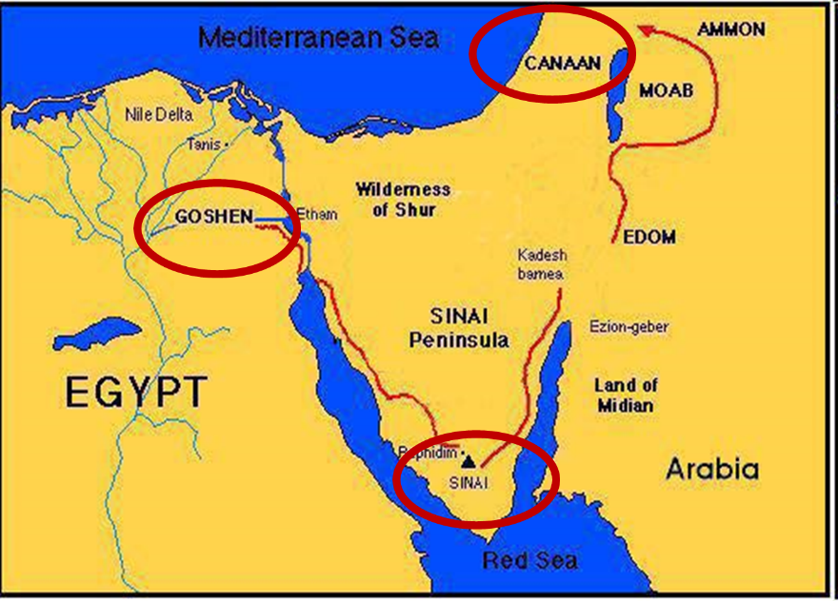
Exodus 19
Notes:
The sacrificial system was the Old Testament equivalent of 1st John 1:9.
The Law was not given to redeem Israel, but to a redeemed Israel.

Slide 28
Notes:
See the Chronology of Christ's Life regarding Peter's conversion.

Slide 29
Lordship Sanctification
Rom. 6:12-13
Rom. 12:1-2
Eph. 6:10-20
1 Pet. 3:15

Slide 30
Lordship Sanctification
Believers
disciples

Slide 31
JUSTIFICATION – SALVATION | DISCIPLESHIP
FREE GIFT | COSTLY
RECEIVED THROUGH FAITH | ENTERED INTO THROUGH COMMITMENT AND OBEDIENCE THROUGH THE SPIRIT’S ENABLEMENT
NOT BY WORKS | INVOLVES OUR COOPERATION
INSTANT | LIFE-LONG PROCESS
JUSTIFICATION | SANCTIFICATION
JESUS PAID THE PRICE | BELIEVER PAYS THE PRICE
TRUSTING JESUS AS SAVIOR | FOLLOWING JESUS AS LORD
BELIEVE THE GOSPEL | OBEY THE COMMANDS
ONE CONDITION | MULTIPLE CONDITIONS
EXPERIENCED BY ALL CHRISTIANS | EXPERIENCED BY SOME CHRISTIANS
RESULTS IN ETERNAL LIFE | RESULTS IN REWARDS & AUTHORITY
Adapted from http://www.gracelife.org/resources/gracenotes.asp?id=23

Slide 33
Ephesians: What Is Inside?
1–3 | 4–6
Relationship | Responsibility
No imperatives | 35 imperatives
Orthodoxy | Orthopraxy
Knowledge | Wisdom
Belief | Behavior
Position | Practice
Privileges | Responsibility

Slide 34
Lordship Salvation 7 Problems
Changes the gospel
Places an impossible burden upon the unsaved
Confuses justification with sanctification
Confuses the result of with requirement for salvation
Fails to make basic dispensational distinctions
Ignores the reality of a carnal Christian
Destroys the assurance of salvation

Slide 35
Dr. Jim McGowan – Dispensationalism and the Nature of the Church: Are Repentance and Confession “Requirements” for Salvation?
“There is a clear distinction between a requirement for salvation and a result of salvation. The two should not be confused with each other. A willingness and desire for Christ to rule over one’s life are prompted by the new spiritual life imparted by the Holy Spirit when He regenerates the believer at salvation.
The unsaved do not and cannot submit to divine rule (Romans 8:7). Just as a tree cannot have apples unless it already has the nature of an apple tree, so a person cannot have a willingness and desire to submit to Christ’s rule unless he already possesses the new nature received by regeneration at salvation (2 Pet. 1:3-4). Thus, even the willingness and desire to submit to Christ’s rule are the result of, and not a requirement for, salvation.”
Dr. Renald Showers - (Quoted in an article entitled, SAVED BY GRACE: A Clarification of the Lordship Salvation Issue, www.middletownbiblechurch.org)

Slide 36
CONCLUSION

Slide 37
Lordship Salvation 7 Problems
Changes the gospel
Places an impossible burden upon the unsaved
Confuses justification with sanctification
Confuses the result of with requirement for salvation
Fails to make basic dispensational distinctions
Ignores the reality of a carnal Christian
Destroys the assurance of salvation

Slide 38
Soteriology Overview
Next Session
V. More Problem Passages

Slide 39
Response to Problem Passages
Repent (Acts 2:38; 3:19; 17:30; 2 Pet 3:9)? Change of mind
Lordship (Matt 16:24-25)? Discipleship vs. justification
Receive/Accept Christ? – Synonym of faith (John 1:12)
Believe and work (Eph 2:8-10; Jas 2:14-26)? Sanctification
Believe and be baptized (Mark 16:15-16; John 3:5; Acts 2:38; Col 2:11-12; 1 Pet 3:21)? Context

