Slide 3
2 Timothy Introduction
The Call to Christian Perseverance

Slide 4
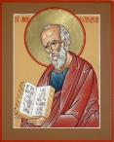
Answering Nine Questions
Who wrote it? – Paul
What do we know about the author? – An Apostle
To whom was it written? – Timothy
When was it written? - A.D. 67
Where was it written from? – Rome
Why was it written? – Timothy’s timidity
What is it about? – Perseverance
What is inside (outline)? – 4 part outline
What makes the book different? – Paul’s final word

Slide 5
Four Part Structure
General call to faithful endurance in the ministry (chapter 1)
Ten metaphors describing what faithful endurance looks like (chapter 2)
What to do in the midst of the coming apostasy (3:1–4:8)
How God met six needs in Paul’s life (4:9-22)

Slide 6
Four Part Structure
General call to faithful endurance in the ministry (chapter 1)
Ten metaphors describing what faithful endurance looks like (chapter 2)
What to do in the midst of the coming apostasy (3:1–4:8)
How God met six needs in Paul’s life (4:9-22)

Slide 7
Four Part Structure
General call to faithful endurance in the ministry (chapter 1)
Ten metaphors describing what faithful endurance looks like (chapter 2)
What to do in the midst of the coming apostasy (3:1–4:8)
How God met six needs in Paul’s life (4:9-22)

Slide 8
2 Timothy 2
Ten Metaphors Illustrating Endurance

Slide 9
Ten Metaphors
Teacher (2:2)
Soldier (2:3-4)
Athlete (2:5)
Farmer (2:6)
Christ (2:7-8)
Paul (2:9-10)
Trustworthy statement (2:11-13)
Workman (2:14-18)
Vessel (2:19-23)
Servant (2:24-26)

Slide 10
Four Part Structure
General call to faithful endurance in the ministry (chapter 1)
Ten metaphors describing what faithful endurance looks like (chapter 2)
What to do in the midst of the coming apostasy (3:1–4:8)
How God met six needs in Paul’s life (4:9-22)

Slide 11
THE LAST DAYS APOSTASY OF THE CHURCH
Dr. Andy Woods

Slide 12
Definition of Apostasy
apos = away from
histēmi = to stand
Apostasy = to stand away from
Apostasy = a departure from known (or previously embraced) truth

Slide 13
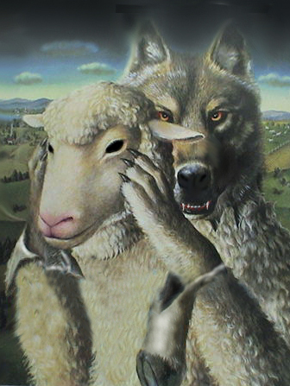
Ten Characteristics of Apostasy
Sign of the last days
A massive NT subject
Impacts every major doctrine
Primarily internal
Knows no limits

Slide 14
Ten Characteristics of Apostasy
Can happen quickly
Satanically energized
Destructive
Makes life difficult for the man of God
Impacts those who have not taken preventive measures

Slide 15
2 Timothy 3:1‒4:8
What to Do in the
Midst of the Apostasy

Slide 16
Apostasy (3:1‒4:8)
The Apostasy (3:1-9)
The evil (3:1-7)
The examples (3:8-9)
The Antidote (3:10‒4:8)
Paul’s example (3:10-13)
Preach the Word (3:14‒4:8)

Slide 17
Apostasy (3:1‒4:8)
The Apostasy (3:1-9)
The evil (3:1-7)
The examples (3:8-9)
The Antidote (3:10‒4:8)
Paul’s example (3:10-13)
Preach the Word (3:14‒4:8)

Slide 18
Apostasy (3:1‒4:8)
The Apostasy (3:1-9)
The evil (3:1-7)
The examples (3:8-9)
The Antidote (3:10‒4:8)
Paul’s example (3:10-13)
Preach the Word (3:14‒4:8)

Slide 19
A. The Evil (3:1-7)
Difficulty & danger (1)
Misplaced Love (2, 4)
Pride (2)
Alpha privitives (2-3)
Four concluding characteristics (5-7)

Slide 20
A. The Evil (3:1-7)
Difficulty & danger (1)
Misplaced Love (2, 4)
Pride (2)
Alpha privitives (2-3)
Four concluding characteristics (5-7)

Slide 21
A. The Evil (3:1-7)
Difficulty & danger (1)
Misplaced Love (2, 4)
Pride (2)
Alpha privitives (2-3)
Four concluding characteristics (5-7)

Slide 22
2. Misplaced love (2, 4)
Lovers of self (2)
Lovers of money (2)
Lovers of pleasure rather than lovers of God (4)

Slide 23
A. The Evil (3:1-7)
Difficulty & danger (1)
Misplaced Love (2, 4)
Pride (2)
Alpha privitives (2-3)
Four concluding characteristics (5-7)

Slide 24
3. Pride (2)
Boastful (2)
Arrogant (2)
Revilers (2)

Slide 25
A. The Evil (3:1-7)
Difficulty & danger (1)
Misplaced Love (2, 4)
Pride (2)
Alpha privitives (2-3)
Four concluding characteristics (5-7)

Slide 26
4. Alpha Privitives (2-3)
Disobedient to parents (2)
Ungrateful (2)
Unholy (2)
Unloving (3)
Irreconcilable (3)
Break up-Malicious gossips (3)
Without self control (3)
Brutal (3)
Haters of good (3)

Slide 27
A. The Evil (3:1-7)
Difficulty & danger (1)
Misplaced Love (2, 4)
Pride (2)
Alpha privitives (2-3)
Four concluding characteristics (5-7)

Slide 28
5. Four Concluding Characteristics (5-7)
Treacherous (4)
Reckless (4)
Conceited (4)
Holding to a form of godliness but denying its power (5-7)

Slide 29
5. Four Concluding Characteristics (5-7)
Treacherous (4)
Reckless (4)
Conceited (4)
Holding to a form of godliness but denying its power (5-7)

Slide 30
5. Four Concluding Characteristics (5-7)
Treacherous (4)
Reckless (4)
Conceited (4)
Holding to a form of godliness but denying its power (5-7)

Slide 31
5. Four Concluding Characteristics (5-7)
Treacherous (4)
Reckless (4)
Conceited (4)
Holding to a form of godliness but denying its power (5-7)

Slide 32
5. Four Concluding Characteristics (5-7)
Treacherous (4)
Reckless (4)
Conceited (4)
Holding to a form of godliness but denying its power (5-7)

Slide 33
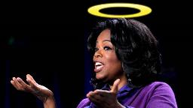
Holding to a form of godliness but denying its power (5-7)
“…one of the mistakes that human beings make is believing that there is only one way…We don’t accept that there are diverse ways of being in the world; that there are millions of ways to be a human being. And many ways…many paths to what you call God. That her path might be something else and when she gets there she might call it the light. But her loving, and her kindness, and her generosity brings her to the…same point that it brings you…
www.youtube.com/watch?v=Lb2RUpMDk3

Slide 34
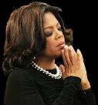
Holding to a form of godliness but denying its power (5-7)
…It doesn’t matter whether she called it ‘God’ along the way or not…There couldn’t possibly be just one way!…There couldn’t possibly be only one way with millions of people in the world!...You think…if you are somewhere on the planet and you never hear the name of Jesus but yet you live with a loving heart. You lived as Jesus would have had you to live. You lived for the same purpose as Jesus came to the planet to teach us all, but you are in some remote part of the earth and you never heard the name of Jesus. You cannot get to Heaven…?”
www.youtube.com/watch?v=Lb2RUpMDk3

Slide 35
Apostasy (3:1‒4:8)
The Apostasy (3:1-9)
The evil (3:1-7)
The examples (3:8-9)
The Antidote (3:10‒4:8)
Paul’s example (3:10-13)
Preach the Word (3:14‒4:8)

Slide 36
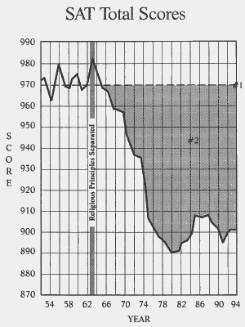

Slide 37
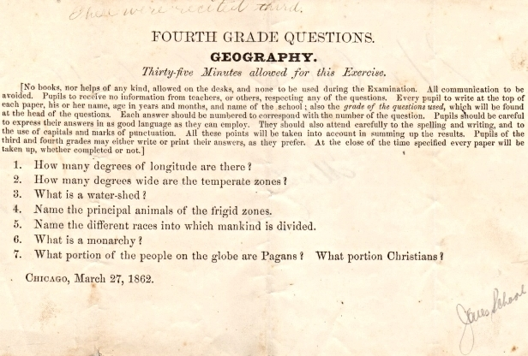
Geography Quiz that was given to Fourth Graders in 1862 (from the WallBuilders' library)

Slide 38
Conclusion

Slide 39
Apostasy (3:1‒4:8)
The Apostasy (3:1-9)
The evil (3:1-7)
The examples (3:8-9)
The Antidote (3:10‒4:8)
Paul’s example (3:10-13)
Preach the Word (3:14‒4:8)

Slide 40
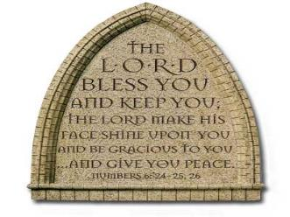
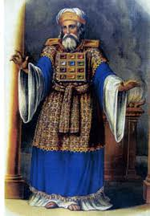
“The Lord bless you and keep you; the Lord make his face shine on you and be gracious to you; the Lord turn his face toward you and give you peace.” (NIV)

