Slide 3
2 Timothy Introduction
The Call to Christian Perseverance

Slide 4
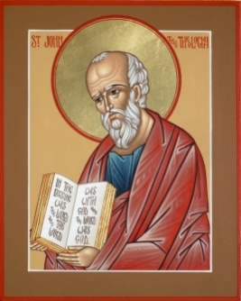
Answering Nine Questions
Who wrote it? – Paul
What do we know about the author? – An Apostle
To whom was it written? – Timothy
When was it written? - A.D. 67
Where was it written from? – Rome
Why was it written? – Timothy’s timidity
What is it about? – Perseverance
What is inside (outline)? – 4 part outline
What makes the book different? – Paul’s final word

Slide 5
Four Part Structure
General call to faithful endurance in the ministry (chapter 1)
Ten metaphors describing what faithful endurance looks like (chapter 2)
What to do in the midst of the coming apostasy (3:1–4:8)
How God met six needs in Paul’s life (4:9-22)

Slide 6
Four Part Structure
General call to faithful endurance in the ministry (chapter 1)
Ten metaphors describing what faithful endurance looks like (chapter 2)
What to do in the midst of the coming apostasy (3:1–4:8)
How God met six needs in Paul’s life (4:9-22)

Slide 7
Four Part Structure
General call to faithful endurance in the ministry (chapter 1)
Ten metaphors describing what faithful endurance looks like (chapter 2)
What to do in the midst of the coming apostasy (3:1–4:8)
How God met six needs in Paul’s life (4:9-22)

Slide 8
2 Timothy 2
Ten Metaphors Illustrating Endurance

Slide 9
Ten Metaphors
Teacher (2:2)
Soldier (2:3-4)
Athlete (2:5)
Farmer (2:6)
Christ (2:7-8)
Paul (2:9-10)
Trustworthy statement (2:11-13)
Workman (2:14-18)
Vessel (2:19-23)
Servant (2:24-26)

Slide 10
Ten Metaphors
Teacher (2:2)
Soldier (2:3-4)
Athlete (2:5)
Farmer (2:6)
Christ (2:7-8)
Paul (2:9-10)
Trustworthy statement (2:11-13)
Workman (2:14-18)
Vessel (2:19-23)
Servant (2:24-26)

Slide 11
Ten Metaphors
Teacher (2:2)
Soldier (2:3-4)
Athlete (2:5)
Farmer (2:6)
Christ (2:7-8)
Paul (2:9-10)
Trustworthy statement (2:11-13)
Workman (2:14-18)
Vessel (2:19-23)
Servant (2:24-26)

Slide 12
Ten Metaphors
Teacher (2:2)
Soldier (2:3-4)
Athlete (2:5)
Farmer (2:6)
Christ (2:7-8)
Paul (2:9-10)
Trustworthy statement (2:11-13)
Workman (2:14-18)
Vessel (2:19-23)
Servant (2:24-26)

Slide 13
Ten Metaphors
Teacher (2:2)
Soldier (2:3-4)
Athlete (2:5)
Farmer (2:6)
Christ (2:7-8)
Paul (2:9-10)
Trustworthy statement (2:11-13)
Workman (2:14-18)
Vessel (2:19-23)
Servant (2:24-26)

Slide 14
Ten Metaphors
Teacher (2:2)
Soldier (2:3-4)
Athlete (2:5)
Farmer (2:6)
Christ (2:7-8)
Paul (2:9-10)
Trustworthy statement (2:11-13)
Workman (2:14-18)
Vessel (2:19-23)
Servant (2:24-26)

Slide 15
Ten Metaphors
Teacher (2:2)
Soldier (2:3-4)
Athlete (2:5)
Farmer (2:6)
Christ (2:7-8)
Paul (2:9-10)
Trustworthy statement (2:11-13)
Workman (2:14-18)
Vessel (2:19-23)
Servant (2:24-26)

Slide 16
Ten Metaphors
Teacher (2:2)
Soldier (2:3-4)
Athlete (2:5)
Farmer (2:6)
Christ (2:7-8)
Paul (2:9-10)
Trustworthy statement (2:11-13)
Workman (2:14-18)
Vessel (2:19-23)
Servant (2:24-26)

Slide 17
Ten Metaphors
Teacher (2:2)
Soldier (2:3-4)
Athlete (2:5)
Farmer (2:6)
Christ (2:7-8)
Paul (2:9-10)
Trustworthy statement (2:11-13)
Workman (2:14-18)
Vessel (2:19-23)
Servant (2:24-26)

Slide 18
Ten Metaphors
Teacher (2:2)
Soldier (2:3-4)
Athlete (2:5)
Farmer (2:6)
Christ (2:7-8)
Paul (2:9-10)
Trustworthy statement (2:11-13)
Workman (2:14-18)
Vessel (2:19-23)
Servant (2:24-26)

Slide 19
Ten Metaphors
Teacher (2:2)
Soldier (2:3-4)
Athlete (2:5)
Farmer (2:6)
Christ (2:7-8)
Paul (2:9-10)
Trustworthy statement (2:11-13)
Workman (2:14-18)
Vessel (2:19-23)
Servant (2:24-26)

Slide 20
Servant (2:24-26)
What is a servant? (24)
Why become a servant? (25-26)
It assists God’s work (25)
It hinders Satan’s work (26)

Slide 21
Servant (2:24-26)
What is a servant? (24)
Why become a servant? (25-26)
It assists God’s work (25)
It hinders Satan’s work (26)

Slide 22
Servant (2:24-26)
What is a servant? (24)
Why become a servant? (25-26)
It assists God’s work (25)
It hinders Satan’s work (26)

Slide 23
Servant (2:24-26)
What is a servant? (24)
Why become a servant? (25-26)
It assists God’s work (25)
It hinders Satan’s work (26)

Slide 24
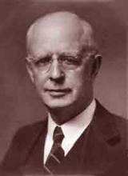
Lewis Sperry Chafer, vol. 7, Systematic Theology (Grand Rapids, MI: Kregel Publications, 1993), 265-66.
[A] serious Arminian error respecting this doctrine occurs when repentance is added to faith or believing as a condition of salvation. It is true that repentance can very well be required as a condition of salvation, but then only because the change of mind which...has been involved when turning from every other confidence to the one needful trust in Christ. Such turning about, of course, cannot be achieved without a change of mind.

Slide 25
This vital newness of mind is a part of believing, after all, and therefore it may be and is used as a synonym for believing at times (cf. Acts 17:30; 20:21; 26:20; Rom. 2:4; 2Tim. 2:25; 2 Pet. 3:9). Repentance nevertheless cannot be added to believing as a condition of salvation, because upwards of 150 passages of Scripture condition salvation upon believing only (cf. John 3:16; Acts 16:31).
Lewis Sperry Chafer, vol. 7, Systematic Theology (Grand Rapids, MI: Kregel Publications, 1993), 265-66.

Slide 26
Servant (2:24-26)
What is a servant? (24)
Why become a servant? (25-26)
It assists God’s work (25)
It hinders Satan’s work (26)

Slide 27
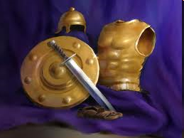
Ephesians 6:10-20
Dressed for Success!

Slide 28
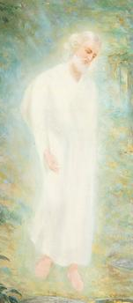
Satan’s Existence
OT – Job 1–2; Zech 3:1; Gen 3:1 (Rev 12:9); 1 Chr 21:1
NT
Every author
Christ (25x)
2 Cor. 11:14
No wonder, for even Satan disguises himself as an angel of light.

Slide 29
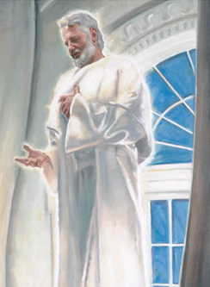
Satan’s Personhood
Elements of personhood
Intellect (2 Cor 2:11)
Emotions (Rev 12:12, 17)
Will (2 Tim 2:26)
Personal pronouns (Mt 4:10)
Moral accountability (Mt 25:41)

Slide 30
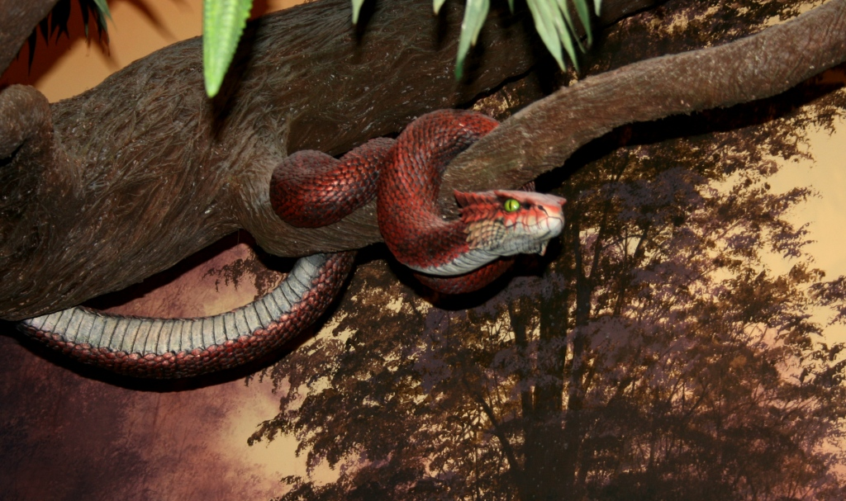
No One Believes In Me Anymore (Satan's Boast) Keith Green
I used to have to sneak around, but now they just open their doors.
No one is watching for my tricks, since no one believes in me anymore!
http://www.songlyrics.com/keith-green/no-one-believes-in-me-anymore-satan-s-boast-lyrics/#LB2B66kPYdkDVz3J.99

Slide 31
Conclusion

Slide 32
Servant (2:24-26)
What is a servant? (24)
Why become a servant? (25-26)
It assists God’s work (25)
It hinders Satan’s work (26)

Slide 33
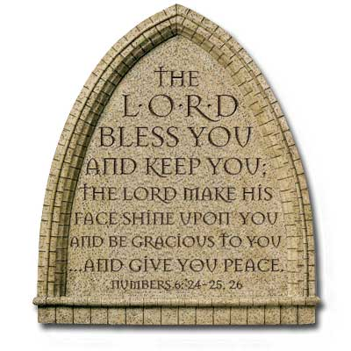
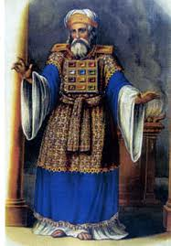
“The Lord bless you and keep you; the Lord make his face shine on you and be gracious to you; the Lord turn his face toward you and give you peace.” (NIV)

