Slide 1
THE LAST DAYS APOSTASY OF THE CHURCH
Dr. Andy Woods

Slide 2
Definition of Apostasy
apos = away from
histēmi = to stand
Apostasy = to stand away from
Apostasy = a departure from known (or previously embraced) truth

Slide 3
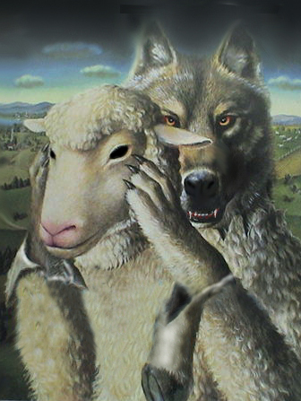
Ten Characteristics of Apostasy
Sign of the last days
A massive NT subject
Impacts every major doctrine
Primarily internal
Knows no limits

Slide 4
Ten Characteristics of Apostasy
Can happen quickly
Satanically energized
Destructive
Makes life difficult for the man of God
Impacts those who have not taken preventive measures

Slide 5
Ten Characteristics of Apostasy
Sign of the last days
A massive NT subject
Impacts every major doctrine
Primarily internal
Knows no limits

Slide 6
Apostasy is a Sign of the Last Days
2 Tim 3:1-”But know this, that in the last days perilous times will come.”
2 Tim 3:13-“But evil men and imposters will grow worse and worse, deceiving and being deceived” (Italics mine).

Slide 7
MESSENGERS OF THE KINGDOM
John the Baptist
Matt. 3:2
Jesus Christ
Matt. 4:17
12 Apostles
Matt. 10:5, 7
Seventy
Luke 10:1, 9

Slide 8
Matthew 13 Parables
Sower (13:1-9, 18-23)
Wheat and tares (13:24-30, 36-43)
Mustard seed (13:31-32)
Leaven (13:33)
Earthen treasure (13:44)
Pearl of great price (13:45-46)
Dragnet (13:47-50)
Householder (13:51-52)

Slide 9
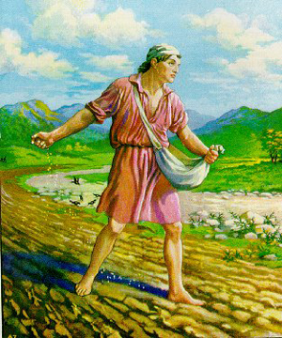
Matthew 13 Parables
The Sower :
Preaching of the gospel with various results

Slide 10
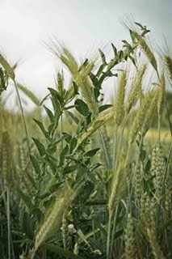
Matthew 13 Parables
Wheat & Tares:
Difficult to distinguish between the saved and the unsaved within professing Christendom

Slide 11
Matthew 13 Parables
The Mustard Seed:
Christendom will experience great numerical and geographical expansion from a humble beginning

Slide 12
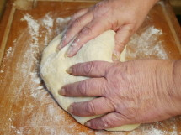
Matthew 13 Parables
Yeast in the Dough:
Christendom will experience internal corruption throughout the age

Slide 13
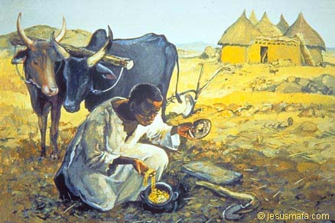
Matthew 13 Parables
The Hidden Treasure:
Israel will remain in unbelief only to be converted at the age’s conclusion

Slide 14
Matthew 13 Parables
The Pearl of Great Price:
The Lord will gain a treasure from among the Gentiles

Slide 15
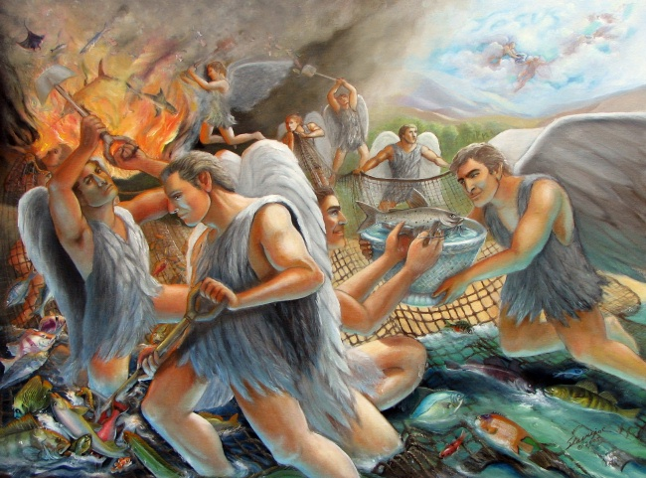
Matthew 13 Parables
The Dragnet:
The coexistence of the righteous and the wicked only to be separated at the age’s conclusion

Slide 16
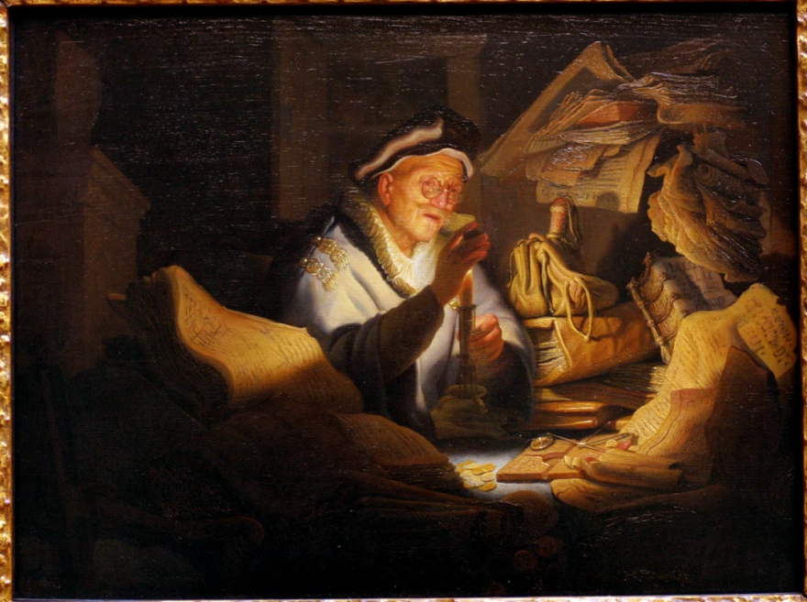
Matthew 13 Parables
The Householder:
NT truths must be considered alongside OT revelation to comprehend the totality of God’s kingdom agenda

Slide 17
Ten Characteristics of Apostasy
Sign of the last days
A massive NT subject
Impacts every major doctrine
Primarily internal
Knows no limits

Slide 18
Apostasy is a Massive NT Subject
Gospels (Matt 13)
Early church (Acts 20:29-31)
Pauline letters (Rom 16:17-18; Gal 1:6-9; 2 Cor 11:1-15; Philip 3:2, 18-19; Col 2:8; 1 Tim 4; 2 Tim 3–4; Titus 1:10)
General letters (Heb 2:1-4; 2 Pet 2–3; Jude; 1 John 4:1-6)
Revelation (2–3)

Slide 20
Ten Characteristics of Apostasy
Sign of the last days
A massive NT subject
Impacts every major doctrine
Primarily internal
Knows no limits

Slide 21
Apostasy Impacts Every Major Doctrine
The faith (1 Tim 4:1)
God (Jude 4)
Christ and His death (2 Pet 2:1)
Christ’s return (2 Pet 3:3-4)
Sound doctrine (2 Tim 4:3-4)
Resurrection (2 Tim 2:16-18)
God as creator (2 Pet 3:5)

Slide 22
Ten Characteristics of Apostasy
Sign of the last days
A massive NT subject
Impacts every major doctrine
Primarily internal
Knows no limits

Slide 23
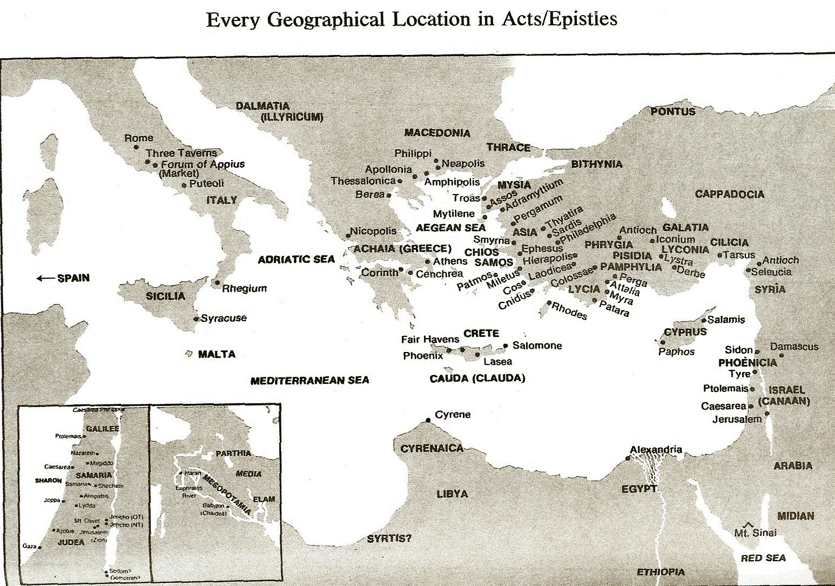

Slide 24
Apostasy is Internal
Acts 20:29-31
“For I know this, that after my departure savage wolves will come in among you, not sparing the flock.”Also from among yourselves men will rise up, speaking perverse things, to draw away the disciples after themselves. Therefore be on the alert, remembering that night and day for a period of three years I did not cease to admonish each one with tears.” (Italics added).

Slide 25
Apostasy is Internal
Jude 4
“For certain men have crept in unnoticed, who long ago were marked out for this condemnation, ungodly men, who turn the grace of our God into licentiousness and deny the only Lord God and our Lord Jesus Christ” (Italics added).

Slide 26
Ten Characteristics of Apostasy
Sign of the last days
A massive NT subject
Impacts every major doctrine
Primarily internal
Knows no limits

Slide 27
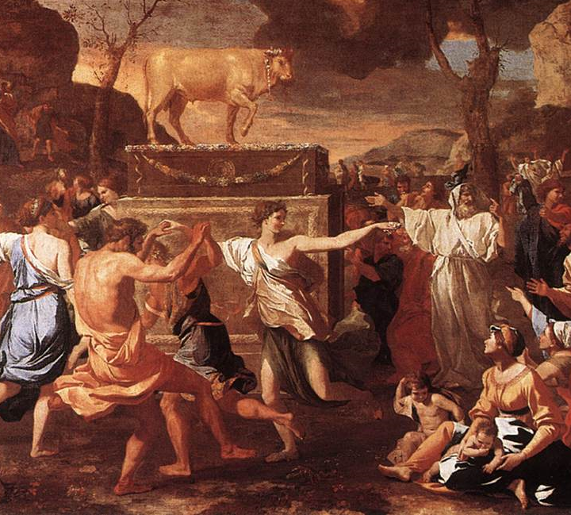
Apostasy Knows No Limits
Aaron (Exod 32:1-10)
Jonathan (Judges 18:30)
Ephesus (Rev 2:4-5)

Slide 28
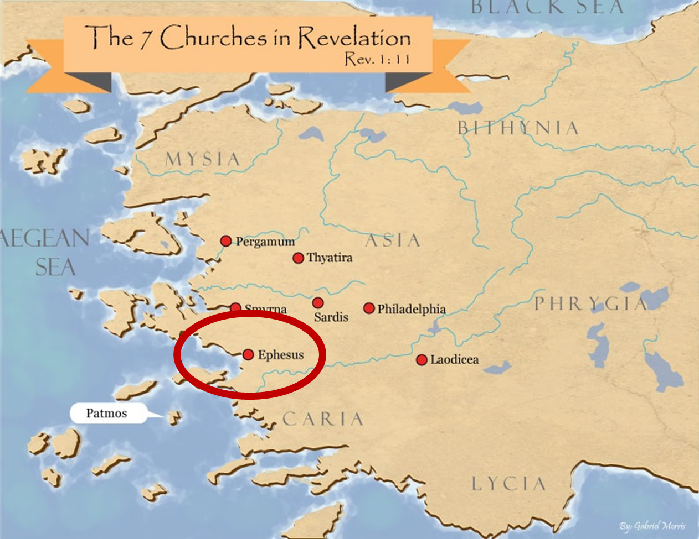

Slide 29
Apostasy Knows No Limits
“Let every student be plainly instructed and earnestly pressed to consider well the main end of his life and studies is to know God and Jesus Christ which is eternal life (John 17:3) and therefore to lay Christ in the bottom as the only foundation of all sound knowledge and learning. And seeing the Lord only giveth wisdom, let everyone seriously set himself by prayer in secret to seek it of Him (Prov. 2, 3). Everyone shall exercise himself in reading the Scriptures twice a day that he shall be ready to give such an account of his proficiency therein.”
Rules of Harvard in 1636; quoted in David Barton, Original Intent, 81

Slide 30
Francis Beckwith

Slide 31
Ten Characteristics of Apostasy
Can happen quickly
Satanically energized
Destructive
Makes life difficult for the man of God
Impacts those who have not taken preventive measures

Slide 32
Apostasy Can Happen Quickly
Gal 1:6
“I marvel that you are turning away so soon from Him who called you in the grace of Christ, to a different gospel.” (Italics mine)
Exod 32:8
“They have turned aside quickly out of the way which I have commanded them” (Italics mine; see also Exod 24:18).

Slide 33
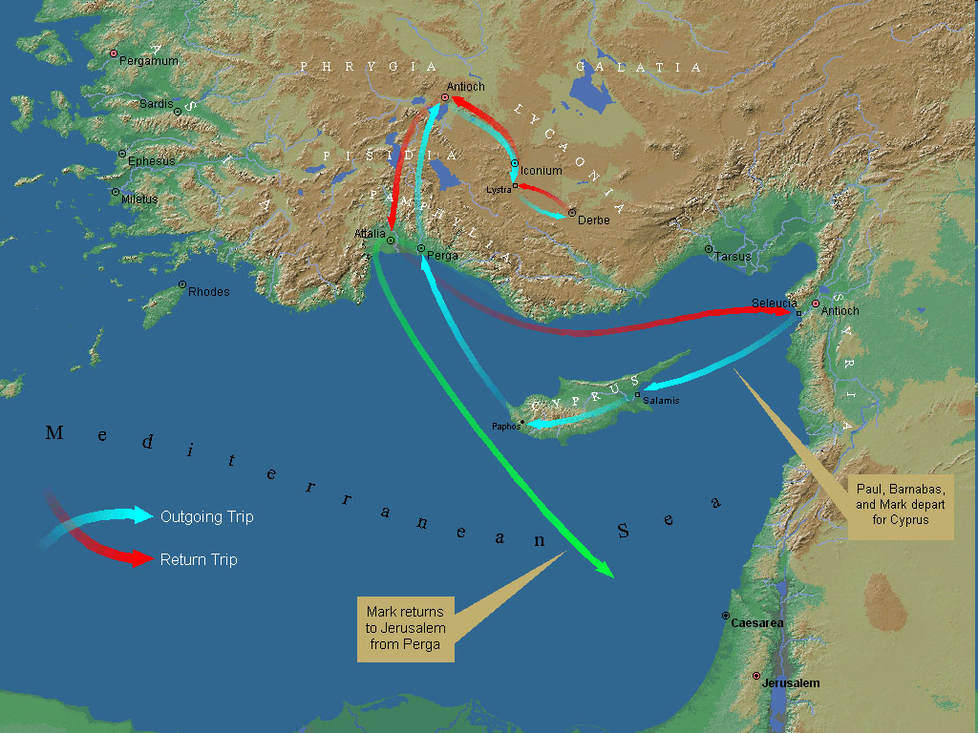
First Missionary Journey

Slide 34
Apostasy Can Happen Quickly
Gal 1:6
“I marvel that you are turning away so soon from Him who called you in the grace of Christ, to a different gospel.” (Italics mine)
Exod 32:8
“They have turned aside quickly out of the way which I have commanded them” (Italics mine; see also Exod 24:18).

Slide 36
Ten Characteristics of Apostasy
Can happen quickly
Satanically energized
Destructive
Makes life difficult for the man of God
Impacts those who have not taken preventive measures

Slide 37
Apostasy is Satanically Energized
2 Cor 11:3
“But I fear, lest somehow, as the serpent deceived Eve by his craftiness, so your minds may be corrupted by from the simplicity that is in Christ.” (Italics mine)
1 Tim 4:1
“Now the Spirit expressly says that in the latter times some will depart from the faith giving heed to deceiving spirits and doctrines of demons” (Italics mine)

Slide 38
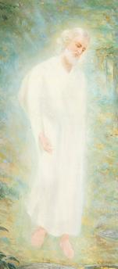
Satan Uses Believers
Peter – Matt. 16:21-23
Ananias & Sapphira – Acts 5:3-4, 11
Ephesians – Ephes. 4:26-27
2 Cor. 11:14
No wonder, for even Satan disguises himself as an angel of light.

Slide 39
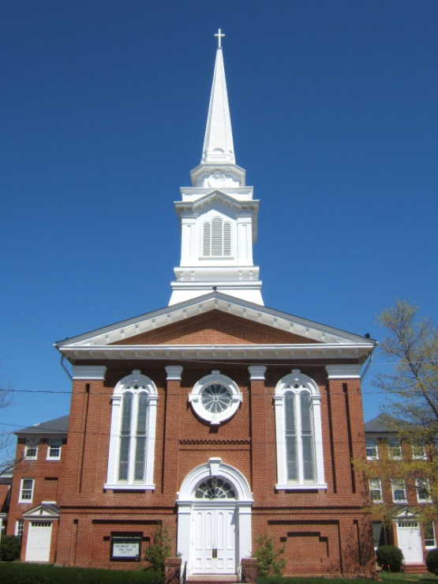
Purposes of the Local Church
Glorify God (Eph 3:21)
Edify the saints (Eph 4:11-16)
Fulfill the Great Commission (Matt 28:18-20)

Slide 40
Ten Characteristics of Apostasy
Can happen quickly
Satanically energized
Destructive
Makes life difficult for the man of God
Impacts those who have not taken preventive measures

Slide 41
Apostasy is Destructive
Acts 20:29
“For I know this, that after my departure savage wolves will come in among you, not sparing the flock.”

Slide 42
Apostasy is Destructive
1 Tim 1:19
“Having faith and a good conscience, which some have rejected, concerning the faith have suffered shipwreck.”

Slide 43
Apostasy is Destructive
2 Tim 2:17-18
“and their talk will spread like gangrene. Among them are Hymenaeus and Philetus, 18 men who have gone astray from the truth saying that the resurrection has already taken place, and they upset the faith of some.” (Italics mine).

Slide 44
Ten Characteristics of Apostasy
Can happen quickly
Satanically energized
Destructive
Makes life difficult for the man of God
Impacts those who have not taken preventive measures

Slide 45
Apostasy Makes Life Difficult for the Man of God
2 Tim 3:13
“But evil men and imposters will grow worse and worse, deceiving and being deceived.”

Slide 46
Apostasy Makes Life Difficult for the Man of God
2 Tim 4:3-4
“For the time will come when they will not endure sound doctrine, but according to their own desires, because they have itching ears, they will heap up for themselves teachers; and they will turn their ears away from the truth, and be turned aside to fables.”

Slide 47
2 Tim 3:2-4
Lovers of self (vs. 2)
Lovers of $
Boastful
Arrogant
Blasphemers
Disobedient to parents
Unthankful
Unloving
Unholy
Unforgiving
Rather than lovers of God (vs. 4)
Slanderers
Without self-control
Brutal
Haters of good
Treacherous
Reckless
Conceited
Pleasure lovers

Slide 48
“Perilous” for Whom?
2 Tim 3:1
“But know this, that in the last days perilous times will come” (Italics mine).

Slide 49
Apostasy Makes Life Difficult
2 Tim 4:3-5
“For the time will come when they will not endure sound doctrine, but according to their own desires, because they have itching ears, they will heap up for themselves teachers; and they will turn their ears away from the truth, and be turned aside to fables. But you be watchful in all things, endure afflictions” (Italics added)

Slide 50
Apostasy Makes Life Difficult for the Man of God
2 Tim 3:12-13
“Yes, and all who desire to live a Godly life in Christ Jesus will suffer persecution. But evil men and imposters will grow worse and worse, deceiving and being deceived” (Italics added).

Slide 51
Ten Characteristics of Apostasy
Can happen quickly
Satanically energized
Destructive
Makes life difficult for the man of God
Impacts those who have not taken preventive measures

Slide 52
Apostasy Impacts Those Who Have Not Taken Preventive Measures
Study God’s Word (2 Tim 2:15; 3:17)
“Test all things” (1 Thess 5:21)
Renew your mind (Rom 12:2)
“Put on the whole armor of God” (Eph 6:11)
“Contend earnestly for the faith” (Jude 3)

Slide 53
Conclusion

Slide 54
Ten Characteristics of Apostasy
Sign of the last days
A massive NT subject
Impacts every major doctrine
Primarily internal
Knows no limits

Slide 55
Ten Characteristics of Apostasy
Can happen quickly
Satanically energized
Destructive
Makes life difficult for the man of God
Impacts those who have not taken preventive measures

Slide 56
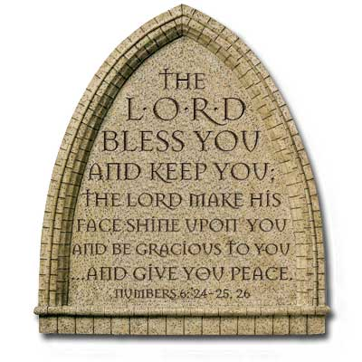
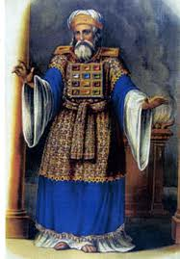
“The Lord bless you and keep you; the Lord make his face shine on you and be gracious to you; the Lord turn his face toward you and give you peace.” (NIV)

