Slide 1
Sugar Land Bible Church Ladies Spring Friendship Luncheon
The Privilege of Prayer
Lynn Munsterman

Slide 2
GODS ATTRIBUTES -
John 15:13-15
Greater love has no one than this, that one lay down his life for his friends. You are My friends if you do what I command you. No longer do
I call you slaves, for the slave does not
know what his master is doing; but I
have called you friends, for all
things that I have heard from My
Father I have made known to you.

Slide 3
JOHN 15 ⁴ Abide in Me, and I in you. As the branch cannot bear fruit of itself unless it abides in the vine, so neither can you unless you abide in Me. ⁵ I am the vine, you are the branches; he
who abides in Me and I in him, he bears much fruit, for apart from Me you can do nothing

Slide 5
Romans 12:1-2 Therefore I urge you, brethren, by the mercies of God, to present your bodies a living and holy sacrifice, acceptable to God, which is your spiritual service of worship. And do not be conformed to this world, but be transformed by the renewing of your mind, so that you may prove what the will of God is, that which is good and acceptable and perfect.

Slide 6
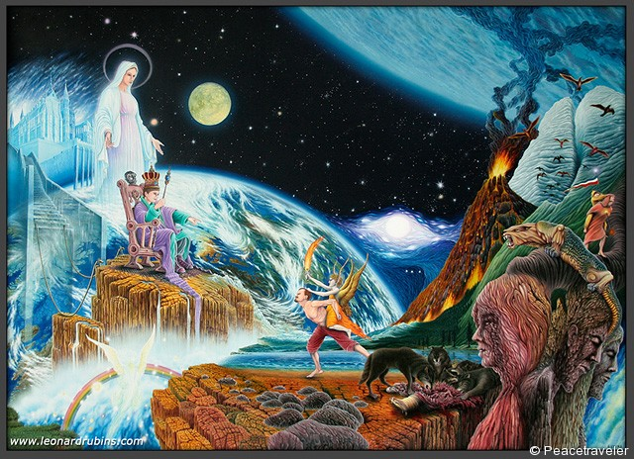
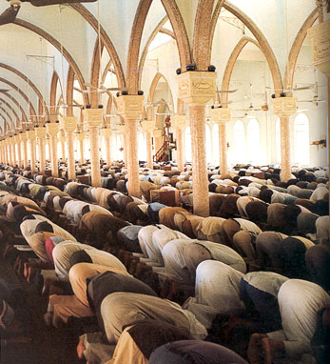
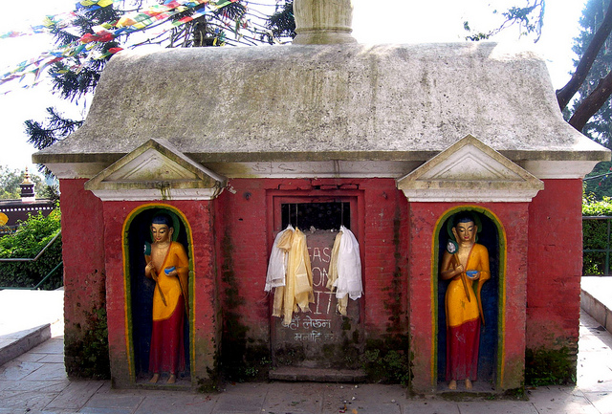
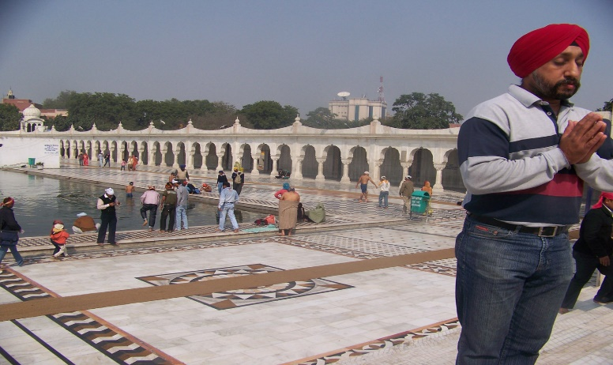
Prayer Defined Broadly
1a (1): an address (as a petition) to God or a god in word or thought

Slide 7
ATTRIBUTES of GOD
Sovereign Omnipotent Omniscient Omnipresent Transcendent Foreknows
Self-Existent Incomprehensible Infinite
Self-sufficient Immutable Holy Faithful
Good Impartial Jealous Just
Eternal Truth Longsuffering Love
Grace Mercy Wise Triune Righteous

Slide 8
Romans 3:23 All have sinned and fall short of the glory of God
Romans 6:23
The Wages of sin is death
but
the gift of God is eternal life
in Christ Jesus our Lord.

Slide 9
Acts 4:12 There is salvation in no one else for there is no other name under heaven that has been given among men by which we must be saved.
Hebrews 9:22 … and without the shedding of blood there is no forgiveness of sin.

Slide 10
Hebrews 1:1-3 In the past God spoke to our ancestors through the prophets at many times and in various ways, but in these last days He has spoken to us by His Son, whom He appointed heir of all things, and through whom also He made the universe. The Son is the radiance of God’s glory and the exact representation of His being sustaining all things by His powerful word. After He Had provided purification for sins, He sat down at the right hand of the Majesty in heaven.
JOHN 3:16 FOR GOD SO LOVED THE WORLD HE GAVE HIS ONLY SON THAT WHOEVER BELIEVES ON HIM SHOULD NOT PERISH BUT HAVE ETRNAL LIFE.

Slide 11
having also believed, you were sealed in Him with the Holy Spirit of promise, who is given as a pledge of our inheritance,
with a view to the redemption of God’s own
possession, to the praise of His glory.
Ephesians 1:13

Slide 12
John 14:6 I am the way, and the truth, and the life; no one comes to the Father but through Me.

Slide 13
1 Thessalonians 4:3
For this is
the will of God,
your sanctification.

Slide 14
The Privilege of Prayer
Purpose in the Father
Position in the Son
Power in the Spirit

Slide 15
The Privilege of Prayer Purpose in the Father We Pray to the Father
1 Corinthians 1:9 God is faithful, through whom you were
called into fellowship with His Son, Jesus Christ our Lord.

Slide 16
…Seeing that His divine power has granted to us everything pertaining to life and godliness, through the true knowledge of Him who called us by His own glory and excellence. For by these He has granted to us His precious and a magnificent promises, so that by them you may become partakers of the divine nature, having escaped the corruption that is in the world by lust
2 Peter 1:3-4

Slide 17
2 Timothy 3:16-17 All Scripture is God-breathed and is useful for teaching, rebuking, correcting and training in righteousness, so that the servant of God may be thoroughly equipped for every good work.
2 Peter 1:20-21 Above all, you must understand that no prophecy of Scripture came about by the prophet’s own interpretation of things. For prophecy never had its origin in the human will, but prophets, though human, spoke from God, as they were carried along by the Holy Spirit.

Slide 18
The Privilege of Prayer
Purpose in the Father
We Pray to the Father
Position in the Son
We Pray in Jesus Name

Slide 19
2 Corinthians. 5:14-15 For the love of Christ controls us, having concluded this, that one died for all, therefore all died; and He died for all, so that they who live might no longer live for themselves, but for Him who died and rose again on their behalf. Philippians 2:12-13 Work out your salvation with fear and trembling; for it is God who is at work in you, both to will and to work for His good pleasure.
1 Corinthians 1:9 God is faithful, through whom you were called into fellowship with His Son, Jesus Christ our Lord.

Slide 20
John 14:13-14 ¹³ whatever you ask in My name, that will I do, so that The Father may be glorified in The Son. ¹⁴ if you ask Me anything in My name, I will do it.
John 15:7-8 ⁷ if you abide in Me, and My words abide in you, ask whatever you wish, and it will be done for you. ⁸ My Father is glorified by this, that you bear much fruit, and so prove to be My disciples.
John 15:16 ..appointed you that you would go and bear fruit, and that your fruit would remain, so that whatever you ask of The Father in My name He may give to you.
John 16:24 until now, you have asked for nothing - in My name; ask and you will receive, so that your joy may be made full.

Slide 21
The Privilege of Prayer
Purpose in the Father
We Pray to the Father
Position in the Son
We Pray in Jesus Name
Power in the Spirit
We Pray in the Spirit

Slide 22
Jude 1:20
But you, beloved, building yourselves up on your most holy faith, praying in the Holy Spirit,
keep yourselves in the love of God,
waiting anxiously for the mercy
of our Lord Jesus Christ
to eternal life.

Slide 23
1 Corinthians 15:49
Just as we have borne the image of the earthy, we will also bear the image of the heavenly.

Slide 24
James 4:8 Draw near to God and He will draw near to you. Cleanse your hands, you sinners; and purify your hearts, you double-minded.
1 John 1:9 If we confess our sins, He is faithful and righteous to forgive us our sins and to cleanse us from all unrighteousness.

Slide 25
Ephesias 6:”take up.. the Sword of the Spirit which is the Word of God and with all prayer and petition pray at all times in the Spirit, and with this in view, be on the alert with all perseverance and petition for all the saints and pray on my behalf that utterance may be given to me in the opening of my mouth, to make known with all boldness the mystery of the gospel for which I am an ambassador in chains that in proclaiming it I may speak boldly as I ought to speak.

Slide 26
1 Thess 5:16-18 always seek after that which is good for one another and for all people. ¹⁶ Rejoice always; ¹⁷ pray without ceasing; ¹⁸ in everything give thanks; for this is God’s will for you in Christ Jesus.

Slide 27
1 Corinthians 15:49
Just as we have borne the image of the earthy, we will also bear the image of the heavenly.

Slide 28
Rom.8:25-28 But if we hope for what we do not see, with perseverance we wait eagerly for it. In the same way the Spirit also helps our weakness; for we do not know how to pray as we should, but the Spirit Himself intercedes for us with groanings too deep for words; and He who searches the hearts knows what the mind of the Spirit is, because He (the Spirit) intercedes for the saints according to the will of God. ²⁸ And we know that God causes all things to work together for good to those who love God, to those who are called according to His purpose.

Slide 29
Galatians 5:22-23 But the fruit of the Spirit is love, joy, peace, patience, kindness, goodness, faithfulness, gentleness, self-control; against such things there is no law.

Slide 30
JOHN 15 ⁴ Abide in Me, and I in you. As the branch cannot bear fruit of itself unless it abides in the vine, so neither can you unless you abide in Me. ⁵ I am the vine, you are the branches; he
who abides in Me and I in him, he bears much fruit, for apart from Me you can do nothing

Slide 31
Hebrews 4:15-16 ¹⁵ For we do not have a high priest who cannot sympathize with our weaknesses, but One who has been tempted in all things as we are, yet without sin.
¹⁶ Therefore let us draw near with confidence to the throne of grace,
so that we may receive mercy
and find grace to help in time of need.

Slide 32
Philippians 4:6-7
Be anxious for nothing,
but in everything by prayer and supplication with thanksgiving let your requests be made known to God. And the peace of God, which surpasses all comprehension, will guard your hearts and your
minds in Christ Jesus.

Slide 33
ATTRIBUTES of GOD
Sovereign Omnipotent Omniscient Omnipresent Transcendent Foreknows Self-Existent Incomprehensible Infinite Self-sufficient Immutable Holy Faithful Good Impartial Jealous Just Eternal Truth Longsuffering Love Grace Mercy Wise Triune Righteous
God is faithful, through whom you
were called into fellowship with His Son,
Jesus Christ our Lord.

Slide 34
Sugar Land Bible Church Ladies Spring Friendship Luncheon
The Privilege of Prayer
THANK YOU FOR COMING

