Slide 1
From God’s Creation to God’s Nation
Genesis 1:1 to Exodus 17:16

Slide 2
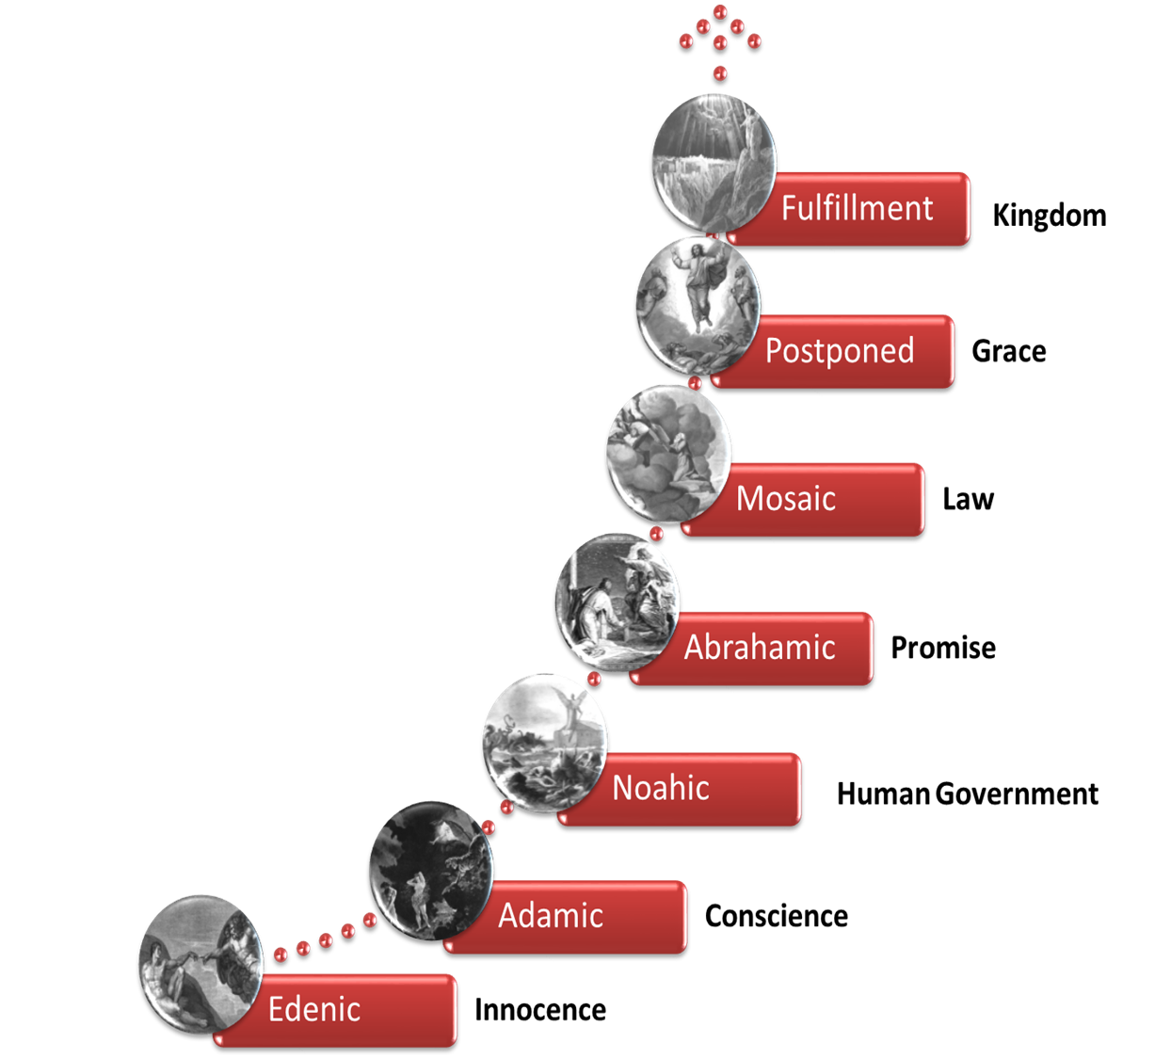
Review of Covenants in the Bible & Dispensations

Slide 3
Abrahamic Covenant
Unconditional covenant with a conditional blessing (Deut. 28; Lev. 26)
From Andy Woods p. point
Notes:
Land….only one not yet fulfilled……………..seed in 2 Sam. 712-16 Nathan prophet takes message from God……………………New Cov. Made with Israel…….we receive indirect blessings from this cov.

Slide 4
Quick Review of Ch. 21
I. The Fulfillment & the Feast 21:1-8 Isaac born
II. The Flouting, the Fury, & the Farewell 21:9-14 Sarah has “the slave woman & her son” expelled
III. The Fear & the Faithfulness of YHWH 21: 15-21 YHWH keeps His promise & takes care of Hagar & Ishmael
IV. Contract with a “Familiar face” 21:22-34 Abraham & Abimelech make a pact

Slide 5

Chapter 22 Audio

Slide 6
Genesis 22 Outline
I. YHWH’s Command & Test of Abraham 22:1-8
  A. The Order (v.1-2)
  B. The Obedience (v.3)
  C. The Ordeal (v. 4-8)
II. The Submission & the substitution 22: 9-14
  A. Isaac’s submission to his father & YHWH (v. 9)
  B. Abraham’s submission to the Father (v. 10-11)
  C. YHWH’s response & substitution & Abraham’s naming (v. 12-14)
III. YHWH swears & declares His promise again 22:15-19
  A. YHWH’s irrevocable swear (v. 15-16)
  B. YHWH’s content of the swearing & declaring (v.17-18)
  C. Abraham, Isaac & the servants return & stay at Beersheba (v. 19)
IV. Abraham learns about his family 22:20-24
  A. Abraham’s brother Nahor has many sons (v. 20-22)
  B. A significant grandniece born (v. 23)
  C. Nahor’s concubine’s sons (v. 24)

Slide 7
Introductory Comments on
Chapter 22
God tests Abraham, not tempting him with evil (the Lord cannot do this, cf. James 1:13)
the word translated “tempt” (Hebrew nasah). It does not, of course, mean “tempt to do evil” (note James 1:13). It means “test” or “try” and, in fact, most of the time is translated “prove.” (Morris)
Abraham’s maturity/sanctification/faith is at it’s apex, “now I know that you fear God”
Abraham loves God more than anything else
Abraham believed in resurrection
YHWH gives a substitutionary “type” to be sacrificed in place of Isaac, ultimately the anti-type fulfilled in His Son, Jesus Christ
YHWH’s swears & declares His promises again

Slide 8
I. YHWH’s Command & Test of Abraham 22:1-8
A. The Order (v.1-2)
Ross’ intro statements to this chapter:
The greatest test in the life of Abraham came after he had finally received the promise—he was to give his son back to God through sacrifice. It was one thing to trust the Lord while waiting for the promise; but it was quite another thing to continue to trust the Word of the Lord when it called for the patriarch to do that which seemed unreasonable. Would Abraham cling to the child that God had given him, the child on which the future was based, or would he continue to obey? The test was designed to see to what extent he would obey.
        Allen P. Ross, Creation and Blessing: A Guide to the Study and Exposition of Genesis (Grand Rapids, MI: Baker Books, 1998), 391.

Slide 9
I. YHWH’s Command & Test of Abraham 22:1-8
A. The Order (v.1-2)
Ross (Cont.)
This emphasis readily suggests a workable idea for the modern exposition. The passage is about a test, but not the kind of tests that we frequently find in Scripture that introduce some adversity so that the believer must respond in faith. This is a test of obedience to a clear commandment of the Lord. Those who believe in the Lord claim to obey God’s Word, or at least agree to obey God’s Word—but to what extent will they obey? When the Lord commands his people to make some costly sacrifice, to do some task that seems unreasonable or impossible, how willing to obey are they?
              Allen P. Ross, Creation and Blessing: A Guide to the Study and Exposition of Genesis (Grand Rapids, MI: Baker Books, 1998), 391.

Slide 10
I. YHWH’s Command & Test of Abraham 22:1-8
A. The Order (v.1-2)
Ross (Cont.)
The primary emphasis seems to fall on the depiction of Abraham’s faith. The basic point of tension in the story, then, concerns Abraham’s faith. From the beginning of the narrative, however, it is obvious that Abraham will obey the command and demonstrate that he feared God—the point of the text. There is not the slightest hint in the story that he wavered in his faith or doubted. As a result, the narrative provides a fitting climax to the Abrahamic narratives, demonstrating the unparalleled faith of the patriarch
          Allen P. Ross, Creation and Blessing: A Guide to the Study and Exposition of Genesis (Grand Rapids, MI: Baker Books, 1998), 392.

Slide 11
  I. YHWH’s Command & Test of Abraham 22:1-8
  A. The Order (v.1-2)
1 Now it came about after these things, that God tested Abraham, and said to him, “Abraham!” And he said, “Here I am.”
It must be reiterated that the prologue is the narrator’s interpretation of the event, that is, that Abraham did not know that it was a test
Had he known that God was testing him to see if he would obey, the value of the test would have been diminished
To be effective as a test, the divine command had to be both sudden and surprising
            Allen P. Ross, Creation and Blessing: A Guide to the Study and Exposition of Genesis (Grand Rapids, MI: Baker Books, 1998), 396.
Notes:
How about us??...do we have a “go to lie?’ that we revert to when wanting to get our way, or when we are fearful??

Slide 12
  I. YHWH’s Command & Test of Abraham 22:1-8
  A. The Order (v.1-2)
Some time later. See 15:1. At least a decade has passed since the last chronological notice that Isaac was weaned (see 21:8). He is now old enough to carry a load of firewood sufficient for the sacrifice of an animal
Fruchtenbaum: these two introductory verses cover a gap of time of about thirty to thirty-one years
“……..God tested Abraham”
Here the Hebrew is Elohim, used here in the first half of story up to 22:10 to emphasize God as creator……..In the last half, the name for God is Yahweh, emphasizing God’s covenantal relationship with Abraham and his descendants

Slide 13
  I. YHWH’s Command & Test of Abraham 22:1-8
  A. The Order (v.1-2)
this was the eighth appearance of God to Abraham. Abraham’s response was: Here am I
Here I am. This emphatic particle hinnēnî is the only word Abraham utters to God in this scene (22:11). Although Abraham has not always been faithful, the repetition shows that in this climactic test of his faith he is attentive and receptive to God’s word (cf. Isa. 6:8) (Waltke)
2 He said, “Take now your son, your only son, whom you love, Isaac, and go to the land of Moriah, and offer him there as a burnt offering on one of the mountains of which I will tell you.”

Slide 14
I. YHWH’s Command & Test of Abraham 22:1-8
A. The Order (v.1-2)
[Please] Take [qaḥ-nāʾ]. The so-called particle of entreaty (“please,” nāʾ) preceding the command to “take” is rare in divine commands
It is proposed that this is commanded this way either because God has a stake in Abraham’s response; or Abraham is free to decline it.
Another solution is that this command is framed/asked in this manner because of the logical consequence….thus conveys Abraham’s attentive and receptive response……therefore could be phrased “Since you are ready to obey me, take your son”

Slide 15
I. YHWH’s Command & Test of Abraham 22:1-8
A. The Order (v.1-2)
The command was given in such a way that a step by step increase of identification of Isaac made the test step by step more painful:
  1. Take your son
  2. Your only son
  3. whom you love
  4. Isaac (the long awaited promised seed)
This verse is an example how the word only can be used in the Jewish concept. It does not necessarily emphasize origin, but can emphasize uniqueness, as is the case here, since Isaac was not the only son Abraham had, but he was the only son of promise because Ishmael had been expelled (Fruchtenbaum)

Slide 16
I. YHWH’s Command & Test of Abraham 22:1-8
A. The Order (v.1-2)
Therefore, from the viewpoint of uniqueness, Isaac was his only son. This verse contains the first use of the word love
Great points by Morris: Another word is mentioned in these verses for the first time, and this in many ways is the most important word in the Bible. It is the word “love.” Love is the greatest of the gifts (1 Corinthians 13:13) and, indeed, God Himself is love (1 John 4:8). We have frequently in these pages referred to the “principle of first mention,” pointing out that, when an important word or concept occurs for the first time in the Bible, usually in the Book of Genesis, the context in which it occurs sets the pattern for its primary usage and development all through the rest of Scripture
Notes:
Hebrews 13:2 Do not neglect to show hospitality to strangers, for by this some have entertained angels without knowing it

Slide 17
          I. YHWH’s Command & Test of Abraham 22:1-8
          A. The Order (v.1-2)
Abraham was told where to take Isaac: Get you into the land of Moriah. The Hebrew here is lech lecha, the same form He used to call Abraham in 12:1 when He first told him to go out from the land of his home
These two usages are the only places the phrase is found in the Hebrew text
Also we see 2 incredible “faith bookends” in Abraham’s responses to lech lecha; in 12:4 “Abram went forth”; and here in 22:3 “Abraham rose early…….and went to the place” (my observation)
The word son is repeated throughout the account (22:2, 3, 6, 7, 8, 9, 10, 12, 13, 16). The emphasis is inescapable. Abraham faces a monumental test. (Waltke)

Slide 18
I. YHWH’s Command & Test of Abraham 22:1-8
A. The Order (v.1-2)
The place was the land of Moriah where Solomon would eventually build the First Jewish Temple (II Chron. 3:1)
Once he got there, he was to: Offer him there for a burnt-offering. The more specific place was: upon one of the mountains which I will tell you of; this was Mount Moriah, later to become Mount Zion
region of Moriah. Although there are some textual difficulties, this probably refers to Jerusalem (see 2 Chron. 3:1, followed by Josephus, the Targums, and the Talmud [b. Taʿan. 16a]).

Slide 19
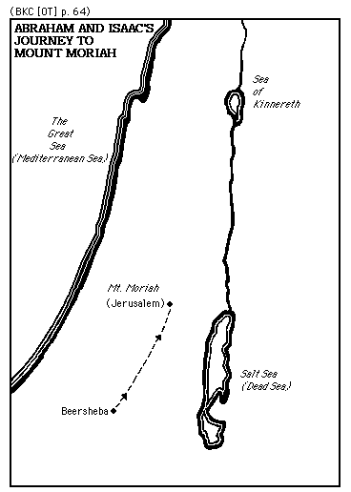

Slide 20
I. YHWH’s Command & Test of Abraham 22:1-8
A. The Order (v.1-2)
The test was not only to see if Abraham would obey God and kill his beloved son Isaac, but also to see if Abraham would kill his only son through whom the Abrahamic Covenant could be sustained and fulfilled
Sacrifice him. This is one of the most theologically difficult texts of the Old Testament. God’s command did not contradict moral law because the firstborn always belongs to the Lord (Ex. 13:11–13); however, the command is extraordinary both morally and theologically (Waltke)
We are left with the inexplicable and exacting realization that faith demands radical obedience. Abraham is asked to behave in a way that it is illogical, absurd, and, to say the least, nonconventional from the human perspective.

Slide 21
  I. YHWH’s Command & Test of Abraham 22:1-8
  A. The Order (v.1-2)
Within the biblical world view, however, such radical behavior proves the true nature of biblical faith. “Abraham had committed himself by covenant to be obedient to the Lord and had consecrated his son Isaac to the Lord by circumcision. The Lord put his servant’s faith and loyalty to the supreme test, thereby instructing Abraham, Isaac and their descendants as to the kind of total consecration the Lord’s covenant requires.
  Bruce K. Waltke and Cathi J. Fredricks, Genesis: A Commentary (Grand Rapids, MI: Zondervan, 2001), 306.

Slide 22
  B. The Obedience (v.3)
3 So Abraham rose early in the morning and saddled his donkey, and took two of his young men with him and Isaac his son; and he split wood for the burnt offering, and arose and went to the place of which God had told him.
Genesis 22:3 records Abraham’s obedience, and his actions are spelled out in seven steps
  1. Abraham rose early
  2. Saddled his donkey
  3. took 2 of his young men with him
  4. took Isaac, his son
  5. split the wood for the burnt offering
  6. He went to the place of which God told him
These are detailed actions of the obedience of faith that Abraham displayed (amazingly, from my perspective)
Notes:
1..Abraham rose early in the morning, just as he did with the expulsion of Ishmael in 21:14, showing again that his decision had been made
Second, he saddled his ass. Third, he took two of his young men with him; and in rabbinic tradition, these two young men were Ishmael and Eliezar of Damascus. Fourth, he took Isaac his son. Fifth, and he cleft the wood for the burnt-offering. Sixth, and he rose up. Seventh, and he went unto the place of which God had told him. These are detailed actions of the obedience of faith

Slide 23
B. The Obedience (v.3)
Why would God tell Abraham to go so far, and to just this spot? There is no explanation in the text; but there must have been a reason, since God is not capricious. The answer can only be that God knew this would be the place where later His temple would be built (2 Chronicles 3:1). Abraham’s sacrifice of Isaac was to foreshadow all the sacrifices that would later be offered in this place, which in turn were types and shadows of the one great Sacrifice that would be offered one day nearby, when the Father would offer the Son as the Savior of the world (Bold added)
          Henry M. Morris, The Genesis Record: A Scientific and Devotional Commentary on the Book of Beginnings (Grand Rapids, MI: Baker Books, 1976), 377.

Slide 24
B. The Obedience (v.3)
Waltke on this verse
Early the next morning. This is another example of Abraham’s prompt obedience (see 20:8). The patriarchs live by the words of God (Deut. 8:3).
Abraham got up. The bargainer falls silent: no debate (unlike with Ishmael [Gen. 17:18] or with Lot [18:22–33]), only movement, hurrying, saddling, taking, splitting, arising, going.
two of his servants [or slaves]. This is a sign of Abraham’s eminence

Slide 25
  C. The Ordeal (v. 4-8)
4 On the third day Abraham raised his eyes and saw the place from a distance.
He now traveled a distance of fifty to sixty miles from where he was, and this would roughly be a three-day journey
The extended interval of time shows that Abraham does not act rashly but proceeds with resolute faith. “It allows time for sober reflection; yet his resolve is not weakened.
At that point: Abraham lifted up his eyes, and saw the place afar off; he could see the mountain from a distance where Isaac was to be brought

Slide 26
C. The Ordeal (v. 4-8)
5 Abraham said to his young men, “Stay here with the donkey, and I and the lad will go over there; and we will worship and return to you.”
Abraham phrased the last sentence as, “we will return,” using the first person plural; that showed that Abraham had faith that both of them were going to return
Abraham had faith in God’s power in resurrection to fulfill His covenantal promises (Heb. 11:17–19)
The basis of Abraham’s faith was the promise of God in 21:12 that: In Isaac will your seed be called; and Isaac was supposed to produce the seed. So far, Isaac had not, and so for God to fulfill His promise if Abraham had to kill Isaac, God would have to resurrect Isaac back to life
        Arnold G. Fruchtenbaum, Ariels Bible Commentary: The Book of Genesis, 1st ed. (San Antonio, TX: Ariel Ministries, 2008), 353354.

Slide 27
C. The Ordeal (v. 4-8)
Great comments by Waltke:
we will come back. Although he does not know how God will work it out, his faith harmonizes God’s promise that in Isaac his offspring will be reckoned (21:1–13) with God’s command to sacrifice Isaac. According to Heb. 11:17–19, he expresses a type of “resurrection” faith, and according to Rom. 4:16–25 his faith is of the same quality and caliber as Christians who believe in Christ’s resurrection from the dead
  Bruce K. Waltke and Cathi J. Fredricks, Genesis: A Commentary (Grand Rapids, MI: Zondervan, 2001), 307.

Slide 28
  C. The Ordeal (v. 4-8)
“………….and we will worship and return to you.”
Morris: But what about Abraham’s statement that he and Isaac were going to worship? Could such an act as killing his own son be considered worshiping? Yes, this was a supreme act of worship. The word “worship,” as we have noted earlier, means simply “bow down,” and is often so translated.
To worship God is simply to bow down to His will, recognizing and acknowledging that His will is best. What He does is right, by definition, whether we understand it now or not. His will may involve waiting and suffering, even dying; but if it is His will, then we must bow down to it and accept it with thanksgiving

Slide 29
  C. The Ordeal (v. 4-8)
Morris (Cont.)
It is then, and only then, that we worship God. Abraham and Isaac indeed were going to worship God. Not understanding, but believing, they were willing to do His will. Somehow they knew that even such a command as this, in the eternal counsels of God, was for their good
This submission to God’s will in an ultimate act of worship pictures beautifully the work of Christ. “Father, if it be possible, let this cup pass from me,” He had prayed; “nevertheless not as I will, but as thou wilt” (Matthew 26:39). “Though he were a Son, yet learned he obedience by the things which he suffered” (Hebrews 5:8)
        Henry M. Morris, The Genesis Record: A Scientific and Devotional Commentary on the Book of Beginnings (Grand Rapids, MI: Baker Books, 1976), 379.

Slide 30
  C. The Ordeal (v. 4-8)
6 Abraham took the wood of the burnt offering and laid it on Isaac his son, and he took in his hand the fire and the knife. So the two of them walked on together.
Isaac must be in his late teens to be able to carry sufficient wood for a sacrifice on his back up a mountain. This is a moment of tremendous tension—Isaac carries wood for his own destruction
So Isaac carried the wood, which as far as Abraham knew now would be the thing upon which his son would die, just as later the Messiah, the Son of God, would carry the cross upon which He was going to die (Fruchtenbaum)

Slide 31
  C. The Ordeal (v. 4-8)
he himself carried the fire and the knife. This detail conveys the weight of Abraham’s burden. He carries the weapons he must wield against his son. This word for “knife” (maʾªḵelet) is used elsewhere only for the knife the priest uses to dissect his concubine (Judg. 19:29) and in parallel with sword (Prov. 30:14). (Waltke)
7 Isaac spoke to Abraham his father and said, “My father!” And he said, “Here I am, my son.” And he said, “Behold, the fire and the wood, but where is the lamb for the burnt offering?”
Isaac spoke up and said to his father. By the repetition of “father” and “son” the narrator relentlessly emphasizes the precious relationship (Waltke)

Slide 32
  C. The Ordeal (v. 4-8)
Morris on verses 6-8
The double record of their fellowship in the approach toward the place of sacrifice must be intentional. The writer would have us know beyond question that Abraham was not compelling his son to go; instead, Isaac willingly accompanied his father. We must remember that Isaac was a grown man, no doubt much stronger than his father, and could easily have escaped had he wished. He certainly could have guessed his father’s intentions; he was well aware of the human sacrifices practiced by the pagan tribes of the area

Slide 33
C. The Ordeal (v. 4-8)
8 Abraham said, “God will provide for Himself the lamb for the burnt offering, my son.” So the two of them walked on together.
In Hebrew, it reads yireh-lo, which allows for two options. The first option is that God will provide for Himself or, second, that God will provide Himself as an offering. It was a divine provision either way. Isaac inquired no further, and: So they went both of them together
provide the lamb. Abraham’s faith in God’s word enables him to see God’s command in the light of the promises

Slide 34
II. The Submission & the substitution 22: 9-14
A. Isaac’s submission to his father & YHWH (v. 9)
9 Then they came to the place of which God had told him; and Abraham built the altar there and arranged the wood, and bound his son Isaac and laid him on the altar, on top of the wood.
Until now, it was only an altar on the mount, but several centuries later, a temple was built on this mount
bound. The term is found nowhere else in the Bible in the context of ritual sacrifice. The rabbis called this story the Aqedah, the Hebrew word for “binding.”
Next, Abraham laid him on the altar, upon the wood. Isaac was not a child anymore, but a young man with enough strength to be able to resist what his father was doing to him.. but Isaac submitted to what his father was doing to him, and obviously trusted him

Slide 35
  B. Abraham’s submission to the Father (v. 10-11)
10 Abraham stretched out his hand and took the knife to slay his son.
Amazingly (to me), Abraham was willing to actually sacrifice his son (more/stronger faith/confidence in God than I have…..I couldn’t do it)
Outside of verses 6 and 10, the Hebrew word for knife is used only twice elsewhere: Judges 19:29 and Proverbs 30:14.
Never was such a loving father or obedient son put to such a test as this. Abraham obeyed God, because he believed God. “Was not Abraham our father justified by works, when he had offered Isaac his son upon the altar? (James 2:21-24) (Morris)
Notes:
Seest thou how faith wrought with his works, and by works was faith made perfect? And the Scripture was fulfilled which saith, Abraham believed God, and it was imputed unto him for righteousness: and he was called the Friend of God. Ye see then how that by works a man is justified, and not by faith only” (James 2:21–24). He had received righteousness imputed by faith, but that faith was tested by works. “God did test Abraham,” and Abraham passed the test.
Henry M. Morris, The Genesis Record: A Scientific and Devotional Commentary on the Book of Beginnings (Grand Rapids, MI: Baker Books, 1976), 381.
.

Slide 36
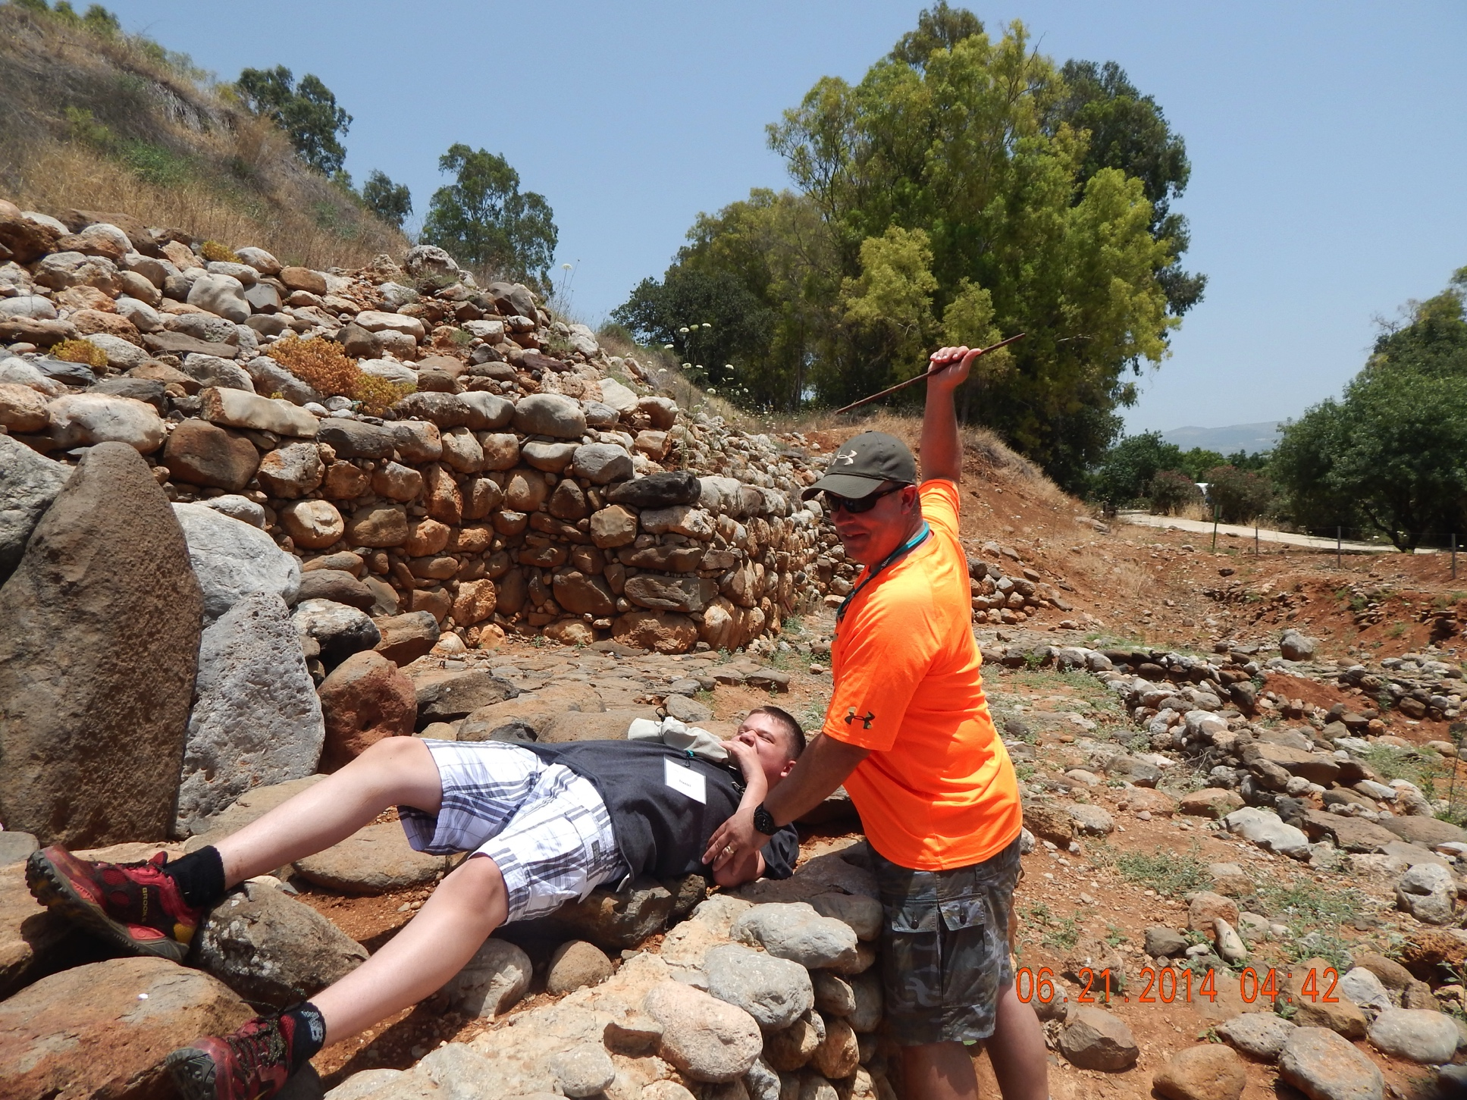
Me “acting out” Genesis 22:10 (incorrectly)

Slide 37
  B. Abraham’s submission to the Father (v. 10-11)
11 But the angel of the Lord called to him from heaven and said, “Abraham, Abraham!” And he said, “Here I am.”
The doubling of a person’s name makes the call emphatic. (cf. Gen. 46:2; Ex. 3:4; 1 Sam. 3:10; Acts 9:4).
This marks the ninth appearance of God to Abraham.

Slide 38
  C. YHWH’s response & substitution & Abraham’s naming (v. 12-14)
12 He said, “Do not stretch out your hand against the lad, and do nothing to him; for now I know that you fear God, since you have not withheld your son, your only son, from Me.”
Ross: Now the divine instructions prevented Abraham from doing any harm to the lad, in contrast to the instructions of verse 2. Here it became clear to Abraham that the episode was a test, and here it became clear to Israel that God took no pleasure at all in child sacrifice
Now I know. The narrator does not wrestle with God’s omniscience, which entails that he knew Abraham’s faith commitment beforehand. Instead, he focuses upon the reality that God does not experience the quality of Abraham’s faith until played out on the stage of history (cf. Deut. 8:2). (Waltke)

Slide 39
  C. YHWH’s response & substitution & Abraham’s naming (v. 12-14)
Therefore, Abraham’s faith has been vindicated by his works; his act of faith was the evidence of salvation he was already declared to have had in 15:6. This same point is made in James 2:22–24.
fear God. See 20:11. The “fear of God” entails an obedience to God’s revelation of his moral will, whether through conscience or Scripture, out of recognition that he holds in his hands life for the obedient and death for the disobedient. Abraham is credited with obedience, which Roop describes as “an obedience which does not protect even what is most precious, but trusts God with the future. Abraham’s faith was not in words but in deeds (James 2:21–22)
          Bruce K. Waltke and Cathi J. Fredricks, Genesis: A Commentary (Grand Rapids, MI: Zondervan, 2001), 308.

Slide 40
C. YHWH’s response & substitution & Abraham’s naming (v. 12-14)
13 Then Abraham raised his eyes and looked, and behold, behind him a ram caught in the thicket by his horns; and Abraham went and took the ram and offered him up for a burnt offering in the place of his son.
Abraham understood this ram to be the substitute for Isaac
The phrase: in the stead of his son, is a clear statement of substitution; the ram dies in Isaac’s place
instead of. This is the first explicit mention of substitutionary sacrifice of one life for another in the Bible, though it was implied in Noah’s sacrifice (8:20–22)

Slide 41
  C. YHWH’s response & substitution & Abraham’s naming (v. 12-14)
14 Abraham called the name of that place The Lord Will Provide, as it is said to this day, “In the mount of the Lord it will be provided.”
The commemorative naming of the place by Abraham indicates that the discovery of the sacrificial ram was not interpreted by the patriarch as mere chance; rather, the Lord provided the animal for the sacrifice. The expositor will have to concentrate on this naming, for it expresses the central lesson of the passage. Belief that the Lord will provide enables the true worshiper to sacrifice without reservation. (Ross)

Slide 42
C. YHWH’s response & substitution & Abraham’s naming (v. 12-14)
Fruchtenbaum:
In 22:14 is the naming: And Abraham called the name of that place Jehovah-jireh, meaning “Jehovah Will See” or “Jehovah Will Provide.” This led to a proverbial saying: As it is said to this day, In the mount of Jehovah it shall be provided; and the mount of Jehovah is Mount Moriah, the Temple Mount, which also became known as Mount Zion
This will be the future place of the atonement, and so atonement on this mountain will be provided
The significance of this place named YHWH yirʾeh, “the Lord provides,” would be lived over and over again in the acts of the worship of Israel
.

Slide 43
C. YHWH’s response & substitution & Abraham’s naming (v. 12-14)
By virtue of the word plays, the essence of the narrative and the significance of the place could easily be recalled. That essence concerned sacrificial worship in which the faithful came to appear before the Lord with their best offering, trusting that the Lord would continue to provide their needs as his people. Through his provision, God appeared to his worshipers.
  Allen P. Ross, Creation and Blessing: A Guide to the Study and Exposition of Genesis (Grand Rapids, MI: Baker Books, 1998), 401.

Slide 44
III. YHWH swears & declares His promise again 22:15-19
A. YHWH’s irrevocable swear (v. 15-16)
15 Then the angel of the Lord called to Abraham a second time from heaven,
16 and said, “By Myself I have sworn, declares the Lord, because you have done this thing and have not withheld your son, your only son,
This is the second appearance of the Angel of Jehovah in this incident, but it is the tenth appearance of God in total to Abraham, and this time it is the angel of Jehovah. This call is also the fifth and final reaffirmation of the Abrahamic Covenant

Slide 45
  A. YHWH’s irrevocable swear (v. 15-16)
To emphasize as strongly as possible that His word would be accomplished, God made an oath to Abraham, swearing by His own name
Hebrews 6: 13-18
By myself have I sworn, said Jehovah, which was the most possible solemn oath that God could make. It is also used in Isaiah 45:23; Jeremiah 22:5, 49:13, and 51:14; Amos 6:8; and Hebrews 6:13–14
“because you have done this.” But there is also an addition to the promise of blessing: not only would Abraham’s descendants be numerous, they would triumph in the gate of their enemies
      Allen P. Ross, Creation and Blessing: A Guide to the Study and Exposition of Genesis (Grand Rapids, MI: Baker Books, 1998), 401.

Slide 46
  B. YHWH’s content of the swearing & declaring (v.17-18)
17 indeed I will greatly bless you, and I will greatly multiply your seed as the stars of the heavens and as the sand which is on the seashore; and your seed shall possess the gate of their enemies.
18 “In your seed all the nations of the earth shall be blessed, because you have obeyed My voice.”
In Genesis 22:17–18a, God states some of the provisions of the covenant, mentioning four things. First, God states that in blessing I will bless you. Second, God states and in multiplying I will multiply your seed, giving two illustrations: as the stars of the heavens, and as the sand which is upon the seashore, showing that these are really synonymous phrases. Third, God continues: Your seed shall possess the gate of his enemies. Fourth, God concludes: In your seed shall all the nations of the earth be blessed. As in the first statement of the Abrahamic Covenant, here in the last affirmation of it to Abraham, God clearly promises Gentile blessing.
      Arnold G. Fruchtenbaum, Ariels Bible Commentary: The Book of Genesis, 1st ed. (San Antonio, TX: Ariel Ministries, 2008), 357.

Slide 47
  C. Abraham, Isaac & the servants return & stay at Beersheba (v. 19)
19 So Abraham returned to his young men, and they arose and went together to Beersheba; and Abraham lived at Beersheba.
Then Abraham. Abraham alone is mentioned because the story is about the test of his faith, not about Isaac’s submission. The name is repeated twice as in 22:1, forming an inclusio around the narrative.
As he said to them earlier, both father and son returned. Abraham lived in Beer-sheba for some time.
After their “mountain-top experience,” Abraham and Isaac returned to the young men, as he had promised, and headed back home. At this time they went to Beersheba, where Abraham from that time on made his home, where he had last “called on the name of the Lord.”
      Henry M. Morris, The Genesis Record: A Scientific and Devotional Commentary on the Book of Beginnings (Grand Rapids, MI: Baker Books, 1976), 384.

Slide 48
  IV. Abraham learns about his family 22:20-24
  B. A significant grandniece born (v. 23)
This section represents a sort of parenthesis in the narrative, showing that Abraham and Sarah had not lost all ties with their original home. Abraham’s brother Nahor still lived back in Mesopotamia, possibly in the city known as Nahor, and he had not seen him, so far as we know, for sixty years or so. He and Sarah doubtless frequently wondered what had happened to him. His other brother, Haran, had died while they all still lived in Ur.
Abraham often must have wondered where he could find a wife for his son. If Isaac was to be the father of the great nation as promised, the choice of a proper wife was all-important

Slide 49
B. A significant grandniece born (v. 23)
The reason Rebekah is mentioned in the narrative (which is a part of “the generations of Isaac,” it will be remembered) is of course that she was later to be the one chosen as Isaac’s wife. (Morris)
This little section records the expansion of the family in the eastern regions by listing the descendants of Nahor, the brother of Abraham. The inclusion of the name of Rebekah indicates the primary interest of the narrator in including this material here—it prepares for the choosing of a bride for Isaac (Gen. 24). By placing the genealogical information here, rather than just before Genesis 24, the writer signals a change in the direction of the narratives
      Allen P. Ross, Creation and Blessing: A Guide to the Study and Exposition of Genesis (Grand Rapids, MI: Baker Books, 1998), 405.

Slide 50
Observations & “Takeaways”
Ross from the BKC (Bible Knowledge Commentary)
The lessons about true worship are timeless: (1) Faith obeys completely the Word of God. (2) Faith surrenders the best to God, holding nothing back. (3) Faith waits on the Lord to provide all one’s needs. But God does not provide until personal sacrifice has been made. True worship is costly. This was always so for Israel when they brought sacrifices. Those offerings were supposed to be given in faith so God would provide all the needs of each willing worshiper.
          Allen P. Ross, Genesis, in The Bible Knowledge Commentary: An Exposition of the Scriptures, ed. J. F. Walvoord and R. B. Zuck, vol. 1 (Wheaton, IL: Victor Books, 1985), 65.

Slide 51
Observations & “Takeaways”
Fruchtenbaum:
A number of observations can be made from the story of Abraham’s obedience to God regarding Isaac. First, there are three lessons to learn from this section: Faith obeys completely and emphatically God’s Word; faith surrenders the best to God holding nothing back; and faith waits on the Lord to provide for all needs.
Waltke: God tests his saints often through adversity or hardship in order to prove the quality of their faith by their obedience in the actual time-space continuum we call “history” (see Ex. 20:20; Deut. 8:2; 2 Chron. 32:31; Matt. 4:1–11)
  Bruce K. Waltke and Cathi J. Fredricks, Genesis: A Commentary (Grand Rapids, MI: Zondervan, 2001), 309.

Slide 52
Observations & “Takeaways”
Waltke (Cont.)
We are not to put God to the test (Ex. 17:2, 7; Deut. 6:16; Luke 4:12) but to respond humbly and obediently when God calls. This is Abraham’s stance when he replies, “Here I am.” Abraham’s humility and obedient action are the models for Christian faith.
No one, however, has perfect faith. As we have seen, Abraham’s faith falters on several occasions (cf. 12:10–20; 16:1–2; 20:1–13). Still, the Lord responds to Abraham’s basic commitment of life to walk before God (17:1).
One of the church’s oldest confessions says: “If we are faithless, he will remain faithful, for he cannot disown himself” (2 Tim. 2:13). Instructively, however, when Abraham obeys, he blesses others and receives God’s promises (12:1–3; 17:1–16; 22:15–18). When he disobeys, he is a burden around the neck of the nations. Faith requires vision and demands radical obedience to God’s word.
  Bruce K. Waltke and Cathi J. Fredricks, Genesis: A Commentary (Grand Rapids, MI: Zondervan, 2001), 310.

Slide 53
  My “Takeaways” from Ch. 22 & the Abrahamic Narratives (11:27-22:24)
As illustrated in the Abrahamic narratives, the middle tense of salvation has it’s “ups & downs”
Living by faith by the grace of God is the ONLY way to have success in the middle tense
God’s promises can NEVER be thwarted!
YHWH demonstrates He cannot lie (Num. 23:19) and cannot break His promises (Josh. 21:45)
YHWH shows throughout the narrative that He is slow to anger and shows loving-kindness (Hesed) to all creation
Abraham’s faith in YHWH is INCREDIBLE and at it’s apex here in chapter 22

Slide 54
Bibliography
Fruchtenbaum, Arnold G. Ariel's Bible Commentary: The Book of Genesis. San Antonio, Tex.: Ariel Ministries, 2009. Print.
Hamilton, Victor P. The New International Commentary on the Old Testament: The Book of Genesis Chapters 1-17. Grand Rapids: Eerdmans, 1990. Print.
Kidner, Derek, and Derek Kidner. Tyndale Old Testament Commentaries: Genesis. London, Downer's Grove, ILL: Intervarsity, 1967. Print.
Morris, Henry M. The Genesis Record: A Scientific and Devotional Commentary on the Book of Beginnings. Grand Rapids, Michigan: Baker Book House, 1976. Print.
Ross, Allen P. Creation &amp; Blessing: A Guide to the Study and Exposition of Genesis. Grand Rapids: Baker Academic, 1998. Print.
Walvoord, John F. The Bible Knowledge Commentary: An Exposition of the Scriptures. Wheaton, Ill.: Victor, 1983. Print.

