Slide 1
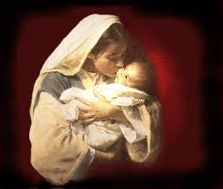
The Christmas That Almost Wasn’t
By Dr. Andy Woods

Slide 2
Revelation 12:1-5
And a great sign appeared in heaven: a woman clothed in the sun, and the moon under her feet, and upon her head a crown of twelve stars; ²and she was with child; and she cried out, being in labor pain to give birth. ³And another sign was seen in heaven: and behold, a great red dragon, having seven heads and ten horns, and upon his heads seven diadems.
American Standard Version. 1995 .

Slide 3
Revelation 12:1-5
⁴And his tail swept a third part of the stars of heaven, and did cast them to the earth: and the dragon stood before the woman that is about to give birth, so that when she gave birth he may devour her child. ⁵And she gave birth to a son, a man child, who is to rule all the nations with a rod of iron: and her child was caught up unto God, and to his throne.
American Standard Version. 1995 .

Slide 4
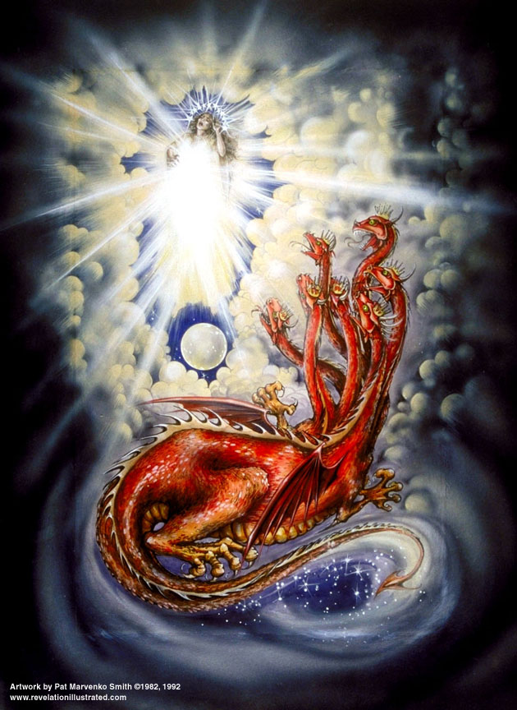
CAST OF 3 CHARACTERS
Revelation 12:1-5
SON (v.5)
2. DRAGON (v. 3)
3. WOMAN (v.1)

Slide 5
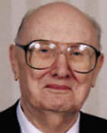
Two Rules of Interpretation
Search the immediate context
  Walvoord: 26X
Search the remote context
  Old Testament
  Thomas: 278 / 404 verses

Slide 6
CAST OF 3 CHARACTERS
Revelation 12:1-5
SON (v.5)=Messiah Ps. 2:9; Acts 1:9
2. DRAGON (v. 3)=Satan Rev. 12:9
3. WOMAN (v.1)=Israel Gen. 37:9-10

Slide 7
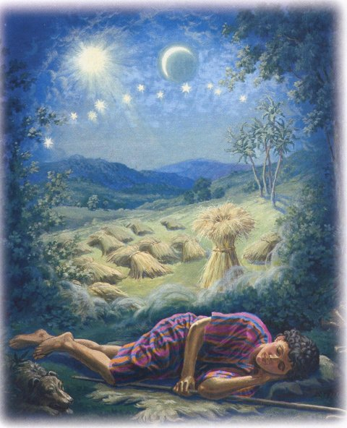
Genesis 37:9
Now he had still another dream, and related it to his brothers, and said, “Lo, I have had still another dream; and behold, the sun and the moon and eleven stars were bowing down to me.

Slide 8
Genesis 37:10
He related it to his father and to his brothers; and his father rebuked him and said to him, “What is this dream that you have had? Shall I and your mother and your brothers actually come to bow ourselves down before you to the ground?”

Slide 9
Sun = Jacob
Moon = Leah
11 Stars=Joseph’s brothers
12th Star = Joseph
12 Stars=Israel’s twelve tribes

Slide 10
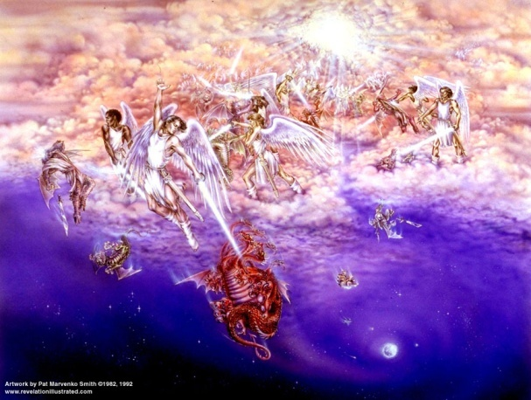
Different Perspectives of the Same Event
Matt 2 - Physical World
Rev 12:1-5 - Spiritual World

Slide 11

Satan as Ruler of this World
Job 1:7; 2:2
Luke 4:5-7
John 12:31; 14:30; 16:11
2 Corinthians 4:4
Ephesians 2:2
1 John 4:4; 5:19

Slide 12
Biblical Reality of the Angelic World
Job 1:12
2 Kings 6:15-17
1 Chron 21:1
Dan 10:12-13, 20
Matt 16:21-23
Eph 6:12

Slide 13
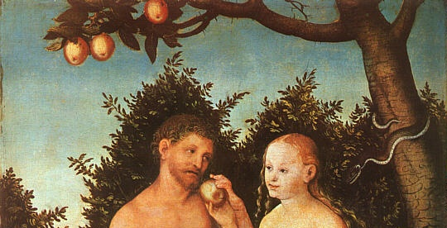
Genesis 3:15
“And I will put enmity between you and the woman, and between your seed and her seed; He shall bruise you on the head, and you shall bruise him on the heel.” (NASB)

Slide 14
Genesis 4:1
“Now the man had relations with his wife Eve, and she conceived and gave birth to Cain, and she said, “I have gotten a manchild with the help of the Lord.”” (NASB)

Slide 15
Genesis 5:29
“Now he called his name Noah, saying, “This one will give us rest from our work and from the toil of our hands arising from the ground which the Lord has cursed.” (NASB)

Slide 16
Genesis 3:15
“And I will put enmity between you and the woman, and between your seed and her seed; He shall bruise you on the head, and you shall bruise him on the heel.” (NASB)

Slide 17
Satanic Attempts to Stop Messiah’s Birth
Cain & Abel (Gen. 4)
Sons of God (Gen. 6)
Pharaoh persecutes Israel (Exod. 1)
Joash protected from Athaliah (2 Chron. 22‒23)
Haman persecutes Israel (Esther)
Herod persecutes Christ (Matt 2; Rev 12:4)

Slide 18
Two-Fold Pattern
Satanic attack
God’s miraculous protection

Slide 19
Satanic Attempts to Stop Messiah’s Birth
Cain & Abel (Gen. 4)
Sons of God (Gen. 6)
Pharaoh persecutes Israel (Exod. 1)
Joash protected from Athaliah (2 Chron. 22‒23)
Haman persecutes Israel (Esther)
Herod persecutes Christ (Matt 2; Rev 12:4)

Slide 20
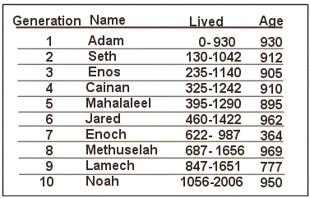

Slide 21
Satanic Attempts to Stop Messiah’s Birth
Cain & Abel (Gen. 4)
Sons of God (Gen. 6)
Pharaoh persecutes Israel (Exod. 1)
Joash protected from Athaliah (2 Chron. 22‒23)
Haman persecutes Israel (Esther)
Herod persecutes Christ (Matt 2; Rev 12:4)

Slide 22
Genesis 3:15
“And I will put enmity between you and the woman, and between your seed and her seed; He shall bruise you on the head, and you shall bruise him on the heel.” (NASB)

Slide 23
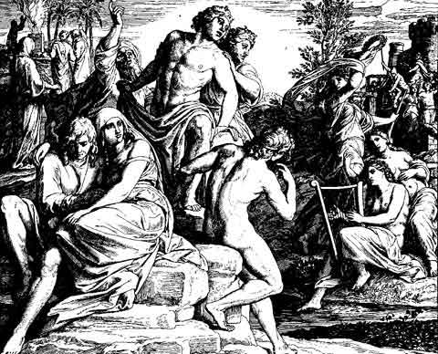
Alternative Views
Intermarriage between the Godly line of Seth and the ungodly lines of Cain
Fallen angels procreating with human women

Slide 24
Not Referring to Angels
Refers to Angels
John MacArthur
Henry Morris
Arnold Fruchtenbaum
Robert Lightner
D. Edmond Hiebert
James Boice
Robert Morey
M. R. DeHann
Charles Ryrie
Millard Erickson
J. Sidlow Baxter
Warren Wiersbe
Paul Enns
Gleason Archer
John Sailhammer
Wayne Grudem
Meredith Kline
Leupold
Williamson, unpublished paper, DTS

Slide 25
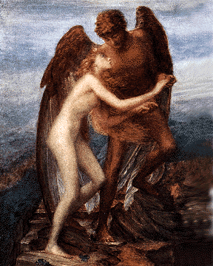
Sons of God?
Old Testament uses (Gen 6:2, 4; Job 1:6; 2:1; 38:7)
Septuagint (LXX)

Slide 26
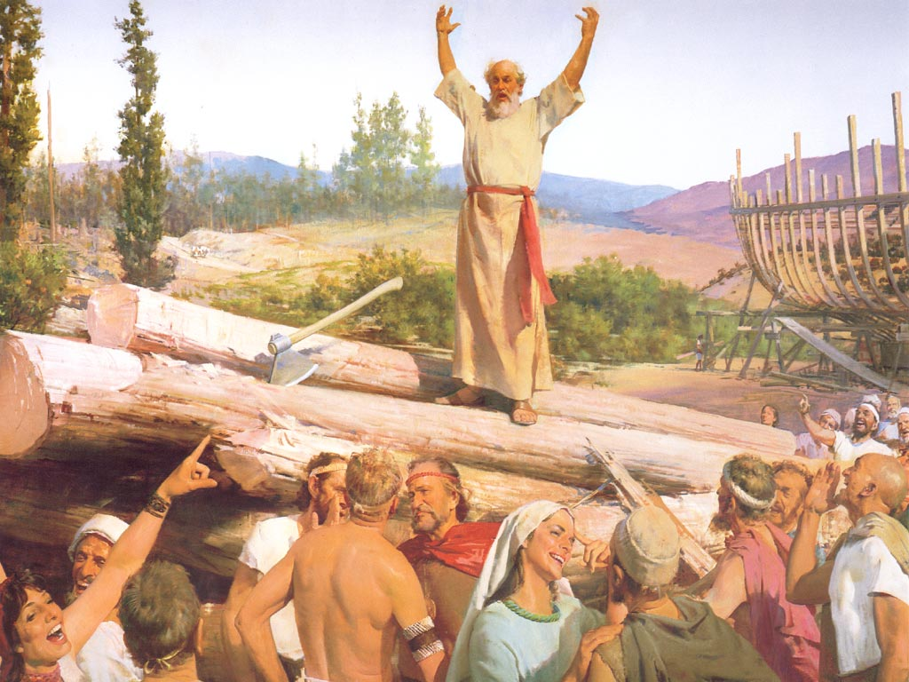
Additional Arguments From Genesis 6
Nephilim (Gen 6:4)
Noah’s perfection (6:9)
Evil of pre-flood humanity (Gen 6:3, 5-7, 11-13)
Necessity of the flood

Slide 27
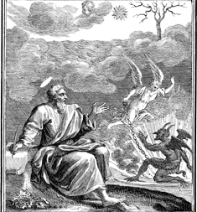
Relevant New Testament Passages
1 Peter 3:19-20
2 Peter 2:4-5
Jude 6-7

Slide 28
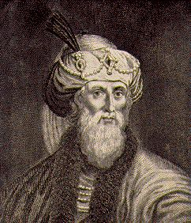
Jewish Tradition
Philo
Josephus
Most Rabbinical Writers
Apocrypha
Pseudepigrapha
Renald Showers, Those Invisible Spirits Called Angels, 93-109

Slide 29
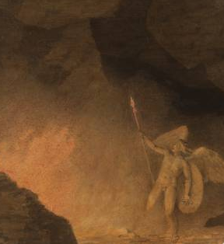
Christian Tradition
Justin
Clement
Tertullian
Cyprian
Ambrose
Lactantius
Renald Showers, Those Invisible Spirits Called Angels, 93-109

Slide 30
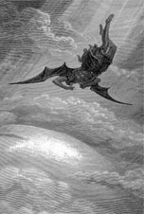
Objections
Angels do not marry? (Matt. 22:30)
Angels are spirits (Heb. 1:14)

Slide 31
Satanic Attempts to Stop Messiah’s Birth
Cain & Abel (Gen. 4)
Sons of God (Gen. 6)
Pharaoh persecutes Israel (Exod. 1)
Joash protected from Athaliah (2 Chron. 22‒23)
Haman persecutes Israel (Esther)
Herod persecutes Christ (Matt 2; Rev 12:4)

Slide 32
Messiah Must Be:
  A man (Gen 3:15)
  Semitic (Gen 9:26)
  From Abraham’s line (Gen 12:3)
  From Isaac’s line (Gen 17:18-19)
  From Jacob’s line (Num 24:17)

Slide 33


Slide 34
Satanic Attempts to Stop Messiah’s Birth
Cain & Abel (Gen. 4)
Sons of God (Gen. 6)
Pharaoh persecutes Israel (Exod. 1)
Joash protected from Athaliah (2 Chron. 22‒23)
Haman persecutes Israel (Esther)
Herod persecutes Christ (Matt 2; Rev 12:4)

Slide 35
Messiah Must Be:
  A man (Gen 3:15)
  Semitic (Gen 9:26)
  From Abraham’s line (Gen 12:3)
  From Isaac’s line (Gen 17:18-19)
  From Jacob’s line (Num 24:17)
  From the tribe of Judah (Gen 49:10)

Slide 36
Satanic Attempts to Stop Messiah’s Birth
Cain & Abel (Gen. 4)
Sons of God (Gen. 6)
Pharaoh persecutes Israel (Exod. 1)
Joash protected from Athaliah (2 Chron. 22‒23)
Haman persecutes Israel (Esther)
Herod persecutes Christ (Matt 2; Rev 12:4)

Slide 37


Slide 38
Levitical Feasts (Lev. 23)
Feast | Season | Purpose | Type
Passover | Spring | Redemption | 1 Cor 5:7
Unleavened Bread | Spring | Separation | John 6:35
1st fruits | Spring | Praise | 1 Cor 15:20
Pentecost | Spring | Praise | Acts 2:1-4
Trumpets | Fall | New Year | Matt 24:31
Atonement | Fall | Lev 16 | Zech 12:10
Booths | Fall | Wilderness provision | Zech 14:16-18

Slide 39


Slide 40
Satanic Attempts to Stop Messiah’s Birth
Cain & Abel (Gen. 4)
Sons of God (Gen. 6)
Pharaoh persecutes Israel (Exod. 1)
Joash protected from Athaliah (2 Chron. 22‒23)
Haman persecutes Israel (Esther)
Herod persecutes Christ (Matt 2; Rev 12:4)

Slide 41
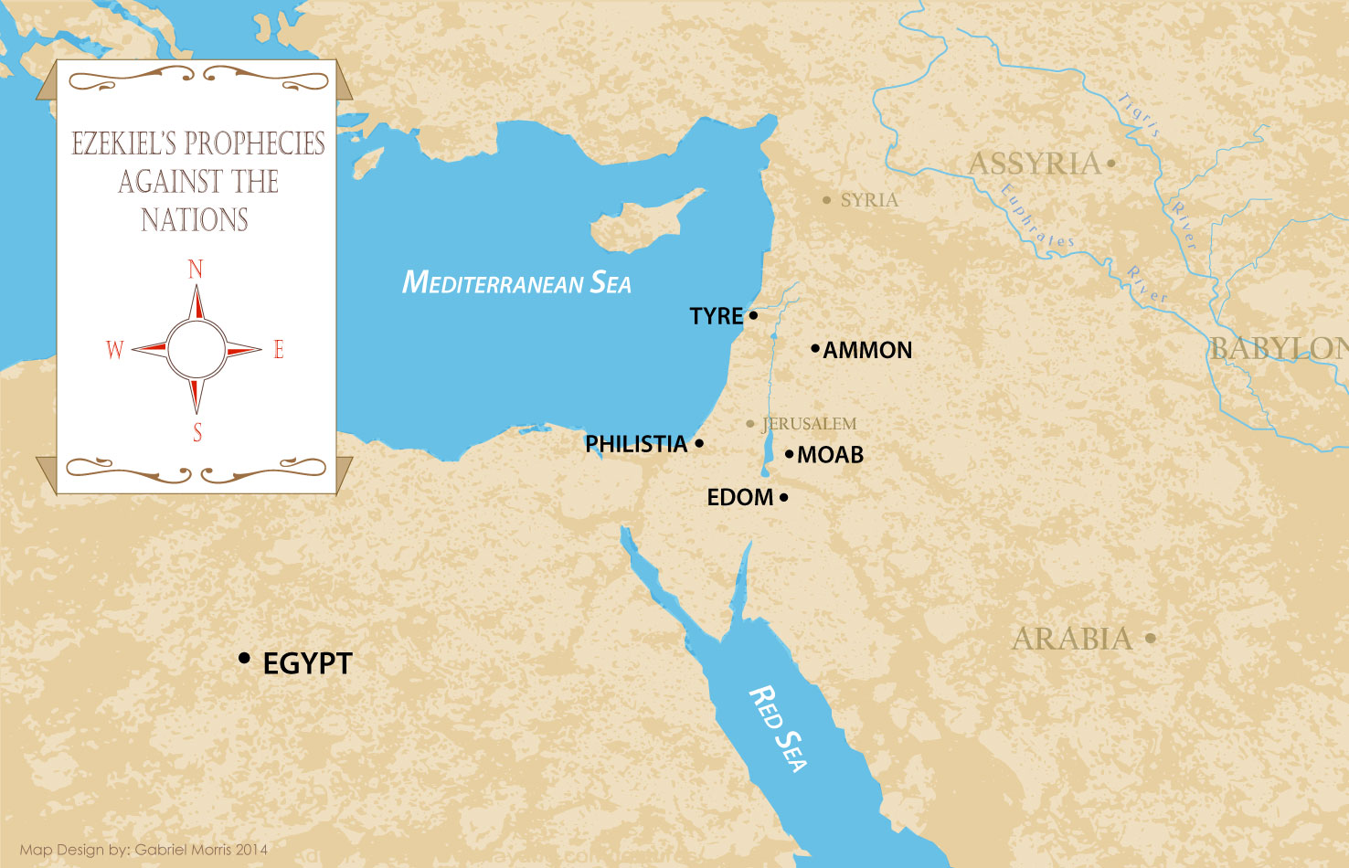

Slide 42
Conclusion

Slide 43
Satanic Attempts to Stop Messiah’s Birth
Cain & Abel (Gen. 4)
Sons of God (Gen. 6)
Pharaoh persecutes Israel (Exod. 1)
Joash protected from Athaliah (2 Chron. 22‒23)
Haman persecutes Israel (Esther)
Herod persecutes Christ (Matt 2; Rev 12:4)

